Slide 1
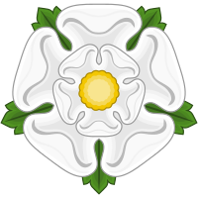
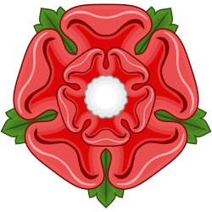
War of the Roses

Slide 2
War of the Roses
Civil war between houses of Lancaster (red rose) and York (white rose) 1455-1485
Both houses part of Plantagenet Dynasty

Slide 3
War of the Roses Family Tree

Slide 4
The problem
Yorkists descended from Edmund, Duke of York, Edward III’s 4th son and Lionel Antwerp, his 2nd son
Henry IV had descended from 3rd son, John of Gaunt
Remember that Henry IV (Bolingbroke) established house of Lancaster when he deposed Richard II while Richard was away in Ireland
Yorkists challenged Henry VI (Henry V’s son) for the throne of England
York had support of London and south, Lancaster had support of Wales and north

Slide 5
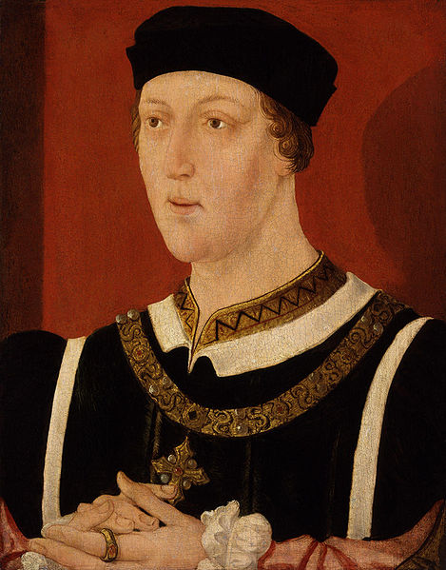
Henry VI and Margaret of Anjou, a model dysfunctional family
Henry VI suffered from mental illness, wife Margaret of Anjou ran things like a tyrant
1454 – Richard, Duke of York appointed as protector of England
When Henry returned, he dismissed Richard and restored Margaret
Yorkists marched on London with 3000 men, won handily at Battle of St. Albans, Richard restored at protector, Henry found hiding
Margaret takes care of Henry

Slide 6
York victories
1456 – Henry improved, dismissed Richard again, sent him off to Ireland
1458 – “Love Day” procession to St. Paul’s Cathedral arranged by Archbishop of Canterbury
1459 – Richard Neville Earl of Warwick, captain of Calais, ally of York, joined Richard in Battle of Ludford Bridge and lost, Richard went back to Ireland, Warwick continued to raid English coast
Lancasters now in Coventry
Yorkists held London
1460 – Warwick defeats Lancasters at Northampton, bring Henry back to London, Parliament arranged a compromise giving throne to Richard after Henry dies (Margaret’s son Edward shut out), Richard made protector again

Slide 7
Margaret wins for Lancaster
Margaret goes to Scotland for financial and military help
Mary, Queen consort to James II, agrees to help in exchange for marriage between little Edward and her daughter (good mom)
Christmas 1460 - Richard meets Margaret’s army (funded by Scots) at Battle of Wakefield, Lancaster wins, Richard killed, Margaret posts heads
Richard’s 18-yr-old son Edward next in line
2nd Battle of St. Albans – Margaret’s army defeats Warwick, Henry under a tree left behind, little Edward decides guards’ fate
London closes gates to Lancastrian army, army heads north
Edward, Warwick and Yorkists return to London, hasty crowning of Edward IV, London rejoices

Slide 8
Edward IV and Warwick
Battle of Towton – the deciding battle, bloodiest battle 20,000 killed, Edward and Warwick defeat Lancasters, Edward replaces heads, Henry and Margaret flee north, many nobles switch allegiances
Minor revolts for several years
Henry captured again!, put in Tower of London, Margaret and son Edward flee to France
Warwick and Edward drift apart, partly due to his marriage to Elizabeth Woodville, Warwick allies with Edward’s treacherous brother George, Edward delcares them traitors, they flee to France
Louis IX of France suggests Warwick and Margaret becomes allies
Warwick’s daughter Anne marries Margaret’s son Edward
1470 - Warwick invades England, takes London, frees Henry VI, restores Henry VI to the throne, Edward flees to Burgundy

Slide 9
The end and the Restoration
1471 - Edward gets enough support in Burgundy to invade England, takes London
Battle of Barnet – Warwick killed
Battle of Tewksbury – Margaret trying to cross from Wales into England, defeated, son Edward killed
May 14, 1471 – Henry VI mysteriously murdered, Edward IV restored

Slide 10
Richard III
1483 – Edward IV suddenly dies, little Edward V only 12, Edward IV’s brother Richard named Protector, he brings little Edward to London
Some nobles did not care for Elizabeth Woodville and her family including little Edward, started executing all nobles favoring Woodvilles
Archbishop of Canterbury persuaded Elizabeth to put younger son Richard with Edward to “keep him company”
Richard declares Elizabeth’s marriage to Edward IV illegitimate
1483 - Parliament names Richard III
1485 – rebellion led by Henry Tudor, Richard killed at Battle of Bosworth Field, Henry crowned Henry VII

