Slide 1
The Ottoman Empire

Slide 3
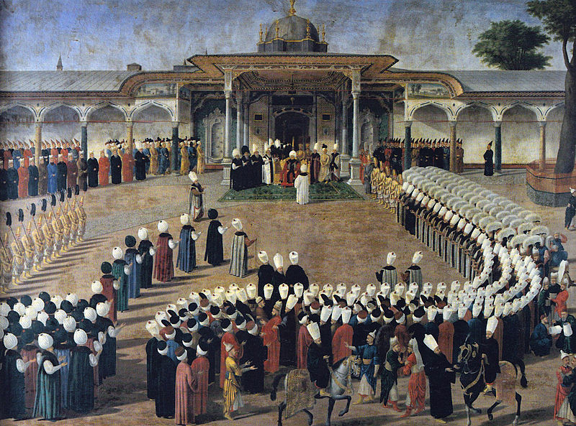
The Ottoman Empire
Founded in Anatolia in 1299
1453 – Mehmet II conquered Constantinople, OC given autonomy
Istanbul – Topkapi Palace
1521 – Suleiman the Magnificent captures Belgrade, lost at Vienna
1547 – conquered Hungary
Covered 3 continents, controlled Mediterranean Sea

Slide 4
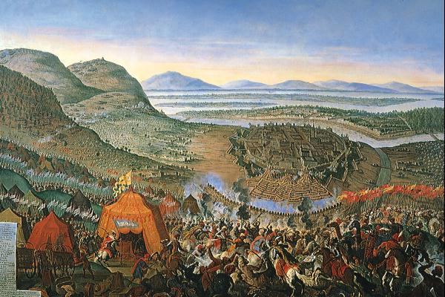
Setbacks
Cape of Good Hope
Spanish silver from New World
1571 – Battle of Lepanto
1683 – 2nd Siege of Vienna failed

