Slide 1

The Hundred Years’ War

Slide 2
Background
Britain had been populated by Scandinavians (Angles, Jutes, Saxons, etc.)
William the Conqueror united the crowns of England and Normandy in 1066
Back and forth tussle over thrones ever since
Strategic marriages, assassinations, alliances
Both England and France Catholic
England had made peace with the Scots

Slide 3
Complicated Situations
King of France has duchies ruled by dukes or duchesses, his vassals
Sometimes, these dukes or duchesses became rulers of England by war or by marriage
Examples: William, Henry II (Count of Aquitaine)
Commonly disputed territories: Normandy, Anjou, Aquitaine

Slide 4
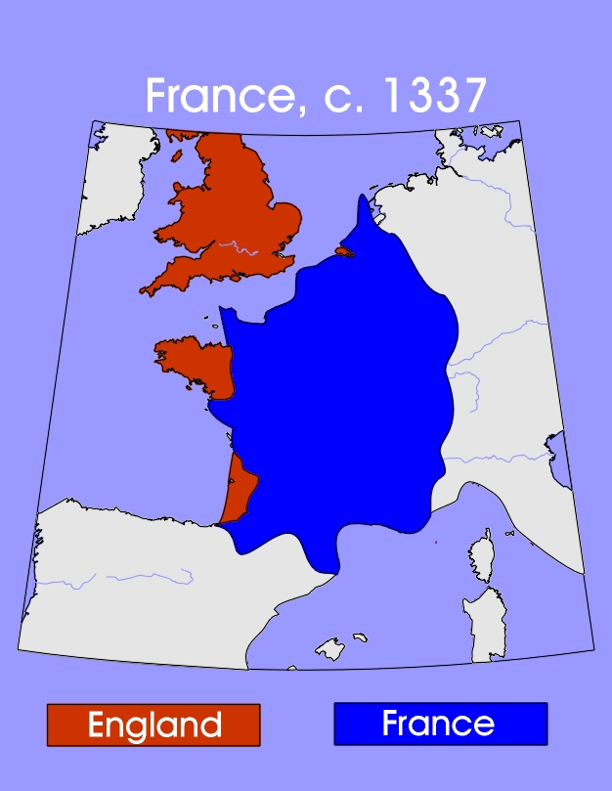

Slide 5
And so it begins…the Caroline Phase
France allied with Scotland
Philip VI, king of France, confiscates Aquitaine from Edward III in 1337
Edward quickly makes peace with Scotland
Edward starts to question Philip VI’s legitimacy to French throne, calls self King of France
Philip VI was son of brother Philip IV
All his cousins of the Capetian line died out
Edward’s mom was the sister of the three brothers that died out
The Black Death hitting France hard

Slide 6
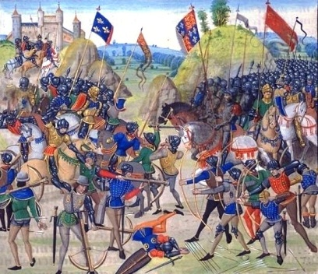
English strategy and victories
Flanders, Brittany and Navarre were happy to ally with England
They all preferred independence over being ruled by Paris
Son Edward “The Black Prince” won at Crecy (1346) and Poitiers (1356), he died before his father did
Crecy – 1st use of cannons
At Poitiers, the English captured Philip’s successor, John of France

Slide 7
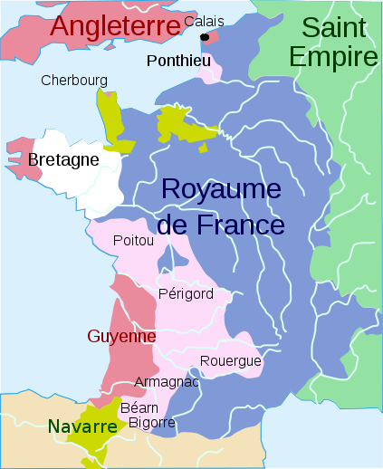
France forced to negotiate
1360 - Charles V (son of prisoner John), agreed to Treaty of Bretigny (later Treaty of Calais)
England got LOTS of land
Had to pay hefty ransom
Edward III renounced claim to French throne
End of first phase of 100 Years War

Slide 8
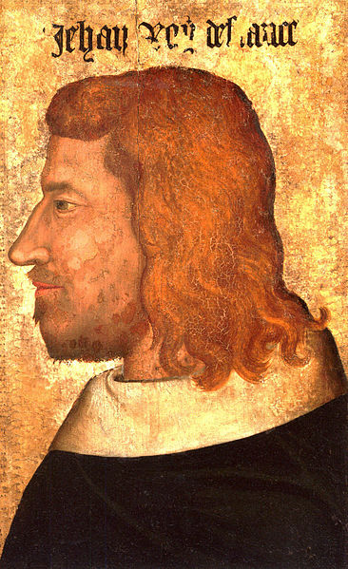
The ransom of John II “The Good”
John II freed to raise the ransom (3 million francs)
Had to give up his son as collateral, Louis taken to England
1363 – Louis breaks the terms of deal by escaping England
John II gives himself up and agrees to be imprisoned in England
Greeted in London with parades, died in captivity
John II is known as “The Good”
Charles V succeeded him

Slide 9
Phase 2
1366 - England and France took sides in a civil war in Castile
The Black Prince was duke of Aquitaine (partially independent of France), backed one side, king of France Charles V backed the other
Charles meddled in Aquitaine affairs, war breaks out between The Black Prince and Charles
1369 - Edward III claims French throne again, Aquitaine revolts for independence
Castile (England’s side lost) helped France with its strong navy
The Black Prince returned to England and died in 1376

Slide 10
English losses
Edward died, Richard II (son of the Black Prince) took throne
Charles V also died
1380 – English pushed back, only held Calais

Slide 11
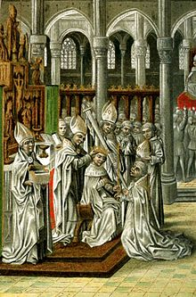
English family infighting
John of Gaunt – 3rd son of Edward III, advisor to Richard II, after he died, Richard disinherited his son Henry of Bolingbroke
Henry – childhood friend of Richard, Crusader, but spoke out against Richard’s rule, exiled
1399 – returned while Richard fighting in Ireland, gained support, crowned self Henry IV, 1st address in English since 1066
Richard II imprisoned

Slide 12
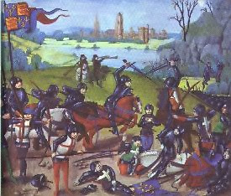
Lancastrian Phase
1413 - Henry IV died naturally, son Henry V crowned
France in midst of civil war
Demanded hand of Catherine of Valois, daughter of Charles VI of France, rejected
Resumption of war
1415 – Battle of Agincourt, St. Crispin’s Day speech, 30,000 to 9,000 (10,000 to 112), the longbow
1420 – Treaty of Troyes, gets the girl, Henry’s heirs will be kings of France after Charles VI

Slide 13
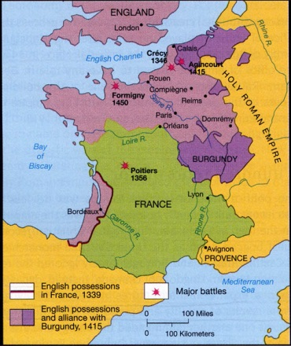
Map of France after Henry V wins

Slide 14
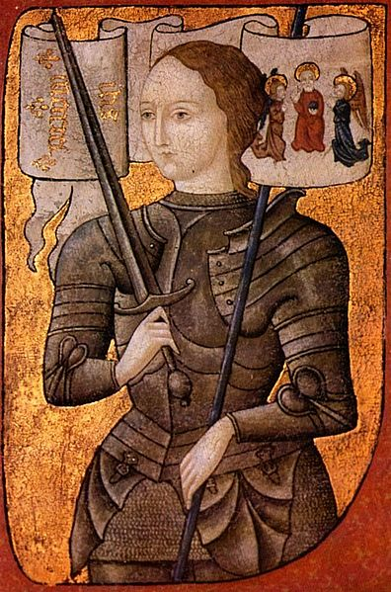
Joan of Arc, the tide turns
1422 – Henry dies, infant son becomes Henry VI
Joan (b. 1412) – peasant girl, visions of saints telling her to help free France, convinced Charles (dauphin) to let her ride with army
1428 – siege of Orleans
1430 – Charles VII installed
1431 - Captured by Burgundians, sold to English, trial for heresy

Slide 15
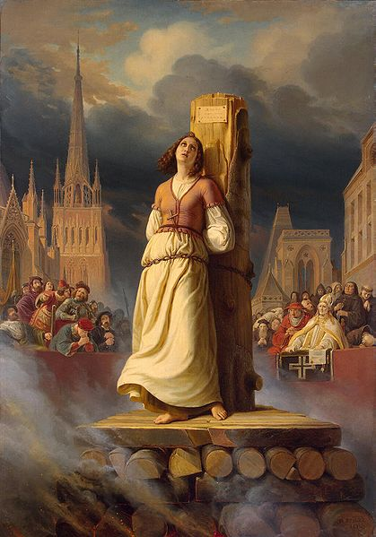
More Joan
Asked if she knew she was in God's grace, she answered: “If I am not, may God put me there; and if I am, may God so keep me.”
1431 - Found guilty, burned at the stake
Posthumous trial found her innocent in 1456
Made a saint in 1909

Slide 16
After Joan, the end for England
1435 – Philip, Duke of Burgundy, broke with England and recognized Charles VII as king of France
Short truce in 1444
English broke the truce
French gradually won all territories back except for Calais
1453 – Battle of Castillon, last battle took Bordeaux back
England kept fleur-de-lis on coat of arms until 1803

Slide 17
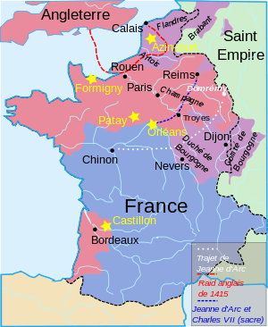

Slide 18
Henry V, film directed by Kenneth Branagh
Saint Joan, play

