Slide 1
The English Reformation
Henry VIII

Slide 2
The English Reformation
Split between Pope and Catholic Church in England
An extension of the Protestant Reformation in Europe
Mostly political split clothed in theology and the church’s teaching on marriage
Birth of the Anglican Church (still exists today)
Monarch of England becomes head of the Church of England

Slide 3
Henry VIII
Ascended throne in 1509 at age 17
Staunch Catholic, advised by Cardinal Wolsey, five masses a day
Married Catherine of Aragon in 1509, produced only Princess Mary
1521 – In Defense of the Seven Sacraments
Named “Defender of the Faith” by Pope Leo X

Slide 4
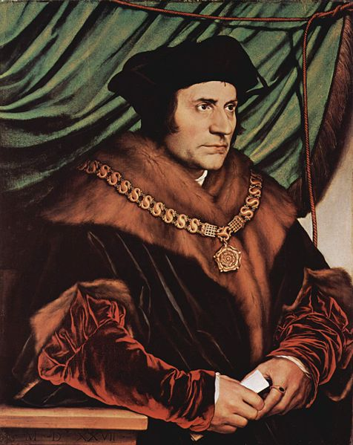
The Seek for Annullment
Henry argued marriage was “blighted by God”
Wanted to marry French-educated Anne Boleyn
1527 – Pope Clement VII refused annullment
Wolsey died, Thomas Cromwell and Thomas More became chief advisors
Both advocated more churh independence from Rome

Slide 5
Henry Takes Power
Parliament would not override the Pope and Pope would not bend to Henry
Henry charged all the clergy with treason
1531 - In return for pardon, he was given title “Supreme Head of the Church and clergy of England” (and 100,000 pounds)
1532-1536 – new laws
1533- new Archboshop Thomas Cranmer grants annullment
Henry married Boleyn, she gives birth to Princess Elizabeth
Pope excommunicates both Cranmer and Henry
Thomas More resigned
1534 – Treasons Act led to execution of More

Slide 6
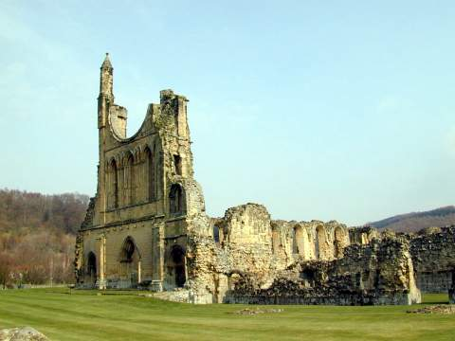
Dissolution of the Monasteries
Change in theology affected daily life
Pilgrimages prohibited
Iconoclasm
“Justification by faith alone”
Retention of only three sacraments
1534 – 1536 – Cromwell ordered inventory of all monasteries, decided to dissolve them
Uprisings from common people
Little Jack Horner Sat in the corner, Eating a Christmas pie; He put in his thumb, And pulled out a plum, And said, What a good boy am I!

Slide 7
Wife #3, Jane Seymour
1536 – Boleyn executed for treason, adultery, she had miscarried several times
Henry married Seymour the day after Boleyn’s execution
1537 - Seymour gave birth to Edward VI, yay, finally
Died two weeks later, buried next to Henry
Henry remained single for two years

Slide 8
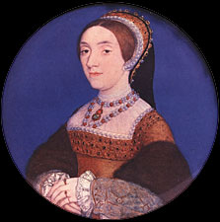
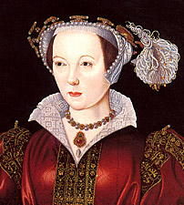
Last three wives, paintings by Holbein
1540 - Anne of Cleves (French) - Cranmer arranged the marriage, lasted less than a year, annulled
1540-42 – Kathryn Howard, 19 when she married, executed for adultery
1543-1547 – Catherine Parr, extreme Protestant reformist, twice widowed before Henry, married her true love after Henry died

Slide 9
Reformation under Edward VI
Edward VI first monarch raised as a Protestant
Further bans – stained glass, bells, vestments, ashes, palm leaves, statues, processions, sometimes crosses
1549 – Book of Common Prayer by Cranmer replaced Catholic prayer books
Age 15 – Edward fell ill and died, named cousin Lady Jane Grey (Prot.) as queen, Nine Days’ Queen (disputed)
Sisters Mary and Elizabeth were Catholic
While in Tower, supporters switched to Mary
Jane and husband executed

Slide 10
The Catholic Restoration
1553-1558 - Re-validated Henry’s marriage to Catherine of Aragon
Reversed some of Henry’s legislation
Had Cranmer burned at stake for heresy
Married Philip II of Spain to get a Catholic heir, no children

