Slide 1
The Plantagenets, Great Schism and the 1st Crusade

Slide 2
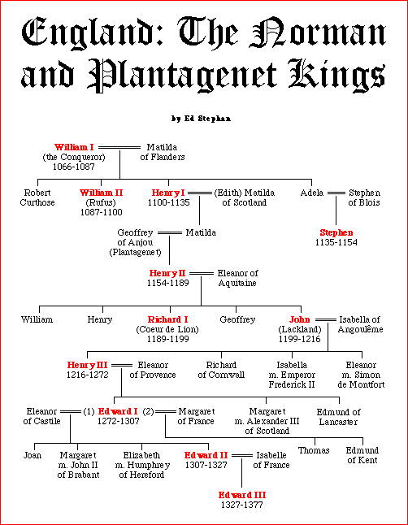

Slide 3
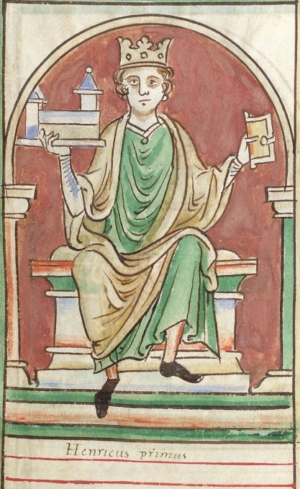
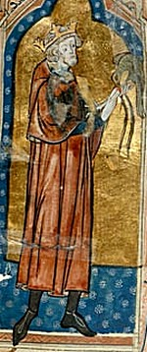
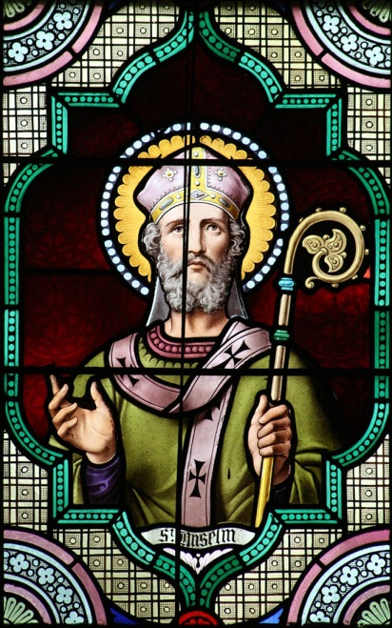
Kings after William the Conqueror
William Rufus the Red king of England, Robert got Normandy
Henry I (1100-1135) –advised by St. Anselm of Canterbury, Benedictine monk
Other monastic orders – Franciscan, Dominican, Cistercian
1135 – Stephen (grandson of Conqueror) seized throne, Henry II (Henry I’s grandson) was still a child

Slide 4
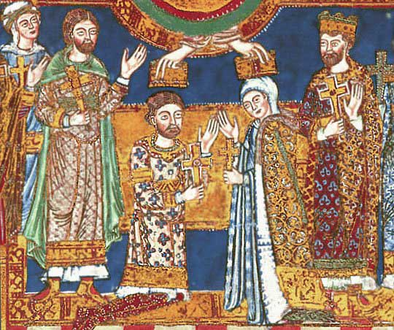
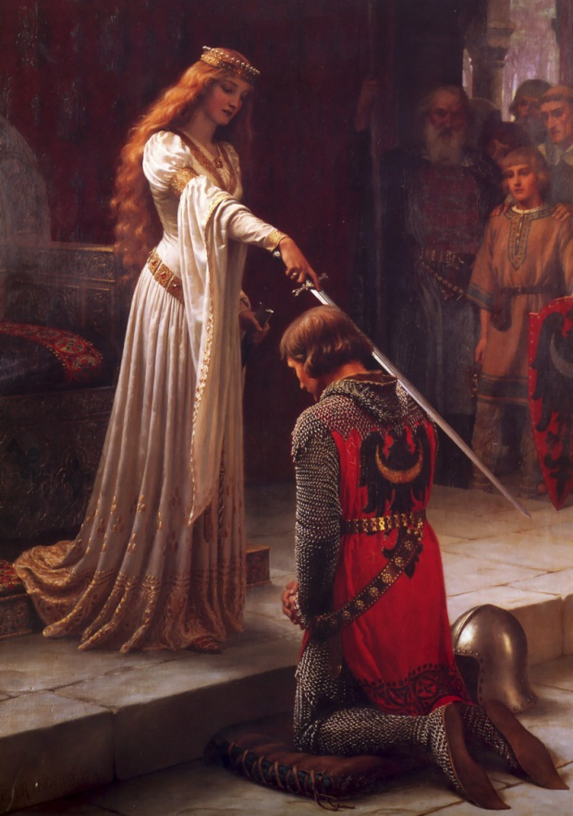
Plantagenet Dynasty
Henry II’s mother Matilda married into Plantagenet family
Henry II grew up and married Eleanor of Aquitaine (France)
Eleanor – Duchess of Aquitaine, Queen of France (Louis VII), 2nd Crusade, annullment
1135-1154 – The Anarchy: Stephen vs. Matilda and Henry
1154 – Stephen surrendered and agreed to let Henry be king, Henry II, Norman era over
1154-1189 – Henry II, rival with Louis VII of France, eventually rivals with Thomas a Becket

Slide 5
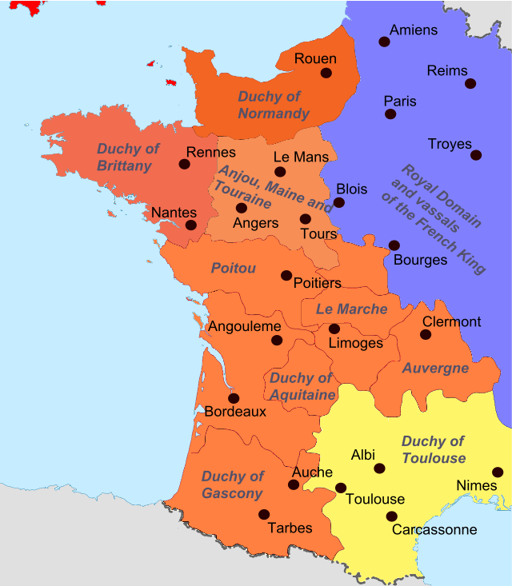
English holdings under Henry II

Slide 6
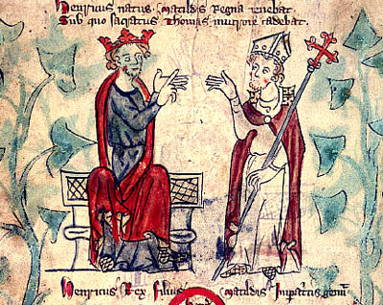
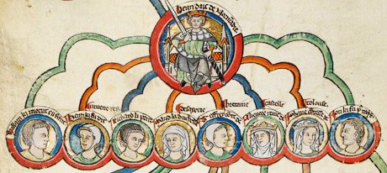
Henry II vs. Thomas a Becket
Thomas a Becket was Chancellor under Henry II
1162 – became Archbishop of Canterbury, defended the Church, lived simply, served the poor
1164 – Henry II convened assembly to sign Constitutions of Clarendon ending clerical immunity, Thomas would not sign
Fled to a monastery in Normandy, Henry banished all of Thomas’ relatives from England
Henry pushed Constitutions through
In Normandy, Thomas excommunicated the bishops who agreed to sign Constitutions
Henry threatened the monastery, abbot forced Thomas to leave, lived as a beggar for a while, Pope finally forced Henry to reinstate Thomas as Archbishop of Canterbury

Slide 7
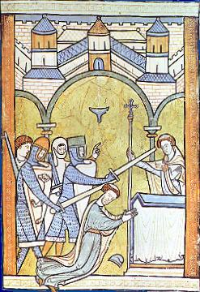
The Death of Thomas a Becket, cont.
1170 – Under pressure from Pope, Thomas returns
“…will no-one rid me of this troublesome priest ?
Four knights went to Canterbury and killed Thomas a Becket while praying at the altar
Henry declared innocence, rescinded Constitutions of Clarendon, promised Pope to go on Crusade
1172 - Church declared Becket a saint
Many pilgrims, even Henry went to his tomb to pay homage and pray, last three miles he went barefoot

Slide 8
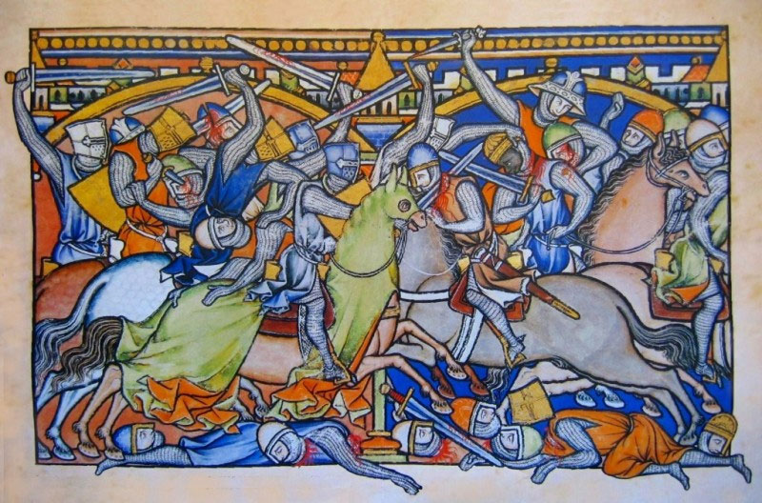
End of Henry II
Henry II had given castles to youngest son John
1173-74 – “Great Revolt”, sons Henry “The Young King”, Richard and John and Eleanor allied with Philip Augustus against Henry II
"cursed be the day when the traitors schemed to embroil the father and the son"
1189 - Died in Chinon in France

Slide 9
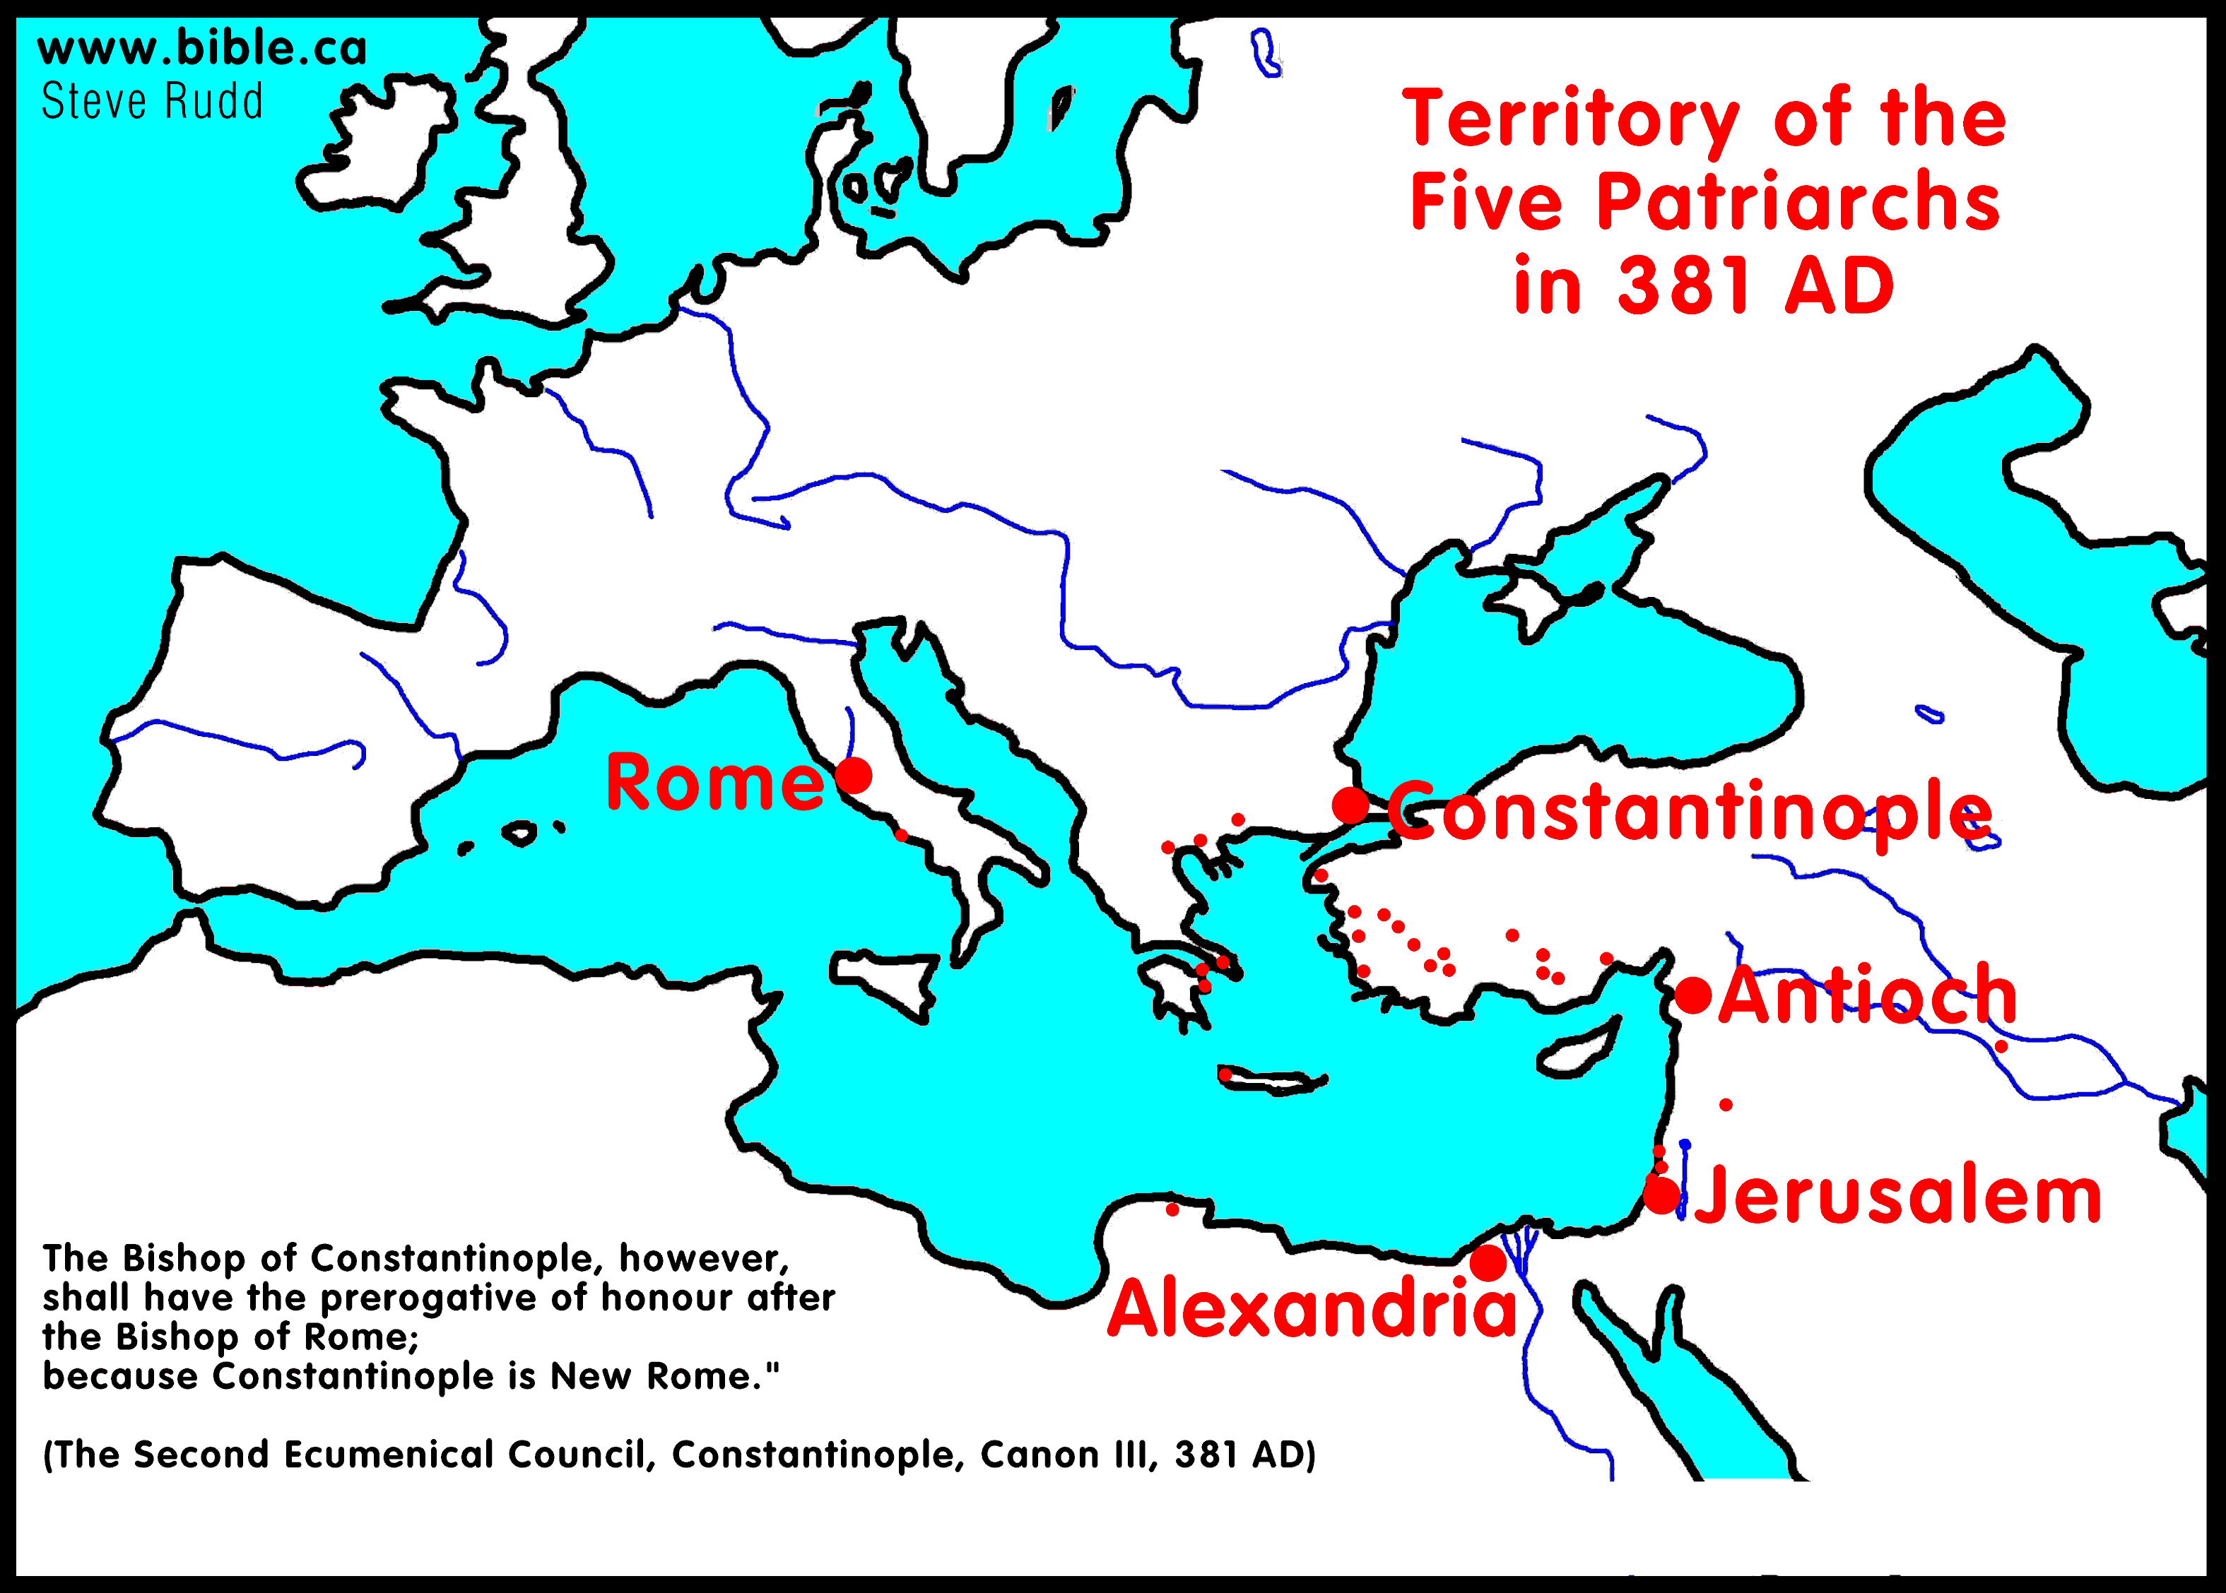

Slide 10
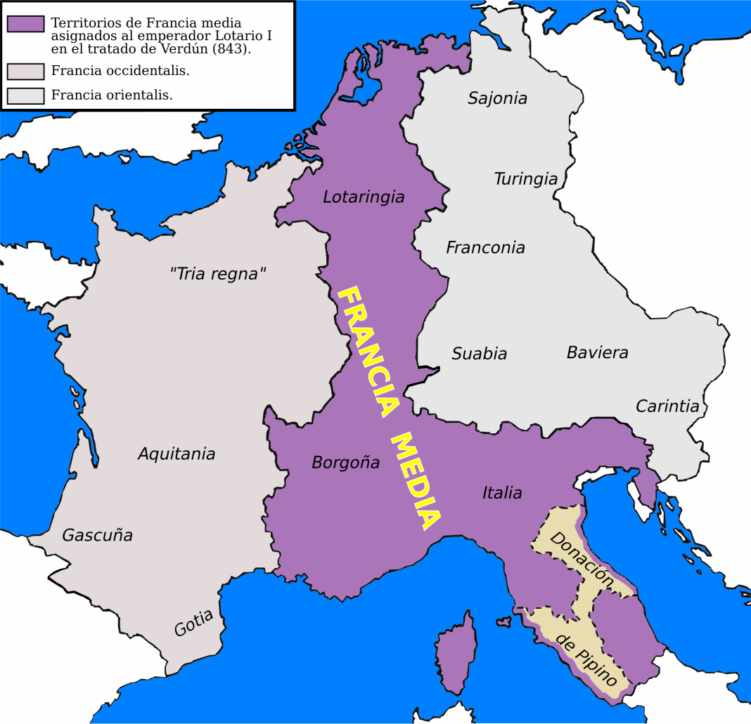
Beginnings of Papal States
1st bishop of Rome – St. Peter
Donation of Constantine – Lateran Palace, Church can own property
754 Donation of Pepin the Short - Pope Stephen II, the Lombards

Slide 11
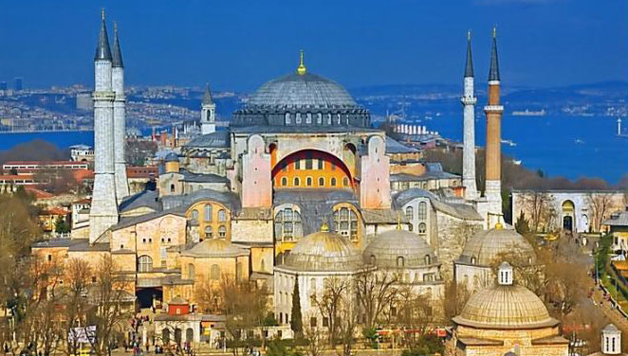
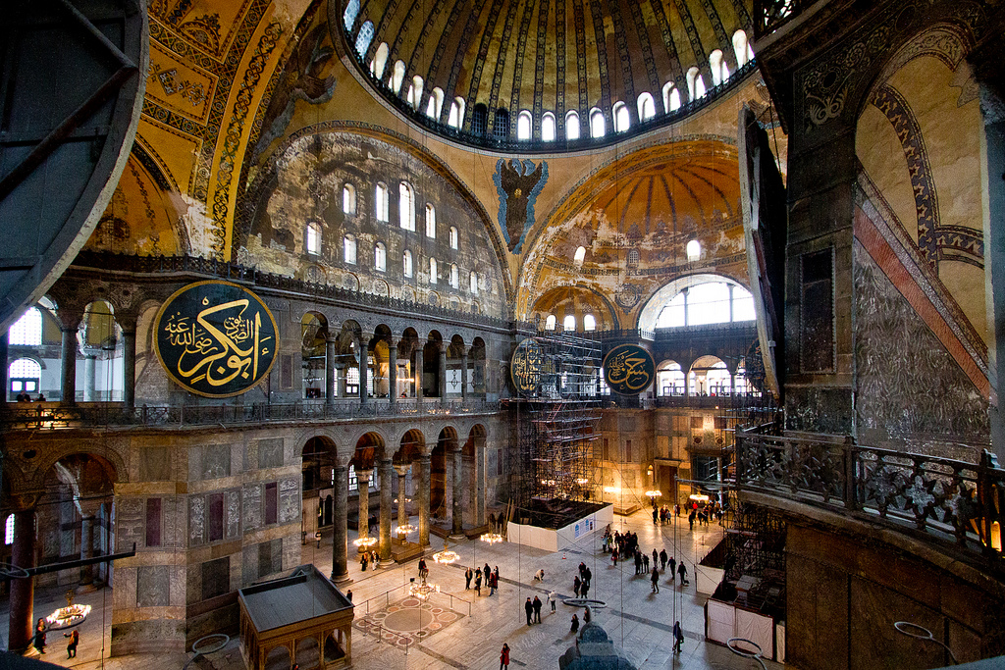
The Growing Divide and Schism (1054)
Filioque – interpretaion of Trinity (Father, Son, Holy Spirit)
Bread, Language (Latin v. Greek), Papal Political Power
East had closed Latin practicing churches
Papal legates come to Constantinople
Pat. Michael Cerulaeus refuses to sign universal jurisdiction for Pope
Papal legates deliver Papal Bull
East excommunicates Pope

Slide 12
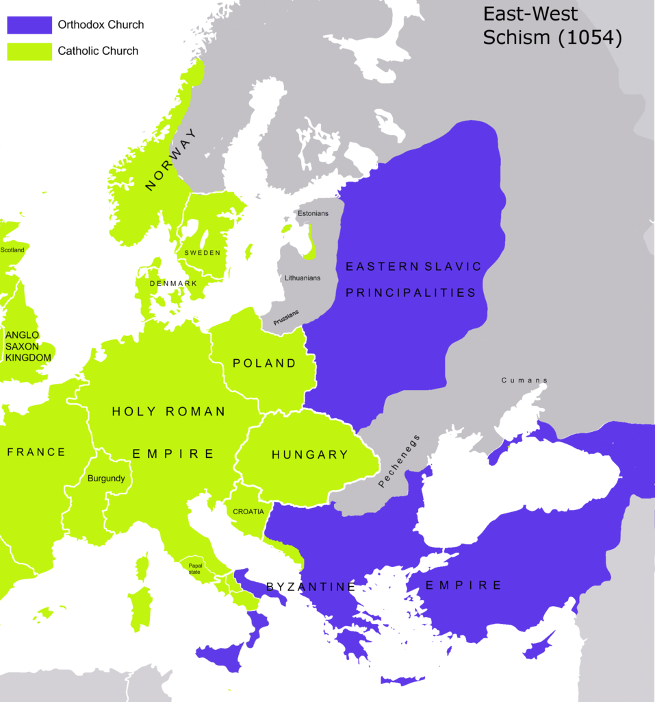
Europe at Great Schism 1054

Slide 13
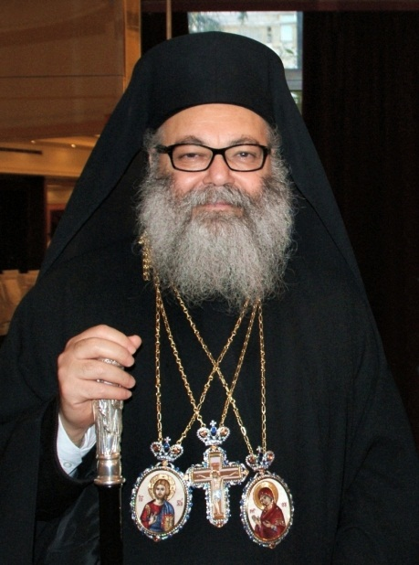
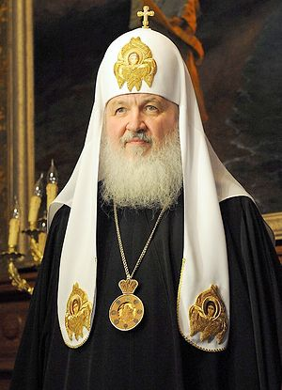
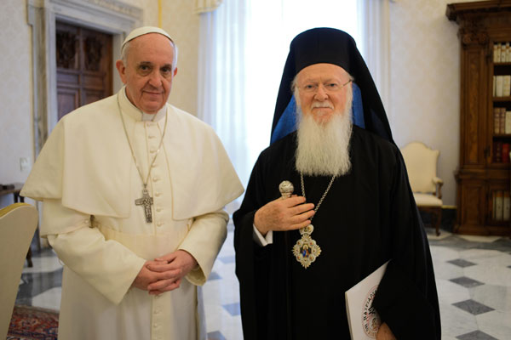
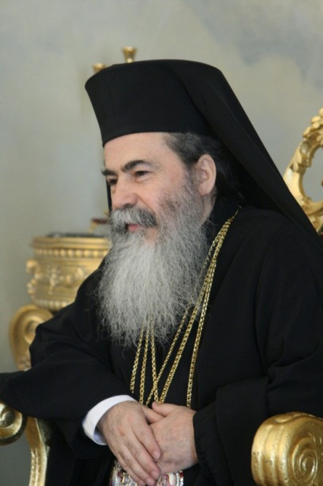
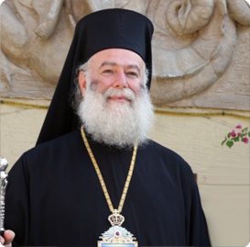
The Pope and the Current Patriarchs of the Orthodox Church

Slide 14
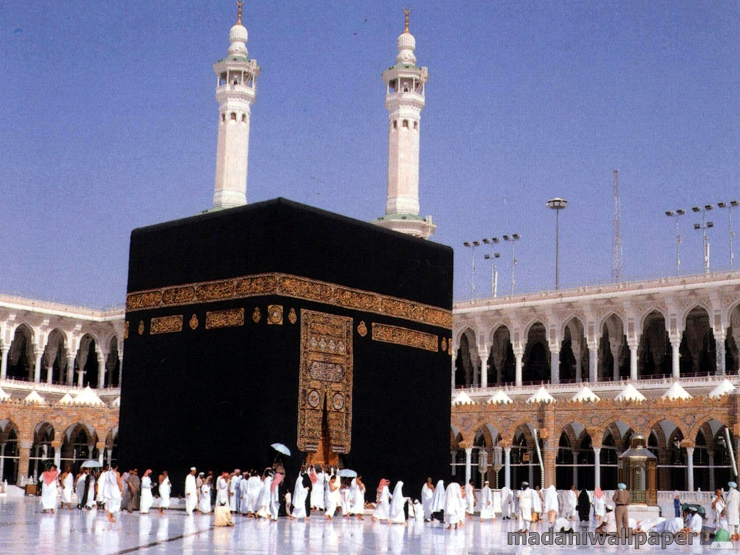
Early Arab Muslim Empires
Muhammad (570-632), born in Mecca
Received revelations during prayer in a cave
Preached “God is One” and “Surrender” (Islam means surrender)
Resistance in Mecca, moved to Medina with followers
Converted rest of Arabian peninsula from paganism, united tribes
Died in Medina
Revelation recorded in Quran, his life stories recorded in Hadith, did not believe in resurrection of Jesus Christ
Caliphs
661-750 Umayyad Dynasty – laid siege to Constantinople twice
750-1258 Abbasid Dynasty – ruled from Baghdad, Golden Age of Islam
1037-1194 Seljuk Turks
1258 – Baghdad sacked by Mongols
1261-1517 – Abbasids moved capital to Cairo

Slide 15
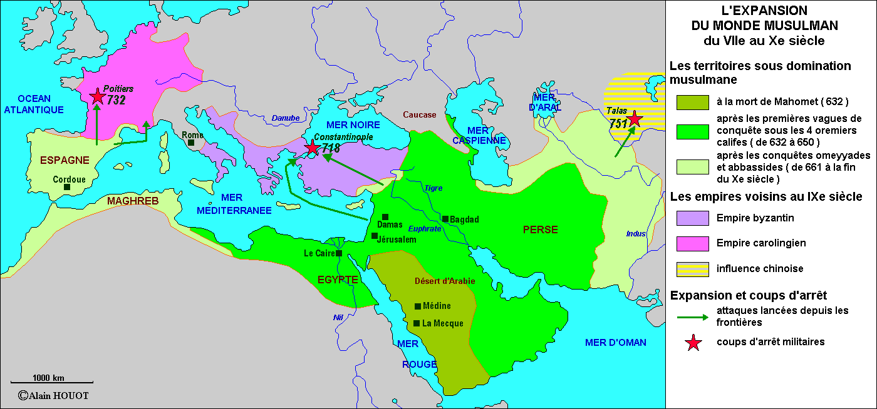
Arab Military Conquests

Slide 16
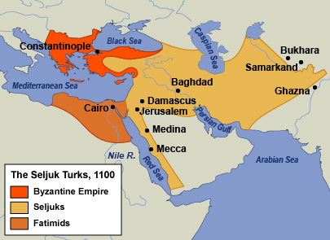
Rise of Seljuk Turks

Slide 17
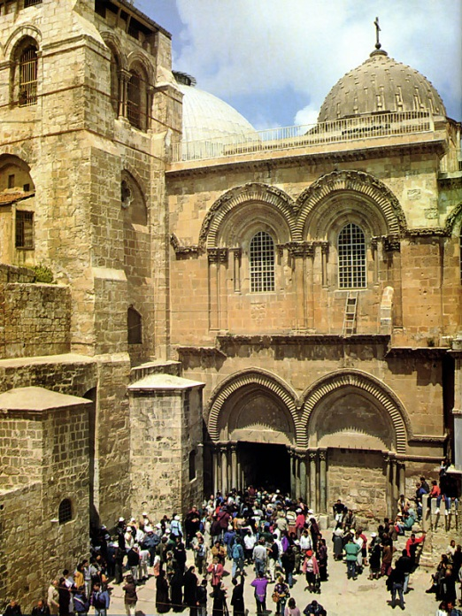
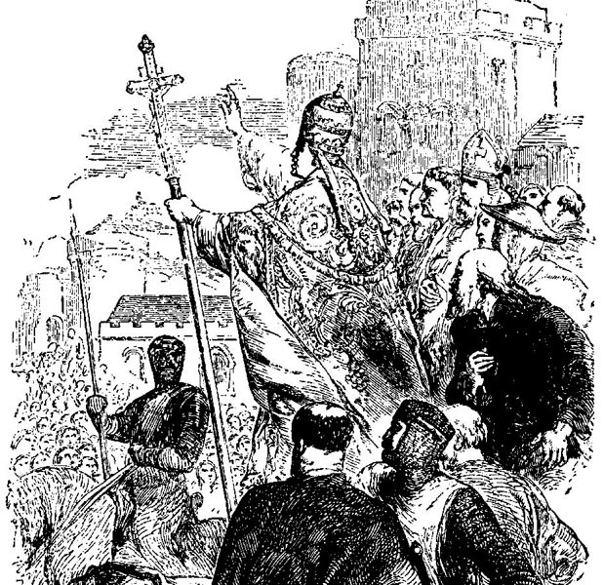
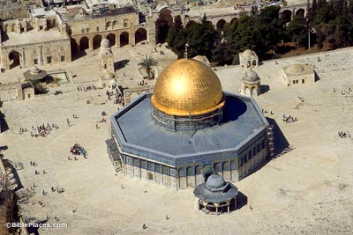
Origins of 1st Crusade
Important to Xianity (east and west) because Christ died and resurrected there, True Cross found there
Important to Judaism because Solomon’s Temple was there
Important to Islam because Muhammad ascended to heaven there (Dome of the Rock)
1070- Seljuk Turks capture Jerusalem, not as nice as Fatimids
Emperor Alexius Comnenus asks Pope Urban II for help in 1094
At Council of Clermont 1095, Pope Urban II gives speech (recorded by Robert the Monk), offered remission of sins for liberating Holy Land from Saracens
Italian cities eager for wealth
Ethnic tensions

Slide 18
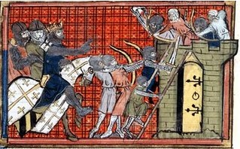
1st Crusade: Two Waves
Peasant Wave: 12000 peasants did not wait for military to gather, led by Peter the Hermit and Walter the Penniless
Most Crusaders were French (Franks)
Peasants pillaged on way to Constantinople
Most died in a feeble attack on Nicea
Military Wave - All kings currently excommunicated
Duke Godfrey, Count Bohemond, Raymond of Toulouse led
Thought to pillage Constantinople, but Alexius bribed them
30,000 marched to Nicea
Alexius promised Turks would be spared, they surrendered 6/19/1097

Slide 19
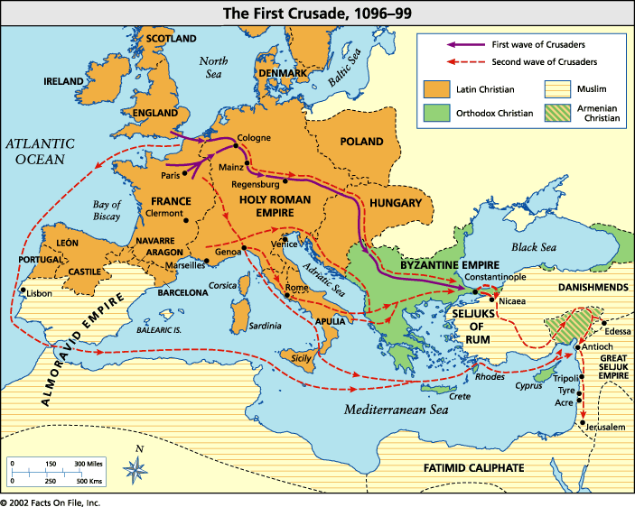
First Crusade Routes

Slide 20
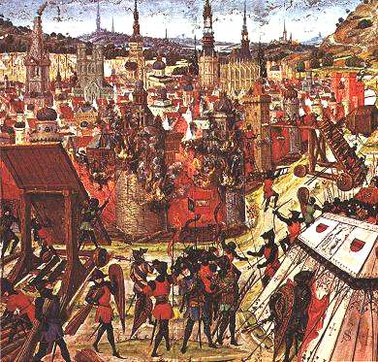
Capture of Jerusalem
Count Bohemond takes Antioch
Marched on Jerusalem in 1099, only 12,000 of them left
The Fatimids had recently retaken Jerusalem from the Seljuks
Caliph offered peace and freedom for Christian pilgrims, Franks wanted unconditional surrender and attacked
1000 Fatimid soldiers resisted for 40 days
Franks killed everyone

Slide 21
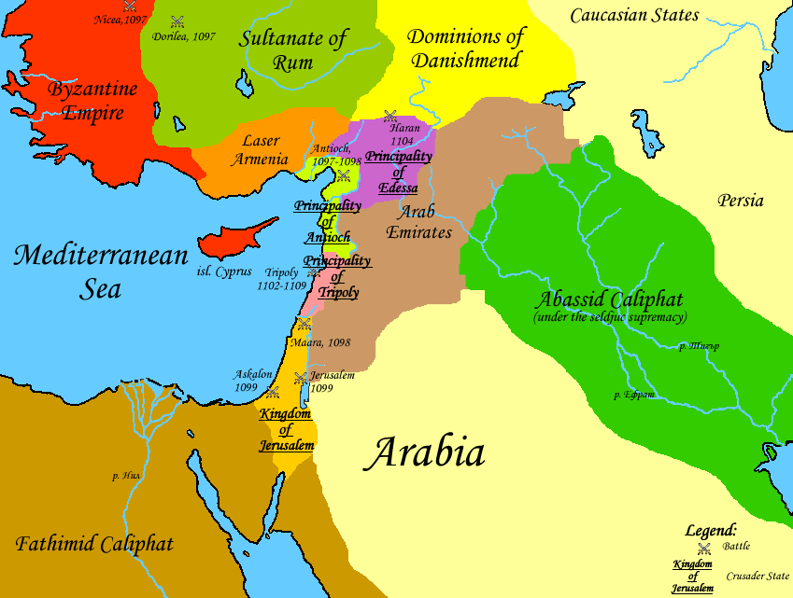
The Latin Kingdom of Jerusalem
Everything Latin and Papal
Orthodox Patriarch kicked out, fled to Cyprus
Sovereign state, not under Constantinople
Hospitalers, Knights Templar, Teutonic Knights started

