Slide 1
The Plantagenets, Great Schism and the 1st Crusade

Slide 2
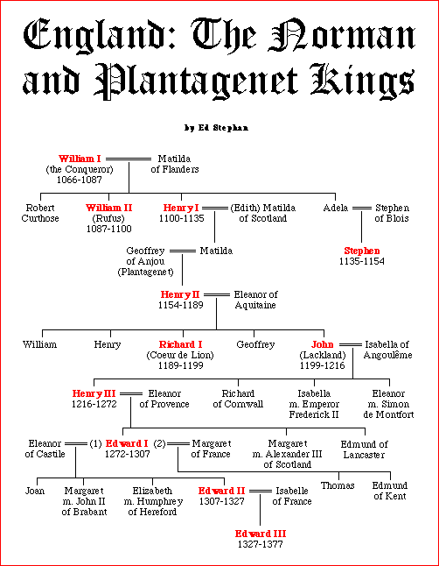

Slide 3
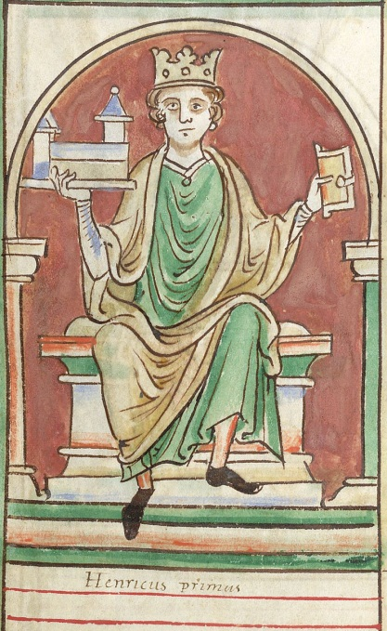
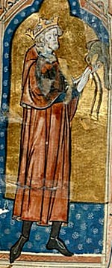
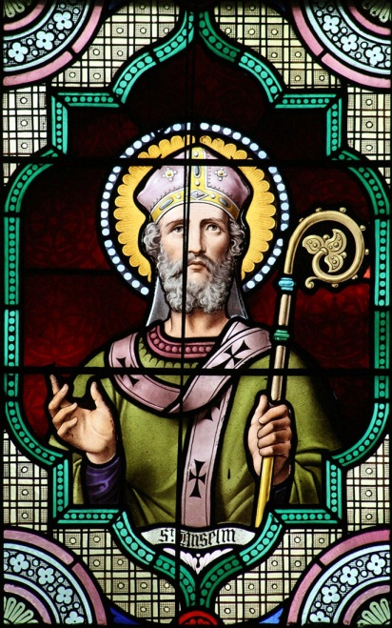
Kings after William the Conqueror
William “Rufus” (red face) of England – put down rebellion by his brother Robert Curthose, killed in hunting accident
Henry I (1100-1135) –advised by St. Anselm of Canterbury, married Matilda of Scotland
1135 – Stephen (grandson of Conqueror) seized throne, ruled during The Anarchy
The Anarchy – 19 year war between Stephen and Empress Matilda, began when Stephen’s forces sank ship with Henry’s son aboard (The White Ship Disaster)
Henry I’s grandson (later Henry II) was still a child
Stephen sued for peace and let Henry II become next king
Norman era ends

Slide 4
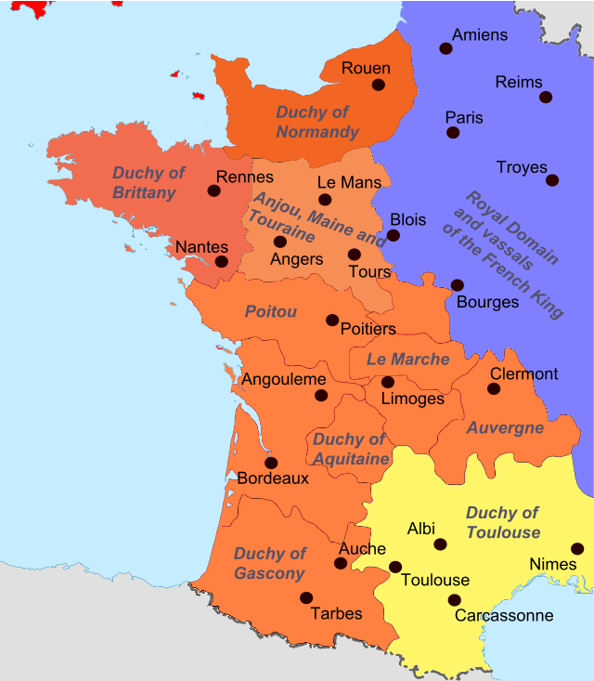
Plantagenet Dynasty
Matilda – daughter of Henry I, married into Plantagenet family (Geoffrey of Anjou)
Henry II – married Eleanor of Aquitaine (French)
Eleanor – Duchess of Aquitaine, for a time, she was Queen of France (married to Louis VII),
1154-1189 – Henry II, rival with Louis VII of France, eventually rivals with Thomas a Becket

Slide 5
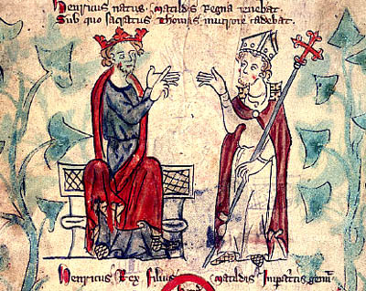
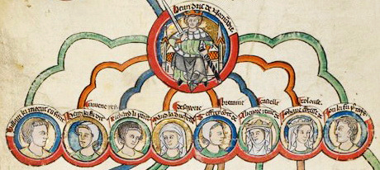
Henry II vs. Thomas a Becket
Thomas a Becket - Chancellor under Henry II, became Archbishop of Canterbury, defended the Church against government lived simply, served the poor
1164 – Henry II convened assembly to sign Constitutions of Clarendon ending clerical immunity, Thomas would not sign
Thomas flees to a monastery in Normandy, Henry banished all of Thomas’ relatives from England
Henry pushed Constitutions through
Henry threatened the monastery, abbot forced Thomas to leave, lived as a beggar for a while,
Pope finally forced Henry to reinstate Thomas as Archbishop of Canterbury

Slide 6
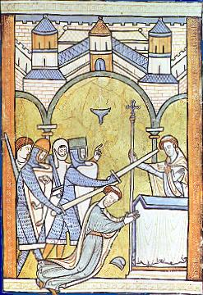
Death of Thomas a Becket; End of Henry II
1170 – Thomas returns
“…will no-one rid me of this troublesome priest?”
Four knights went to Canterbury and killed Thomas a Becket while praying at the altar
Penitent Henry declared innocence, rescinded Constitutions of Clarendon, promised Pope to go on Crusade
1172 - Church declared Becket a saint
Many pilgrims, even Henry went to his tomb to pay homage and pray, last three miles he went barefoot
1173-74 – “Great Revolt”, sons Henry “The Young King”, Richard and John and Eleanor allied with Philip Augustus (of France) against Henry II
1189 - Died in Chinon in France

Slide 7
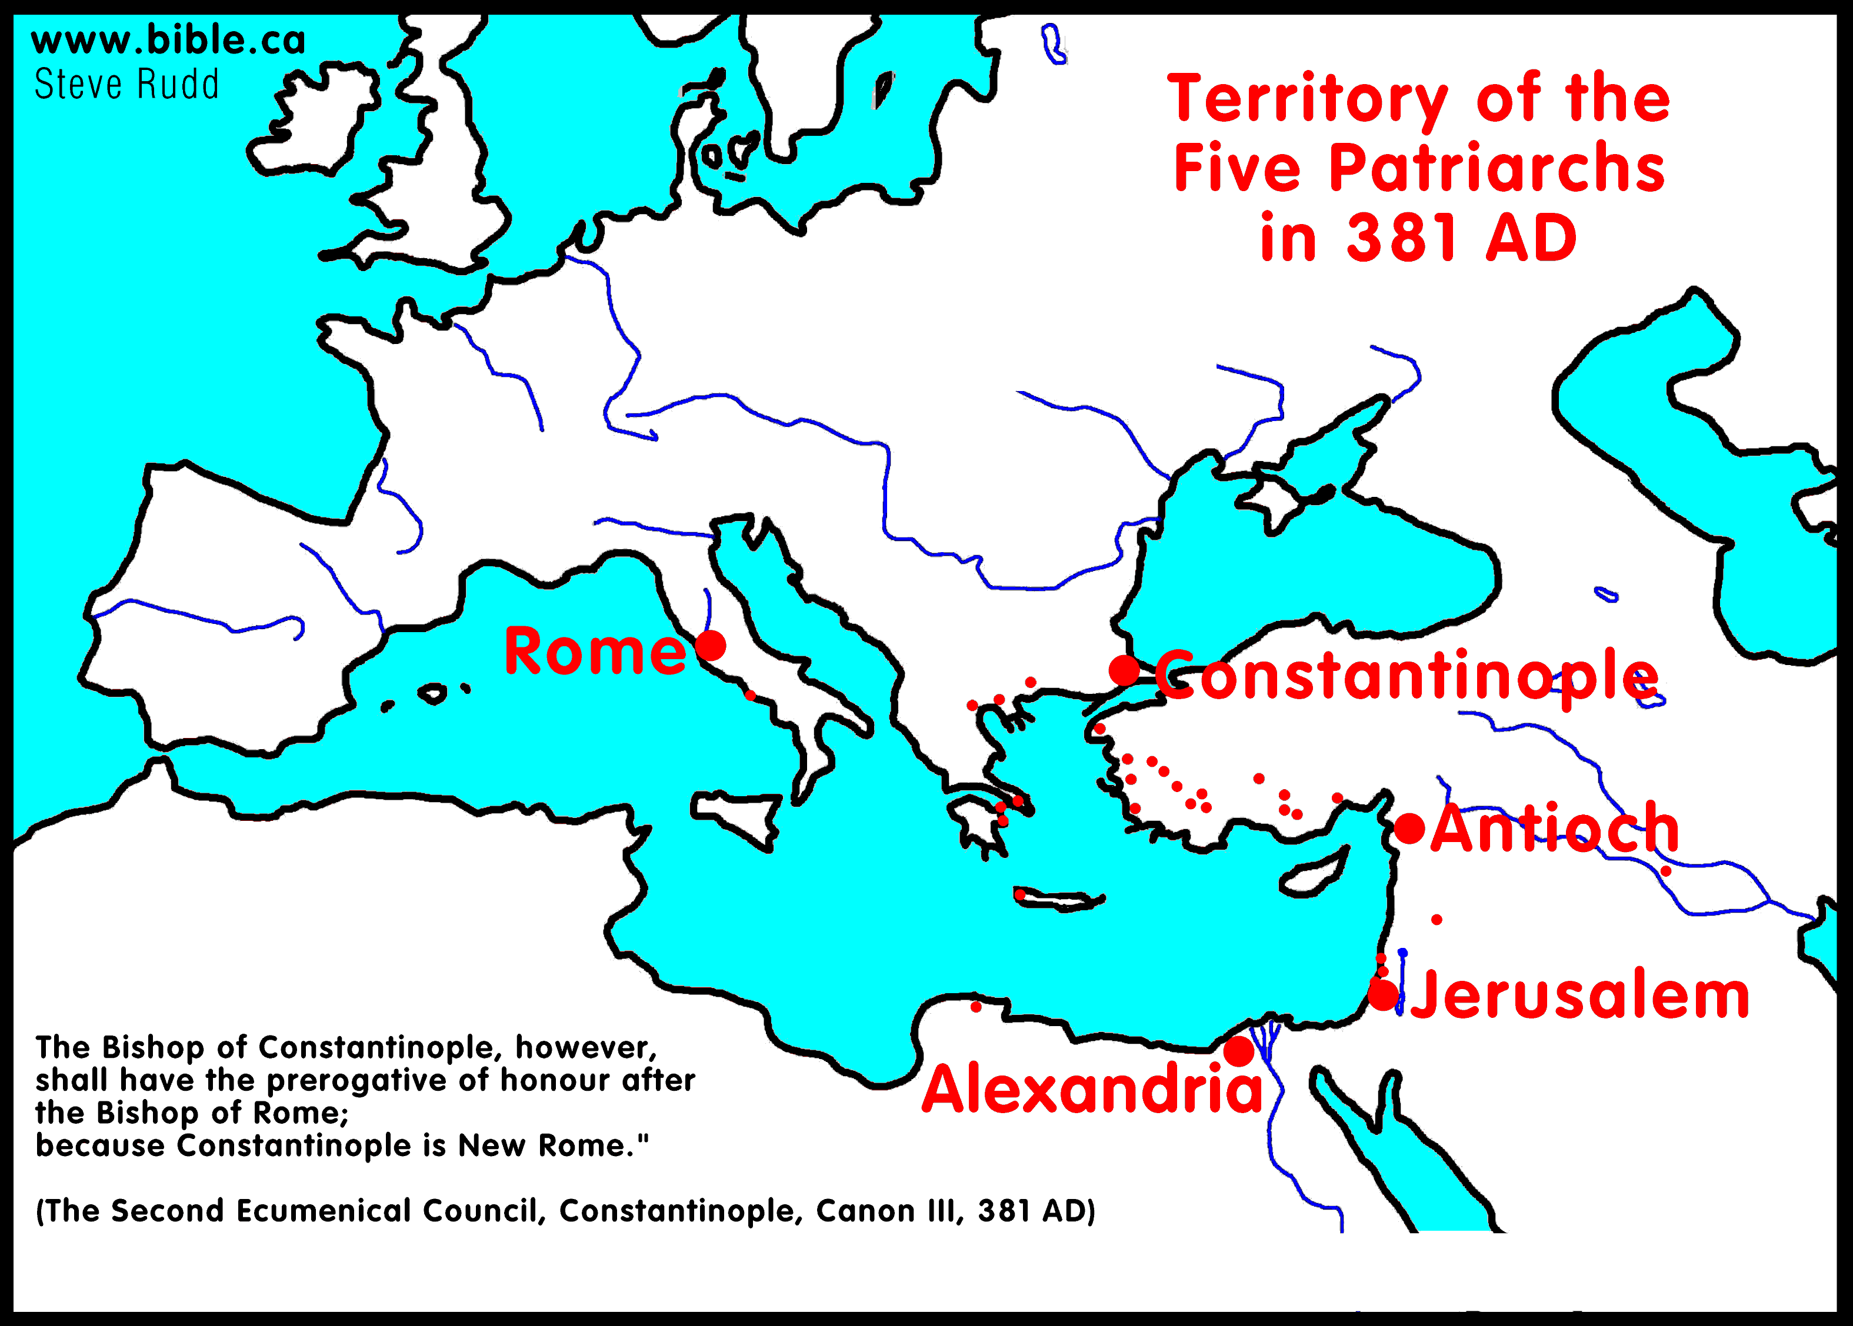
Papal States; Five Patriarchs of Early Church
1st bishop of Rome – St. Peter
Donation of Constantine – Lateran Palace (Church can own property)
754 Donation of Pepin the Short - Pope Stephen II, Lombard territory

Slide 8
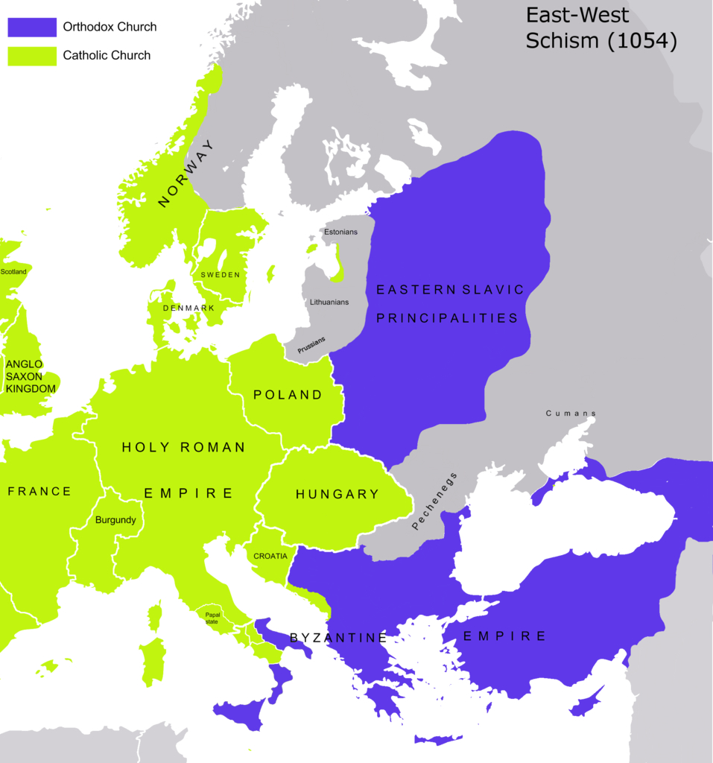
The Growing Divide and Schism (1054)
Filioque – Latin phrase in the Creed in the West but not the East
Bread, Language (Latin v. Greek), Papal Political Power grows
East closed Latin speaking churches
1054 - Papal diplomats come to Constantinople
Patriarch Michael Ceruleus refuses to sign “universal jurisdiction” for Pope
Papal legates deliver Papal Bull
East excommunicates Pope

Slide 9
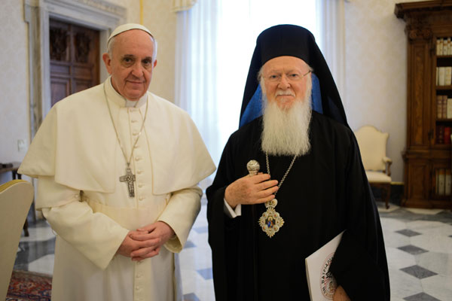
The Pope and the Current Patriarch of Constantinople, Bartholomew

Slide 10
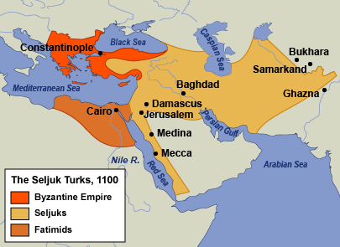
Early Arab Muslim Empires
Muhammad (570-632), born in Mecca, member of Qureysh tribe
Received revelations during prayer in a cave
Preached “God is One” and “Submission”
Resistance in Mecca, moved to Medina with followers
Converted rest of Arabian peninsula from paganism, united tribes
Revelation recorded in Quran, his life stories recorded in Hadith
Four Caliphs followed
661-750 Umayyad Dynasty – laid siege to Constantinople twice
750-1258 Abbasid Dynasty – ruled from Baghdad, Golden Age of Islam
909 – 1171 – Fatimids in Egypt
1037-1194 Seljuk Turks
1258 – Baghdad sacked by Mongols
1261-1517 – Abbasids moved capital to Cairo

Slide 11
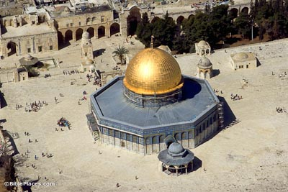
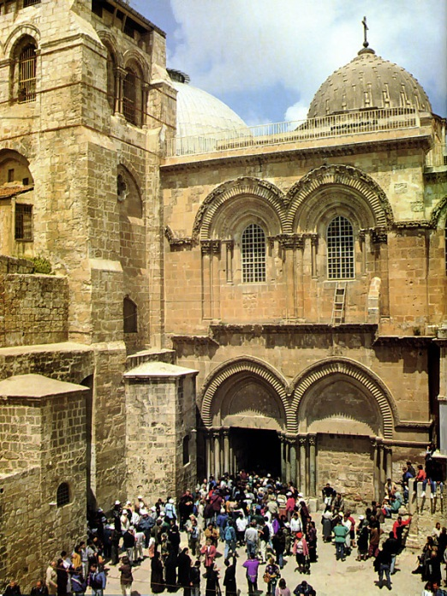
Origins of 1st Crusade
“Holy Land” - important to Xianity because of historical significance to Jesus Christ’s life
Important to Judaism because Solomon’s Temple was there
Important to Islam because Muhammad started Night Journey at Dome of the Rock on flying horse Buraq
1070- Seljuk Turks capture Jerusalem
Emperor Alexius Comnenus asks Pope Urban II for help in 1094
Council of Clermont 1095 - Pope Urban II gives speech (recorded by Robert the Monk), offered forgiveness of sins for liberating Holy Land from Saracens
Motivations: spiritual, economic, racial

Slide 12
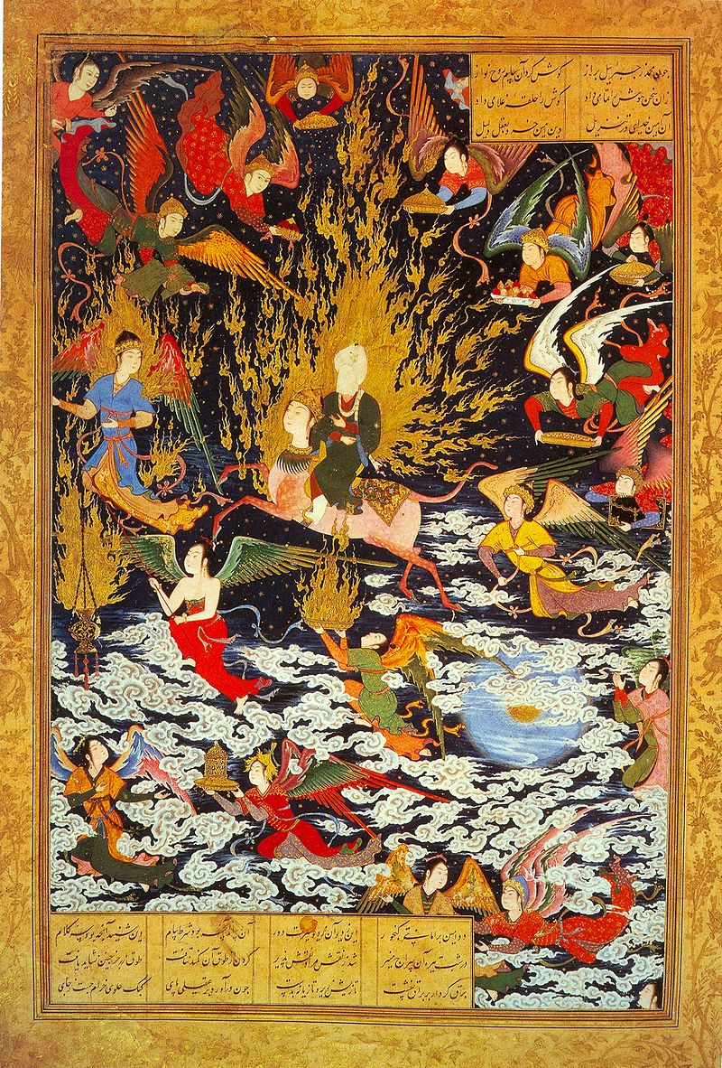

Slide 13
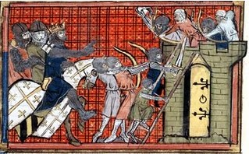
1st Crusade: Two Waves
Peasant Wave: 12000 peasants did not wait for military to gather, led by Peter the Hermit and Walter the Penniless
Most Crusaders were French (aka Franks)
Peasants pillaged on way to Constantinople
Most died in a feeble attack on Nicea (near Constantinople)
Military Wave - All kings were currently excommunicated seeking reinstatement
Led by Duke Godfrey (England), Count Bohemond (French), Raymond of Toulouse (French)
Planned to pillage Constantinople, but Emperor Alexius bribed them
30,000 marched to Nicea
Nicea surrendered in 1097

Slide 14
First Crusade Routes

Slide 15
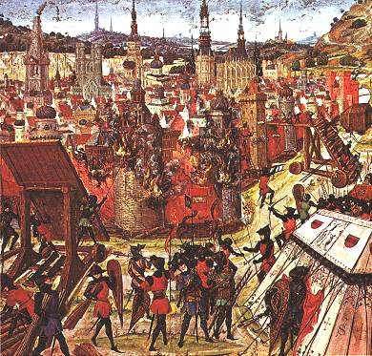
Capture of Jerusalem
Count Bohemond takes Antioch
The Fatimids had recently retaken Jerusalem from the Seljuks
Marched on Jerusalem in 1099, only 12,000 of them left
Caliph offered peace and freedom for Christian pilgrims to visit the city, Franks wanted unconditional surrender and still attacked
1000 Fatimid soldiers resisted for 40 days
Franks killed everyone

Slide 16
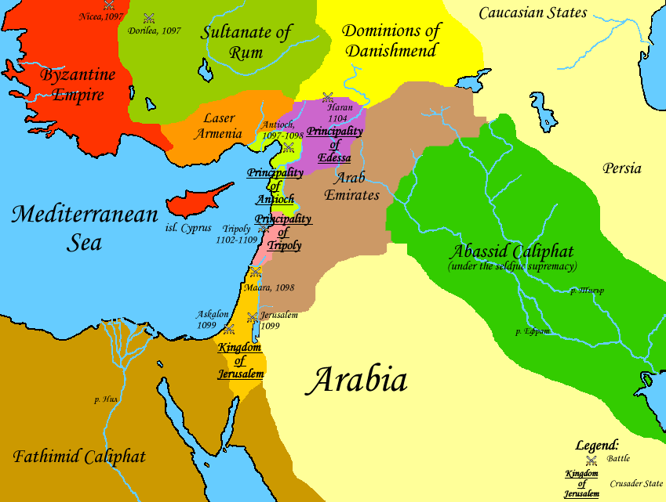
The Latin Kingdom of Jerusalem
In churches, everything changed to Latin and Papal
Orthodox Patriarch of Jerusalem kicked out, fled to Cyprus, Papal Patriarch installed
Jerusalem became sovereign state, a kingdom not under Constantinople
Knights Hospitallers – since 1099, dedicated to medical care
Knights Templar – rival of Hospitallers, named after Solomon’s temple
Teutonic Knights – German knights, formed to help pilgrims travel east

