Slide 1
The Rise of the Franks/The British Isles

Slide 2
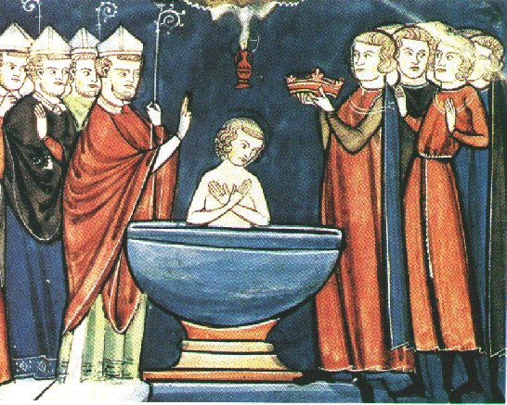
State of the West
Visigoths, Ostrogoths, Vandals all weakened
Christianity still the predominant religion in cities and in barbarian regions
The Franks – growing Gemanic tribe in Gaul
Merovingian Dynasty – known as “long-haired kings”, Clovis (Louis)
Mayor of the Palace – advisor to king
Salic Law – property, inheritance, criminal law
King Clovis – founder of Merovingians, defeated Alemanni at Tolbiac, converted after marrying Christian wife Clothilde
Siegebert III – first of the “do-nothing kings”, figureheads to the Mayors
Dagobert I – made Paris the capital
Childeric III – last Merovingian
Pope still in Rome but weak politically
486-507 – Clovis conquers many parts of Gaul

Slide 3
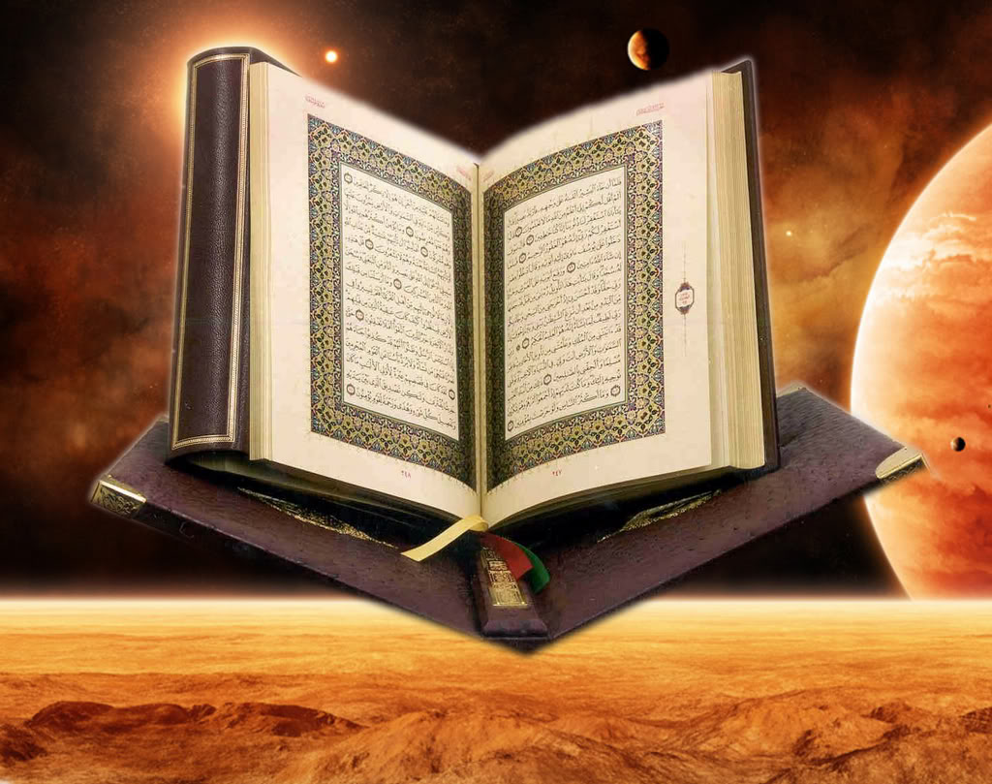
Muhammad’s Life cont.
Medina
Originally Yathrib
Renamed Medina, meaning “City of the Prophet”
War
Between Mecca and Medina
Mecca wasn’t happy that Muhammad was receiving followers
Treaty that acknowledged Muslims and allowed them in Arabia
Muhammad was able to successfully unite the Arabian peninsula
Pilgrimage
632
From Medina to Mecca with tens of thousands of followers
Died in June 632 from illness in Medina
Notes:
Muhammad and his followers went to Yathrib as mediators for the civil war. Looked upon as a hero, the city’s name changed to Medina, meaning city of the prophet.
Mecca was unhappy with Muhammad’s success of spreading Islam. A total of three battles between them resulted in a peace treaty acknowledging Islam. Mecca later broke the treaty.
Muhammad marched to Mecca and joined them with now bloodshed.
He successfully united the Arabian peninsula before his last pilgrimage in 632, three months before he died.
Source: http://www.pbs.org/muhammad/timeline_html.shtml

Slide 4
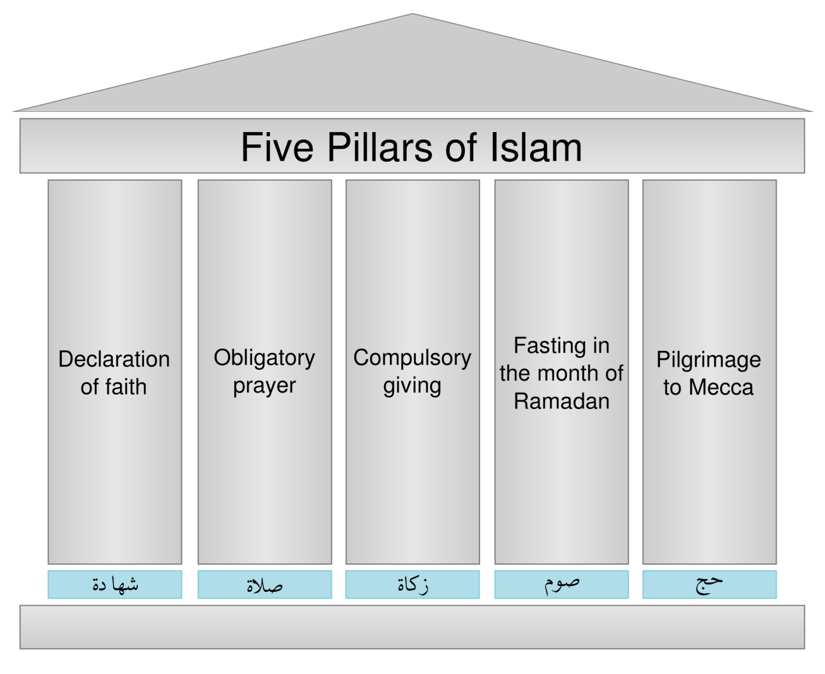
Qur’an
Islam means “submission” (to God)
114 suras, the longest is called “The Cow”
Abu Bakr was the first to compile Muhammad’s revelation into a book, the Qur’an
Another book The Hadith has stories about Muhammad’s life
Teaches 5 principles, known as the 5 Pillars of Islam
Faith – Muhammad is God’s Prophet
Prayer – 5 times a day
Almsgiving
Fasting – during Ramadan
Pilgrimage – to Mecca at least once in life
Notes:
DISCUSS 5 PILLARS
DISCUSS PRAYER TIMES

Slide 5
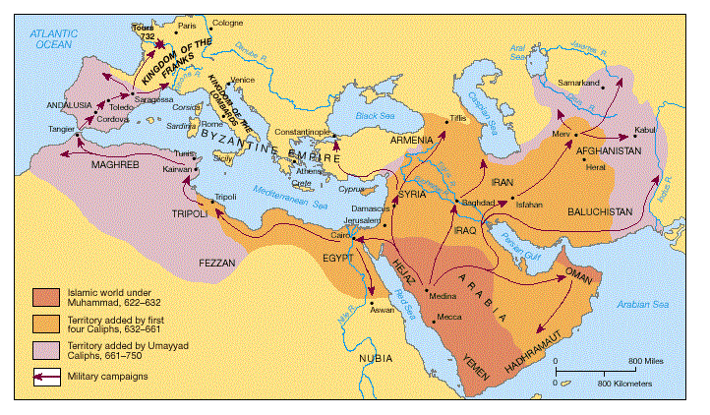
Successors to Muhammad
The first caliph: Abu Bakr
Compiled the Qur’an
Tribes in the Arabian peninsula united under Islam
The second caliph: Omar
Expansion: all of north Africa, the Middle East, parts of Asia
The third caliph: Othman
Civil war resulting in separation of the empire
The fourth caliph: Ali
Today’s followers are Shi’ites
Conflicts between the Umayyad's and Ali
Notes:
Discuss conflicts between Umayyads and Ali

Slide 6
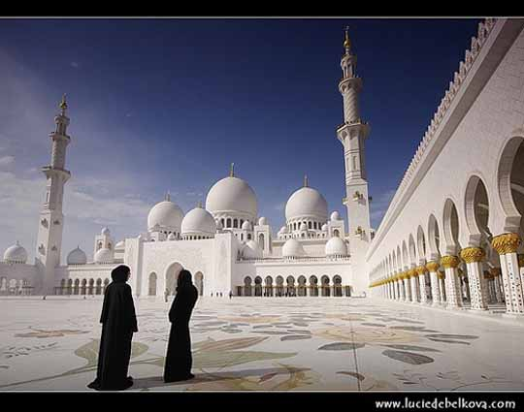
Shia vs. Sunni vs. Sufi
Three divisions of Islam
Shia
Followers of Ali, the 4th Caliph
Believe he was chosen by Muhammad to be his successor
Sunni
Follow the 4 caliphs who followed Muhammad
Most Muslims are Sunni Muslims
Sufi
Seek union with God
Give up worldly things
Divine/Mystical side of Islam

Slide 7
Umayyad Empire

Slide 8
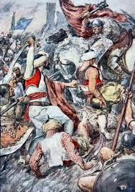
The Carolingians
Charles Martel (“The Hammer”) – formerly a Mayor of the Palace
732 Battle of Tours - halted Islamic invasion of Umayyad Dynasty into Europe
Pepin the Short – first Carolingian King of Franks, son of Martel, Donation to Papacy (Pope Stephen II) after defeating Lombards
Donation of Pepin the Short – Papal States

Slide 9
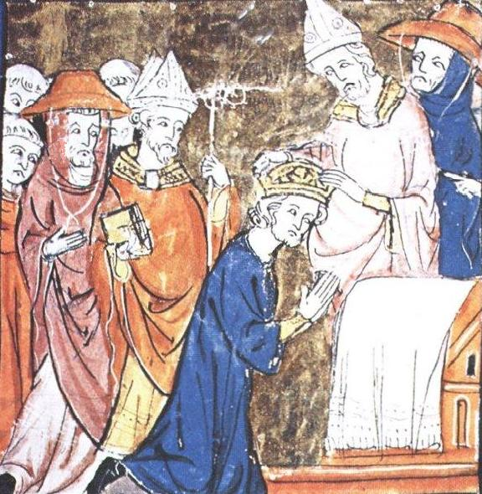
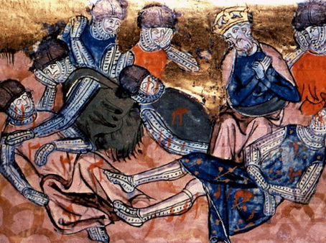
Charlemagne
Son of Pepin the Short
778 Battle of Roncevaux Pass –attacked by Basques on way back to France, Roland’s knights cut off, only battle Charlemagne lost
“Song of Roland” – earliest French literature, Roland and Oliver debate whether to blow Oliphant (horn)
800-814 – becomes King of Franks after brother Carloman died, conquered Lombards, Bavaria, parts of Spain, Saxons, made himself king of Lombards
Illiterate but good administrator
800 – crowned first Holy Roman Emperor by Pope Leo III

Slide 10
Growth of The Franks

Slide 11
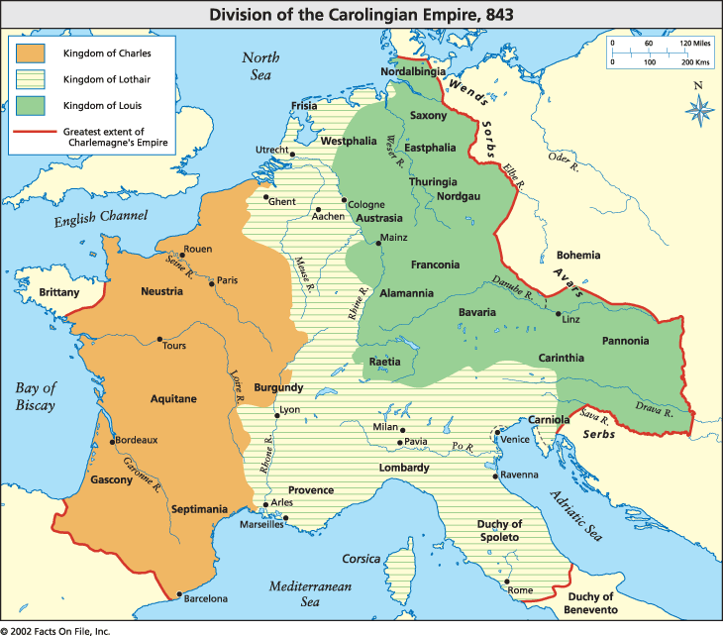
Breakup of Carolingians
814-833 – Louis I “The Pious” forced to abdicate by first three sons
843 Treaty of Verdun - three sons divide up empire: Charles the Bald, Lothair, Louis the German
West Francia became modern France: included Brittany, Burgundy, Aquitaine
987 – Carolingian rule over, Capetian line begins with Hugh Capet

Slide 12
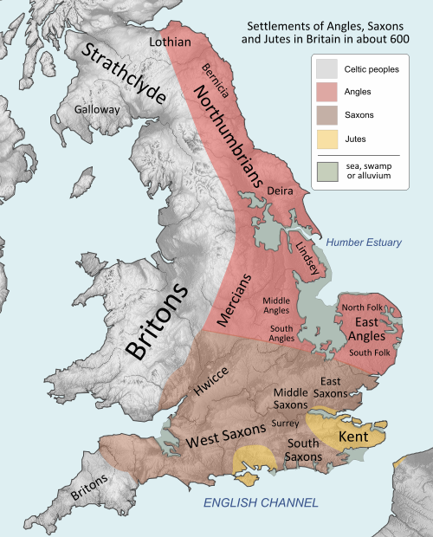
Early Battle for Britain
Meanwhile, “Barbarians” (Angles, Saxons, Jutes) also invaded Britain
By 5th Century, Rome no longer able to defend Britain (remember Hadrian)
577 Battle of Durham - Angles, Saxons and Jutes conquered England, divided up the country
597 – first Archbishop of Canterbury
601 – Ethelred, first Christian Anglo-Saxon king
8th-9th centuries – constant raids by Danes, Britons migrated to Europe

Slide 13
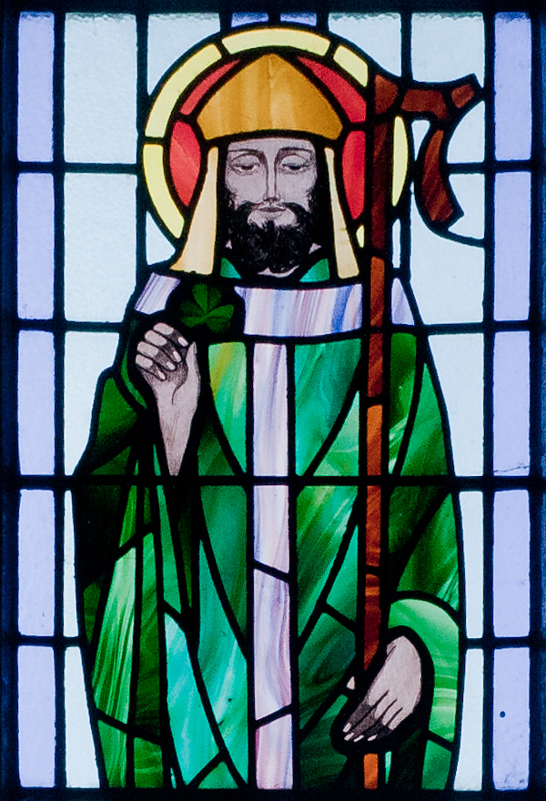
St. Patrick
5th Century Roman Briton
At age 16, captured by Irish raiders, held prisoner for 6 years
Escapes, returns to Britain
Decides to return to Ireland as a missionary
Used shamrock to teach Christian doctrine
Banished snakes (legend)

Slide 14
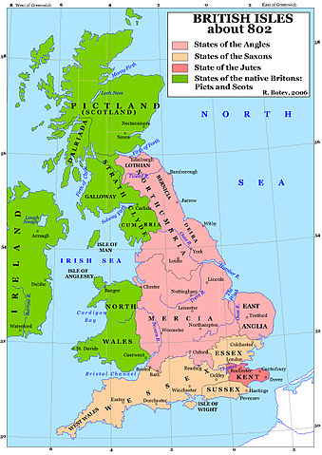
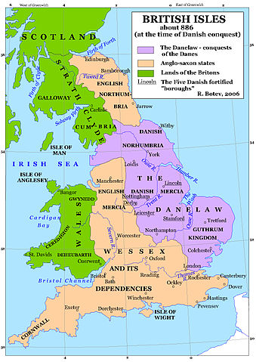
Rise of Anglo-Saxons

Slide 15
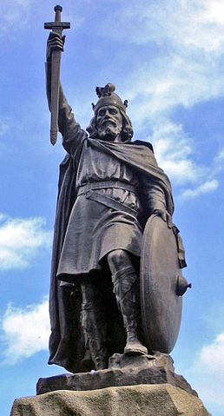
Alfred The Great
Battle at Merton - King Ethelred (Wessex) and brother met Danes, Ethelred killed, Alfred takes throne (871)
Alfred “The Great” – drove Danes out of Wessex, signed Treaty of Wedmore with the Dane Guthrum, later conquered Danes in east and unified England

Slide 16
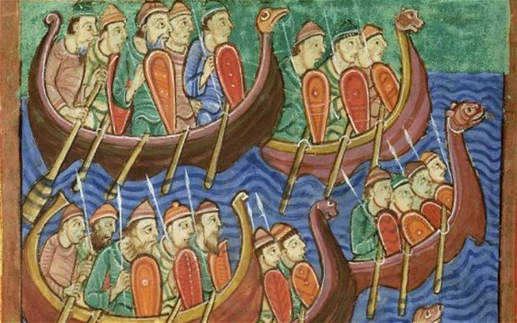
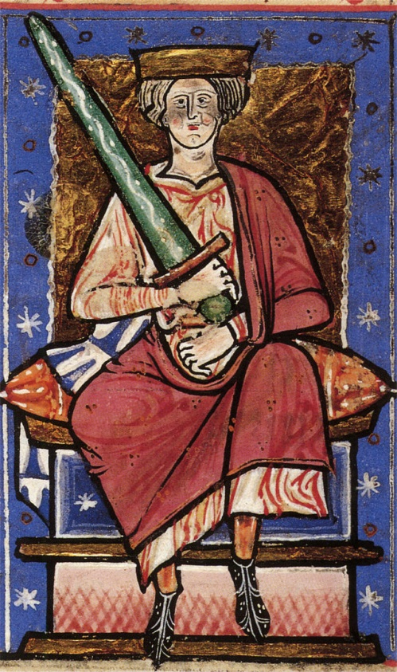
Danish Conquest of England
991 – Norwegian Vikings land and plunder coast
Ethelred “The Unready” married Emma, daughter of Norman duke
1002 – St. Brice’s Day Massacre
1013 – the Dane Sweyn invaded, Ethelred fled to Normandy, Danes now on throne
Sweyn dies, Ethelred tried to regain throne against Canute (Sweyn’s son) but died in London
1016 - Danish conquest complete with Canute defeating Ethelred’s son Edmund

Slide 17
Early English Literature
Ecclesiastical History of the English Nation
Beowulf (anonymous)
673-735 – written by Venerable Bede, father of English history, translated many Greek and Latin works into English
Beowulf – epic poem, earliest manuscript - 10th century
Beowulf is a prince from Geat Sweden, comes to free Danish King Hrothgar from monster (dragon) Grendel and Grendel’s mother, helped by friend Wiglaf

Slide 18
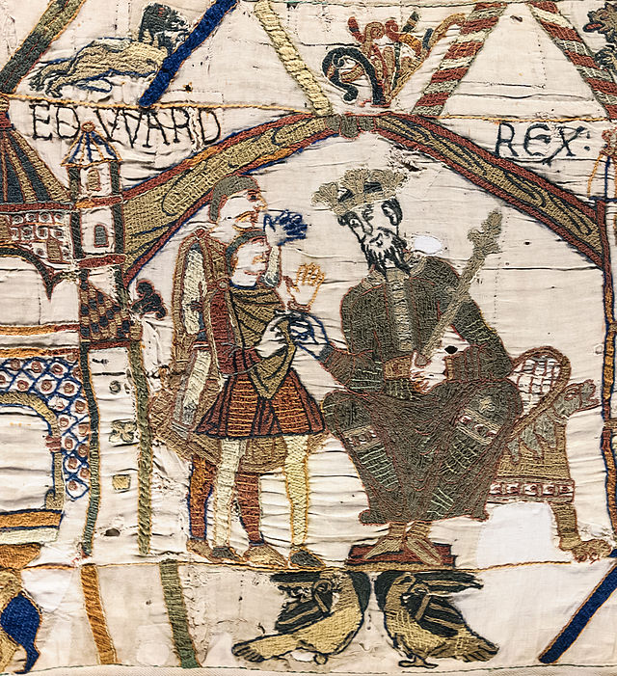
Frenchifying of England
Canute married Emma of Normandy, yes, the same Emma
1042 - Harthacnut, Canute’s son, made step-brother Edward his heir, Edward was son of Ethelred and Emma
1042-1066 - Edward “The Confessor” had grown up in Normandy, brought with him French language and culture
Started building of Westminster Abbey
Appointed all French nobles, Edward was jealous of power of Godwin, Earl of Wessex, deposed him

Slide 19
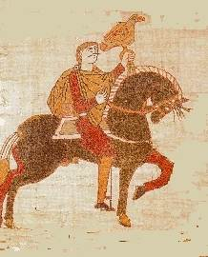
Harold Godwinson
1051 - Godwin fled to Flanders (Belgium)
Son Harold raised Irish army and attacked Edward
Took England easily and Edward gave Godwin all his property back, Harold made Earl of Wessex
1066 – Edward AND Godwin died
William of Normandy claimed throne (descended from Ethelred), Edward had earlier promised him throne in return for protection in Normandy
But Edward named Harold successor on deathbed, William appealed to Pope
Pope Alexander II excommunicated Harold and declared William rightful king of England (first time ever Papacy decided on thrones), blessed William’s invasion

Slide 20
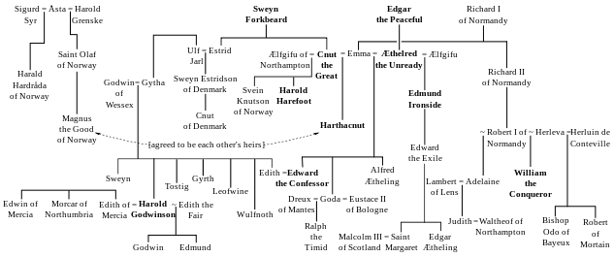
Claimants of the English Throne

Slide 21
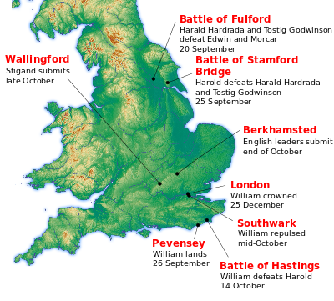
1066, Battle of Hastings
While William I invaded from Normandy, Tostig and King Harald Hardrade of Norway came from the north
Harold defeated Tostig and Hardrade at Stamford Bridge (Chelsea FC)
Harold lost to William at Senlac, near Hastings, Harold got an arrow in the eye
William crowned king of England on Christmas Day 1066

Slide 22
Death of Harold in Bayeux Tapestry

Slide 23
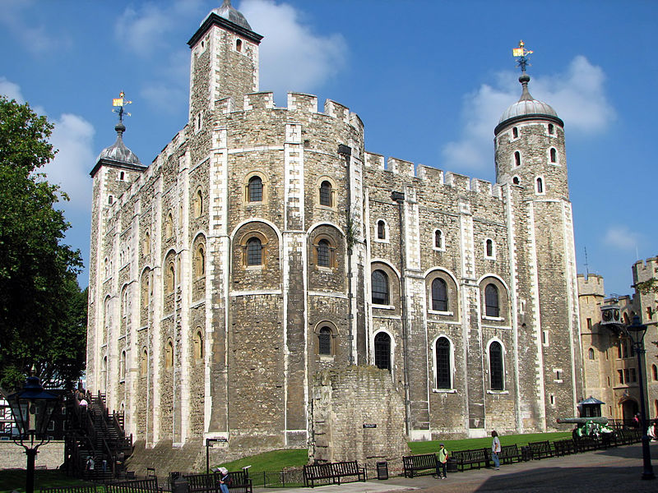
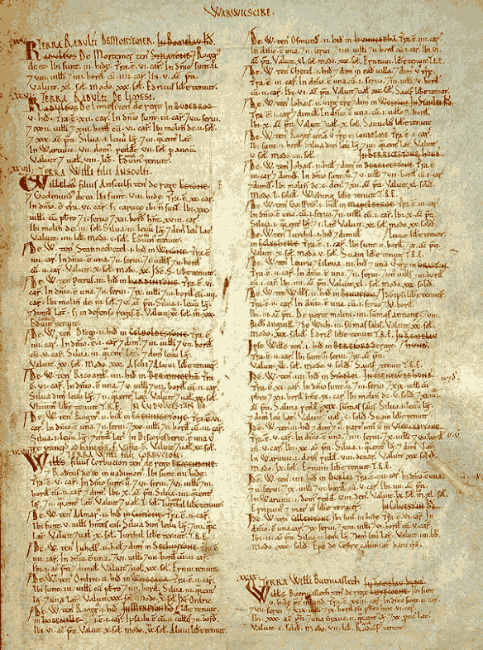
William as reforming ruler
Centralized power, seized much land for the crown, established curfews, took hidden money from monasteries
Domesday Book – record of who owned what down to the smallest piece of land
Replaced English clergy with Normans
No papal bull without his approval, he would approve any decisions made by bishops
Wife was Matilda
He died very fat in 1087 (horse accident)
French/English language
Serfdom and feudalism became the system

Slide 24
Identify the text. What other text is referenced?
"Till the monster stirred, that demon, that fiend/Grendel who haunted the moors, the wild/Marshes, and made his home in a hell./Not hell but hell on earth. He was spawned in that slime/Of Cain, murderous creatures banished/ By God, punished forever for the crime/ Of Abel's death."

Slide 25
Identify who is speaking
"The pagans are in force, While of our Franks it seems there are too few. Therefore, companion Roland, sound your horn! King Charles will hear, the army will turn back." Roland replies, "That would be mad, insane! For I would lose renown throughout sweet France."

Slide 26
Identify the book
STANTON, DERBYSHIRE
Hundred: Walecros
County: Derbyshire
Total population: 2 households (very small).
Total tax assessment: 0.5 geld units (very small).
Value: Taxable value 0.5 geld units. Value to lord in 1066 £1. Value to lord in 1086 £0.5.
Households: 1 smallholder. 1 freemen.
Ploughland: 0.5 ploughlands (land for). 1 men's plough teams.
Other resources: Meadow 10 acres.
Lord in 1066: Alwin of Stanton.
Lord in 1086: Henry of Ferrers.
Tenant-in-chief in 1086: Henry of Ferrers.

