Slide 1
Roman Empire, Part 2
Diocletian to Constantine to Justinian

Slide 2
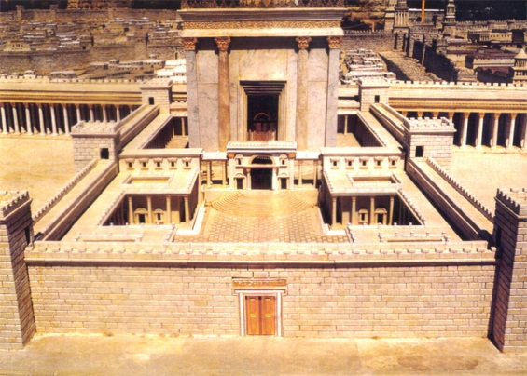
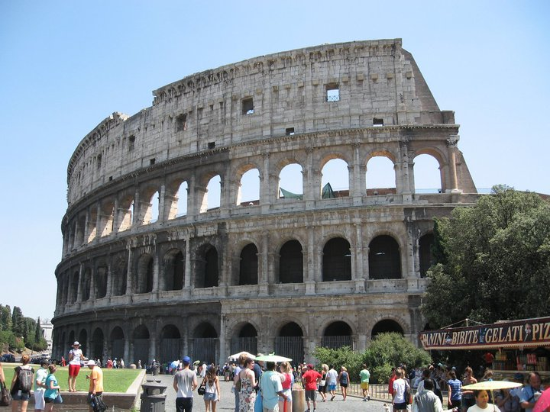
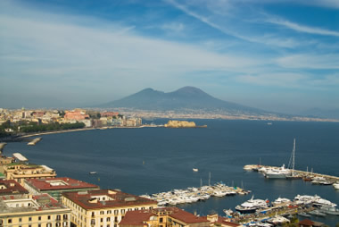
Flavian Dynasty
Vespasian 69-79 – founder of Flavians, final ruler during Year of The Four Emperors, started Colosseum, quelled Great Jewish Revolt, mass suicide at Masada, sent Titus to Judea to destroy Temple in 70 AD,
Titus 79-81 – son of Vespasian, Mt. Vesuvius, Pompeii, Herculaneum, finished Colosseum
Domitian 81-96 – son of Vespasian, brother of Titus, assassinated with help of assistant Parthenius, erected arch in honor of Titus, succeeded by Nerva

Slide 3
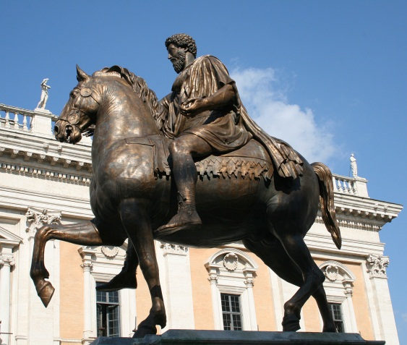
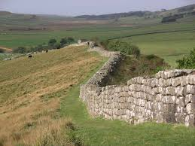
The Five Good Emperors
Nerva 96-98 -
Trajan 98-117 – adopted by Nerva, Trajan’s Column in Rome, empire reached greatest extent, annexed Sinai, Parthia and Dacia
Hadrian 117-138 – tried to build temple on site of Solomon’s Temple, Bar Kochba Revolt, Hadrian’s Wall, Picts in northern Britain, lover Antinous
Antoninus Pius 138-161 – adopted by Hadrian, most peaceful reign
Marcus Aurelius 161-180 – stoic philosopher, Meditations, Pax Romana ends, only equestrian statue to survive antiquity

Slide 4
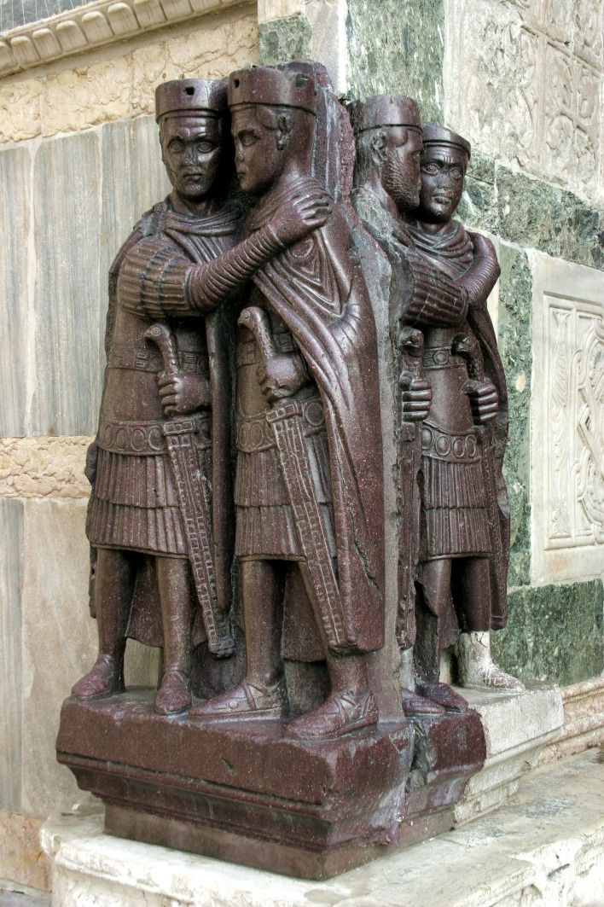
Diocletian and the Tetrachy
Commodus 180-192 – son of Marcus Aurelius, brutal, loved gladiatorial contests, strangled by gladiator/wrestler Narcissus
Diocletian 284-305 –divided empire into Tetrarchy, lots of Christian persecution, Edict of Maximum Prices, last major persecution of Christians
Tetrarchy – East and West had one “Augustus” and one “Caesar” each, lasted 20 years
East: Diocletian and Galerius
West: Maximian and Constantius I

Slide 5
Diocletian’s Division of the Empire

Slide 6
The Tetrarchy Chaos Begins
305 AD – Maximian and Diocletian abdicated, Constantius and Galerius raised to Augustus
Flavius Valerius Severus and Maximinus raised to Caesar (2nd tetrarchy)
306 – Constantius died, Severus promoted but troops supported the son, Constantine
307 - Maxentius, son of Maximian, also claimed Augustus, had Severus murdered
Retired Diocletian and Maximian appointed new Augusti and Caesers
West: Licinius and Constantine
East: Galerius and Maximinus
Maxentius married Galerius’ daughter

Slide 7
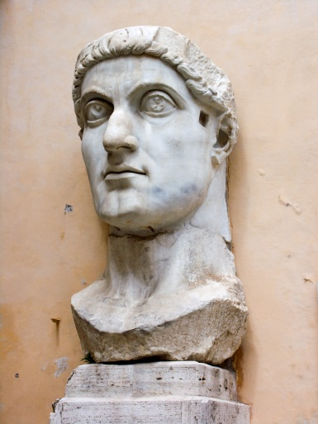
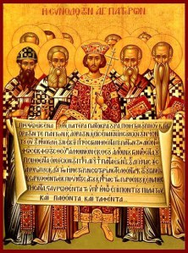
Constantine the Great, 306-337
309-313 – Civil War , Maxentius allied with Galerius and Maximinus against the West
310 – Galerius dies
Battle of Milvian Bridge 312 – Maxentius vs. Constantine near Rome, “In this sign, conquer.” (Cross), defeated Maxentius
Maxentius drowned in the retreat, his head later sent to Carthage
313-324 – Constantine (West) and Licinius (East) last two standing
Edict of Milan 313 – Constantine and Licinius, property returned to Christians, made Christianity legal
324 – Constantine defeats Licinius, becomes sole emperor of Roman Empire, city of Constantinople founded, formerly Byzantium
Mother Helena – finds True Cross
325 AD - 1st Council of Nicea – combats the heresy Arianism, 1st official Nicene Creed, date of Pascha set

Slide 8
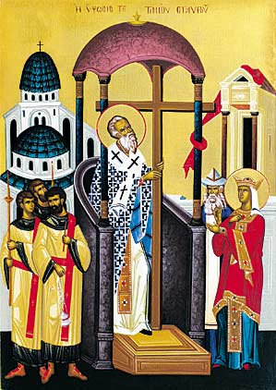
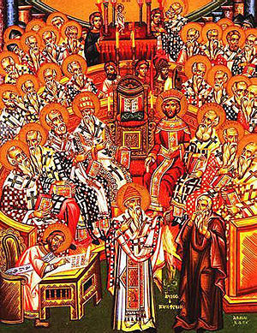
Early Christian Church
Jesus
12 Apostles
Paul
Underground church
1st Bishop of Rome – Peter
Persecutions
Edict of Milan – Christianity legalized
Patriarchs and bishops

Slide 9
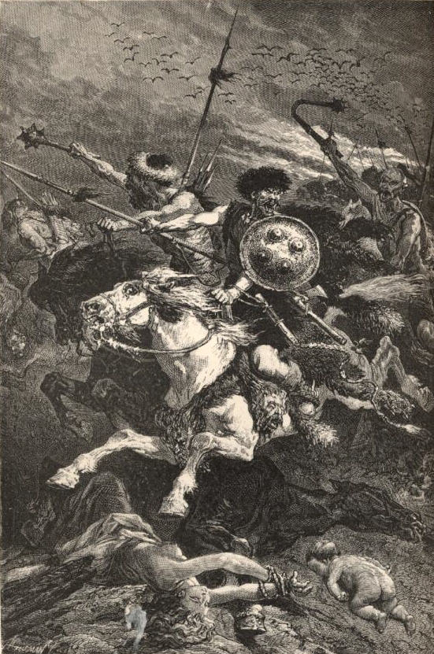
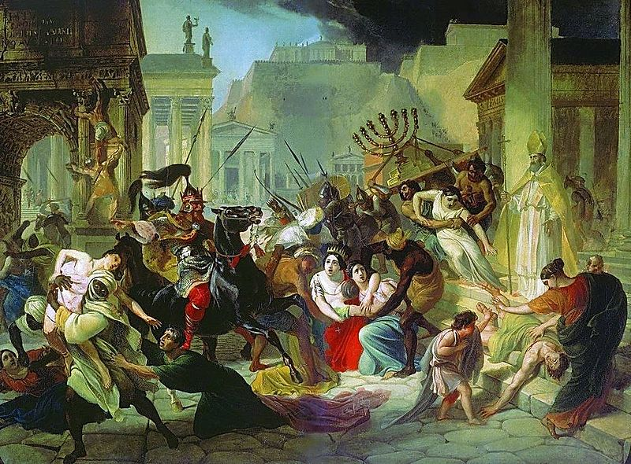
Barbarian Invasions
Alaric the Visigoth – sacks Piraeus and Sparta, defeated by Stilicho at Battle of Pollentia, Stilicho executed by enemies in Rome, Alaric captures sister of Emperor Honorius, sacks Rome in 410
409-429 – Vandals (Arians) move to N. Africa, take Carthage in 439
434-453 - Attila the Hun “The Scourge of God”, took over from brother Bleda, conquered Gaul and much of Italy
Lost Battle of Chalons in Gaul to Flavius Aetius
451 – lost Battle of Catalaunian Plains to Theodoric I
452 – persuaded by Pope Leo not to attack Rome
Dies from nosebleed on wedding night
455- 2nd sack by Vandal Genseric

Slide 10
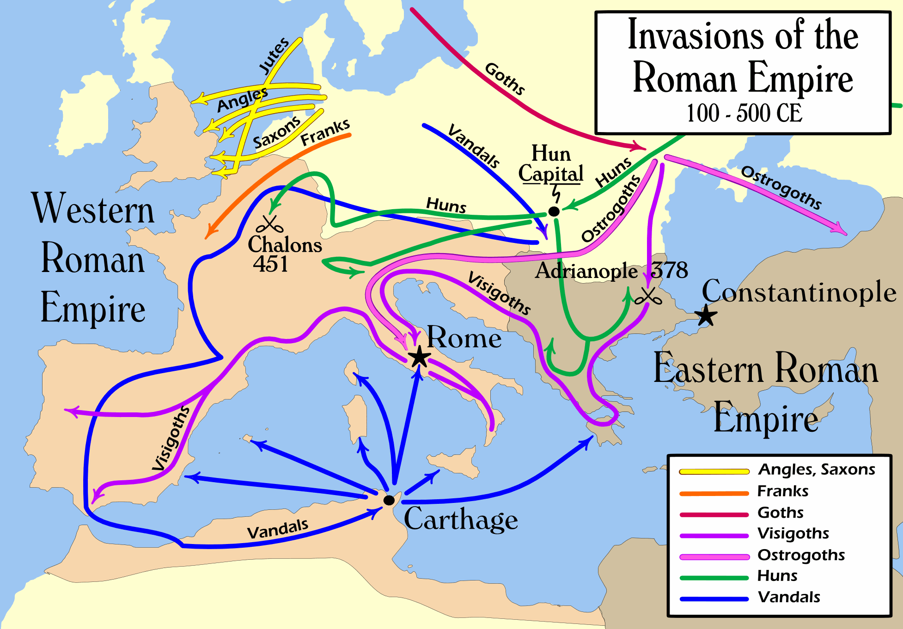

Slide 11
Hun Empire

Slide 12
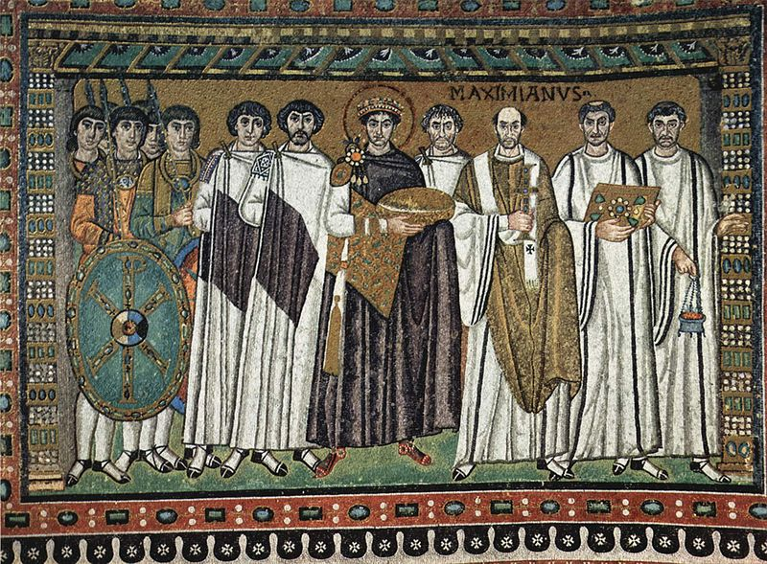
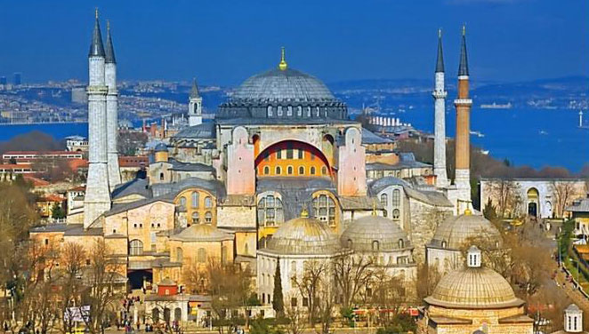
Meanwhile…over in the East
527-565 AD – Emperor Justinian “Last of the Romans”, last of Heraclean Dynasty, Empress Theodora ruled alongside wisely
The Justinian Law Code – compiled by John the Cappadocian and Tribonian
Starts building Hagia Sofia in Constantinople
Nika riots – rival chariot race teams at Hippodrome attack palace, generals Mundus and Narses to quell Nika riots, Hagia Sophia burned down, later rebuilt by Justinian
Belisarius – favorite general, successful in Persia and won back Africa from Vandals, won Italy back temporarily
Stopped Latin in government, switched to Greek language
540 – Justinian’s Plague

Slide 13
Hagia Sofia

Slide 14
Just before reconquest

Slide 15
Just after reconquest

Slide 16
Loss of Italy again

Slide 17
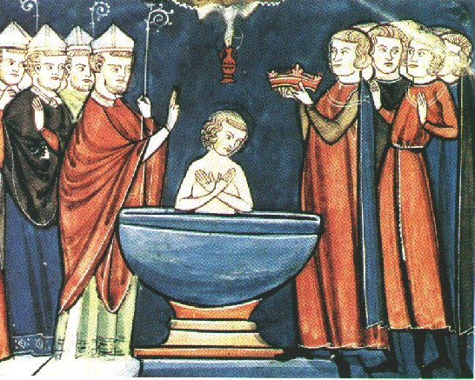
The state of the West
Visigoths, Ostrogoths, Vandals all weakened
Germanic tribe known as Franks poised to fill the vacuum left
Christianity still the predominant religion in cities and in barbarian regions
Pope still in Rome but weak politically
Merovingian Dynasty of the Franks starts with Clovis (Louis) who converted to Christianity through his Catholic wife Clothilde
Merovingians known as the “long-haired kings”
486-507 – Clovis conquers many parts of Gaul

Slide 18
Growth of The Franks

Slide 19
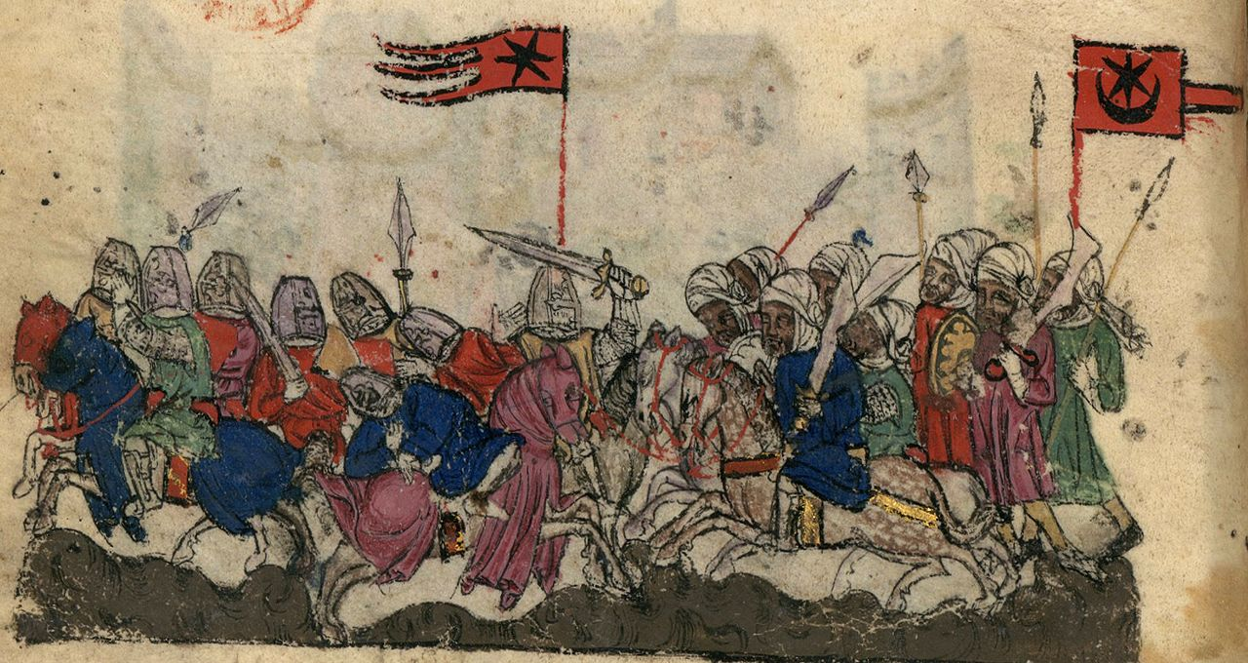
Byzantine Empire after Justinian
Persia attacked Byzantines
610-641 – Emperor Heraclius fights war with the Sassanid Empire, sacks Persepolis
Heraclius promoted Greek over Latin
Both empires unprepared for invading Arab armies from Arabia
636 – Battle of Yarmouk – Byzantines lose control of Syria to Rashidun Caliphate (the first 30 years after Muhammad)

Slide 20
Tossup
One of this man's generals won the Battle of Tricamarum, thereby forcing Gelimer and the Vandals out of northern Africa; that general later captured the Ostrogothic capital at Ravenna.
This man ended the inconclusive Iberian War by signing the Eternal Peace with Khosrau I.
Tribonian compiled a (*) law code named after this man, whose reign saw Hypatius proclaimed emperor during an uprising at the Hippodrome between rival chariot-racing factions.
This subject of Procopius' Secret History used Narses and Belisarius to put down the Nika Riots.
For ten points, identify this husband of Theodora and Byzantine emperor who constructed the Hagia Sofia.
ANSWER: Justinian I [or Justinian the Great]

