Slide 1
The Rome: Republic to Empire
Never trust a pirate

Slide 2
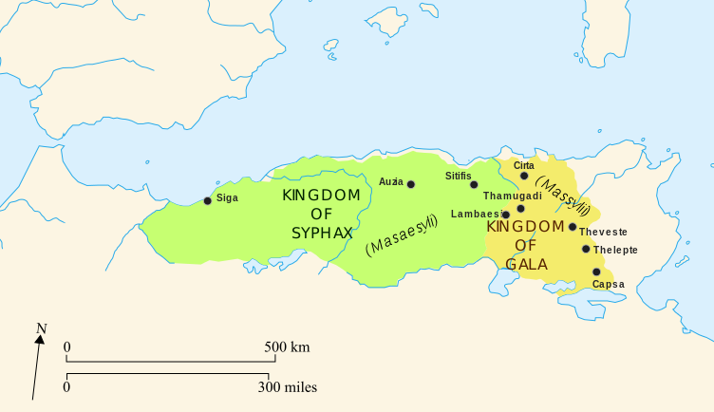
After the Punic Wars
Marius – general, consul from 107-86 BC
Sulla – general, consul, dictator 82-81 BC, rival of Marius
Numantine Wars 154-152 BC – Roman Republic vs. Spain, Jugurtha from Numidia fought with Rome
Jugurthine War – Jugurtha, king of Numidia, made trouble in Africa, pursued by Marius, turned over to Rome by his father-in-law, executed
100 BC – Julius Caesar born

Slide 3
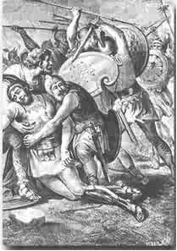
Spartacus
73 BC - Thracian, sold as slave-gladiator
Led revolt at a gladiator school, Third Servile War
Left town and picked up 70,000 rural slaves on the way to the Alps
Camped at Mt. Vesuvius
Rapelled down vines to surpise Glaber in one battle
Left behind by pirate ships who promised to take them to Sicily
General Crassus defeated slaves at Siler River, Sparatacus killed there
Gen. Pompey had 6000 crucified on Appian Way and claimed credit

Slide 4
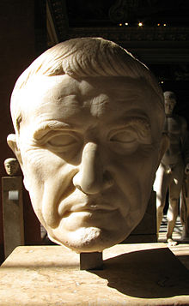
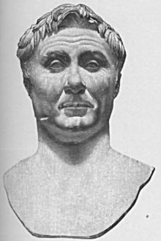
First Triumvirate
Normal - Two consuls, sometimes one dictator, consuls were often generals
Pompey annexes Syria and Jerusalem
Crassus – wealthy general
Pompey – they didn’t like each other
Julius Caesar, nephew of Marius, rising up ranks
59 BC - They form 1st Triumvirate, three consuls in power
58-50 BC – Gallic Wars, Caesar in modern-day France, wrote a book
Crassus dies in war against Parthians at Battle of Carrhae, has molten gold poured down his throat
Back down to two consuls
Friendship between Caesar and Pompey unravels

Slide 5
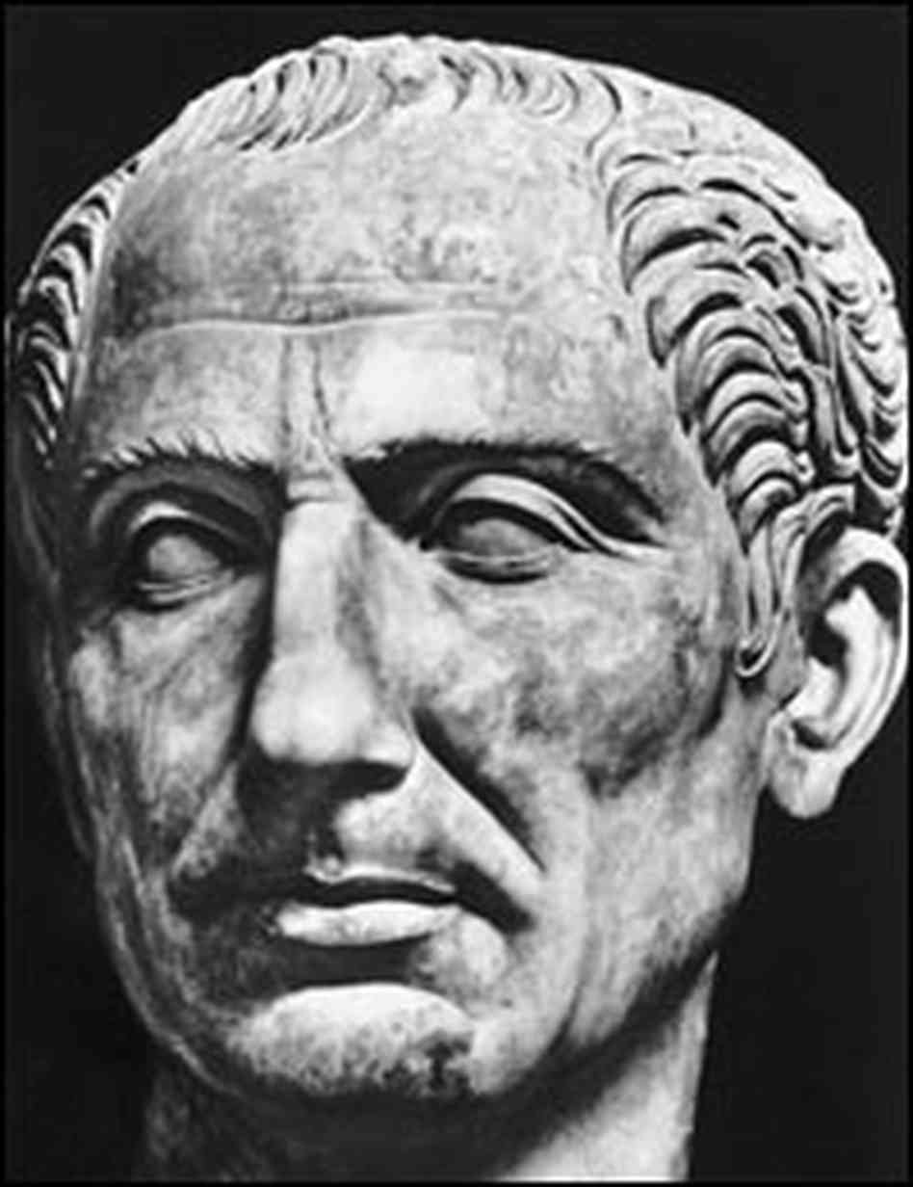
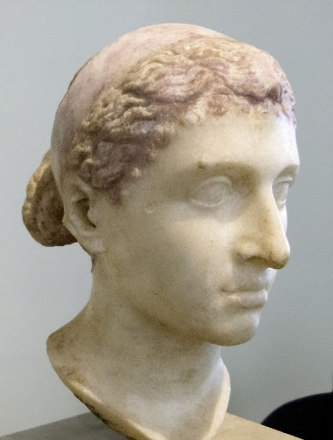
Rise of Julius Caesar
Proconsul Caesar defeated nemesis Vercingetorix in Gaul at Battle of Alesia
Pompey marries daughter of Caesar’s enemy
Caesar crosses Rubicon in 49 BC
“The die is cast.” Roman Civil War begins
Pompey flees Rome to Greece
Caesar re-elected consul/dictator, then resigns
Caesar defeats Pompey’s lieutenants in Spain
48 BC - Pompey flees to Egypt, tricked and beheaded
Pompey loses at Pharsalus, murdered while fleeing
Marc Antony made second in command “Master of the Horse”
Caesar receives his head, allies with Cleopatra
Helps Cleopatra in Egyptian Civil War

Slide 6
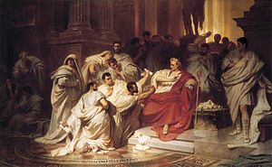
Caesar Back in Rome
Caesar returns to Rome in 47 BC
Starts enacting reforms
“Father of the Fatherland”
Increased Senate to 900
Puts own image on coins
Offered title of rex but rejected it, “I am Caesar, not Rex”
44 BC – Ides of March (March 15), Caesar stabbed to death by 60 senators fearful of his becoming king and ending the republic, wife Calpurnia tried to prevent JC from going to the Senate
Battle of Philippi – many of perpetrators killed

Slide 7
Roman Republic Map, 40 BC

Slide 8
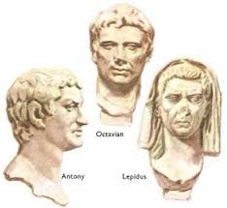
The Second Triumvirate and Octavian
Octavian - Julius Caesar’s great nephew, JC adopted him
Marc Antony did not support his adoption
After JC assassinated, Octavian gathered armies and marched on Rome
Cicero spoke out against Marc Antony, Octavian elected proconsul
43 BC - Second Triumvirate formed: Octavian, Marc Antony, Lepidus
Lepidus favored Antony
Territories divided
Octavian – Sardinia, Sicily Africa
Marc Antony – parts of Gaul
Lepidus – Spain, parts of Gaul

Slide 9
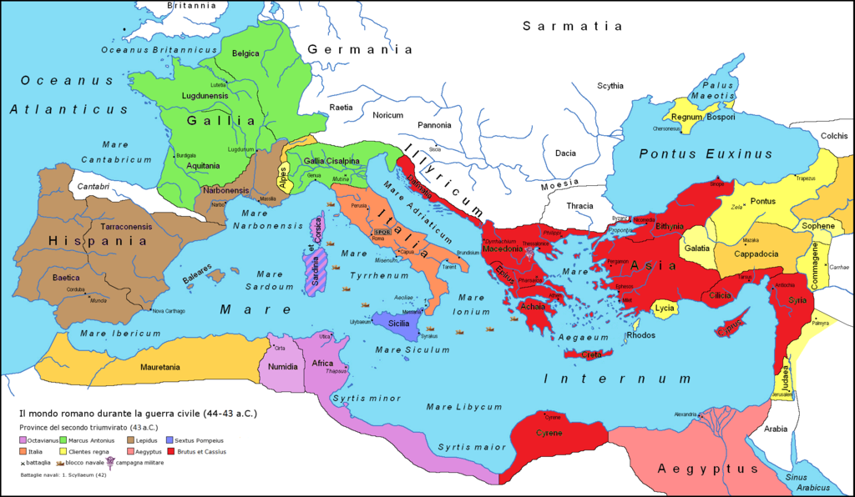
Rome divided up by 2nd Triumvirate

Slide 10
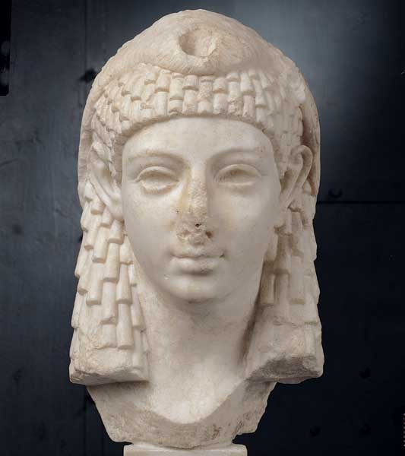
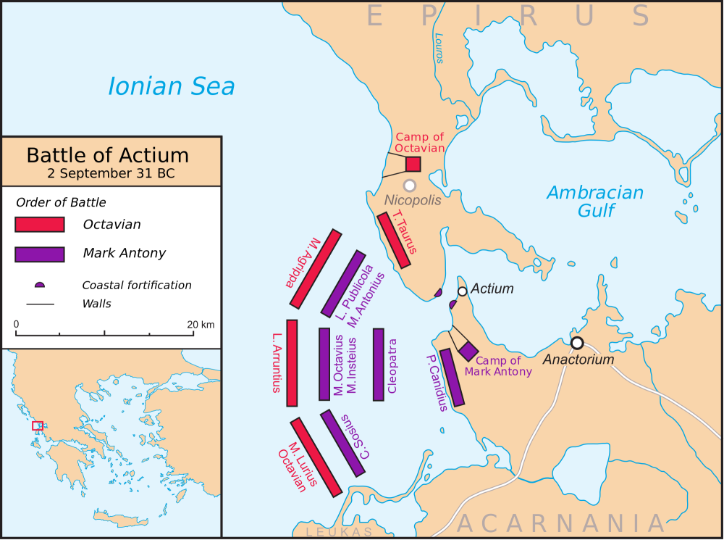
Breakup and war
Marc Antony divorced his wife Octavia (Octavian’s sister) and falls for Cleopatra
2nd Triumvirate over in 33 BC
Octavian accuses Antony of allying with Egypt to overthrow Rome
31 BC Battle of Actium – Agrippa led Octavian’s fleet, Antony defeated, he and Cleopatra commit suicide in Egypt, Agrippa given Octavian’s niece’s hand in marriage

Slide 11
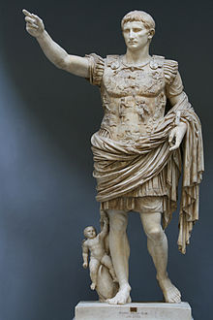
Rule of Augustus Caesar
27 BC – 14 AD – Octavian changes name to Augustus Caesar
“Pax Romana” – Roman peace, infrastructure
Fire-fighters in Rome
Peace with Parthians
Praetorian guard
Road system, courier system
Jesus Christ in the New Testament refers to a “Caesar” (Augustus Caesar)

Slide 12
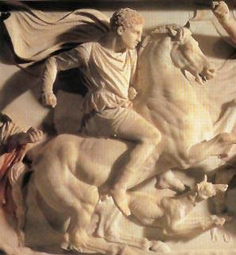
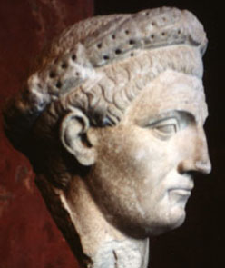
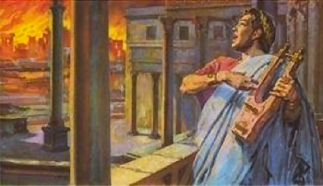
Julian-Claudian Dynasty
The first five emperors
Tiberius 14-37 AD – historian Pliny the Elder called him “gloomy”, exiled to Capri for last 10 years of life
Caligula 37-41 AD – claimed divinity, Incitatus the horse made senator, assassinated by senators and Praetorian guard, incest with sister Agrippina the Younger, name meant “little boots”, assassinated by stabbing
Claudius 41 – 54 AD – Caligula’s uncle, cozy with Senate, stuttered, invaded Britannia, may have eaten poisoned mushroom
Nero 54-68 AD – Great Fire in 64, played music, blamed Christians, avoided assassination, Pisonian Plot – Seneca the Younger executed, advised by mother Agrippina, committed suicide after Vindex’s Rebellion

Slide 13
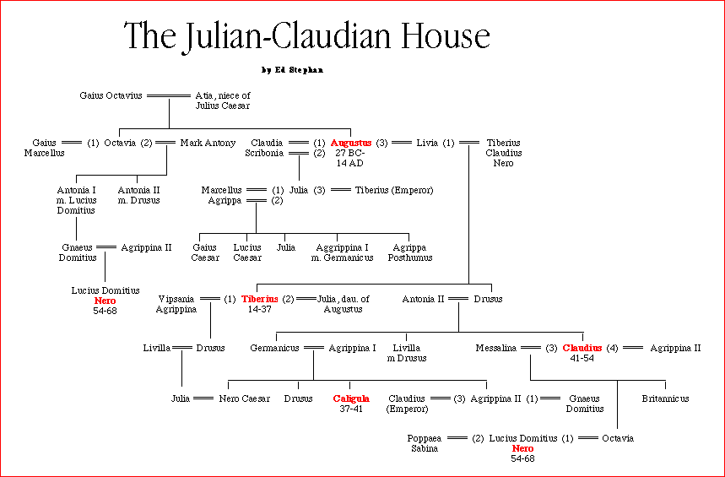

Slide 14
Tossup
This man issued the Donations of Alexandria and divorced his wife Fulvia to marry Octavia the Younger.
This loser at the Battle of Mutina also was defeated at a battle near the Ambracian Gulf due to the treachery of Quintus Dellius.
This man was criticized by Cicero's Philippics and delivered the (*) eulogy at Julius Caesar's funeral.
Along with a younger counterpart, he defeated Cassius and Brutus at the Battle of Philippi, and that same counterpart later sent naval forces under Marcus Agrippa to defeat this man at the Battle of Actium.
For ten points, identify this Roman general who lost to Octavian and committed suicide with his lover Cleopatra.
ANSWER: Mark Antony (or Marcus Antonius)

Slide 15
Tossup
This man won the battles of Vercellae and Aquae Sextiae against the Cimbri and the Teutones, two German tribes that had invaded Italy.
Despite clear rules against it, this man was elected as Consul in six consecutive years, and after his death he was replaced by his conservative rival, Lucius Cornelius Sulla.
For 10 points, name this politician from the late Roman Republic, best known for his military reforms.
ANSWER: Gaius Marius

Slide 16
Tossup
Plutarch pairs this man's life with Nicias and states that a prisoner of war who resembled this man was dressed in drag and paraded through the streets after he died.
This politician acquired property by purchasing burning buildings for a low price, then using his fire brigade to put out the blaze.
This general, who revived the practice of decimation, won the Battle of Siler River during the Third (*) Servile War, which ended with his defeat of Spartacus.
While serving as Governor of Syria, he was killed by Surena, a Parthian general who supposedly ordered gold to be poured down this man's throat after he was defeated at the Battle of Carrhae.
For 10 points, name this "richest man in Rome" who formed the First Triumvirate with Julius Caesar and Pompey.
ANSWER: Marcus Licinius Crassus

Slide 17
Tossup
One of this man's aids, Crixus, was defeated by the armies of Luicus Gellius Publicola at Mount Garganus.
Gaius Claudius Glaber unsuccessfully attempted to defeat him, and this man's base was located at Mount Vesuvius.
This man died while fighting near the Siler River.
The [*] most successful attacks against this man were led by Crassus; after his defeat, members of his army were crucified along the Appian Way.
For 10 points, identify this former gladiator, the leader of a slave uprising against the Roman Republic.
ANSWER: Spartacus

Slide 18
Tossup
This leader was embarrassed by an episode in which the elephant pulling his chariot did not fit into the Roman city gates, after he had been given an illegal triumph by Sulla.
After replacing Lucullus, this leader was aided by the Parthians, allowing him to defeat Mithridates VI.
He failed to use his advantage after the Siege of Dyrrachium and lost at the Battle of Pharsalus.
On the order of Ptolemy XIII, this man was assassinated upon landing in Egypt.
For 10 points, name this leader supported by the Optimates; he was a member of the First Triumvirate and rival of Julius Caesar.
ANSWER: Pompey the Great [accept Gnaeus Pompeius Magnus]

Slide 19
Tossup
This man frequently corresponded in letters with Titus Atticus.
This man defended Milo, the murderer of Clodius Pulcher, who had earlier helped exile this man.
This man modeled his Phillipics off of Demosthenes's works.
This man exclaimed "O the times, o the morals" in a speech in which he exposed the (*) Catilinian Conspiracy.
This man had his hand and head nailed to the Rostra after he was killed, which resulted from the proscription placed on this man by Mark Antony due to this man's attacks on Antony and the Second Triumvirate.
For 10 points, name this famously eloquent orator in the Roman Republic.
ANSWER: Marcus Tullius Cicero

Slide 20
Tossup
One commander in this conflict ordered a massacre at Cisalpine when he believed his rival was distracted by the Bona Dea Scandal.
This conflict began because of the botched migrations of the Helvetii.
The losing Arverni commander came to power at the Battle of Gergovia.
The Suebi tribe were soundly defeated during this conflict at the Battle of Vosges.
This conflict ended after a surrender at the Battle of Alesia by Vercingetorix.
In his "Commentaries" on this conflict, the winning commander divided the central region into three parts.
For 10 points, name this series of wars waged by Julius Caesar against the tribes of a region of modern-day France.
ANSWER: Gallic Wars [or Bello Gallico; or war with the Gauls; or Rome annexing Gaul; or Julius Caesar's conquest of Gaul; or any other clear knowledge answers]

Slide 21
Tossup
This leader's sister, Arsinoe, was controversially killed on the steps of the Temple of Artemis.
This leader's son, Caesarion, lived briefly as the last Pharaoh of Egypt one year after this leader ordered a decisive retreat from (*) Octavian's navy at the Battle of Actium with her lover, Marc Antony.
For 10 points, name this Egyptian Pharaoh who, shortly after Marc Antony's suicide, legendarily killed herself by snakebite.
ANSWER: Cleopatra VII Philopator

Slide 22
Tossup
This ruler faced a conspiracy from a less notable Lepidus, and his father died in Antioch under mysterious circumstances, accusing the governor of Syria, Gnaeus Calpurnius Piso, of poison.
He aborted a campaign to Britain but celebrated a triumph for it anyway, and he really liked his sister Drusilla.
This son of Germanicus was assassinated by the Praetorian Guard in 41 CE, and was followed by his uncle Claudius.
For 10 points, name this Roman emperor whose name means "little boots," best known for being insane.
ANSWER: Caligula [or Gaius Julius Caesar Germanicus]

Slide 23
Tossup
This leader failed to uphold his end of the Treaty of Tarentum despite receiving the troops requested for a fight against the Parthians [PAHR-thee-uns].
His military successes included naval victories at Cape Naulochus [NOW-loe-kus] and the Gulf of Ambracia [am-BRAY-shuh].
Marcus Agrippa led the victorious forces in both of those battles, and the latter led to a resounding victory over Marc Antony and Cleopatra at Actium [AK-tee-um].
Along with Marc Antony and Marcus Lepidus, this man formed the Second Triumvirate.
Name this Roman emperor, the successor to Julius Caesar.
ANSWER: Caesar Augustus (accept Gaius Octavius or Gaius Julius Caesar Octavianus)

Slide 24
Tossup
The prefect Sextus Afranius Burrus was an early advisor to this man, who sent his general Corbulo to fight the Parthians, poisoned his stepbrother Britannicus, and built the Domus Aurea.
His reign was marked by a rebellion of the Iceni, as well as an assassination plot that led to the suicide of Seneca the Younger.
This ruler suppressed the Pisonian Conspiracy and (*) Boudica's Rebellion, and he had earlier murdered his mother Agrippina the Younger, who helped him become the successor to Claudius.
His overthrow by Galba began the Year of the Four Emperors.
For ten points, identify this Roman emperor whose reign saw a fire that devastated Rome.
ANSWER: Nero Claudius Caesar Augustus Germanicus

