Slide 1
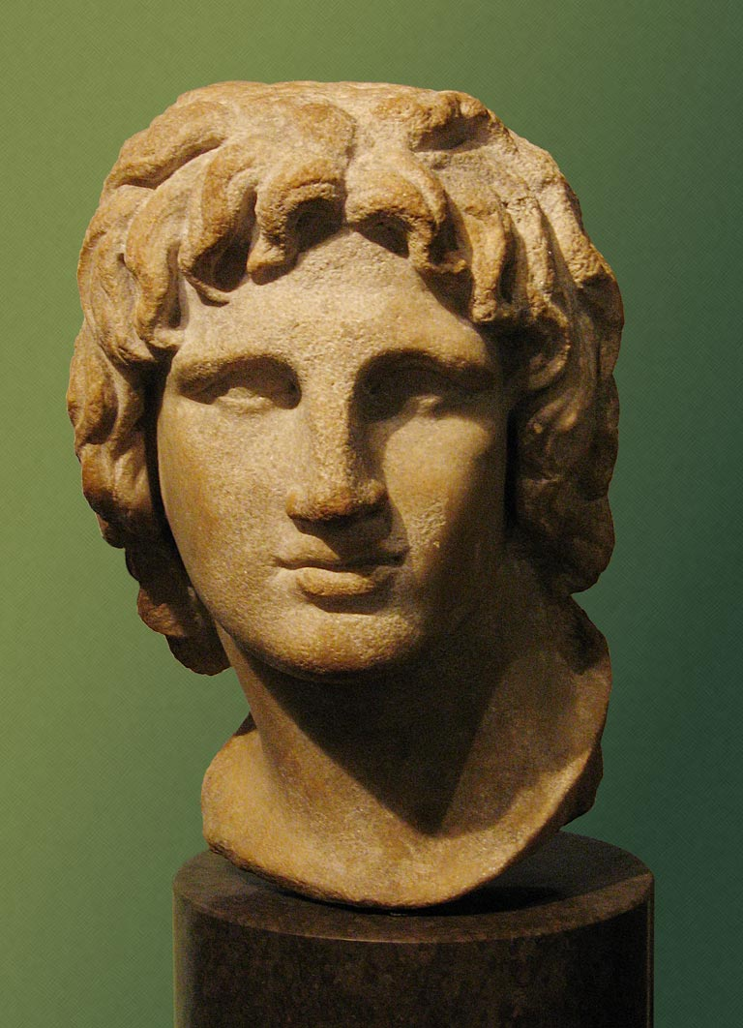
Alexander the Great

Slide 2
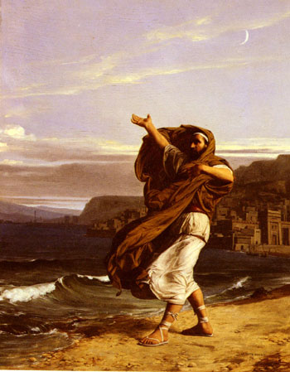
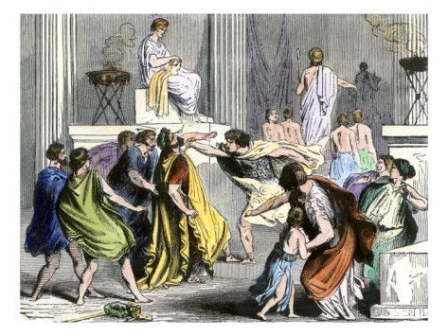
Philip II of Macedon
Became king of Macedon in 359 BC
Began growing empire south
Athenian Demosthenes spoke out against him in the Three Philippics
Battle of Chaeronea 338 BC – with son Alexander, defeated Athens and Thebes (The Sacred Band)
Assassinated in 336 BC – stabbed by his own bodyguard Pausanias during his daughter’s wedding

Slide 3
Greek mainland at death of Philip II

Slide 4
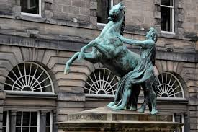
Young Alexander
Born in 356 BC to Philip II and Olympias (non-Macedonian)
Tutored by Aristotle and Leonidas
Tamed the horse Bucephalus
Life of Alexander by Plutarch

Slide 5
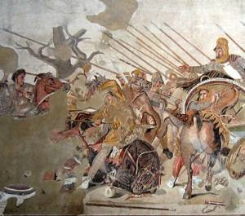
Alexander’s early triumphs
Gordion Knot - tied by King Midas or his father Gordius
333 BC - Alexander “untied” it by cutting it
Built causeway to siege island city of Tyre
Battle of Granicus 334 BC - first major victory over Persians and Darius III, fought near supposed site of Troy
Battle of Issus 333 BC - Alexander defeats Darius III despite being heavily outnumbered, Darius III flees
Empire expands to include Persia

Slide 6
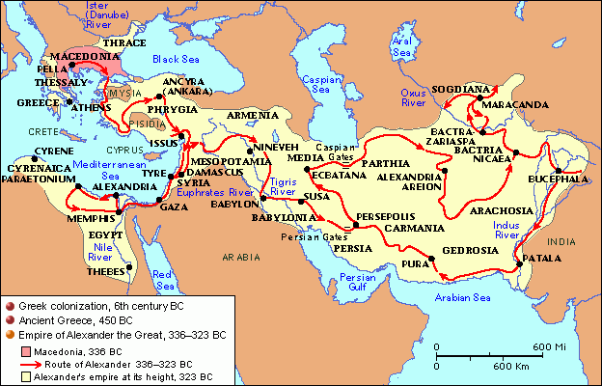
More battles
Battle of Gaugamela 331 BC - defeats Darius III for last time, Darius then assassinated by satrap Bessus
Bessus later executed by Alexander
Battle of Hydapses 326 BC - Punjab region of Pakistan, against King Poros and his war elephants, empire extends to western India
Alexander’s soldiers refuse to go any further

Slide 7
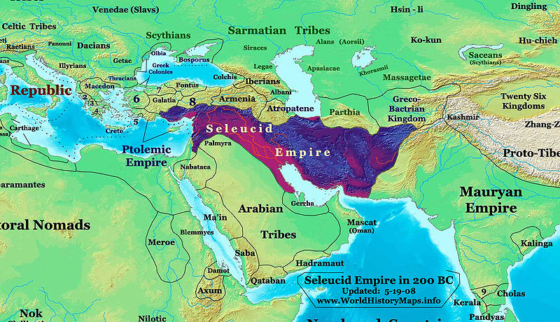
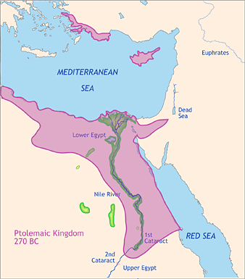
Alexander’s Death and the Hellenistic Period
Got sick and stayed in Babylon, died there in 323 BC
Divided up empire among the Diadochi (The followers)
Hellenistic Period
Egypt – The Ptolemy Dynasty 305-30 BC, former bodyguard of Alexander, Cleopatra VII was last Ptolemaic leader of Egypt
Asia – Seleucid Dynasty 305-63 BC, Seleucus, a cavalry commander
Macedonia – Antigonids, 295-168 BC, Antigonus I, fell to Romans at Battle of Pydna in 168 BC

Slide 8
Alexander’s empire superimposed on modern map

Slide 9
Early Rome and Punic Wars

Slide 10
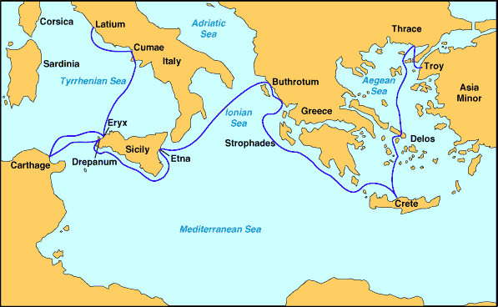
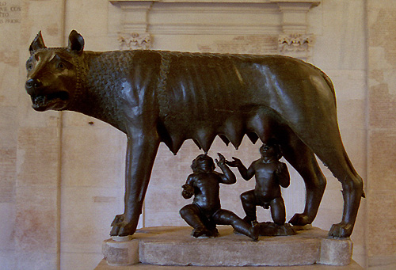
The Founding of Rome
Rome founded around 750 BC on the Palatine Hill
Etruscans – early rival of Rome
Aeneas – The Aeneid by Virgil, mythical ancestor of Romans
Romulus and Remus – twin sons of Rhea Silvia and Mars, taken from them and raised by she-wolf, founded Rome
Romulus was first king of Rome
7 kings spanned the next 200 years, ending in 510 BC
Tarquin the Proud – last king of Rome, descendant of Etruscans, reign ended in 509 BC

Slide 11
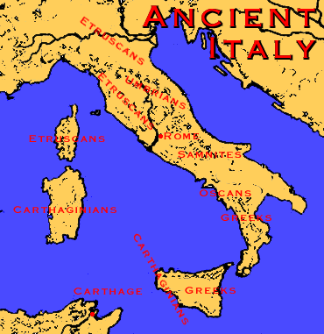
Early Roman Republic
The Latin League – confederation of villages for protection against Etruscans
509 BC – Roman Republic, Twelve Tables
493 BC – alliance between Roman Republic and Latin League
Cincinnatus, 458 BC – farmer to dictator back to farmer, model of virtue
338 BC – War with League ends up dissolving League, Rome incorporates other cities into the Republic
Appian Way – construction began in 312 BC during Samnite War, trenches, higher in middle for water run-off

Slide 12
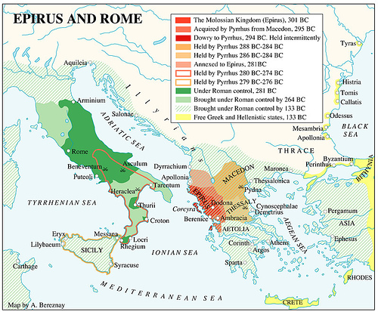
Pyrrhus of Epirus
281 BC – Pyrrhus, king of Epirus, asked by Tarentum to help rebel against Rome
Heraclea – first battle against Rome, “Pyrrhic victory”
Asculum 279 BC – Rome versus Tarantines and Samnites led by Pyrrhus
278 BC – Greek cities in Sicily asked him to help drive out Carthaginians, made king of Sicily
Forced contributions to drive out Cathage
Left Sicily to Rome and Carthage
According to Plutarch, Hannibal said he was the greatest

Slide 13
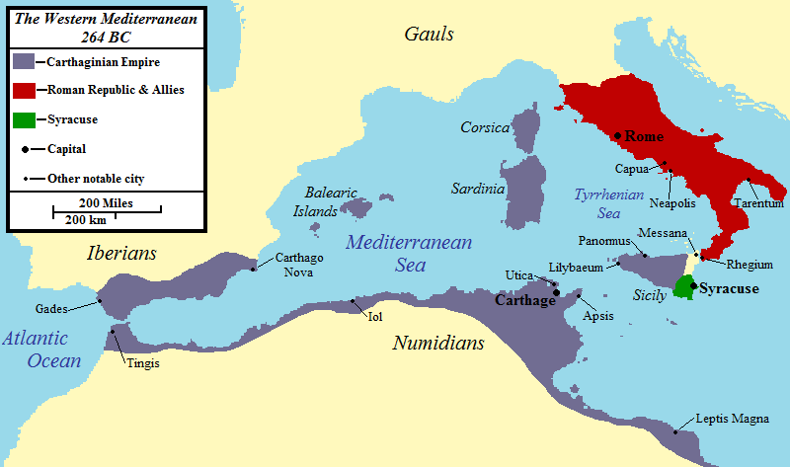
First Punic War 264-241 BC
Carthaginians were descendants of Phoenicians
Hiero, king of Messana on Sicily, chooses Roman rule over Carthage
Rome besieges Agrigentum in 262 BC
War ends up stalemate but Rome becomes Mediterranean power
Carthage agrees to leave Sicily

Slide 14
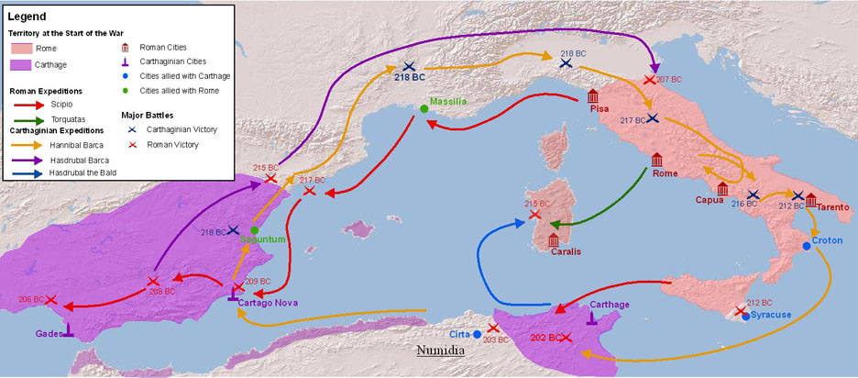
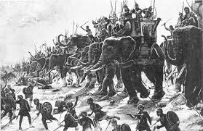
Second Punic War 218-201 BC
Cathaginian general Hamilcar Barca took Spain, Rome took Corsica
Barca taught his son Hannibal to hate Rome
Barca died, Hannibal took a faraway Sarguntum in Spain, left his brother Hasdrubal to guard Spain
Took elephants across Pyrenees to invade Rome from north

Slide 15
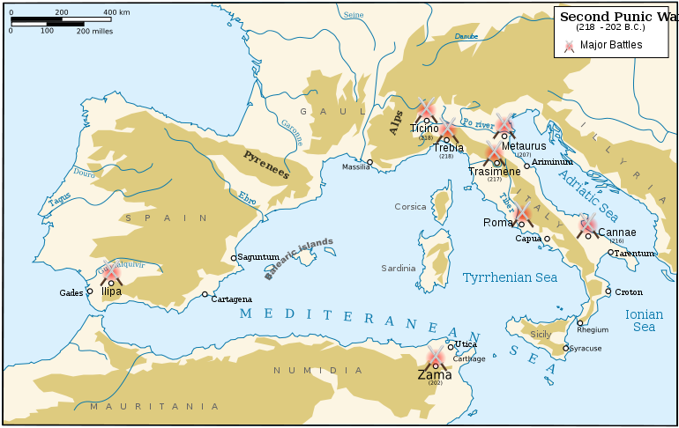
Hannibal in Italian peninsula
Had 30,000 men when he met Romans
Won at Trebia and Lake Tresimene
216 BC – Battle of Cannae was decisive victory even though Hannibal outnumbered 2 to 1
Terrorized southern Italy, survived 15 years but Carthage would not send reinforcements
Hannibal asked Hasdrubal for help
Hasdrubal killed en route to Italy, head ends up in Hannibal’s camp, Hannibal mired in southern Italy

Slide 16
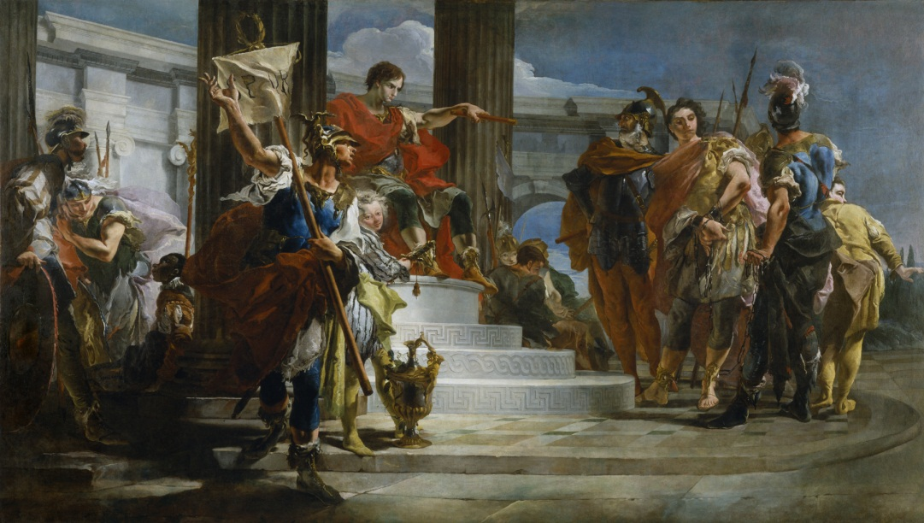
Scipio Africanus
While Hannibal in Italy, Scipio invaded North Africa
203 BC - Hannibal recalled to Carthage
Battle of Zama 202 BC – Scipio defeats Hannibal
Harsh terms of surrender
Cato’s words: “Carthage must be destroyed.”
Carthage still allowed to be a trading power
Hannibal fled to Greece and Asia Minor, fought for several kingdoms including Seleucids
The line in the sand

Slide 17
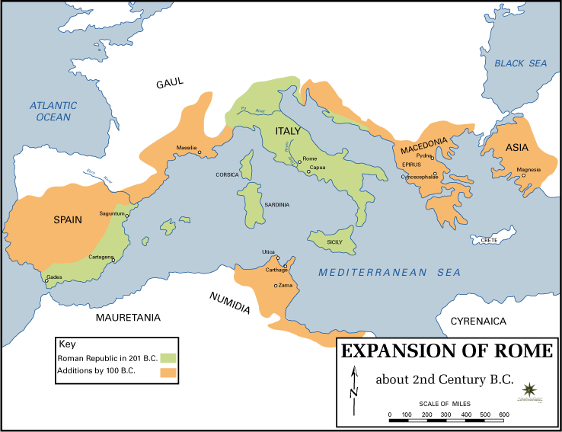
Third Punic War 149–146 BC
Carthage broke Rome’s sand line
Invaded Numidia in 149 BC
Rome sent Scipio Africanus again
Carthage held out for 3 years
All citizens killed or sold into slavery
Land salted
100 BC – Julius Caesar born

Slide 18
Tossup
In one battle, this ruler sent his soldiers out wearing crowns of laurel to appear as holy avengers of Apollo against an enemy force that drowned en-masse trying to reach the ships of Chares.
He received the news that his wife gave birth to a son at the same time as a report that his racehorse won the Olympic Games.
The historian Theopompus lambasted him for getting drunk in the daytime, in a digression-filled 58-book history of his rule.
This man lost his right eye besieging the city of Methone, and defeated Onemarchos at the bloodiest engagement in Greek history, the Battle of Crocus Field.
At the celebration of his daughter Cleopatra's wedding to Alexander of Epirus, this man was assassinated by one of his seven bodyguards, Pausanias.
This man established the League of Corinth after winning a battle where the companion cavalry that broke the Sacred Band was commanded by his eighteen-year old son.
For 10 points, name this King of Macedon, the father of Alexander the Great.
ANSWER: Philip II of Macedon [prompt on "Philip"]

Slide 19
Tossup
After his greatest defeat, this man went into self-exile and led Seleucid forces belonging to Antiochus III at the Eurymedon River.
This man's siege of Saguntum resulted in his most famous war, during which he faced scorched- earth tactics that resulted in Fabius Maximus' nickname, "the Delayer.“
This general pinned the army of Flaminius against Lake Trasimene in one victory and was assisted by his brother Mago in wiping out forces under the consuls Paullus and Varro at the Battle of Cannae.
The invasion of Scipio Africanus recalled this man to his home city.
For 10 points, name this Carthaginian general of the Second Punic War who led elephants across the Alps.
ANSWER: Hannibal Barca

Slide 20
Tossup
This man established a personal guard called the Celeres.
This slayer of Acron was once fed by Picus and helped to overthrow Amulius to restore Numitor to the throne.
His brother died after being struck for leaping over a wall in one myth.
This husband of Hersilia inherited the kingdom of Alba Longa and became the god Quirinius after dying once the Senate turned on him.
This man abducted women from a neighboring tribe to populate his city during the Rape of the Sabine Women.
This son of Rhea Silva was suckled by Lupa, a she-wolf.
For 10 points, name this brother of Remus who founded Rome.
ANSWER: Romulus

Slide 21
Tossup
This politician ended the practice of awarding surplus funds to the Theorica, and gave them to the military instead.
This man defended Ctesiphon after the latter proposed that this man receive a special reward for his merit.
Along with his colleague Aeschines, he negotiated the Peace of Philocrates in order to protect Phocis at the end of the (*) Third Sacred War.
This politician pleaded for assistance to the people of Olynthus and later gave a funeral speech in honor of those killed at the Battle of Chaeronea.
In Parallel Lives, Plutarch pairs this man with Cicero and claims that he practiced speaking with pebbles in his mouth, allowing him to deliver speeches like On the Crown.
For 10 points, name this Athenian orator and statesman who warned against Macedonian expansionism in his Philippics.
ANSWER: Demosthenes

Slide 22
Tossup
This man's brother-in-law Demetrius Poliorcetes sent him as a hostage to Ptolemy I of Egypt, during which time he married Ptolemy's stepdaughter Antigone.
He was killed after a woman dropped either a pot or a roof tile on his head.
This man's best known campaign began as an effort to support the city of Tarentum against incursions into Magna Graecia.
This commander spent the winter in Campania after defeating (*) Publius Valerius Laevinus.
At the 280 BCE Battle of Asculum, and a year later at Heraclea, this man's elephant-laden army suffered heavy casualties against his Roman foes despite carrying the day.
For 10 points, name this king of Epirus who lends his name to a type of costly victory.
ANSWER: Pyrrhus of Epirus

Slide 23
Tossup
This general made a brilliant nighttime attack against enemy tents to break up a coalition force besieging him at Utica.
This general served as legate during his brother Lucius's campaign against Antiochus III of Syria.
His victory at Baecula prompted the losing commander at that battle to launch a failed attempt to link up with his brother's forces.
This general used heavier flanks to execute a "reverse (*) Cannae" maneuver at the Battle of Illipa in Spain.
This general saved his father's life at the Battle of Lake Ticinus.
In his most famous battle, he opened up his ranks to neutralize the effect of the Carthaginian Elephant Corps.
For 10 points, name this Roman general who won the Battle of Zama by defeating Hannibal and thus ended the Second Punic War.
ANSWER: Scipio Africanus the Elder [or Scipio Africanus Major; or Publius Cornelius Scipio Africanus; prompt on "Scipio"]

Slide 24
Tossup
One of this man's officers, Cleitus the White, defeated the Athenian navy during the Lamian War.
In a fit of rage, this king skewered Cleitus the Black with a javelin, even though Cleitus had earlier saved him from two satraps under Memnon of Rhodes.
Arrian of Nicomedia claims that this leader was told he needed "men with wings" to capture a fortress at Sogdian Rock; after doing so, he married the princess Roxana.
This king built a giant causeway during his siege of (*) Tyre.
This man fought against Darius III at the Battles of the Granicus and Gaugamela.
After he defeated King Porus at the Battle of Hydpases River, his troops refused to campaign further into India.
For 10 points, name this son of Philip of Macedon who conquered much of the ancient world.
ANSWER: Alexander the Great [or Alexander III of Macedon; accept Alexandros for "Alexander"]

Slide 25
Tossup
The founder of this dynasty joined an alliance with Antipater and others against the regent Perdiccas, and conquered Cyrenaica.
Arsinoe IV of this dynasty was forced to flee from her half-sister in a power struggle, while another ruler of this dynasty ordered the execution of the loser at the Battle of Pharsalus.
It supplied several of the ships destroyed by Agrippa at Actium, and it was an ally of Mark Antony.
It was founded by its namesake general, Alexander. For 10 points, name this Egyptian dynasty whose rulers included Cleopatra VII.
ANSWER: Ptolemaic Dynasty or Lagid Dynasty [accept word forms]

Slide 26
Tossup
One of this city's borders was marked with two pillars where the Philaeni twins were buried alive.
This city had an artificial harbor called the cothon and was centered on the Byrsa citadel.
Aristotle claimed that boards called pentarchies elected judges to this city's Council of One Hundred and Four.
A leader of this city used the Saw canyon to starve out Spendius's mercenaries in the Truceless War.
Tophet graveyards suggest that people of this city (*) sacrificed children on statues of Tanit.
Writings from this city include an agricultural manual by Mago and a periplus by Hanno the Navigator.
This city won the battles of Lake Trasimene and Cannae in a war which ended with its loss at Zama.
For 10 points, name this city once led by Hannibal which fought the three Punic wars with Rome.
ANSWER: Carthage

Slide 27
Tossup
One member of this dynasty, with a name meaning "Hawk," tried to form a splinter state during the rule of his brother, a ruler from this dynasty known as "Callinicus."
Near the end of the life of this dynasty's founder, he crushed Lysimachus of Thrace at Corupedium.
The rulers of this dynasty agreed to the Peace of Apamea with Rome after Eudamos defeated this dynasty's army, which was commanded by an exiled Carthaginian.
This dynasty's founder, who was slain by a man sent by Ptolemy, defeated Demetrius the Besieger and (*) Antigonus the One-Eyed at the 301 BCE Battle of Ipsus.
This dynasty warred with Rome at the Eurymedon River under its ruler Antiochus the Great.
For 10 points, name this dynasty that ruled Syria and Mesopotamia in the wake of Alexander the Great's death, started by a general known as "Nicator."
ANSWER: Seleucid dynasty [accept word forms]

