Slide 1
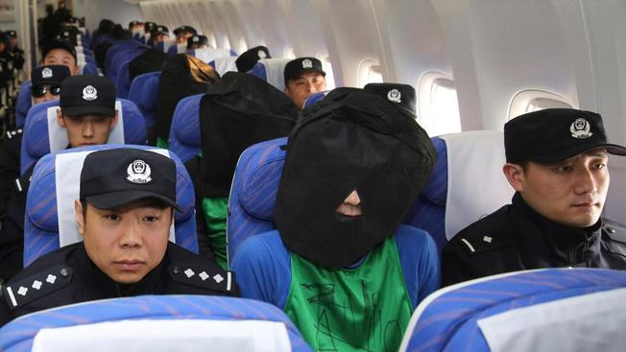

Slide 2
Middle east
1980s – 2000s

Slide 3
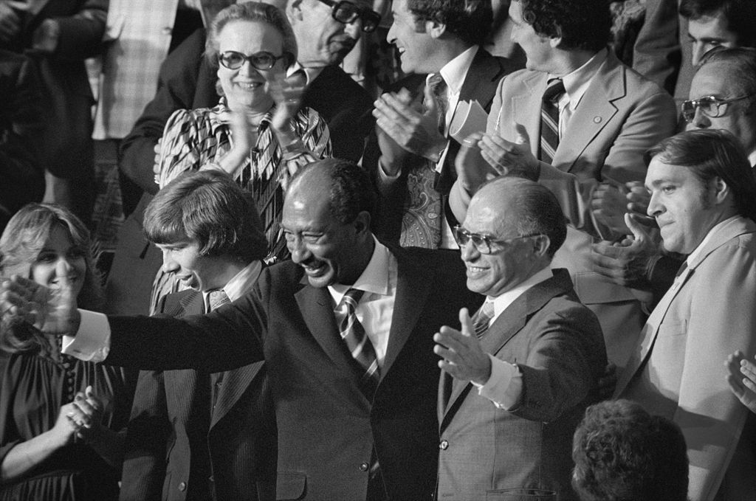
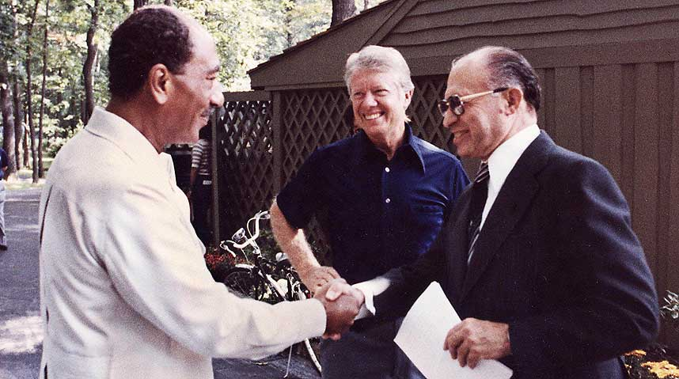
Egypt and Israel
1967 Six Day War, Yom Kippur War
Anwar Sadat, Menachim Begin, Jimmy Carter
Secret meetings at Camp David, Maryland
Camp David Accords signed at White House in 1978
The CD Accords: Autonomy for Gaza Strip and West Bank, Israel withdraws from Sinai, Suez Canal and Straits of Tiran reopened for Israel to use
Both get money and arms from USA
Nobel Peace Prize for Sadat and Begin
Oct. 1981 – Sadat assassinated by members of Egyptian Islamic Jihad (VP Hosni Mubarak also injured)

Slide 4
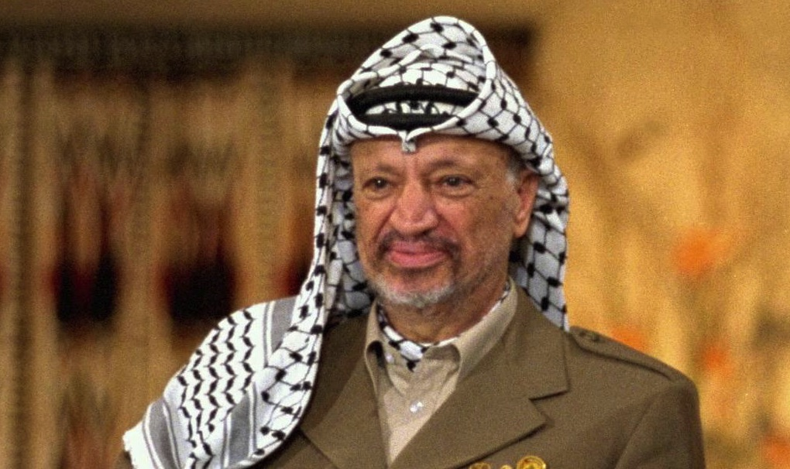
The Palestine Liberation Organization (PLO) and Israel
Nation of Israel established 1948
Founded by displaced Palestinians in 1964
Original Purpose of PLO: to liberate Palestine from Israel through armed struggle, very anti-Zionist
1969 – Yasser Arafat, founder of Fatah, becomes leader of PLO
UN observer status since 1974
Dec. 1987 – collision in refugee camp kills four Palestinians, uprising called First Intifada begins, strikes, rock-throwing
1987 – Hamas founded, social service and military wings, based in Gaza Strip, offshoot of Muslim Brotherhood, more extreme than PLO

Slide 5
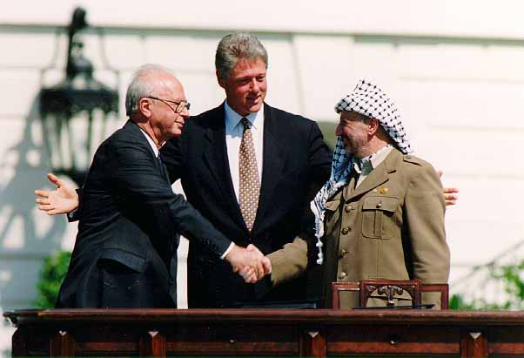
Post-First Intafada
1988 – UN General Assembly condemns Israel for actions against intifada, Security Council drafts resolutions condemning Israel, USA vetoes
PLO wins worldwide support for two-state solution
1991 – Madrid Conference
1993 Oslo I Accord – Arafat, Rabin, Clinton; PLO finally recognized Israel “right to exist”, Israel recognized PLO as official representative of Palestinian people, IDF pulls back from parts of GS and WB, Arafat returns to occupied territories
1994 – Arafat, Rabin and Peres get Nobel Peace Prize
1994 - Palestine National Authority established
Nov. 5, 1995 – Rabin assassinated by right-wing Jew who opposed Oslo accords

Slide 6
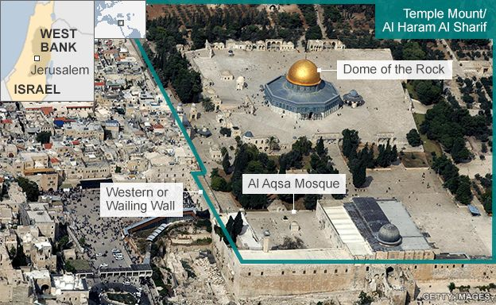
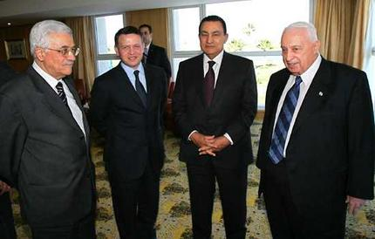
Second Intifada
Sept. 2000 – Ariel Sharon (leader of Likud Party) visited Temple Mount complex (Dome of the Rock and al-Aqsa Mosque), declared that Temple Mount will always be under Israeli control, he was running for PM of Israel at the time
Demonstrations started next day, four people killed
2nd Intafada ended in 2005, 3000 Palestinians killed, 1000 Israelis killed
2005 - Sharm-El-Sheikh Summit – Abbas, Sharon, Mubarak, King Abdullah of Jordan attended
Sharon and Abbas agreed to cessation of all violence

Slide 7
Timeline of PMs of Israel during Intifadas

Slide 8
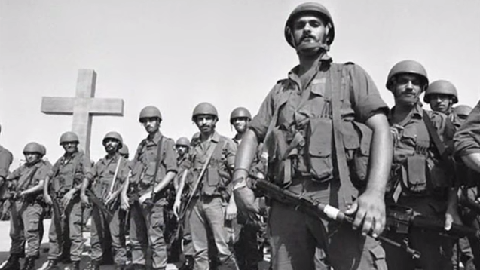
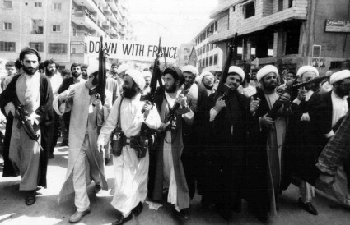
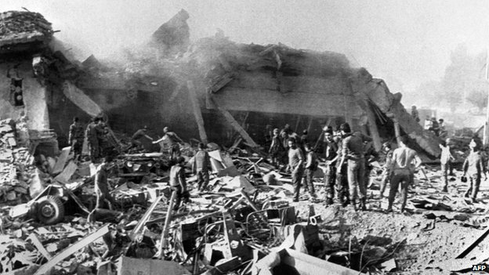
Lebanon Civil War
After 1920 – Syria/Lebanon part of French Mandate
1943-44 – Lebanon granted independence
President – Maronite Christian,
PM – Sunni Muslim,
Speaker of Chamber of Deputies – Shia Muslim
1958 – Lebanon asks US Marines to keep peace
1967 Arab-Israeli War – Lebanon neutral but Palestinian refugees begin using Lebanon to attack Israel
1975 – Phalangists attack bus of mainly Palestinians, killing 27 and sparking civil war: Israel vs. Phalangists vs. PLO/Hezbollah/Iran vs. Syria vs. western nations
1982 – Israel launches full scale invasion, Israel occupies West Beirut, phalangists kill Palestinian civilians, Western powers bring in peacekeepers
1983 – Suicide attack on US embassy kills hundreds including Marines
October 1990 – civil war ends

Slide 9
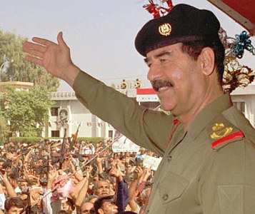
Persian Gulf War
1990 - Iraqi Dictator Saddam Hussein invades Kuwait, claims Kuwait was taken from Iraq
Saudi Arabia and Egypt ask western powers to intervene
UN Security Council demands withdrawal, Hussein does not comply
2/3 of Arab League condemn Hussein, including Saudi Arabia
USA, UK and USSR condemn it
Iraq supported by Jordan, PLO, Tunisia, Yemen, Algeria (minority of Arab countries)
August 8, 1990 – Iraq annexes Kuwait and calls it Iraq’s 19th province
Hussein concludes hasty peace with Iran
300,000 Iraqi troops in Kuwait, Hussein declares Jihad

Slide 10
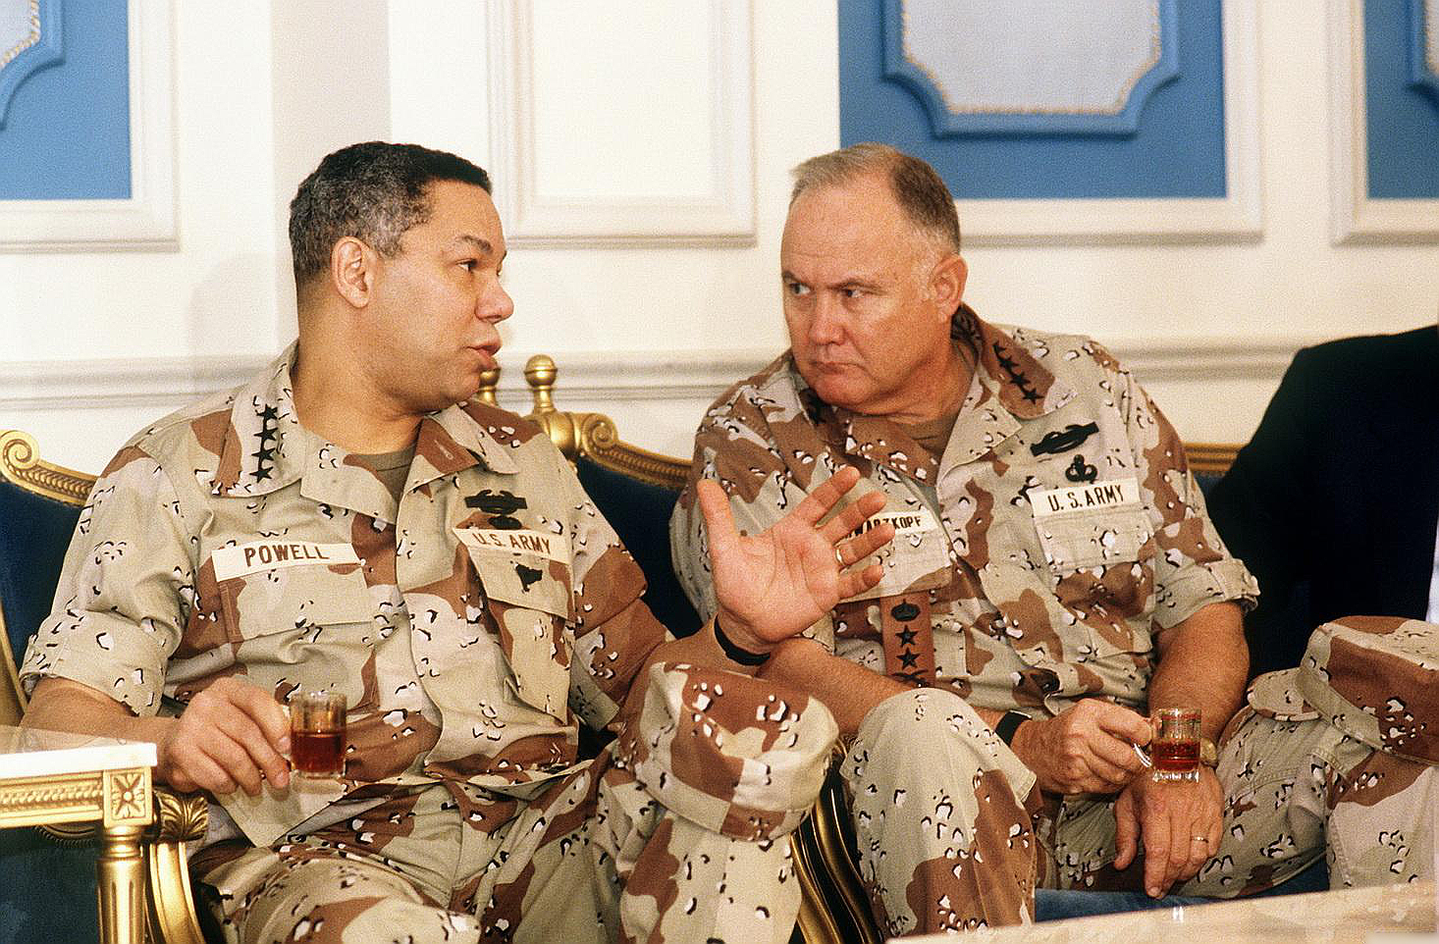
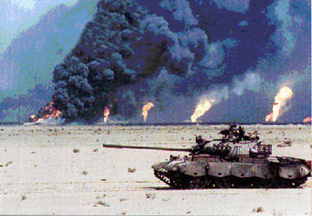
Operation Desert Storm
Nov. 1990 – UN authorizes use of force (Operation Desert Storm), 750,000 troops (540,000 American), UK, France, Germany, Russia, Japan, Egypt, Saudi Arabia
Jan. 1991 – massive air attack begins
Feb. – massive ground offensive beings called Operation Desert Sabre
Iraqi Republican Guard
Gen. Norman Schwarzkopf, Gen. Colin Powell, stealth bombers, “smart” bombs
Patriot vs. Scud missiles
Feb. 28 – Bush declares cease-fire, war ends
9,000 Iraqis killed, about 300 allied troops killed
Hussein allowed to stay in power, but UN weapons inspections and no-fly zone
During war, Hussein was brutal to Kurdish Iraqis and Shi’ites

Slide 11
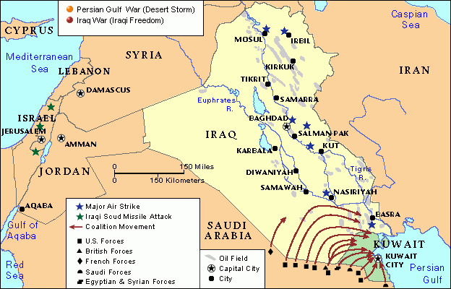
Persian Gulf War

Slide 12
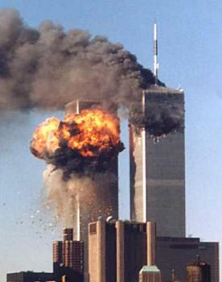
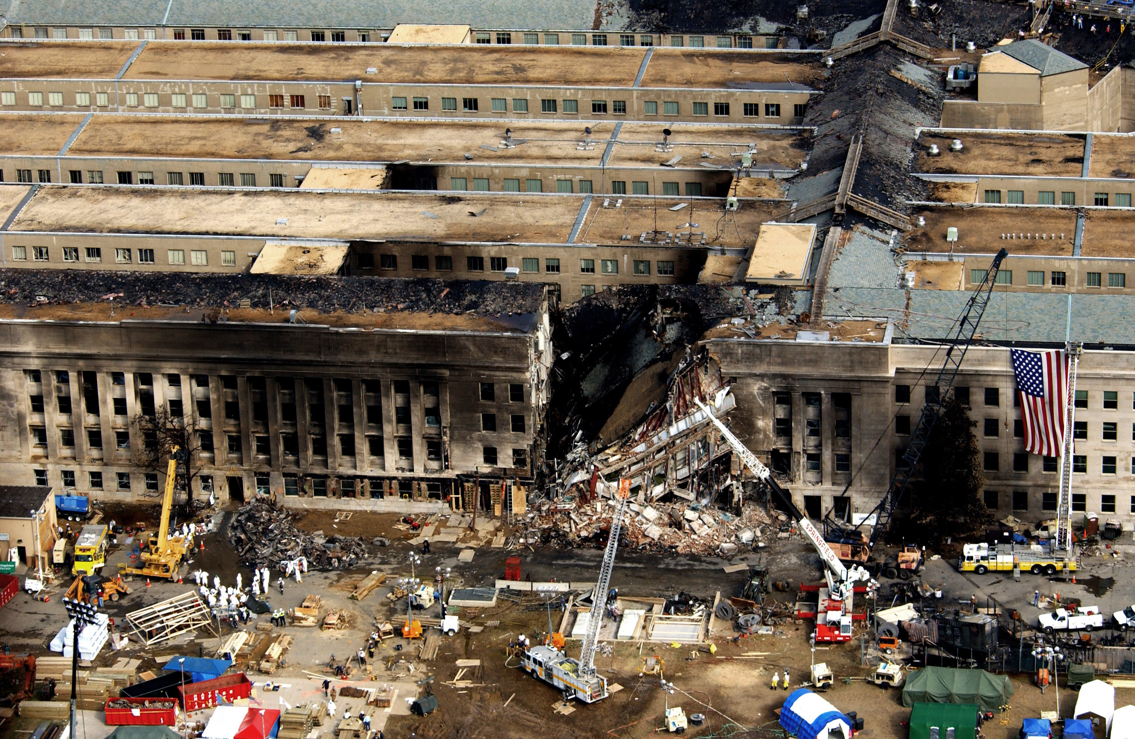
9/11/2001
1993 – initial bombing attempt in parking garage under towers
8:45 am – United Airlines plane hits North Tower of WTC
9:03 am – another UA flight hits South Tower
9:45 am – American Airlines 77 plane hits Pentagon
At about 10 and 10:15 am, the two towers collapsed
Another UA 93 flight crashed near Shanksville, PA, passengers tried to take plan back
Total 19 hijackers on four planes, flight-trained in the USA, working for Al-Qaeda organization led by Osama bin-Laden, 15 were Saudi, ringleader Mohammad Atta was Egyptian
Mayor Rudy Giuliani of NYC

Slide 13
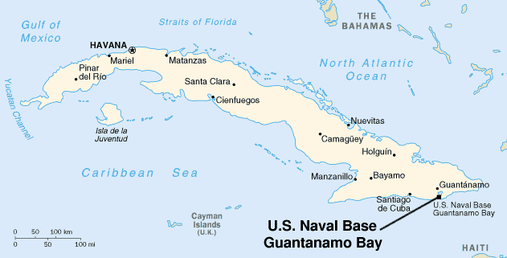
American Reaction
Department of Homeland Security created as part of US cabinet– Tom Ridge is first secretary
Patriot Act passed by Congress – more access to records and more ability to search property
One month after attacks - US and coalition forces begin to overthrow Taliban regime in Afghanistan, Pakistan allies with US and hands over suspected Al-Qaeda prisoners
US sets up Guantanamo Bay detention camp, USA has had the bay since 1903 under lease
Taliban overthrown in December 2001
New Afghani govt. led by Hamid Karzai

Slide 14
Iraq War
Iraq not complying with UN weapons inspections
USA makes case that Iraq has weapons of mass destruction (WMDs)
March 19, 2003 – Hussein ignored deadline for him to leave Iraq, 90 minutes later hostilities began, Tomahawk cruise missiles launched from ships in Persian Gulf, “shock and awe”, major cities captured in 3 weeks
May 1 – Bush’s “Mission Accomplished” speech ended invasion phase
Summer 2003 – Hussein’s sons Uday and Qusay killed
Dec. 2003 - Saddam Hussein captured outside hometown of Tikrit after hiding in a hole (Operationi Red Dawn)
Jan. 2005 – Iraq elected new national assembly
October 2005 – Hussein on trial for mass killings
Nov. 2006 – Hussein found guilty, hanged in December
No WMDs ever found

Slide 15
Arab Spring

