Slide 1
Fall of Communsim: Changes in USSR, Germany, Yugoslavia

Slide 2
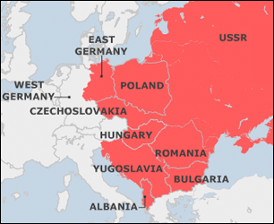
Post WWII Eastern Europe

Slide 3
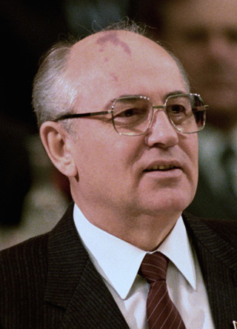
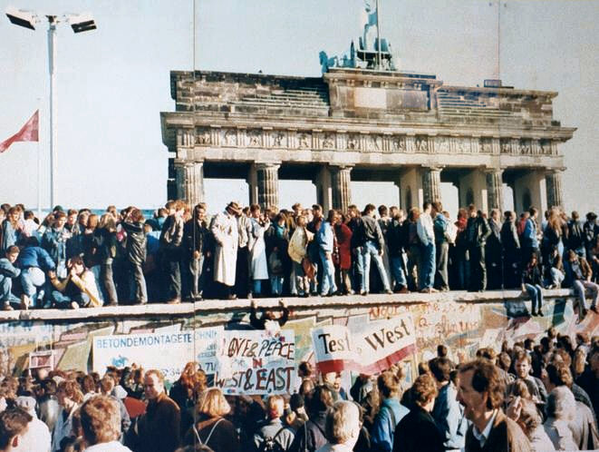
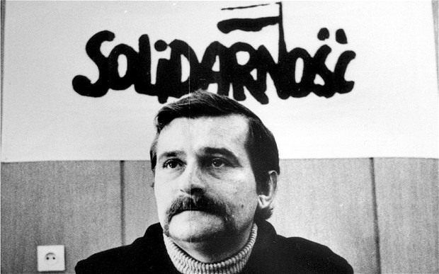
Changes in the USSR and Eastern Europe
1985 – Mikail Gorbachev becomes Gen. Secretary
Glasnost – openness, elimination of political suppression
Perestroika – loosening of government-controlled economy
He vowed to leave Afganistan
1989 - Solidarity Movement in Poland by Lech Walesa, first trade union not communist controlled
1989 – Velvet Revolution in Czechoslovakia – two countries: Czech Republic and Slovakia
1989 – Romanians executed communist dictator Ceaucescu

Slide 4
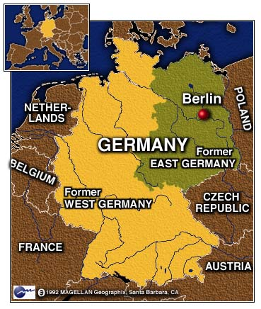
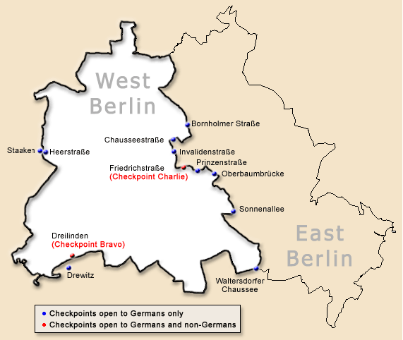
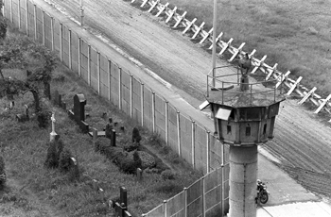
East and West Germany

Slide 5
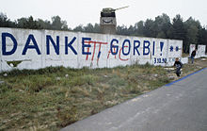
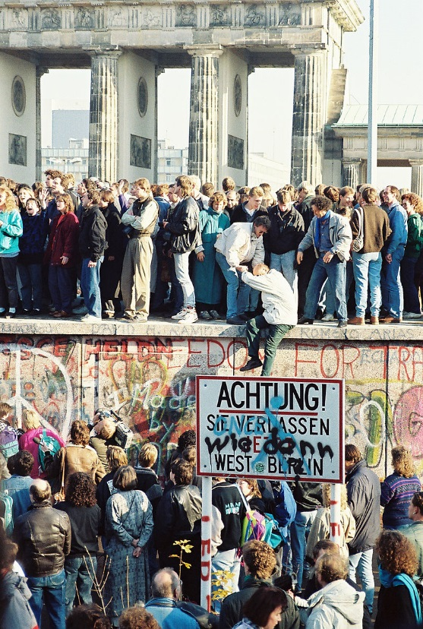
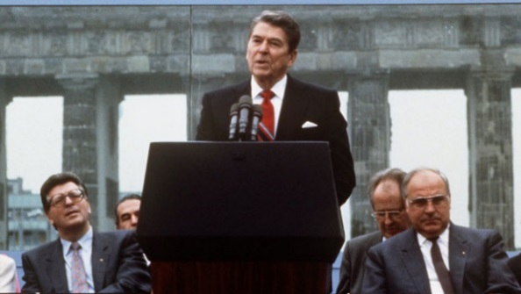
Reunification
1961 – Berlin Wall erected
Nov. 9, 1989 – East Germany announces that anyone can visit West Germany, people start chipping away at wall, govt eventually brings in machinery to take down wall
Helmut Kohl (chancellor of West Germany) becomes first chancellor of reunified Germany
“We defeated Germany twice, and now they’re back!” – Margaret Thatcher, PM of GB

Slide 6
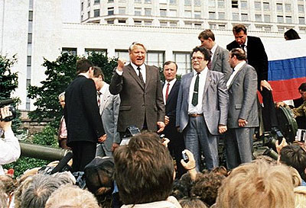
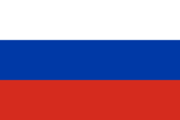
Breakup of the Soviet Union
1991 - Baltic states (Estonia, Lithuania, Latvia) declare independence
June 1991 – Yeltsin elected president of Russia (new office)
August 1991 – attempted coup by hardline Soviets, Yeltsin blocks it
Dec. 8, 1991 - Belarus, Ukraine, Russian Federation form Commonwealth of Independent States (CIS)
Eight more joined CIS and Georgia joined two years later CIS (right now, CIS has 9 members)
Dec. 25, 1991 – Gorbachev resigns
Dec. 26, 1991 – USSR officially dissolved, flag change at Kremlin

Slide 7
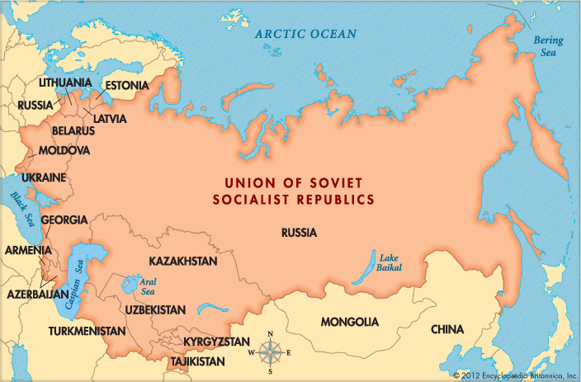
USSR, pre-dissolution

Slide 8
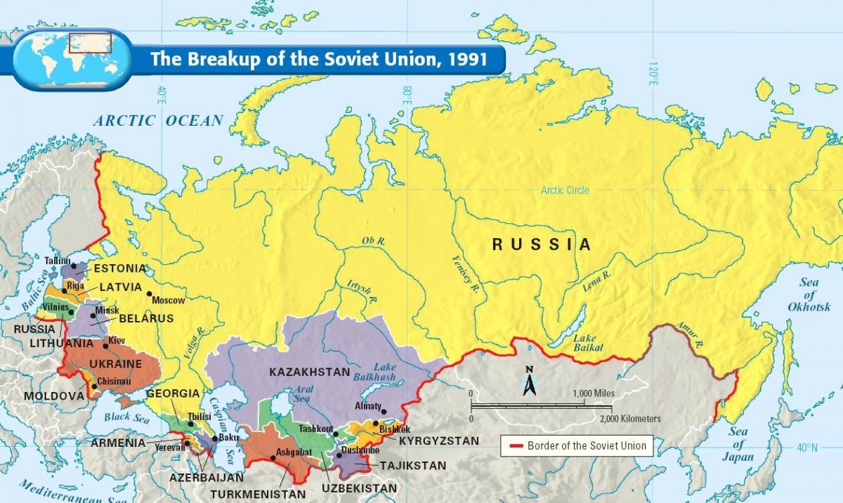

Slide 9
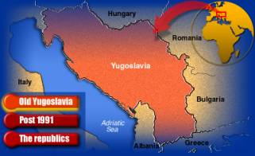
Yugoslavia, pre-breakup

Slide 10
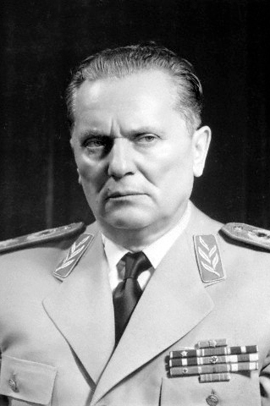
Yugoslavia
Formed in 1918 post WWI, formerly part of Austro-Hungarian Empire, Yugoslavia united Croats, Slovenians and Bosnians with Serbian Kingdom
WWII – Axis invades (Germans, Hungarians, Bulgraians), Croats allied with Nazis
Partisans (Yugoslav resistance movement) fight back, Allies also help (including Soviet Red Army)
1945 – Federal People’s Republic of Yugoslavia established as socialist state with six republics inside
Marshal Tito becomes first PM
1948 – broke from Soviet influence
1953 – Tito becomes president, later becomes president for life, dies in 1980
1961 – founding member of Non-Aligned Movement

Slide 11
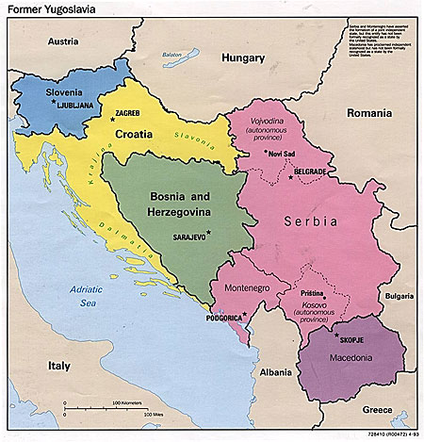
The breakup
By 1992, nationalism on the rise, communism in decline
Slovenia and Crotia break away first
Bosnia declared independence but Serbs living there did not want to be separated from Serbia
Bosnian Serb forces fought Bosnian Muslims
“ethnic cleansing”
Bosnian Muslims also fought Bosnian Croats who wanted to be part of Croatia
“Blue hats” were there too but largely ineffective
1995 Croatia also fought Serbia and took back lands, 200,000 Serbs relocated to Serbia from Croatia
NATO also bombed in 1995
1995 Dayton Agreement – two separate parliaments and armies in Bosnia – one Serb and one Muslim/Croat

Slide 12
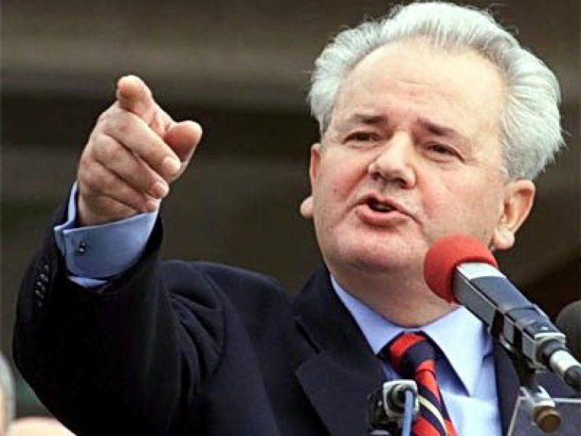
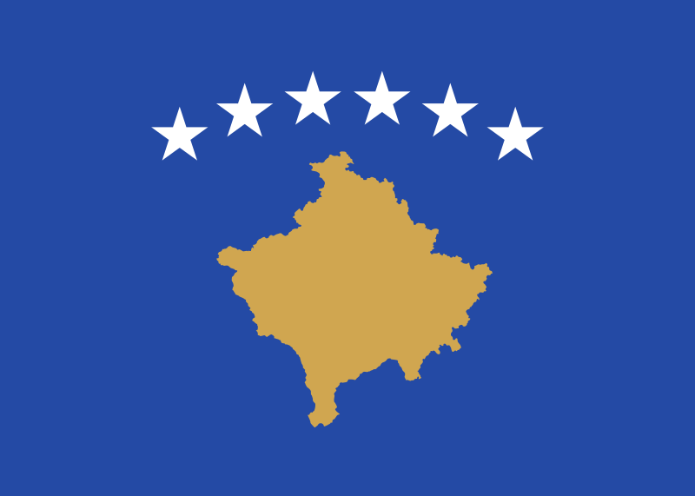
Kosovo
1998 – Kosovo Liberation Army (ethnically Albanian) rebelled against Serbian rule
Slobodan Milosevic was in power in Belgrade, Serbia at the time
March – June 1999 - NATO bombs Serb positions in Kosovo to stop ethnic cleansing
1999 – Milosevic arrested and indicted for war crimes and crimes against humanity in Kosovo (Bosnia added later)
2005 - Died while standing trial at the Hague, Netherlands
2008 – Kosovo declares independence, Serbia still does not recognize it (105 UN members do)

Slide 13
