Slide 1
Tiananmen, South Africa, Afghanistan

Slide 2
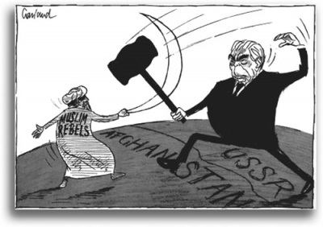
Communists in Afghanistan
1978 – Afghan govt overthrown by leftist military led by Taraki
Power shared by two Marxist groups: People’s Party and Banner Party
Afghan govt now had close ties to Soviet Union but little popular support
Mujahadeen – collective term for tribal groups opposed to communist govt
1979 - Soviets invade to preserve govt from Mujahadeen
Soviets propped up Banner Party leader Karmal

Slide 3
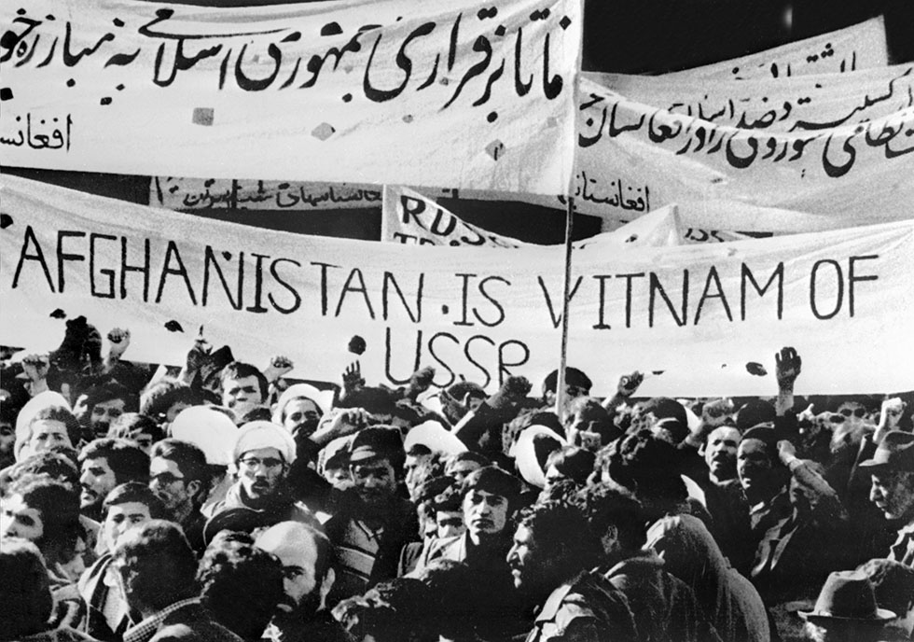
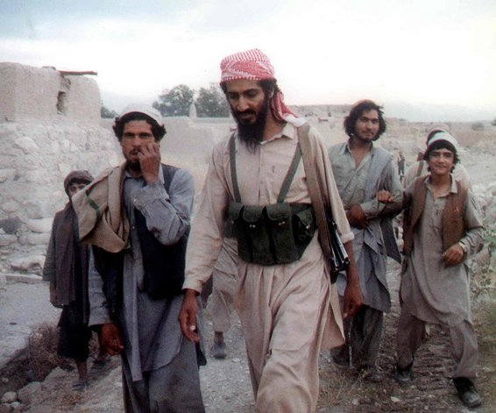
Soviets in Afghanistan
Mujahadeen supported militarily by USA
USA and UK also contributed 20 billion to Pakistan to train and arm 90,000 Afghans (later became Taliban)
Lots of Muslims from other countries traveled to Afghanistan to fight Soviets including Osama Bin Laden
Due to stalemate, Soviets signed a peace accord with USA, Pakistan and Afghanistan in 1988

Slide 4
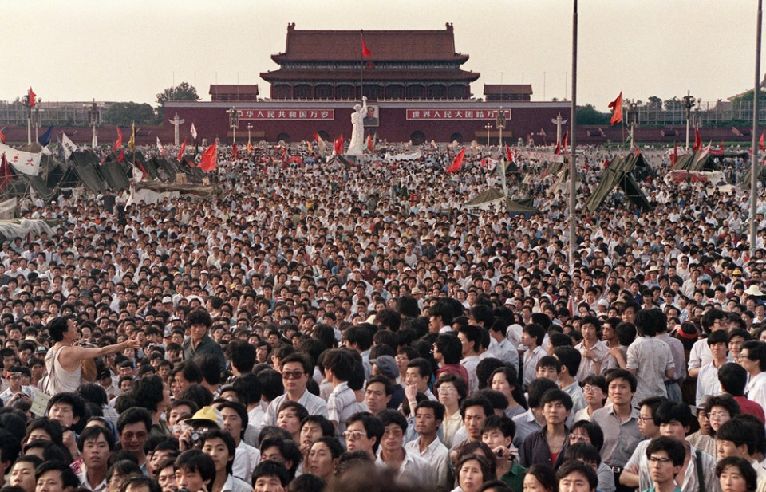
Lead up to Tiananmen Square Massacre
China had been opening up since 1970s (remember Nixon’s visit)
1980 - Hu Yaobang becomes General Secretary, starts purging Maoist ideology
China cracks down on ideas that were too western and liberal
1987 – Hu forced to resign by old guard, dies in 1989, becomes martyr for students and democratic thinking Chinese

Slide 5
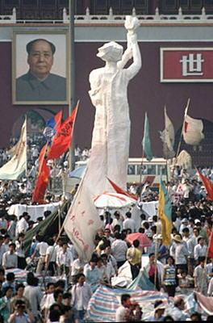
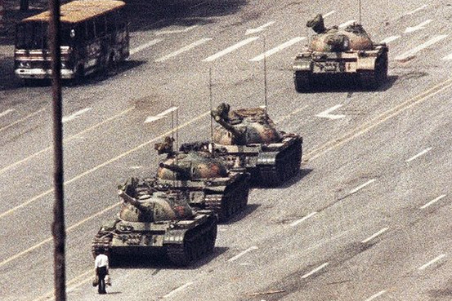
June 4, 1989
Student protestors in Tiananmen Square in Beijing and in other cities starting April 22 (Hu’s funeral)
Crowds grew to over 1 million by mid-May (Gorbachev also visiting)
Zhao Ziyang vs. Li Peng
Zhao wanted to negotiate, Li wanted to force the students out
Late May – martial law
Night of June 3, tanks rolled in and shots fired
By June 5, square cleared
Tank Man on June 5
Zhao Ziyang put under house arrest
Govt reported 241 killed, several thousand wounded
Reforms did happen starting 1992

Slide 6
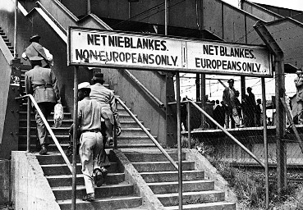
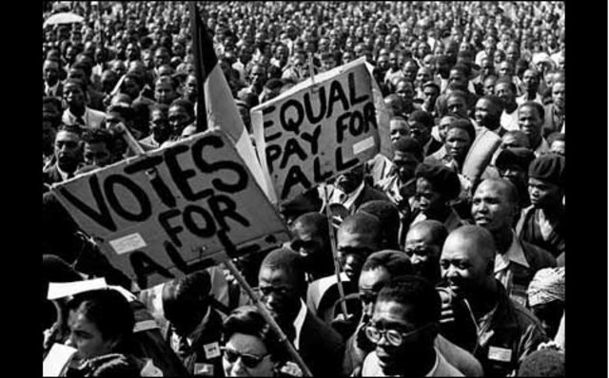
Apartheid in South Africa
1948 – Afrikaner white govt establishes Apartheid
Apartheid – racial segregation that privileged whites
1948 – Nelson Mandela (called Madiba) joins African National Congress
Organized protests against apartheid laws, opened first black law firm
Mandela at first promoted non-violence

Slide 7
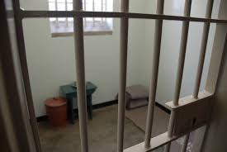
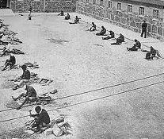
Mandela in prison
1959 – Sharpeville Massacre, 69 demonstrators killed
ANC banned
1961 – Mandela co-founds Spear of the Nation, armed wing of ANC, sabotage campaign begins
1962 – Mandela and others arrested in Rivonia for treason, found guilty, got life imprisonment in the Rivonia Trial
Imprisoned for 27 years, first 18 at Robben Island, wrote autobiography Long Walk to Freedom while there
Much international pressure to release Mandela

Slide 8
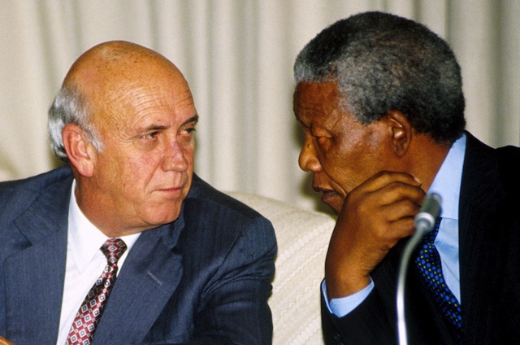
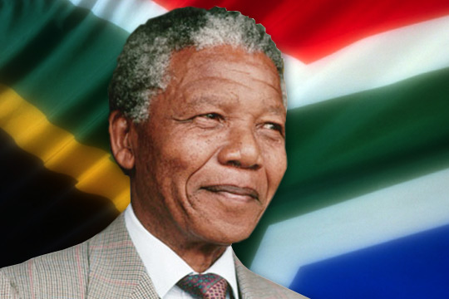
After prison
1982 – moved to Pollsmoor Prison
1988 – moved to house arrest
1989 – new president F.W. de Klerk reinstates ANC
1990 – de Klerk releases Mandela
Mandela and de Klerk agree to free elections, they win Nobel Peace Prize in 1993
1994 – first multi-racial elections ever, Mandela becomes 1st black president, de Klerk is first deputy
“Rainbow Nation”
1995 Rugby World Cup
1999 - retires

Slide 9
Hezbollah and Iran
Islamic Revolution
Iran-Iraq War
Iran and Israel
Hostage Crisis
Marines in Beirut

Slide 10
Fall of Soviet Union

Slide 11
A New Eastern Europe
Poland
Velvet Revolution
Romania
Germany

Slide 12
Persian Gulf War

Slide 13
Iraq War

