Slide 1
China, Iran, Northern Ireland
1950s-1970s

Slide 2
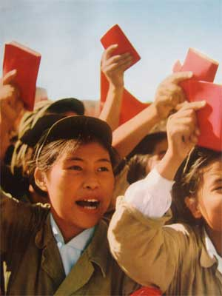
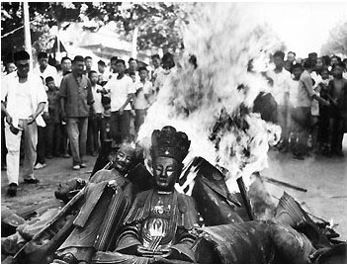
China Under Mao
KMT led by Chiang Kai-Shek flees to Taiwan
1958 – 1961 Great Leap Forward – five year economic plan, labor intensive, collective farming
GLF abandoned after two years, widespread famine
Sparrow-killing led to locusts
1966-76 Cultural Revolution – ideological campaign, anti-intellectualism, anti-West, burnings, promoted revolutionary ideas
Jiang Qing (Mao’s wife) was cultural advisor
Mao’s Little Red Book
Red Guard – anti-west police

Slide 3
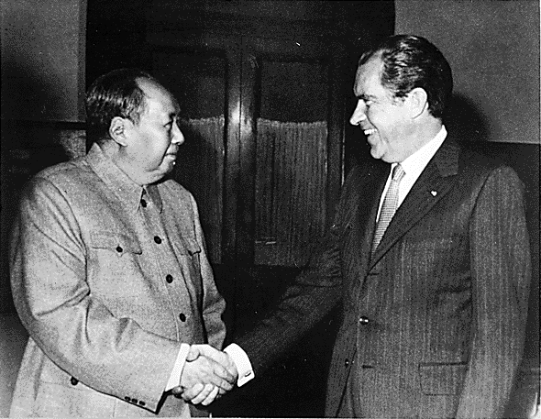
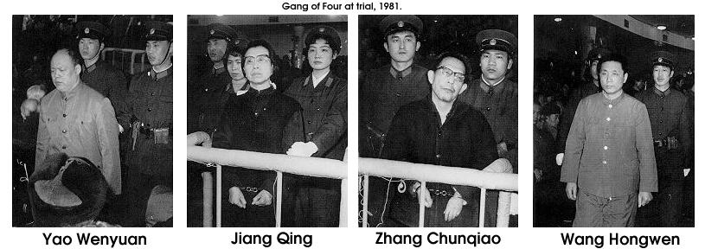
Opening Up of China
Ping-Pong Diplomacy – first Americans to visit since 1949
1972 – Nixon secretly visits, relations with USA normalized
1976 – Mao dies, Gang of Four (including Jiang Qing) jockey for power
Gang of Four arrested for trying to usurp power, put on trial in 1981 for anti-party activities
1977 – 1997 – Deng Xiaoping, “Beijing Spring”
Deng encouraged criticism of Cultural Revolution (30,000 people died), worked with Eight Elders, never held title of General Secretary, more open to West
Jan. 1, 1979 – USA officially recognizes China

Slide 4
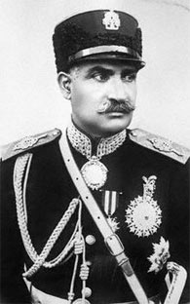
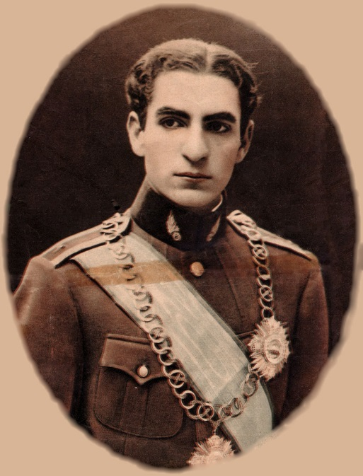
Iran: WWI to WWII
Persia is officially neutral during WWI
1923 - Reza Khan becomes PM
1925 – parliament votes Khan ruler, previous shah deposed, he is crowned Reza Shah Pahlavi, Mohammad Reza is crown prince
1935 – Persia changes name to Iran
1941 – UK and Russia occupy pro-Axis Iran, Reza Shah deposed and Mohammad Reza made shah

Slide 5
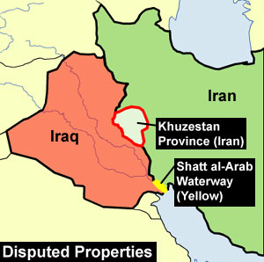
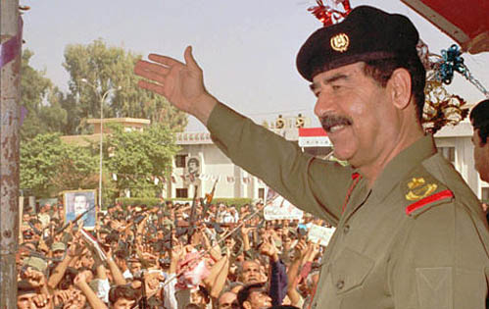
Iran-Iraq War, 8 Years
September 1980 – Iraqi president Saddam Hussein invades Iran
Hussein afraid of Iran inciting Shia minority in Iraq
Iraq used ballistic missiles on cities and chemical weapons against Iran and Iraqi Kurds thought to be allied with Iran
Iraq supported by Saudi Arabia, Kuwait, USA and USSR
Iran supported by Libya and Syria
July 1988 – Iran accepts UN mediated cease-fire

Slide 6
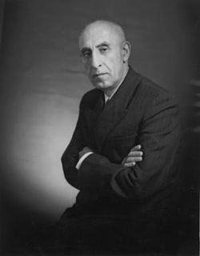
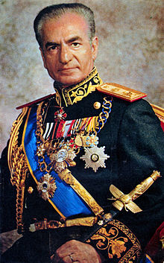
Mossadeq and the Shah
1950 – Ali Razmara made PM, assassinated nine months later
Nationalist Mohammed Mossadeq new PM, anti-West (like Nasser in Egypt)
1951 – Iran nationalizes oil industry, UK embargo and blockade
Power struggle between Shah and Mossadeq, Shah flees country
1953 - US and UK intelligence organize coup (Operation Ajax), Mossadeq forced out, General Zahedi new PM, Shah returns, Mossadeq died in house arrest
White Revolution – Shah’s social and economic modernization campaign, westernizing country
SAVAK – Shah’s secret police
1964 – Ayatollah Khomeini exiled

Slide 7
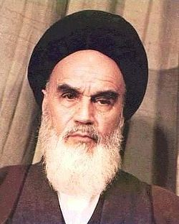
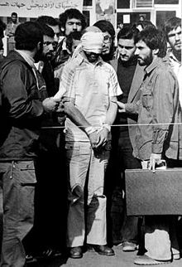
The Islamic Revolution in Iran
Iran mostly Shia Muslim
1978 – authoritarian rule leads to riots, Muslim clergy angry
Royal family forced into exile
April 1979 – Islamic fundamentalists led by Ayatollah Khomeini (returning from exile) proclaim Islamic Republic of Iran
Nov 1979 – Islamic militants take 63 American hostages from US embassy, demand return of the Shah from US to face trial
Jan 1980 – prisoners freed after 444 days
“Argo”
July 1980 – Shah dies in exile in Egypt

Slide 8
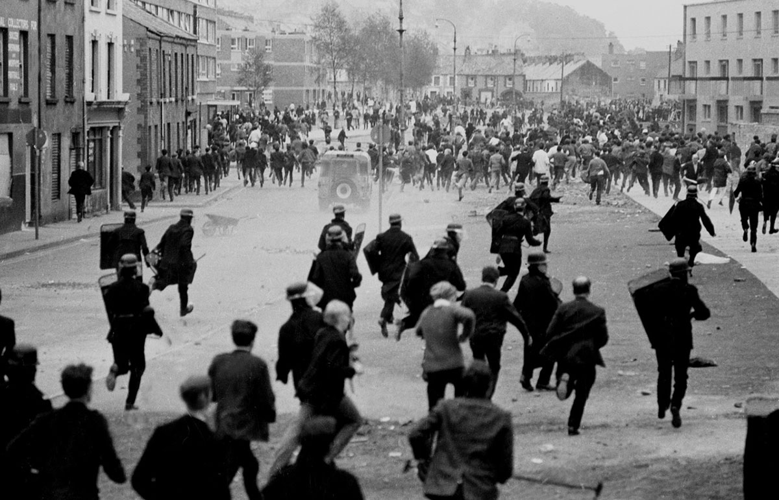
The Troubles: 1968-1998 Northern Ireland
Unionists dominated Northern Irish parliament since WWI
Violence grew between Unionist Protestants and Republican Catholics
1971 – Internment policy by N. Irish govt agsint terrorists
1972 “Bloody Sunday” – Londonderry demonstration ends with 13 killed by British army
1972 – London imposes direct rule

Slide 9
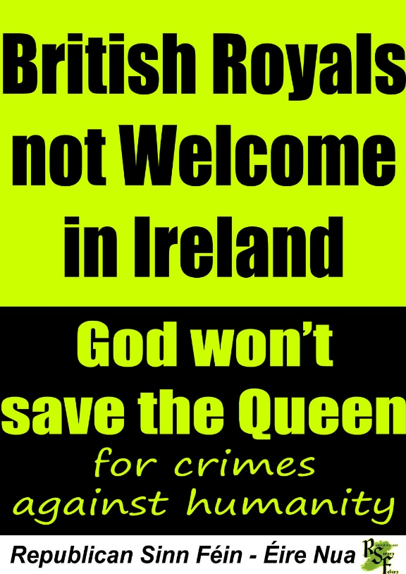
Attempts at peace (many failed)
1973 – Sunningdale Agreement – power sharing in govt and Ireland would have role in Northern Ireland (collapsed in 1974)
1985 – Ango-Irish Agreement (moderate), both extremes hated it
Sinn Fein vs. Unionists
Sinn Fein – political wing of the Irish Republican Army

Slide 10
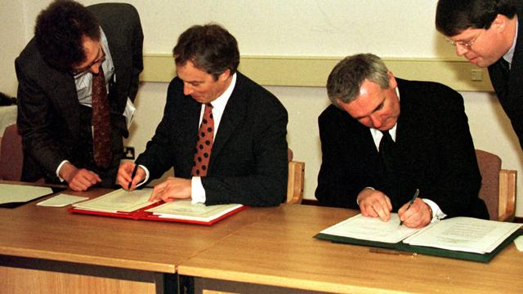
Good Friday Agreement 1998
Talks began in 1996
Pres. Bill Clinton sent Sen. George Mitchell to chair the talks
Agreement set up power-sharing in N. Ireland parliament
Ireland drops claims to the six counties in N. Ireland
Decommissioning of weapons in paramilitary orgs.
End of “The Troubles”…sort of
Orange Order marches (Unionists)
2007 St. Andrew’s Agreement amended GFA

