Slide 1
Korean War, China under Mao, Vietnam, Iron Curtain, North Africa, The Middle East
50s, 60s, 70s

Slide 2
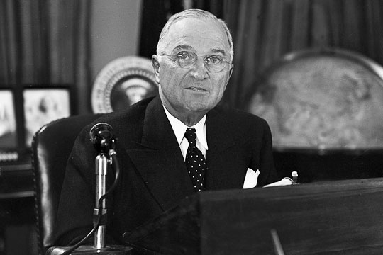
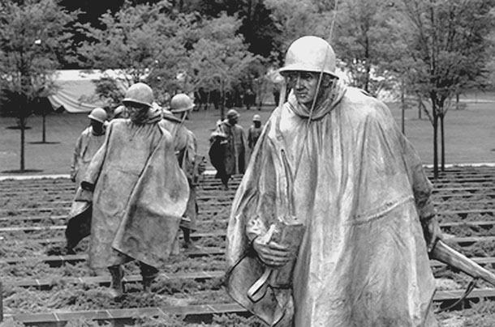
Korean War, 1950-53
Post WWII – USSR and USA divided Korea at 38th parallel
Syngman Rhee (ROK) v. Kim Il Sung (DPR)
June 25, 1950, North Korean army crossed the 38th parallel
July – USA enters
MacArthur’s landing at Inchon
The Yalu River
Truman fires MacArthur
1953 – Armistice signed
The DMZ

Slide 4
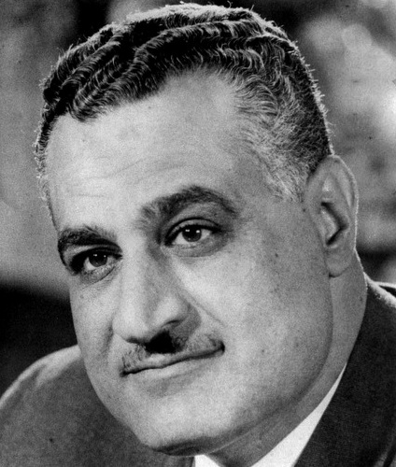
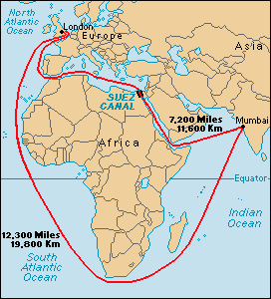
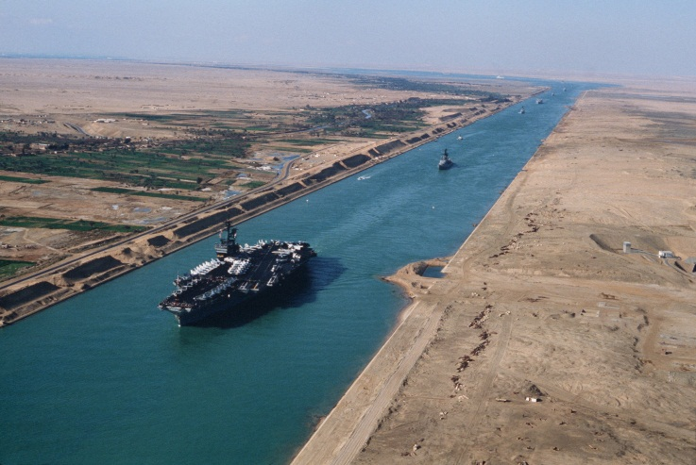
Nasser and Egypt, 1956-1970
President from 1956-1970
United Arab Republic with Syria
Free Officers Movement
Deposed King Farouk
The Non-Aligned Movement
High Aswan Dam
Nationalized Suez Canal
Six-Day War
Anwar Sadat

Slide 5
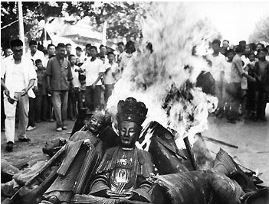
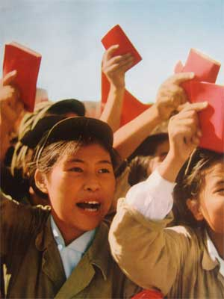
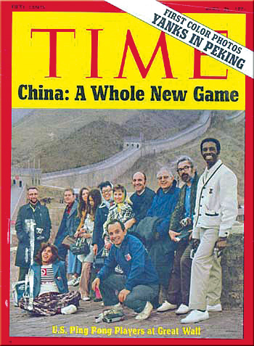
China Under Mao
1958 – 1961 Great Leap Forward
Cultural Revolution
Little Red Book
Red Guards
Anti-intellectualism
Anti-West
Gang of Four
Ping-Pong Diplomacy
1972 – Nixon visits
1976 – Mao dies
1977 – 1997 – Deng Xiaoping

Slide 6
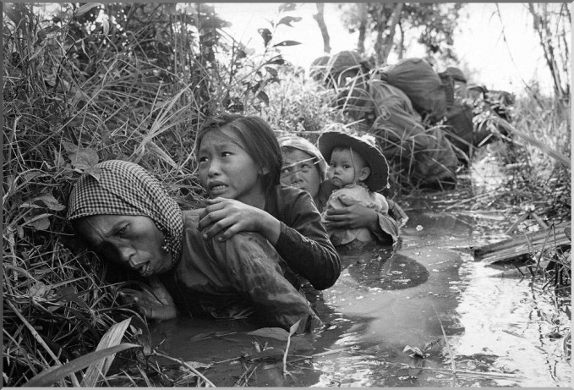
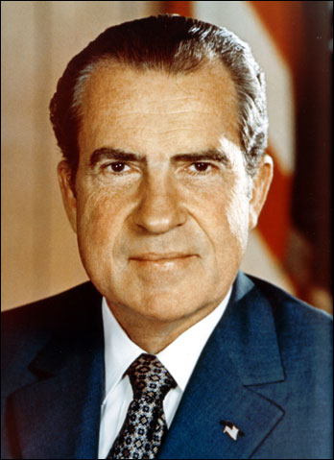
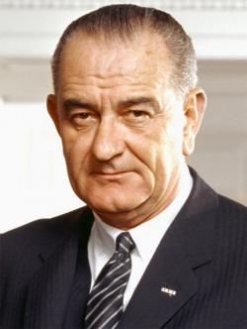
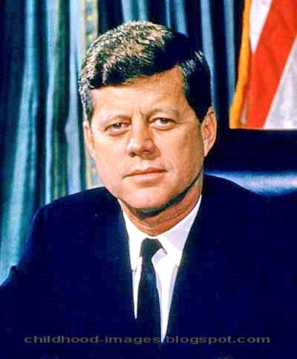
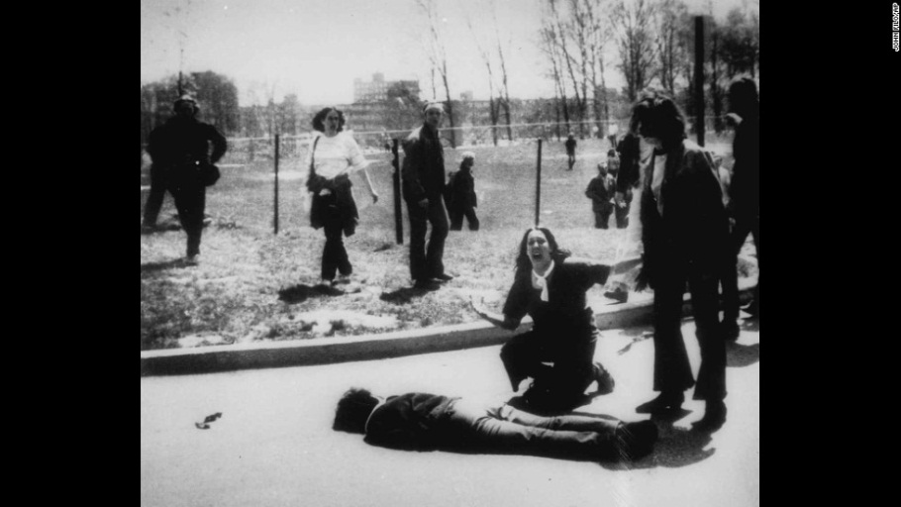
Vietnam War, 1965-1975
French Indochina
Dien Bien Phu
Japan invades during WWII
1945 - Ho Chi Minh seizes Hanoi
USS Maddox in Gulf of Tonkin
Robert Mcnamara
William Westmoreland
My Lai Massacre and Lt. Calley
Tet Offensive
Agent Orange
Kent State University and Cambodia
Fall of Saigon

Slide 7
North Africa
Algeria – French colonization, War of Independence, FLN, Boumedienne and Ahmed Be Bella, Charles de Gaulle and Evian Accords
Algiers, Oran, Constantine
Morocco – Atlas Mountains, Marrakech, Casablanca, Tangiers, Rabat
Libya – Barbary Wars, Tripoli, Italian invasion, Qaddafi and Lockerbie,

