Slide 1
Ireland, India and Spain in the 20th Century
Road to Independence

Slide 2
Previous Irish Rebellions
1688 Williamite War (aka Jacobin War) – reacted to Glorious Revolution in England
1798 Irish Rebellion – inspired by revs in America and France

Slide 3
Current Map of Ireland and Northern Ireland
Rep. of Ireland is an independent nation since 1922
Northern Ireland is a part of the UK (since 1921) just like Scotland and Wales are
Both have FIFA football teams
Capital of Ireland: Dublin
Capital of Northern Ireland: Belfast
Last scene of The Force Awakens was on Skellig Michael, an island off the coast of Ireland

Slide 4
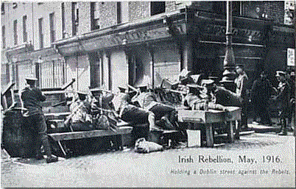
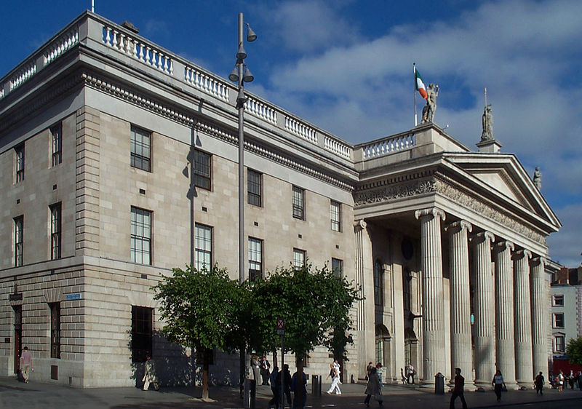
Irish Independence
Sinn Fein – founded in 1905, “we ourselves”
Roger Casement – investigator of human rights abuses, Peru, Congo, met Joseph Conrad
1914 Casement met with Germans – guns in exchange for distracting Britain, deal failed
The 1916 Easter Rising – staged by Irish Republican Brotherhood
Easter Monday – IRB took the General Post Office, held it a week
Eamon de Valera was the only IRB commander NOT executed, he was American
1918 Conscription Crisis – Britain passed conscription of Irish for WWI, strikes and demonstrations, Britain decided not to enforce

Slide 5
Irish War of Independence, 1919-1921 Irish Civil War 1922-23
Irish Republican Army vs. British Army
1919 Versailles – Sinn Fein attended, ignored
January 1919 – guerrilla warfare begins in Tipperary and Cork
Michael Collins – president of IRB in 1920
Act of 1920 – two parliaments, six counties became Northern Ireland, the rest became “Southern Ireland”, plan to reunite them later
July 11, 1921 – Collins signs Anglo-Irish Treaty with UK, accepted partition, Collins is president of provisional govt
Irish Free State – Eamon de Valera first PM
Irish Civil War 1922-1923
August 1922 – Collins ambushed by radical anti-treaty Irish

Slide 6
South Asia 1925

Slide 7
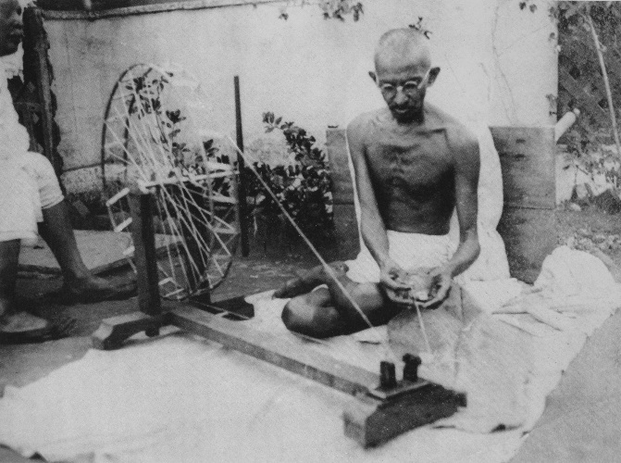
India and Pakistan
1858 Government of India Act – India transferred from British East India Company to British crown, Queen Victoria now Empress of India
Gandhi – merchant caste, lawyer in South Africa for Indians there, returns to India in 1915, assumes leadership of Indian National Congress in 1921, fights for human rights and self-rule
Non-cooperation, non-violent demonstrations
1931 – Salt March
August 15, 1947 – Independence Day for India, First PM Nehru raise flag above Red Fort, Pakistan also created to appease Muslim north
Radcliffe Line
Fighting in Punjab region between Hindus and Muslims days later
1948 – Gandhi assassinated by Nathuram Godse, a radical Hindu
1971 East Pakistan (formerly East Bengal) becomes Bangladesh

Slide 9
Spanish Civil War, 1936-1939
1931 – King Alfonso XIII authorized elections (whoops)
Monarchy abolished, 2nd Republic formed, Catalonia (Barcelona) and Basque regions are autonomous
1933 – monarchists temporarily regain government control
1936 – Popular Front regains leftist control, Franco exiled to Canary Islands

Slide 10
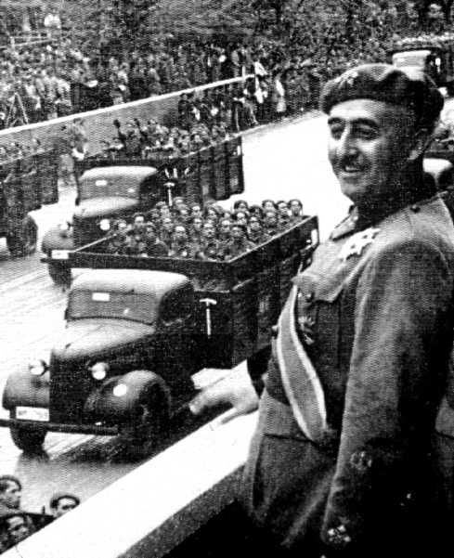
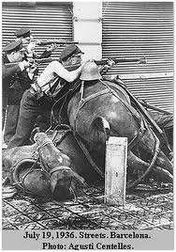
The Civil War
July 17, 1936 - Franco joined units in Spanish Morocco, garrison uprisings all over Spain
Franco and army ferry across Strait of Gibraltar
November – siege of Madrid
1937 Falange – fascist party behind Franco
The Republicans increasingly communist – aided by Soviets
Germany and Italy (both fascist) aid Franco
Jan. 1939 – Barcelona falls
March – Madrid falls
Franco is dictator until 1975, he reinstalls monarchy before he dies

Slide 12
Guernica by Picasso April 26, 1937

