Slide 1
India, Cold War, Cuba, Chinese Civil War
1940s, 50s, 60s

Slide 2
South Asia 1925

Slide 3
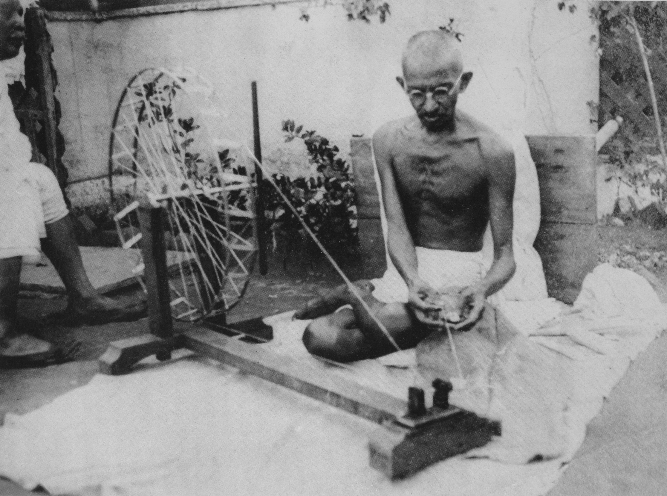
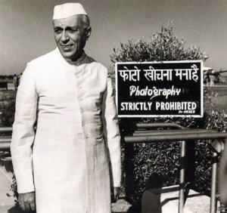
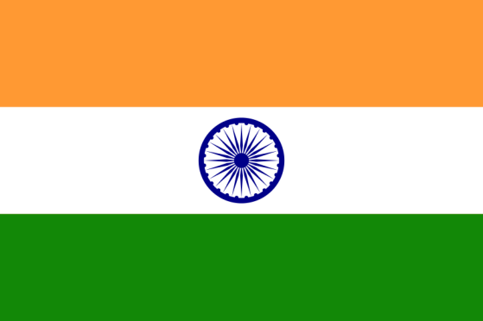
India and Pakistan
1858 Government of India Act – British East India Company to British govt
1890s – 1914 – Gandhi in S. Africa
Non-cooperation
1931 – Salt March
August 15, 1947 – Independence Day
First PM Nehru raise flag above Red Fort
Muslim and Hindu nationalism
1948 – Gandhi assassinated by Nathuram Godse

Slide 5
Movies
Slumdog Millionaire
Gandhi
A Passage to India

Slide 6
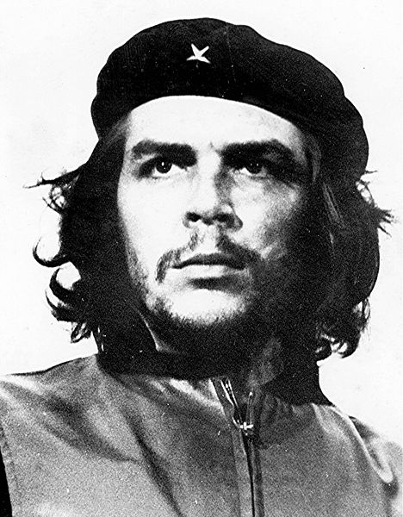
Cuban Revolution
1952 – coup led by Fulgencio Batista, USA supports
1953 – Castro attacks, imprisoned
1955 – Castro set free, Che Guevara and Castro meet
1955-1958 – Guerrilla war
1958 – Batista flees to DR
1960s – Che goes to S. America, killed in Bolivia (CIA)
1961 – Bay of Pigs Invasion
Castro really likes baseball
PM until 1975
President until 2008

Slide 7
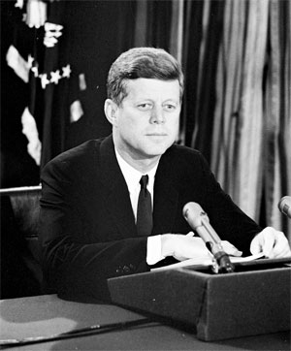
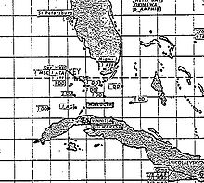
Cuban Missile Crisis
13 day crisis in 1962, Oct. 15 to Oct. 28
U2 spyplane photographs Russian missiles in Cuba
JFK informs public in TV speech, orders Soviets to remove missiles, orders naval blockade
Soviet navy arrives, stalemate
Kruschev refuses to remove missiles, JFK plans possible invasion
Deal: Kruschev removes missiles, JFK doesn’t invade, JFK removes missiles from Turkey

Slide 8
Movies
Motorcycle Diaries
Che
13 Days

Slide 9
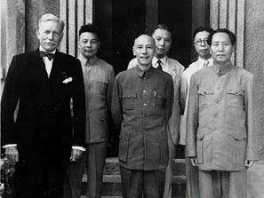
Resumption of Chinese Civil War
Mao v. Chiang Kai-Shek
KMT’s burden against Japan
USSR in Manchuria plays both sides
1949 – PLA enters Beijing, Mao declares People’s Republic of China
KMT and Chiang retreat to island of Taiwan (formerly part of Japan)

Slide 10
“It was perfectly clear to us that if we told the Japanese to lay down their arms immediately and march to the seaboard, the entire country would be taken over by the Communists. We therefore had to take the unusual step of using the enemy as a garrison until we could airlift Chinese National troops to South China and send Marines to guard the seaports.” – President Truman

