Slide 1
The Middle East in the 20th Century
From WWI to Six-day war

Slide 2
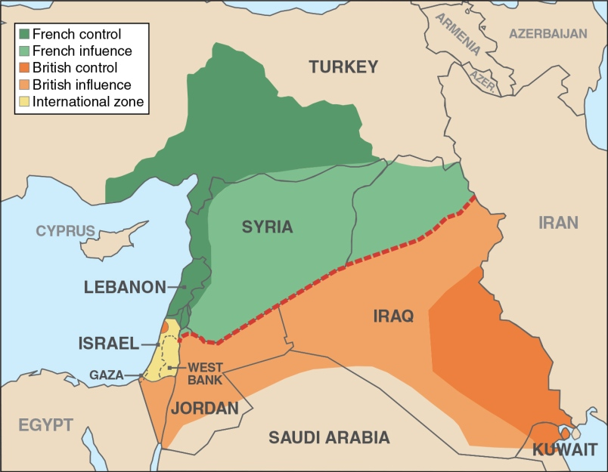
European Shenanigans During WWI
Faisal Hussein, member of Hashemite Dynasty, dreamed of a large single Arab nation
McMahon-Hussein Correspondence 1915 – British promised independent Arab land in exchange for Arab uprising, did not mention Palestine specifically
1916 – Arab uprising against Ottomans began
Sykes – Picot Agreement 1916 – UK and France secretly planned to partition Ottoman lands, Lebanon/Syria to France, Baghdad and Basra to UK, Palestine internationally controlled, leftovers would be governed semi-autonomously by Arabs

Slide 3
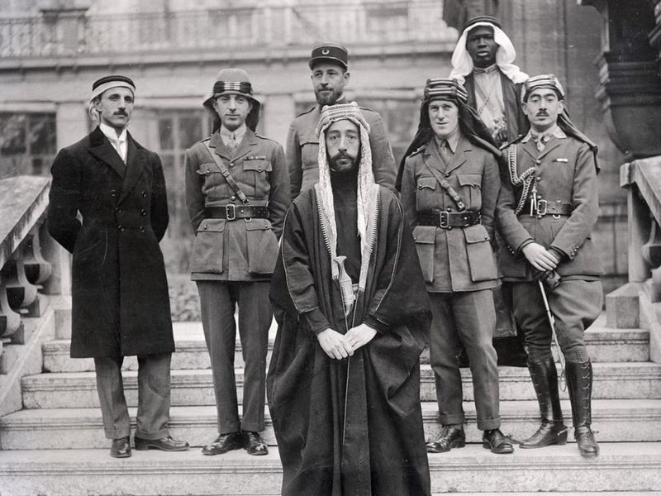
Zionism, End of WWI, and the Balfour Declaration
Zion was a fortress in Jerusalem, became synonymous with the city
Theodor Herzl, author of The Jewish State (1896), founded World Zionist Organization
Main objective was establishment of Jewish state in Palestine
1903 – Britain offered 5000 sq. miles in Uganda, WZO declined offer in 1904
1917 Balfour Declaration – letter from Foreign Secretary Balfour to Jewish Zionists in Britain
“His Majesty's government view with favour the establishment in Palestine of a national home for the Jewish people”
Russia leaked the letter to Arabs
1919 – at Paris Peace Conference, Faisal met with WZO president Chaim Weitzmann
Faisal – Weitzmann Agreement – Faisal had no problem with Jewish state as long as Arabs received independence from western powers

Slide 4
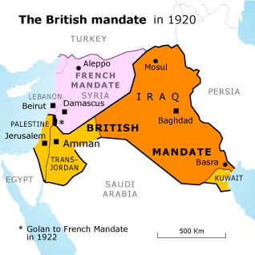
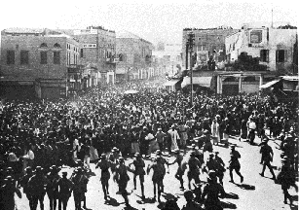
British Palestine Mandate and Arab Uprisings
1922 - Palestine Mandate (part of PPC): “The Mandate will secure the establishment of the Jewish national home ... and the development of self-governing institutions, and also safeguard the civil and religious rights of all the inhabitants of Palestine, irrespective of race and religion.”
1936-39 Arab Revolt against British rule and rising Jewish migration
Peel Commission recommended two state solution and transfers of population
White Paper of 1939 – Britain’s policy (formed w/o consultation with either party) did not follow Peel’s recommendations: rejected idea of Jewish state and partitioning of Palestine and no more than 75,000 migrants for next 5 years
Jewish strikes and attacks on govt for several months

Slide 5
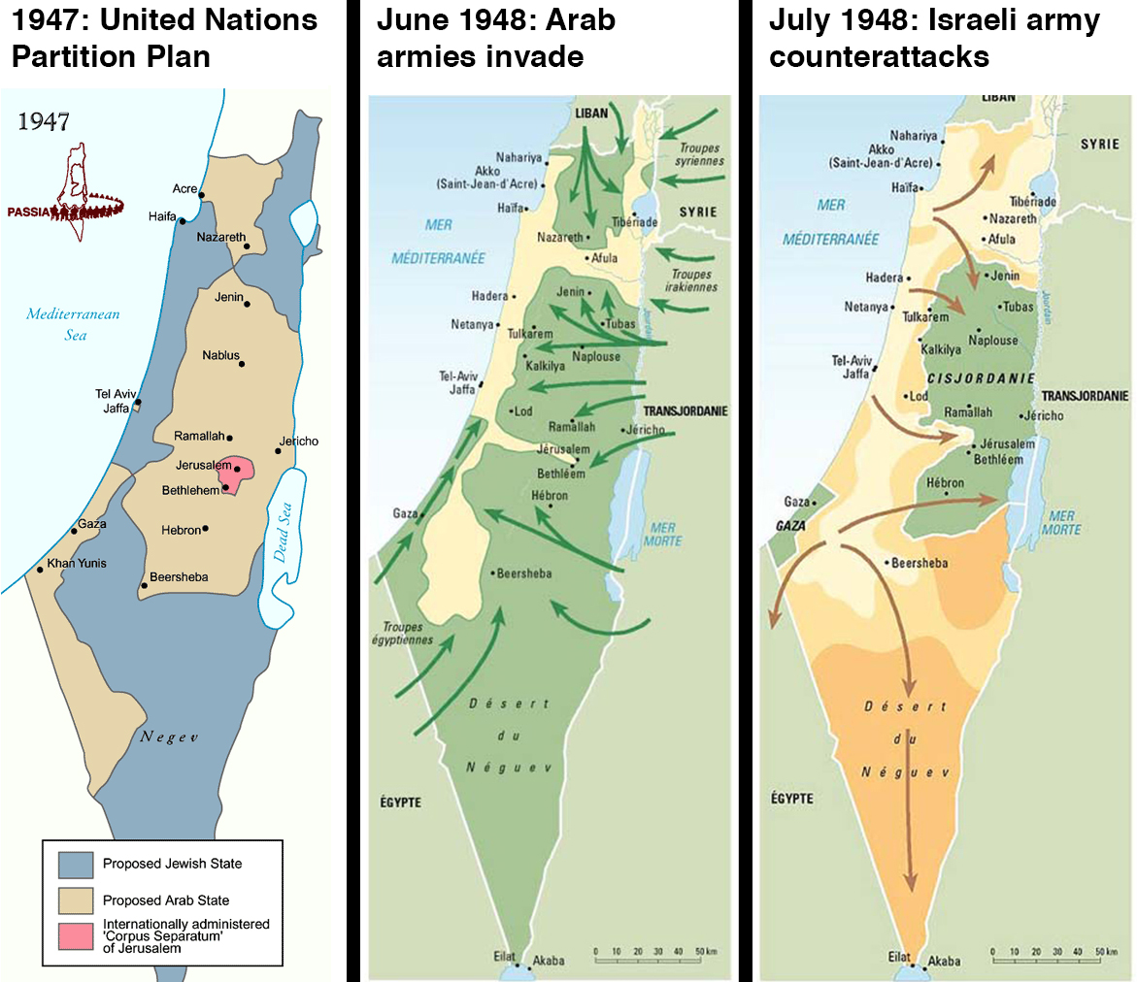
Post WWII, Establishment of Israel and War
1946 – Transjordan given independence under Hashemites
1947 – UN proposes two states and UN-controlled area around Jerusalem
Palestinian Arabs and Arab states rejected plan
May 18, 1948 – British Palestine Mandate ends
David Ben-Gurion (1st PM) declares the new State of Israel
1948 Arab-Israeli War (War of Independence or The Catastrophe) – Egypt, Jordan, Syria and Iraq invaded the next day, 10 month war
King Abdullah I of Jordan had previously promised he would not attack Israel (in exchange for annexation of West Bank)
Results: Israel retained its area proposed by UN in 1947, also took 60% of Arab land, Transjordan took SE part of Mandate, Egypt occupied Gaza Strip, still no Palestinian state
700,000 Palestinians fled Israel, about 700,000 Jews immigrated to Israel in the next three years

Slide 6
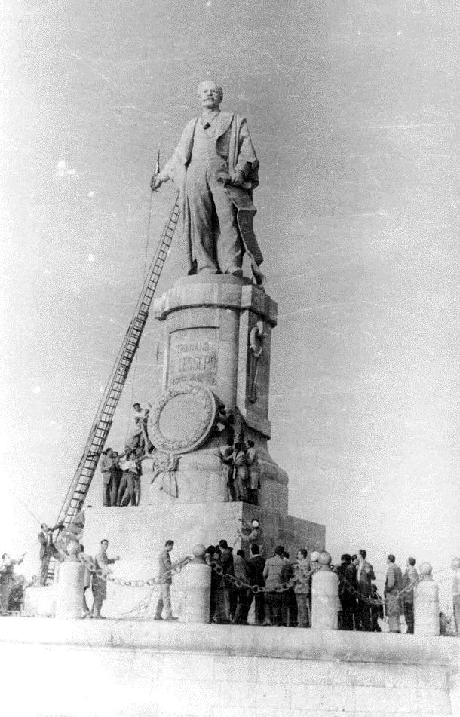
Suez Crisis
Background: Anglo-Egyptian Treaty of 1936 guaranteed British lease 20 more years, 80,000 British troops at Suez, Egyptian monarchy friendly with Britain
Growth of Muslim Brotherhood, anti-British, anti-monarchy sentiments
1952 – military coup by Free Officers Movement led by General Nasser, Egyptian Republic formed, Nasser became 1st president
Nasser an Arab nationalist
Nasser courts USSR and China for Aswan Dam funding
Eisenhower refuses to fund it, Nasser gives “Ferdinand de Lesseps speech”
Oct. 1956 - Nasser nationalizes Suez Canal to charge high tolls, closes it to all shipping
British, French and Israelis invade Sinai and occupy canal zone
UN and USA pressure them to withdraw in March 1957
Secretary-General Hammarskjöld of UN creates UN Peacekeeping Force and blue helmets

Slide 7
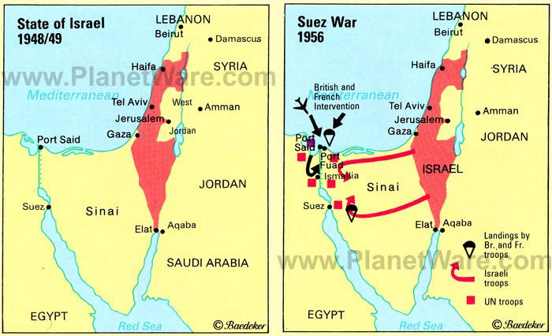
Suez Crisis Map

Slide 8
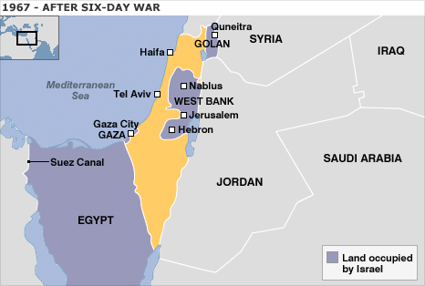
Six-Day War, June 1967
Border skirmishes with Syria, heightened tension, Israel shot down 6 Syrian MiG fighters
Egypt expels UN peacekeepers from Sinai and closes Straits of Tiran to Israeli shipping
Jordan signs defense treaty with Egypt and Syria
Iraq, Kuwait, Algeria all send forces to help
June 5 – Israel pre-emptively struck Egyptian air forces
Israel took Sinai and Gaza Strip in three days
Also took East Jerusalem and West Bank from Jordan and Golan Heights from Syria
In six days, Israel doubled its size
Israel would return land in return for Arab recognition of Israel and guarantees of no further attack

Slide 9
Toni Morrison

Slide 10
Maya Angelou

Slide 11
Zora Neale Hurston

