Slide 1
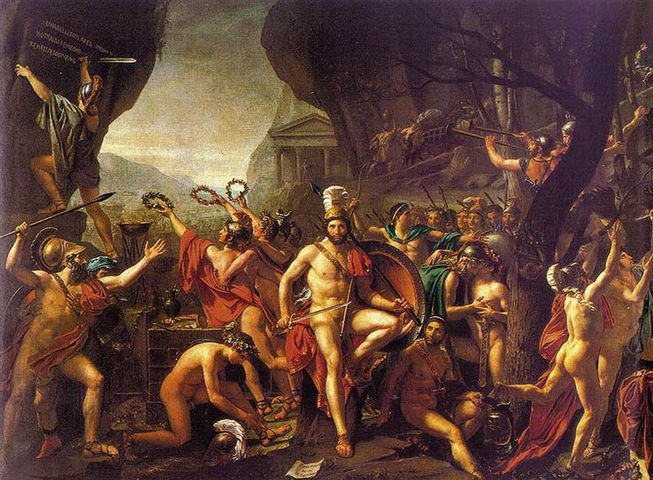
The Persian Wars
and
The Peloponnesian Wars

Slide 2
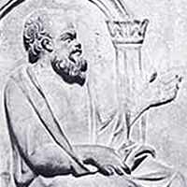
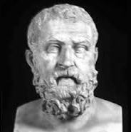
Democracy in Athens
Draconian Law Code 7th C. BC – very severe law code, death, exile and slavery for most crimes, supposedly written in blood (rumor propagated by Aristotle and others)
Draco – created Council of 400 to take power from Areopagus
Solon 630-558 BC established wealth-based democratic government open to all classes, repealed most of Draco’s laws, created juries and assemblies

Slide 3
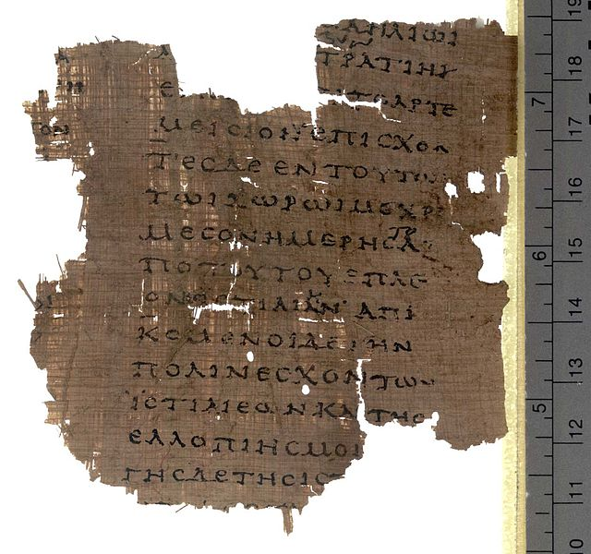
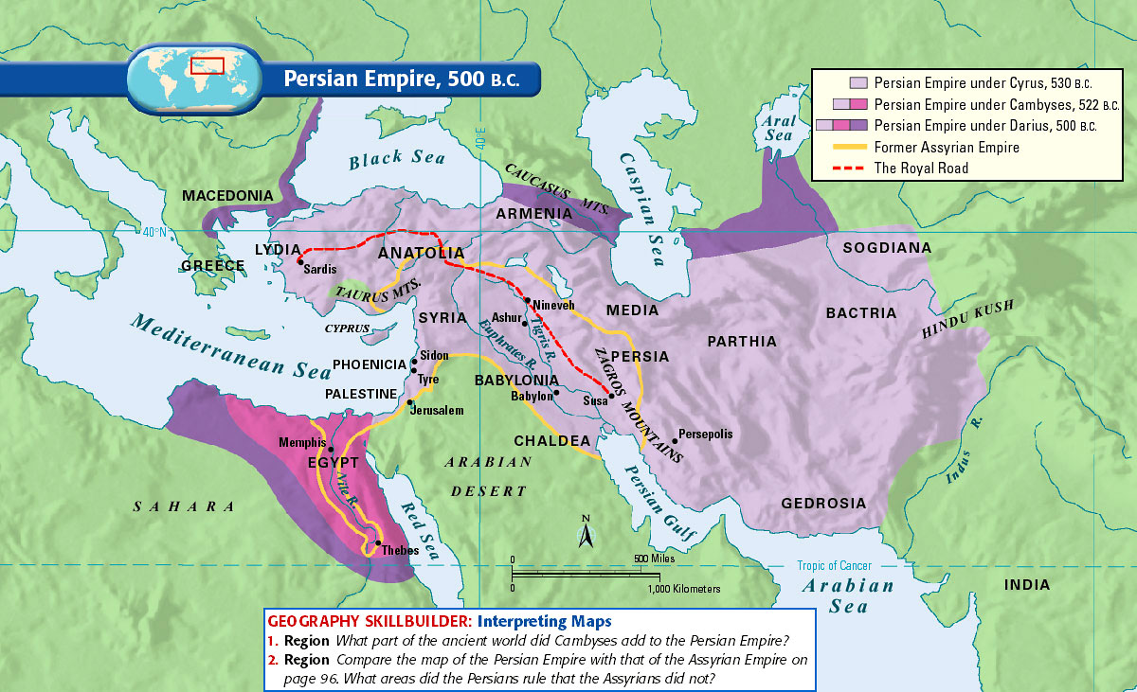
The Persian Wars, 492 – 448 BC
Acahemenid kings of Persia invade Greeks as punishment for Ionian Revolt
499-493 BC - Aristagoras incited all of Ionia to revolt against Persia, Athens and Eritrea supported Ionia
Herodotus, the father of history, only written account of Battles of Thermopylae, Marathon and Salamis, elaborate tellings
Later criticized by the Greek historian Plutarch

Slide 4
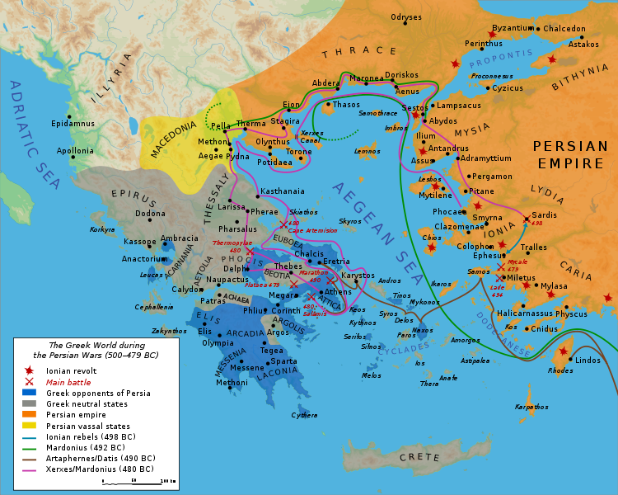
Battle of Marathon
Persia had sacked Eretria and intended to sack Athens for supporting Ionian Revolt
Darius I “The Great” of Persia preceded by Cyrus the Great and Cambyses
490 BC - Darius sent about 25,000 men to plains of Marathon
10,000 Athenians and 1000 Plataeans under Callinachus and Miltiades
Spartans delayed by Carneia peace festival
Herodotus wrote that the god Pan helped Athenians
First victory for Greeks

Slide 5
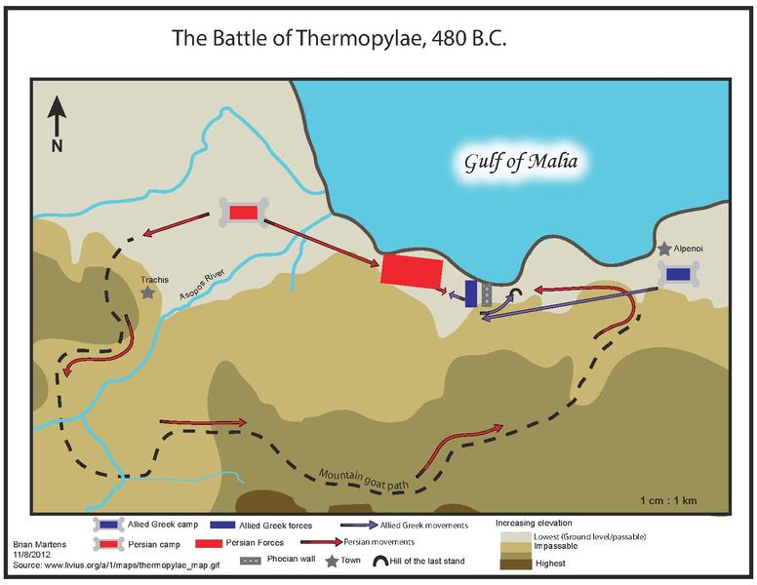
Battle at Thermopylae, 480 BC
Xerxes – King of Persia, son of Darius I
70,000 Persians crossed the Hellespont
Thermopylae name of the gates of a narrow pass
10,000 “Immortals” – Persian elite fighters led by Hydarnes
Themistocles led navy at Athens
Athens and Sparta form alliance
Leonidas I and 300 Spartans and 1000 Boetians
Naval battle at Artemesium fought at same time
“Come and take them!”
The traitor Ephialtes revealed a hidden path to the Persians
Persians win and go on to sack Plataea

Slide 6
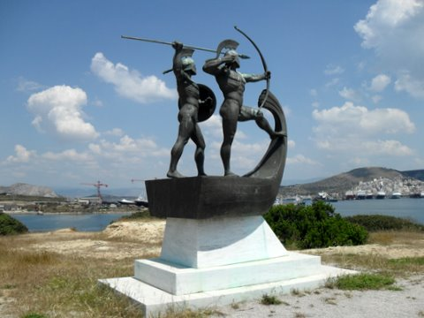
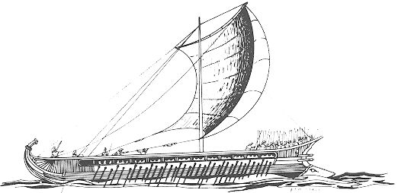
Battle of Salamis, also 480 BC
Athens evacuated after Thermopylae
Athens burned by Persians
Navy waiting around island Salamis
Themistocles’ trick
Confined waters around Salamis
Egyptians, Phoenecians, Ionian Greeks with Persians
40 Greek ships lost, 200 Persian ships lost
Queen Artemisia of Halicarnassus
"My men have become women, and my women men.“
Artemesia rammed one if its own ships so she could escape

Slide 7
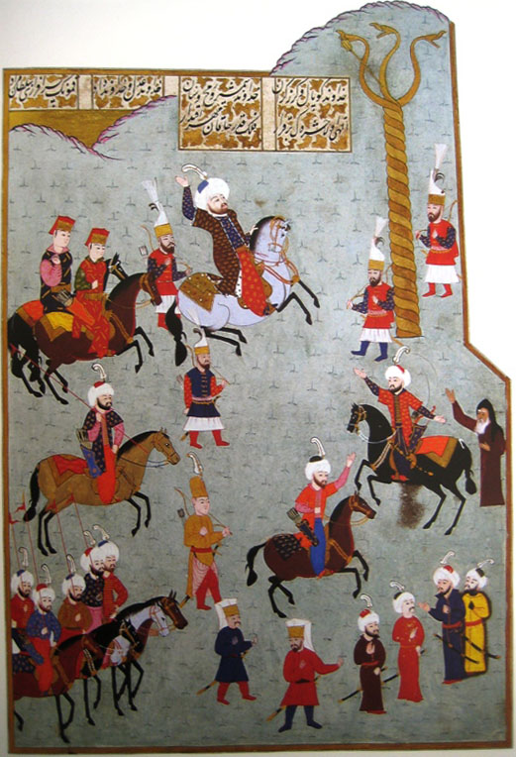
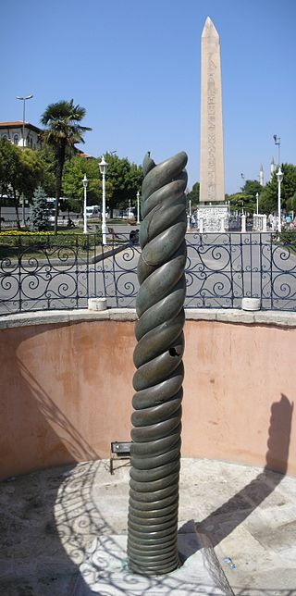
Battle of Plataea, 479 BC
Xerxes I had left a land army under Mardonius
Spartans and Athenians rode up
Lycurgus, the Spartan orator’s, oath about rebuilding temples
Met at isthmus of Corinth
Greeks led by half-blind Aristodemus
Mardonius fled
Sensing weakness, other regions then rebelled from Persia
Serpentine Column built from melted Persian weapons to commemorate victory
“Having brought all the loot together, they set apart a tithe for the god of Delphi. From this was made and dedicated that tripod which rests upon the bronze three-headed serpent, nearest to the altar.”
— Herodotus Histories 9.81.1

Slide 8
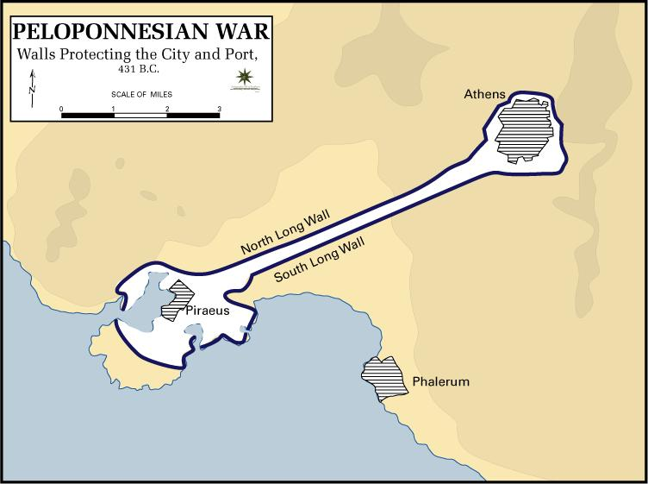
The Delian League, 478 BC
Ionian city-states joined for mutual protection
Treasuary on island of Delos, Aristides leads Athens
Athens in charge due to naval supremacy
Pericles leads Athens during Golden Age, moves treasury to Athens, his father was Xanthippus, a general during the Persian Wars
Parthenon, temple to Athena, built on Acropolis hill
Phidias
Long Walls built – 6 miles long, later destroyed during First Mithridatic War, 90 BC
Sparta captures Athens in 404 BC

Slide 9
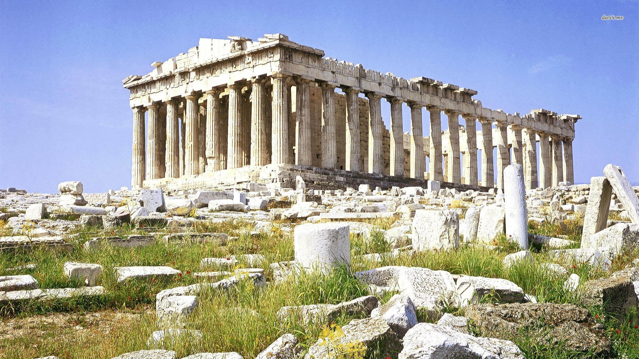
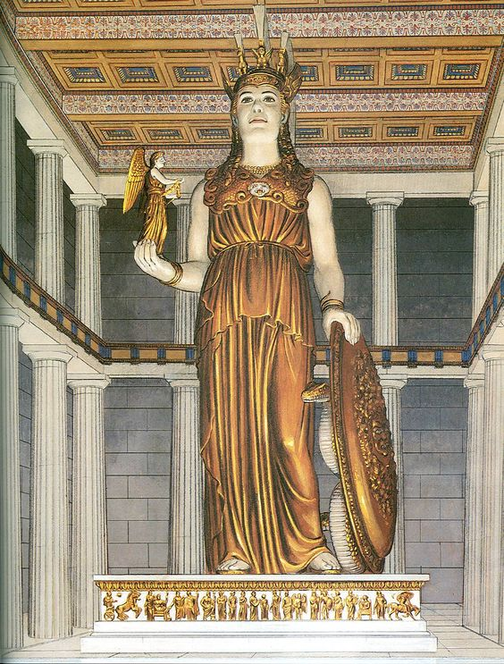
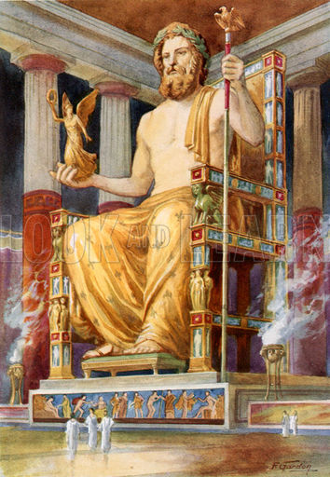
The sculptor Phidias
Artistic director of the Parthenon
The Elgin Marbles
Athena in the Parthenon made of ivory and gold
Zeus at Olympia

Slide 10
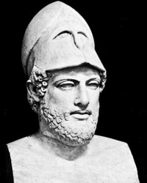
Peloponnesian Wars
Historian Thucydides
Three-stage war, begins in 431 BC between Athens and Sparta
429 BC – Pericles dies of plague
Most of Delian League sided with Sparta
404 BC – Sparta wins war with defeat of Athenian navy at Aegospotami by Lysander with help from Persia
Lysander installs 30 rulers at Athens, later known as the “30 Tyrants”, extremely strict

Slide 11
The Thirty Tyrants, 404 BC
Spartan hegemony – indirect imperial dominance
Long Walls destroyed – later rebuilt in 300s BC with help from Persia
Democrats exiled, oligarchy pro-Spartan appointed by Sparta led by Critias, only lasted 13 months
Council of 500 were the judiciary
Only 3000 Athenian had citizenship
Insurgents sentenced to hemlock including Socrates
Other city-states helped exiled democrats who retook Piraeus by force
Democracy restored in 403 BC
Battle of Leuctra 371 BC – Thebans over Spartans
Macedonians to the north notice power vacuum

Slide 12
Homer, the Blind Poet (1100-800 BC ?)
The Iliad
The Odyssey
Trojan War, sparked by kidnapping of Helen of Troy, wife of Menelaus, by Paris
Troy: Hector, Priam
Greeks: Agamemnon, Achilles, Patroclus, Odysseus, Ajax
Greeks sneak into city using wooden horse
Odysseus’ journey home
Wife Penelope and son Telemachos waiting in Ithaca, so are the suitors
Lotus Eaters
Cyclops
Laestrygonians
Circe
Sirens
Scylla and Charibdis
Odysseus and Telemachos kill all the suitors

Slide 13
Tossup
According to the Suda, this man died at a theater in Aegina, where he was suffocated by cloaks and hats thrown at him by adoring supporters.
This man was given power after Cylon was killed by Megacles in the sanctuary of a temple during a failed coup.
One of this politician's reforms stripped the power of the Areopagus and gave it to the Council of Four Hundred, which he created.
Aristotle claims that this man chose to (*) write not using ink, but rather blood.
He ended the system of blood feuds and oral laws by promulgating the first Athenian constitution, almost all of which was repealed by Solon, except for its statutes on homicide.
For 10 points, name this 7th century B.C. lawgiver whose namesake code was known for its severity.
ANSWER: Draco

Slide 14
Tossup
This ruler argues against Otanes and Megabyzus that monarchy is the best form of government in a passage of a major historical work called the "Constitutional Debate."
This ruler described his overthrow of the usurper Gaumata in a monument carved into the face of a cliff.
Ruling from Tachara Palace, he increased the number of Satraps to twenty-three.
This author of the Behistun inscription began the construction of Persepolis.
His expedition to crush Eretria following the Ionian Revolt was defeated by the Athenians at the Battle of Marathon.
For 10 points, name this Persian king, the father of Xerxes I.
ANSWER: Darius I [or Darius the Great]

Slide 15
Tossup
An army supposedly set sail for this battle after a traitor signaled them by flashing a shield in the sun.
Before this battle, a general gave a speech beginning "With you it rests" to convince a colleague to break a five-to-five vote to fight or flee.
Because this battle coincided with the Carneia festival, the Spartans did not participate in it.
The polemarch Callimachus died at this battle, which was part of a campaign to punish Eretria and another city for supporting the Ionian revolt.
Herodotus claims that after this battle, the messenger Pheidippides carried the news that Miltiades had defeated the forces of Darius the Great.
For 10 points, name this 490 BCE battle that gives its name to a 26.2-mile race.
ANSWER: Battle of Marathon

Slide 16
Tossup
One feature at the site of this battle was discussed in a 1980 paper by Paul W. Wallace; that paper discredited starting locations for that feature here such as the Damasta Spur, the Chalkomata Spring, and the Asopos Gorge.
That feature at this battle was determined to have started at Vardates and was abandoned by 1000 Phocians seeking to defend their homeland when they caught sight of troops led by Hydarnes.
That feature at this battle allowed the victors to (*) outflank a nearby defending army that was entirely withdrawn except for a rearguard that included 700 Thespians.
At this battle, Ephialtes, a traitorous resident of Trachis, revealed a hidden goat path in the mountains to forces under a frustrated Xerxes II.
For 10 points, name this battle which was fought at the same time as Artemisium, where the namesake gates were the site of a last stand by the Spartan King Leonidas.
ANSWER: Battle of Thermopylae [or the Hot Gates of Thermopylae; prompt on Hot Gates; prompt on Malis]

Slide 17
Tossup
Before this battle, a many civilians were relocated to Troezen, and the result of the battle of Mycale completed the efforts of one side during this battle.
Artemisia of Caria used friendly fire in order to escape during this battle, during which one side's center successfully broke through the others after killing their commander.
The three lines used by one side quickly dissolved against a force of Allied triremes.
A throne was erected on Mount Aigialos for this battle, which saw the vindication of Themistocles's belief in sea power.
For 10 points, name this 480 BC naval battle in which a Persian fleet from Xerxes's invasion force was decisively defeated in narrow straits by an alliance of Greek city-states.
ANSWER: Battle of Salamis

Slide 18
Tossup
This man's father, Xanthippus, served as naval commander during the Battle of Mycale, and this man provoked conflict with his economic sanctions against the city of Megara.
One building project began by this man resulted in the imprisonment of Phidias, although a display of emotion by this man resulted in his lover Aspasia being acquitted.
He crushed a revolt on Naxos, and moved the treasury of the Delian League to his own capital city.
For 10 points, name this Athenian statesman who was responsible for the construction of the Parthenon and who died of the plague during the Peloponnesian War.
ANSWER: Pericles

Slide 19
Tossup
This man tells of a "boar of monstrous size" which ravishes some fields before killing the son of Croesus.
Later on he describes the fall of Croesus and his kingdom, and one of his works concludes with the defeat of Mardonius at Plataea.
A contemporary of Pericles, his critics included Plutarch, who wrote On the Malignity of [this man], and Thucydides, but Cicero praised him.
Providing the only written account of Thermopylae, Salamis, Marathon, and the rest of the Greco-Persian Wars, For 10 points, name this first ancient Greek historian.
ANSWER: Herodotus

Slide 20
Tossup
Plaster casts represent these objects in a 2009 building designed by Bernard Tschumi, on a top floor askew from the other floors.
The only record of the firman authorizing the transportation of these objects is in Italian.
Some of these objects sank in the ship Mentor before being recovered two years later by Thomas Bruce, an ambassador to the (*) Ottoman Empire.
In June 2013, UNESCO's ICPRCP was asked to mediate a dispute over these objects that had been reignited by Melina Mercouri.
Amal Alamuddin Clooney is a lawyer involved in a dispute regarding these objects, which often invokes the concept of the "universal museum."
For 10 points, name these sculptures in the British Museum that were removed from the Parthenon frieze by their namesake Scottish nobleman.
ANSWER: Elgin Marbles [prompt on "Parthenon sculptures" or "Parthenon frieze"]

Slide 21
Tossup
This body achieved an important victory at the Eurymedon River and drove Pausanias out of Byzantium on accusations of Medizing.
It is contested that this body perpetrated the first genocide against the residents of Naxos and forced Carystus into membership.
It sent cleruchies to the islands of Scyros and the city of Eion and its finances were controlled by hellenotamiai.
After the failure of Alcibiades' campaign, support began to waver, and it was disbanded after the defeat of Aegospotami.
Centered on an island that was the site of the Temple of Apollo, for 10 points each, name this league of "states," effectively an Athenian Empire.
ANSWER: Delian League (prompt on anything to do with Athens)

Slide 22
Tossup
A lesser-known group of this name was written about by Trebellius Pollio and was said to exist during the reign of the Roman emperor Gallienus.
They were established by the decree of Drakontides of Aphidna during the archonship of Pythodoros and the failed campaign to restore them by Pausanias followed their being driven out by Thrasyboulos.
Their deeds included the murder of one of their own by hemlock for lack of ruthlessness and the removing of the laws of Ephialtes from the Areopagus.
FTP, name this group including Theramenes and the author of Sisyphus and uncle of Plato, Critias, established in Athens after the Battle of Aegospotami by Lysander; a group named for the quantity of men involved.
ANSWER: Thirty Tyrants

