Slide 1
1930s – 40s
Hitler, Mussolini, Mao, Stalin, WWII

Slide 2
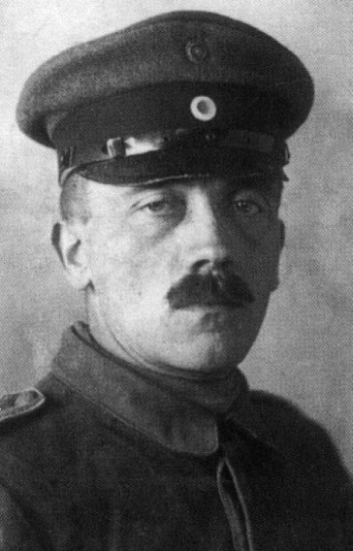
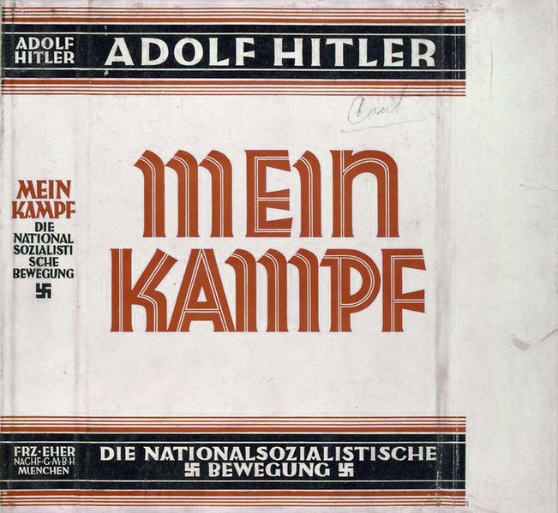
Rise of Adolf Hitler
1889 – Hitler born in Austria-Hungary
1909-1913 – poor artist in Vienna
1914-1918 – fights in WWI, wounded at Battle of the Somme, did cartoons for army newspaper
Weimar Republic 1919-1933 – replaced German Empire post WWI, president Hindenburg (WWI general)
1920 – heads propaganda at National Socialist German Workers Party, anti-Versailles
1923 – Beer Hall Putsch - failed attempt to seize power in Munich, Bavaria, 9 months in jail, writes Mein Kampf
1930s – high unemployment, global economic troubles

Slide 3
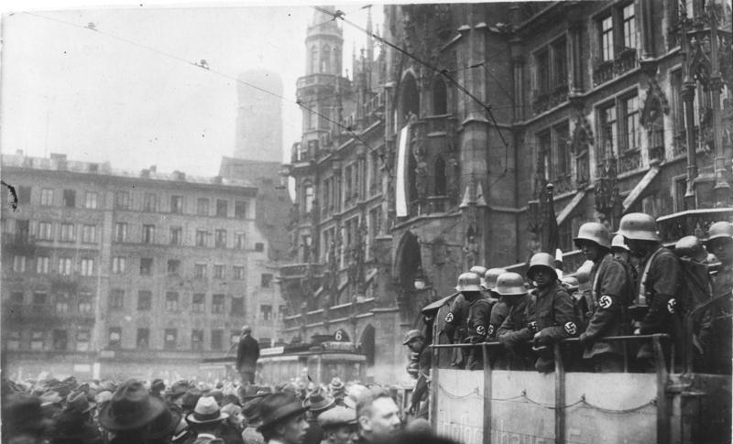
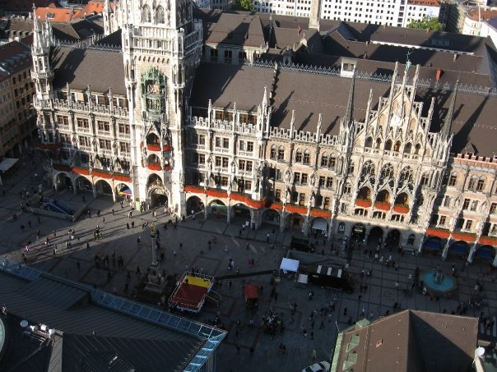
Marienplatz, Munich
Then
Now

Slide 4
More Hitler, Nazi Power Grows
1931 – loses presidential election to Hindenburg, Nazis 2nd largest party in Germany
1933 – chosen by Hindenburg as chancellor of coalition government
Reichstag – German parliament building, destroyed by fire, prob. Nazis, communists blamed
1933 Enabling Act – legislative powers to Hitler without parliament
All other parties, trade unions, strikes banned
Withdraws from League of Nations, military buildup
1934 – Night of the Long Knives
1934 President Hindenburg dies, office of president abolished, Hitler made Fuerher
1938 – Anschluss
Munich Agreement – Chamberlain PM, permitted annexation of Sudentenland
Kristallnacht – pogrom, Nov. 9-10, 1938

Slide 5
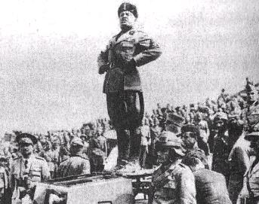
Rise of Benito Mussolini
Born 1883
Originally socialist
Supported WWI
1919 – formed Fascist Party
1922 – Black Shirts march on Rome
King Victor Emmanuel III invites Mussolini to form a government
1925 – makes self dictator “Il Duce”
1935 – invades Abyssinia
1939 – Pact of Steel with Hitler
Supported Francisco Franco in Spain

Slide 6
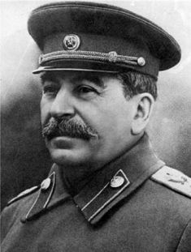
Joseph Stalin
Born 1879
1902 – exiled to Siberia, escapes in 1904
1905 – Nicholas II creates the Duma
Stalin and Lenin meet at Bolshevik conference
1912 – Stalin appointed to Bolshevik central committee
1917 – October Revolution
1918-1920 – Stalin commands Red forces
1922 – USSR born, Stalin made General Secretary
1924 – Lenin dies
Leon Trotsky – founder of Red Army, exiled by Stalin
1934-1938 – The Great Terror, “Show Trials”
1940 – Trotsky assassinated in Mexico

Slide 7
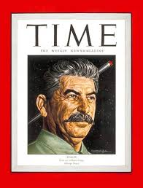
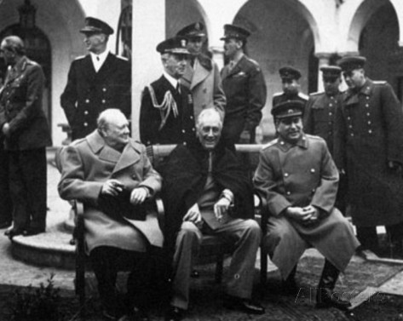
WWII Summary (Europe)
September 1, 1939 – Germany invades Poland, USSR gets half
1940 – Denmark, Holland, Norway, Belgium, France
1941 Operation Barbarossa – invasion of USSR
Dec. 7, 1941 Pearl Harbor
1943 – German retreat from Stalingrad
1944 – Valkyrie, Col. Stauffenberg (Tom Cruise)
D-Day – Eisenhower
Bombing of Dresden – not militarily significant, cultural center, 700 bombers, 20,000 killed
Battle of the Bulge
1943 – Mussolini overthrown, Italy signs armistice
1945 – Mussolini shot by Italian partisans
May 8, 1945 – Germany surrenders
Tehran, Yalta, Potsdam Conferences

Slide 8
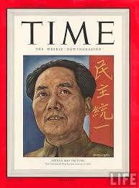
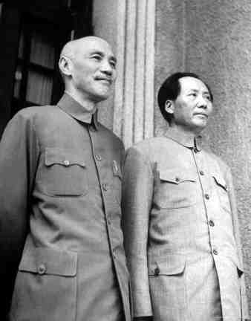
Mao
1893 – Born to farmers
New Youth Magazine
1920 Beijing University – read Communist Manifesto, worked for Communist party
1927 – Chiang Kai-Shek’s White Terror (KMT)
Japan invades Manchuria – Emperor Pu Yi
1927 – 1934 - Jiangxi soviet, Mao’s HQ until overrun by KMT
1934 – 1935 – The Long March, lost many, Mao’s prestige grew
1937 – Marco Polo Bridge Incident – start of 2nd Sino-Japanese War
Rape of Nanking
Flying Tigers – USA air force in China

Slide 9
The Long March

Slide 10
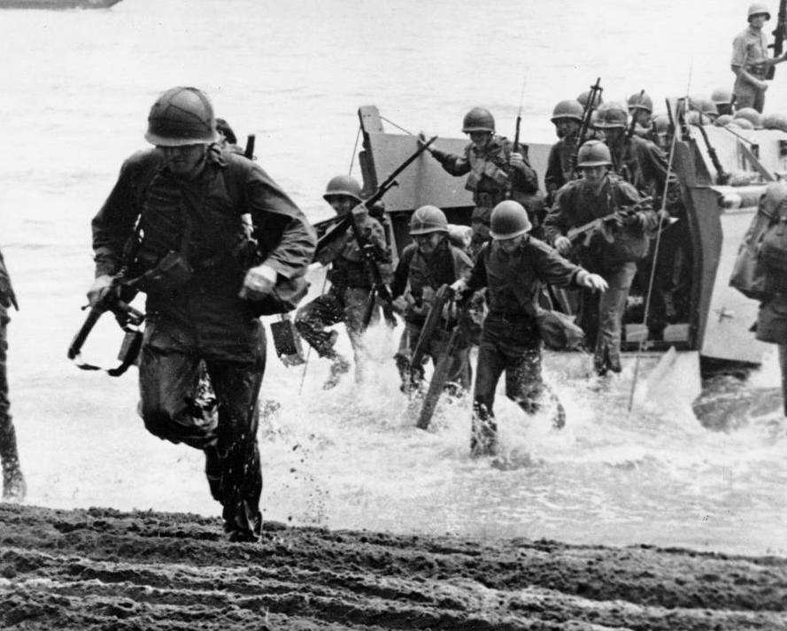
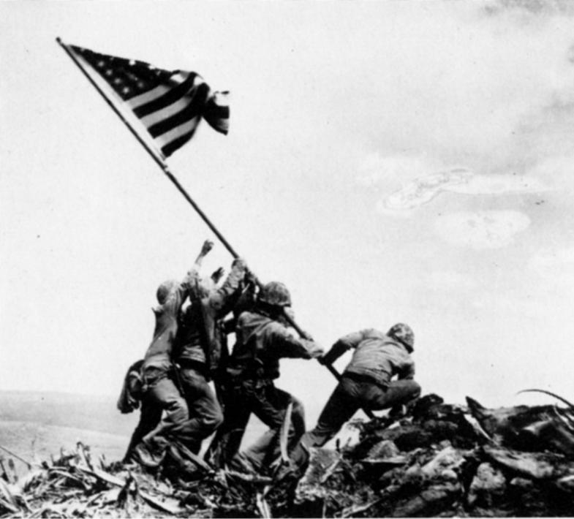
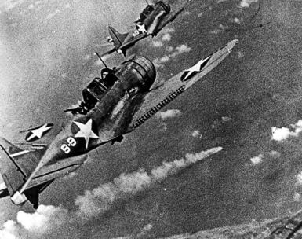
Pacific Theater
Emperor Hirohito and Gen. Tojo
Pearl Harbor – Admiral Yamamoto
Battle of Coral Sea
Midway – turning point, Yorktown
Island Hopping
Guadalcanal
Iwo Jima – Marines raising flag
Doolittle Raids – bombers landed in China
Hiroshima and Nagasaki – Aug. 6 and Aug. 9
Enola Gay - “Little Boy”
Bockscar - “Fat Man”

Slide 11
Movies and Books
Tora Tora Tora! – Pearl Harbor
Midway – turning point in Pacific
Valkyrie – assassination attempt of Hitler
The Longest Day – D-Day, John Wayne
Patton – USA vs. Rommel
Enemy at the Gates – Stalingrad
Pearl Harbor – Doolittle raids, Ben Affleck
The Rape of Nanking
Guadalcanal Diary

