Slide 1
Early 20th C and WWI

Slide 2
Map of Europe 1914

Slide 3
Origins of the Assassination of Archduke Franz Ferdinand
Austria
Hungary
Since Middle Ages – quasi-indpendent in HRE
1526 – Battle of Mohacs – Hungarian crown transferred to Hapsburg Dynasty
1806 – HRE abolished, Austrian Empire created
1866 – Austro-Prussian War
1867 – Compromise with Hungary (now Austro-Hungarian Empire)
Outside HRE
1526 – Battle of Mohacs – Ottomans occupy Hungary (crown transferred)
Personal union until 1806
1848 – failed Hungarian Rev. (Magyars)
1867 Compromise – separate PMs and govts, one monarchy
Other minorities ignored: Czechs, Romanians, Serbs, etc.

Slide 4
Flag of Austro-Hungarian Empire

Slide 5
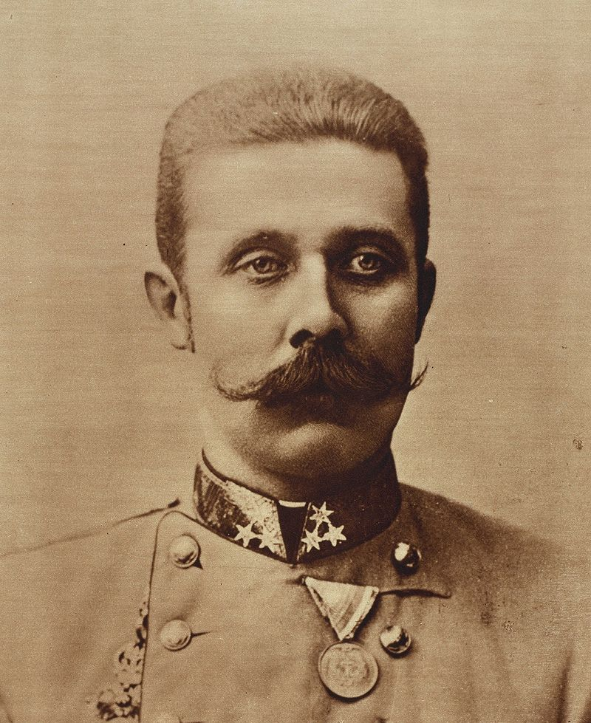
Quote from heir Archduke Franz Ferdinand
"irredentism in our country ... will cease immediately if our Slavs are given a comfortable, fair and good life“
According to Foreign Minister Berchtold, in ten years, Ferdinand would have replaced the dual monarchy with supranational federation

Slide 6
Setting the stage
1871 Treaty of Frankfurt – ended Franco-Prussian War, est. French Third Republic and German Empire, France lost land to Germany
1878 Treaty of San Stefano – ended Russo-Turkish War, Ottomans weakened
1878 Treaty of Berlin – at Congress of Berlin, revised San Stefano, granted independence from Ottomans for Bulgaria, Romania, Serbia, Montenegro
Slavs happy, Austria-Hungary weaker, Ottomans weaker
Russia allies with France, fearing Germany
Triple Entente – UK, France, Russia
Central Powers – Germany, Ottomans, Austria-Hungary, Bulgaria (aka Quadruple Alliance)

Slide 7
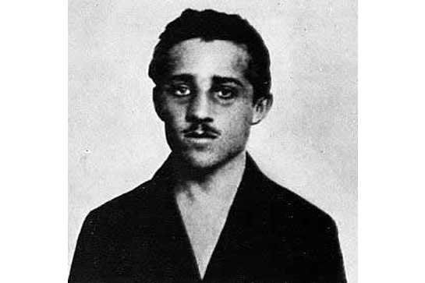
Assassination of Archduke Franz Ferdinand, July 23, 1914
Heir to throne of Austria-Hungary
Importance of Bosnia to Serbs
Sarajevo – capital of Bosnia (Winter Olympics in 1984)
The Black Hand – extreme Serb group
Gavrilo Princip - Bosnian Serb and Yugoslav nationalist, member of Young Bosnia, recruited by BH
"I am a Yugoslav nationalist, aiming for the unification of all Yugoslavs, and I do not care what form of state, but it must be freed from Austria.“
Seven conspirators: first chickened out, second failed, others prevented by heavy crowds
Ferdinand wanted to visit hospital, driver took wrong turn, Princip happened to see car by coffee shop

Slide 8
Domino Effect
July 23 - Austrian ultimatum to Serbia
Serbia appealed to Russia for help, Russia mobilizes military
July 28 – Austria-Hungary declares war on Serbia
August 1 – Germany delcares war on Russia and France, invades France through neutral Belgium
UK delcares war on Germany

Slide 9
Fighting
The Schlieffen Plan – quickly defeat France, then turn attention to Russia
1914 First Battle of the Marne – saved Paris from being overrun, reinforcements in taxicabs, Schilieffen Plan abandoned
Trench warfare
1916 Verdun – Phillippe Petain French national hero, 10-month long battle
1916 The Somme – tanks introduced
Stalemate on both fronts
1917 – Bolshevik govt of Russia pulls out of war
Baron von Richtofen “The Red Baron (Snoopy) – 80 kills

Slide 10
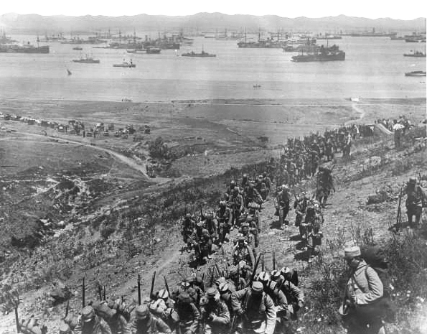
Elsewhere
Dardanelles and Gallipoli Campaign 1915-16 – Britain invaded Gallipoli Peninsula against Ottomans
ANZAC – Australian and New Zealand troops
Churchill – 1st Lord of the Admiralty pushed for attack, campaign failed
Battle of Jutland May 1916 – ended German attacks on naval blockade (battleships)
1915 – Lusitania sunk by German u-boat
USA – Zimmerman Telegram, joins in 1917
Gen. Pershing “Black Jack”

Slide 11
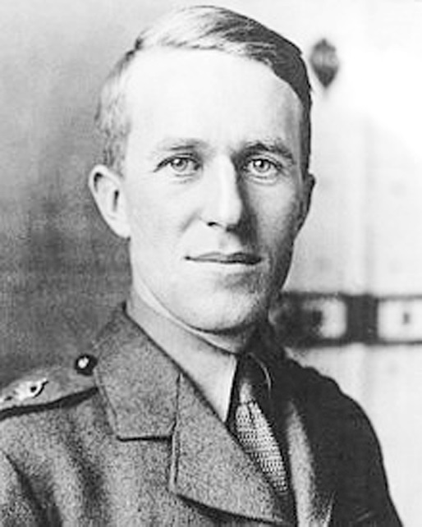
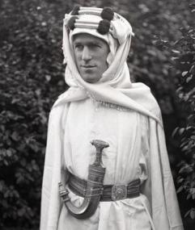
Late Stages and Armistice
Germany focuses on Western Front after Bolshevik Revolution
March 3, 1918 – Treaty of Brest-Litovsk, Russia loses big
July 15, 1918 2nd Battle of the Marne – last big German offensive, includes USA, UK, turning point
British-encouraged Arab revolt led by T.E. Lawrence weakened Ottoman Empire
Nov. 11, 1918 – Armistice signed in Compiegne, France by UK, France, Germany

Slide 12
Legacy
9 million soldiers killed
20 million wounded
10 million civilian casualties
Increased ethnic nationalism
Four imperial dynasties fell (German, A-H, Ottoman, Russian)
1919 Paris Peace Conference – Treaty of Versailles, Wilson’s 14 points, League of Nations
German resentment
Trench warfare, mustard gas, mass casualties as never before

Slide 14
Movies and Books Set During WWI
Books
Movies
All Quiet on the Western Front – Nobel Prize winning book by Remarque, also a movie
A Farewell to Arms – Hemingway, Nurse Barkley, Single Players Handbook (film) scene includes the book
War Horse - film
Lawrence of Arabia – young Peter O’Toole, 4 hours long
Gallipoli – young Mel Gibson, Australians in Gallipoli Campaign
Hell’s Angels – Howard Hughes
Wings

Slide 15
Post WWI: Birth of Modern Turkey
Chaotic leftover – army remnants, Brits in Levant, French and Greeks cross into Asia
1920 Treaty of Sevres – carved up Levant for UK and France, Greeks get eastern Thrace and western Anatolia, Armenians and Kurds given autonomous lands
Mustafa Kemal Ataturk – 1st president of Grand National Assembly, nationalists
Turks defeat Greeks, reclaim eastern Thrace and Constantinople
1923 - Treaty of Lausanne, Ataturk becomes 1st president
Hemingway in Thrace at the time

Slide 16
Deterioration of Ottoman Empire

Slide 17
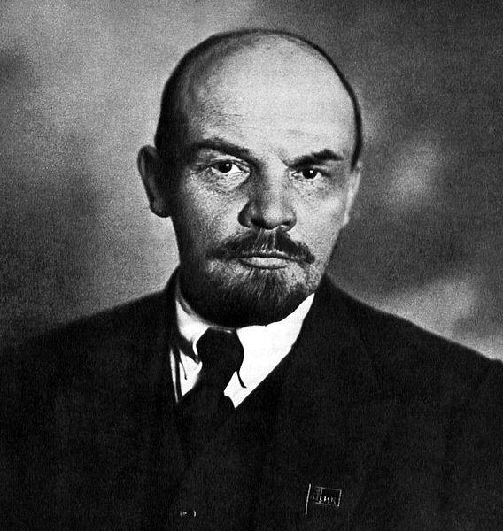
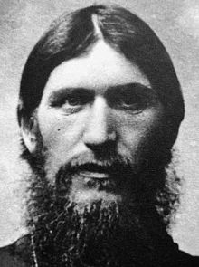
The October Revolution 1917
Rasputin – advisor to Tsarina Alexandra
March 1917 – Tsar Nicholas II abdicates
The provisional govt - Kerensky, soviets
Royal family moved to house arrest
Constituent assembly planned for November
Bolsheviks vs. Menschiviks
Vladimir Lenin – Bolshevik, published in western Europe
September 1917 – Bolsheviks gain majority in soviets in Moscow and Petrograd
October 23 – newspapers closed
October 24 – Bolshevik army takes city
October 25 – Kerensky flees
The Cheka – police wing of Bolsheviks, Red Terror

Slide 18
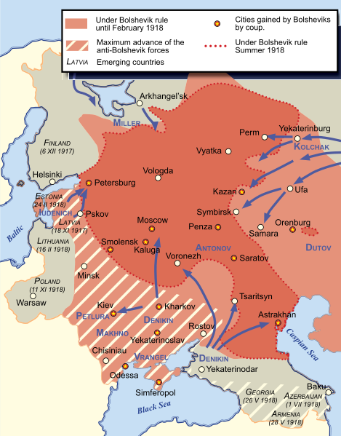
The Russian Civil War 1918-1920
Treaty of Brest-Livotsk March 1918 (Finland) – pulled out of WWI
Nicholas II, Tsarina Alexandra, Alexei, Olga, Tatiana, Anastasia arrested
Hemophilia - Alexei
April 1918 - The Royal Family moved to Yekaterinburg
White Army versus Red Army
White Russians gaining ground
July 16 – family and servants executed in basement
Civil War over by 1920
Polish-Soviet War 1919-1921– Treaty of Riga

Slide 19
After Treaty of Riga

