Slide 1
Early 20th Century Latin America
South American Independence and the Mexican Revolution

Slide 2
Spanish Colonies around 1700

Slide 4
Independence Days
1804 – Haiti (France)
1809 – Ecuador (Spain)
1810 – Mexico, Chile, Colombia (Spain)
1811 – Paraguay, Venezuela (Spain)
1816 – Argentina (Spain)
1821 – Costa Rica, Honduras, El Salvador, Guatemala, Peru, Nicaragua (Spain)
1825 – Bolivia (Spain), Uruguay (Brazil)
Why these dates?

Slide 14
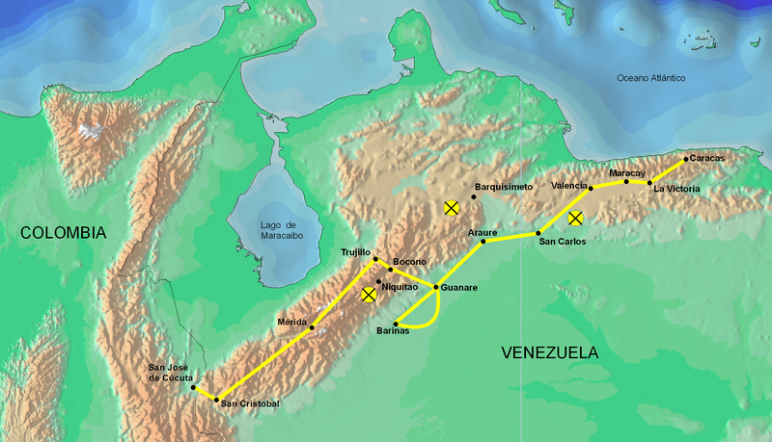
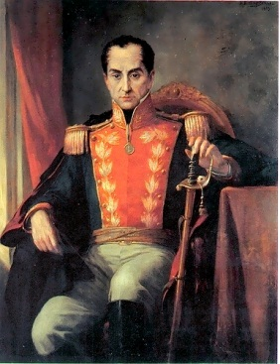
Simon Bolivar, the Liberator of S. Amer
1783-1830, born in Caracas (Venezuela)
Left S.A. for France, witnessed coronation of Napoleon
Juntas
June 1813 - The Admirable Campaign against Spain
The Decree of War to the Death (Trujillo)
Teamed with Jose de San Martin in Peru
Bolivia named after him
Liberated Venezuela, Gran Colombia, Ecuador, Peru, Bolivia, New Granada

Slide 15
Quotes from the Decree of War to the Death
May the monsters that infest Colombian soil, and have covered it with blood disappear for good; may their punishment be equal to the magnitude of their treason, so that the stain of our ignominy is washed off, and to show the nations of the universe that the sons of America cannot be offended without punishment.
All Spaniards who do not conspire against tyranny in favor of our just cause, using the most effective and active resources, will be considered enemies, and will be punished as traitors to the homeland, and therefore, will be promptly executed
Spaniards and Canarians, count on death, even if indifferent, if you do not actively work in favor of the independence of America. Americans, count on life, even if guilty.“
(“America” means the South American continent)

Slide 17
Gran Colombia after liberation
1828 – Constitutional Convention in Gran Colombia
Federalists unhappy with proposal
1830 – resigned, later died of TB
1831 – GC Federation abolished, Ecuador, Venezuela, and New Granada become independent states
1886 – NG becomes United States of Colombia
1899-1902 – Thousand Days’ War between liberals and conservatives of US of Colombia
USA supported conservatives
Treaty of Wisconsin

Slide 18
Colombia, Ecuador, Venezuela

Slide 19
Gabriel Garcia-Marquez, Colombian novelist, 1950s-1960s
One Hundred Years of Solitude
No One Writes to the Colonel
Magical realism
Seven generations (100 years) of the Buendia family after patriarch Jose builds Macondo after a dream
Unusual events in the town
Ghosts
Many misfortunes to the family
Deciphering the encryption
Veteran colonel waiting for pension
Attends funeral of town musician who died of natural causes
Set during La Violencia of Colombia 1948-1958

Slide 20
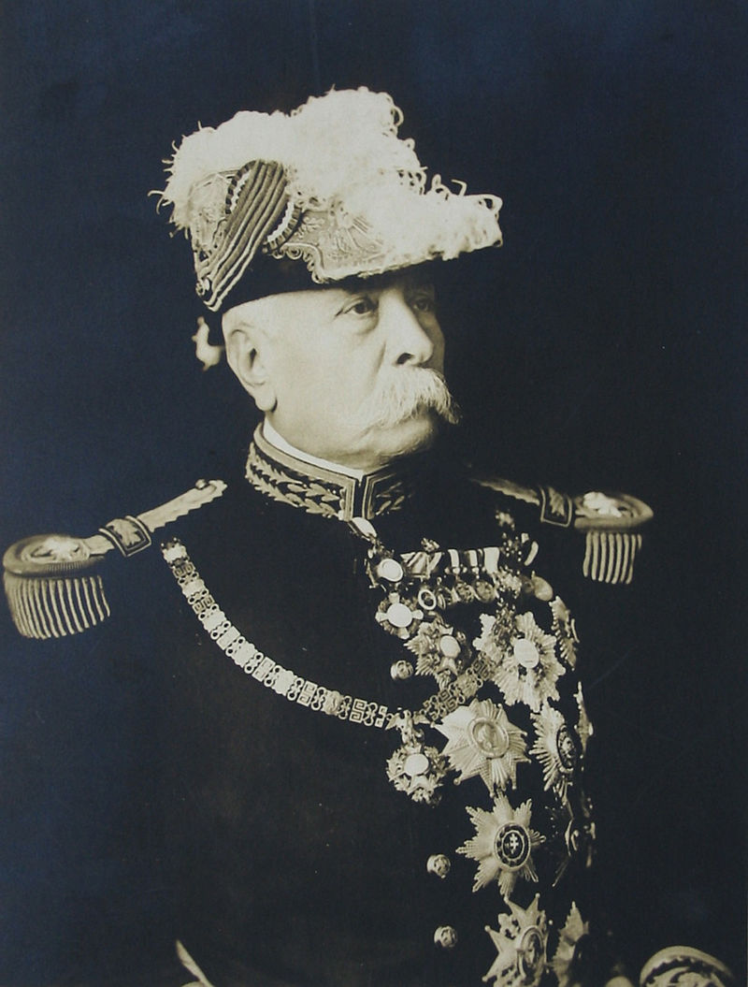
Portofirio Diaz
Portofirio Diaz – president for 35 years, “Porfiriato”
Fought against French in 1860s
Offered positions by Maximilian, declined
Unhappy with Juarez administration, civil war
After Juarez died, Diaz used rebel military to occupy Mexico City
1877 – became president, amended constitution to remove all restrictions on re-election
1911 – Diaz ran against Madero, voter fraud, people rose up and Diaz forced from office, went into exile in France, died there

Slide 21
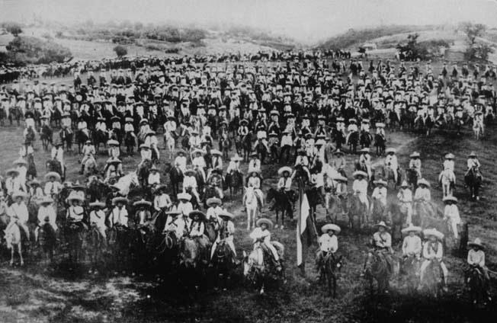
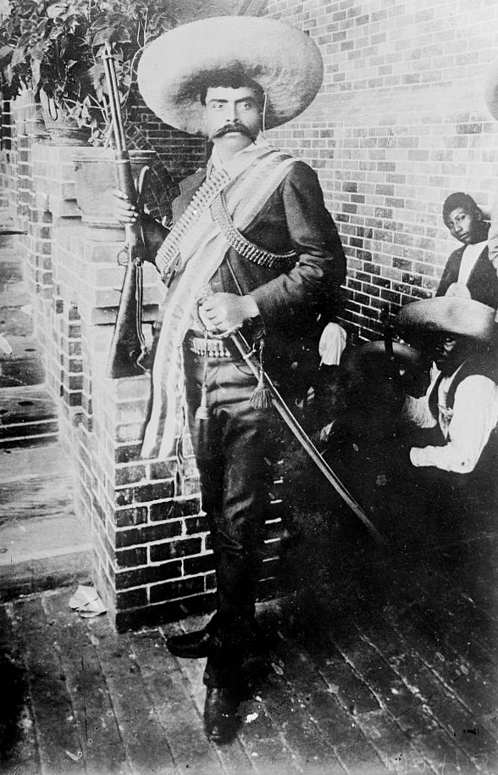
The Mexican Revolution
Madero atttracted support of anti-Diaz rebel leaders
Pancho Villa – guerilla fighter along Rio Grande
Emiliano Zapata – champion of peasant farmers
Madero administration 1911-1913 a failure, factions broke out all over Mexico
1914 - Ypringa Incident – USA arms embargo on Huerta administration 1913-14, German boat Yrpinga brought arms to Mexico, blocked by Amer. Navy (illegal), later allowed to pass

Slide 22
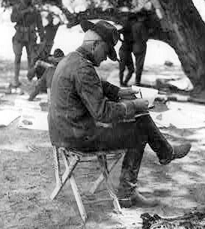
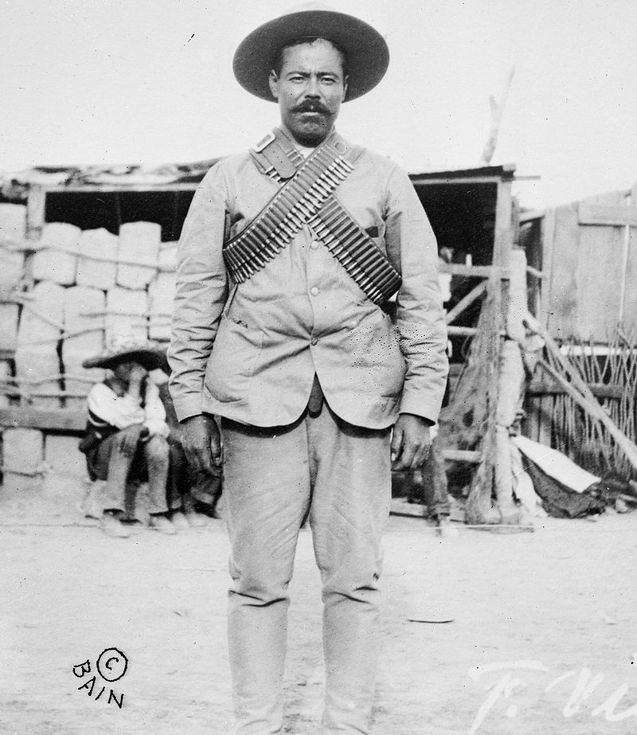
American Involvement in Mexico
Border War
US supported Pres. Carranza (Constitutionalist and former supporter of Madero) who ousted Huerta
1916 – Pancho Villa (anti-Carranza) raids Columbus, NM
Pancho Villa Expedition – Wilson sends Gen. “Black Jack” Pershing to track down Pancho Villa, many battles but never got him

Slide 23
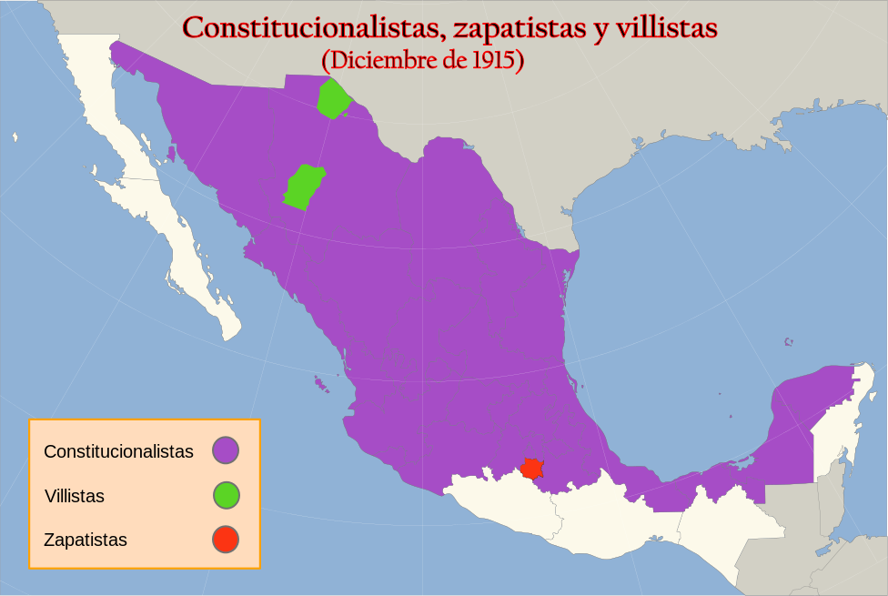
Mexico, 1915

