Slide 1
Napoleon Bonaparte

Slide 2
Overview of Coalition Wars
1st Coalition – Austria-Hungary, Prussia, GB 1792-1797, ended by Campo Formio
2nd Coalition 1798-1802 – Russia, Austria-Hungary, GB
1801 – Treaty of Luneville - Austria
1802 – Treaty of Amiens - GB
3rd Coalition 1803-1805 – GB, Austria, Russia

Slide 3
Rise to Power
1799 – First Consul
1800 – crosses Alps into northern Italy
1801 – Treaty of Luneville ends 2nd Coalition
1802 – Constitution of Year X – Napoleon 1st consul for life (revolution in Haiti)
1803 – Gives up on N. America, sells Louisiana Territory

Slide 4
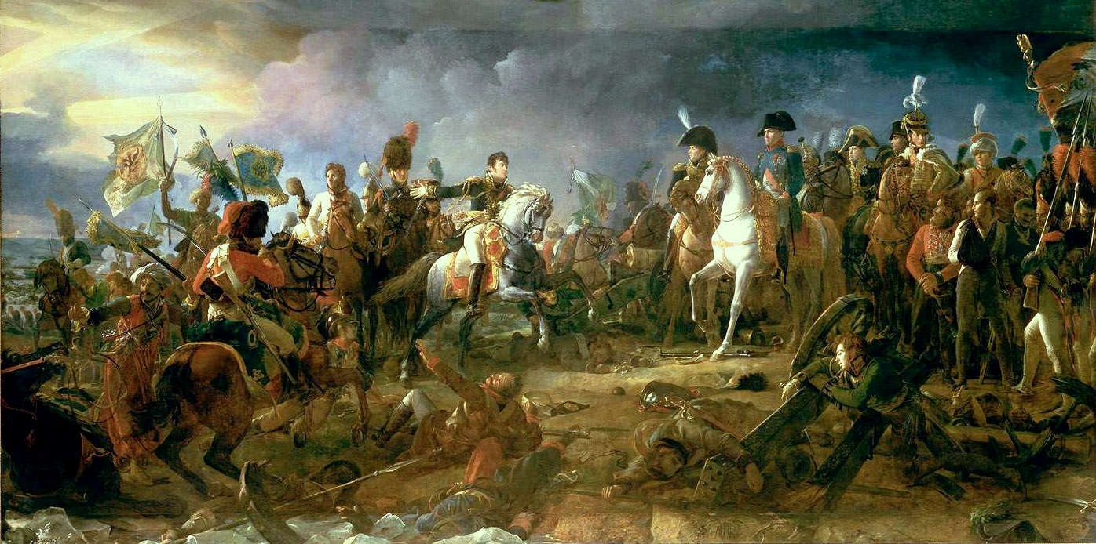
War of Third Coalition
May 1803 – UK (now including Ireland) declares war
Napoleon crowns self emperor, Napoleon I
1805 3rd Coalition – Austria, Russia join UK
October 1805 – Battle of Trafalgar, French navy destroyed (Nelson dies), near Gibraltar
Battle of Ulm – harvest season, defeats Austrians
Battle of Austerlitz – defeats Russ./Aust., end of 3rd Coalition, France gains Italy, Bavaria
HRE renamed Confederation of the Rhine

Slide 5
Map of Dominance

Slide 6
War of Fourth Coalition
Arc de Triomphe – commemorated victory at Austerlitz
1806 – Prussia (Frederich Wilhelm III) declares war on France; UK, Russia join in
October 1806 – Battle of Jena Aurstadt
Feb. 1807 – stalemate at Eylau
June 1807 – defeats Russians (Tsar Alexander I)
July 1807 – Treaties of Tilsit

Slide 7
Consolidation of Power
Treaty of Tilsit – carves up Prussia, western portion (west of Elbe) becomes Kingdom of Westphalia under Jerome (relative), Duchy of Warsaw also taken from Prussia
“friends” with Alexander I
Nov. 1807 – Continental System – embargo against UK
Napoleon and Charles IV (Spain) invade Portugal (won’t join system)

Slide 8
Peninsular Campaign, 1808-1809 Weaknesses
March 1808 – French occupy Madrid and Charles IV steps down
May 1808 – popular uprising in Madrid and all over Spain
Appoints brother Joseph as king of Spanish Empire
Guerrilla warfare hurts French in Spain, retreat from Madrid
Feb. 1808 – French occupy Papal States (not in system)
Dec. 1808 – retaking of Madrid
1809 – Austria declares war, 5th Coalition, Napoleon leaves to fight Austria, 300,000 troops left in Spain
August 1809 – Arthur Wellsley (UK) force French out of Portugal
Independence movements in Americas
France annexes Papal States
Pope Pius VII excommunicates Napoleon, 1809 – Pope abducted

Slide 9
Third of May, 1808 by Francisco Goya

Slide 10
Napoleon and Russia
1811 – Russia leaves continental system
1812 – rumors that Russia will attack Warsaw
April 1812 – Napoleon invades first with 450,000
The weather
“Scorched earth” tactics
Sept. 1812 – Battle of Borodino, 35,000 casualties
Moscow – deserted, burned, no food
10,000 made it back to Poland

Slide 12
Menard’s Map, 1869

Slide 13
The 6th Coalition
Encouraged by what happened in Russia
GB, Russia, Prussia – amassed 1 million in the German confederation
Napoleon down to 400,000 total
May 1813 – Napoloen wins Lautzen, Bautzen
August 1813 - Dresden
October 1813 – Austria, Sweden, Spain, Portugal join coalition
Battle of Leipzig – 600,000 versus 200,000, Napoleon retreats

Slide 14
6th Coalition, cont.
Wellsley pushing up through Spain
Six-Day Campaign
March 1814 – Russians march into Paris
April 1814 – dissension among generals, Napoleon forced to abdicate (Treaty of Fontainebleu), exiled to Elba
Coalition makes Louis XVIII king of France (brother of Louis XVI)

Slide 15
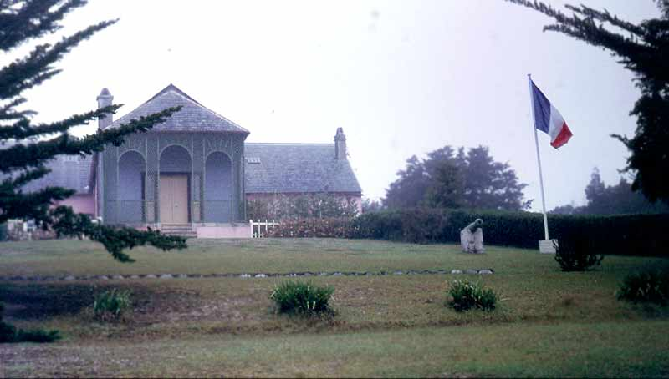
The Hundred Days
French morale low
After 10 months in Elba, he leaves
Turns the army sent to capture him
Louis XVIII escapes Paris
The Hundred Days: March 1815 – July 1815
Attacks British/Prussians at Waterloo, Belgium and loses, surrenders to British
Exiled to St. Helena

