Slide 1
East Asia 1900-1927
Canals, Boxer Rebellion, Russo-Japanese War, End of Imperial China

Slide 2
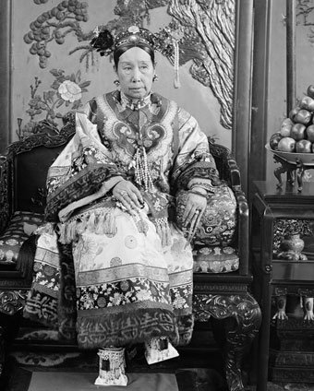
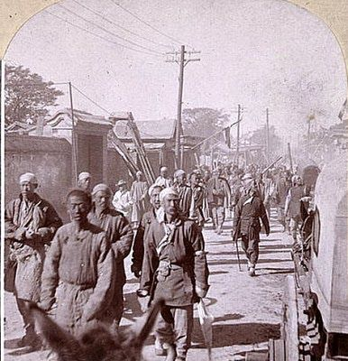
The Boxer Rebellion, 1900
Qing (Ching) Dynasty since 1644, were Manchurian
Mainly Han peasant uprising
Society of Righteous and Harmonious Fists – belief in protection from bullets
Empress Dowager Cixi originally anti-Boxers
Foreign district of Beijing (Peking) created by Opium Wars treaties, largely unprotected
Eight Nation Alliance - Britain, US, France, Germany, Austria, Italy, Russia, Japan
Film: “55 Days in Peking” starring Charlton Heston

Slide 3
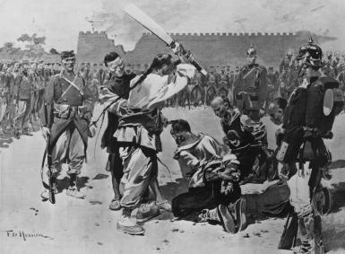
Boxer Rebellion
June 20 – Boxers attacked foreign legation (relatively unprotected) in Beijing
Killed foreigners, Chinese Christian converts, destroyed property
August 14 – 20,000 troops from 8 western nations arrived in Beijing from northern China
September 7 Boxer Protocol – troops in Beijing, Boxers punished, China prohibited from importing weapons for 2 years
Qing Dynasty weakened

Slide 4
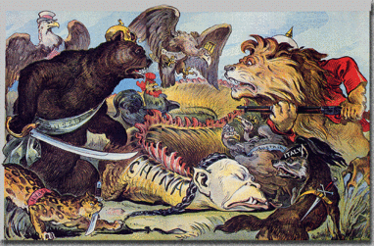
From the magazine Puck, 1900

Slide 5
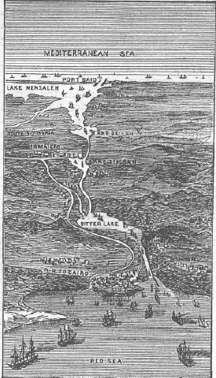
The Suez Canal
Napoleon had scrapped plans for a canal
Ferdinand de Lesseps – Suez Canal Company, proposed idea to khedive of Egypt (under Ottoman Empire), canal would be open to all nations
Britain against the idea
Forced Egyptian labor
Opened in 1869 after ten years of construction under French control
After financial difficulties, the khedive sold shares to British government (PM Disraeli)
1879-1882 – Urabi Revolt, British asked to helped quell revolt, British occupied Egypt
1888 – Convention of Constantinople – Suez Canal made a neutral zone protected by British forces

Slide 6
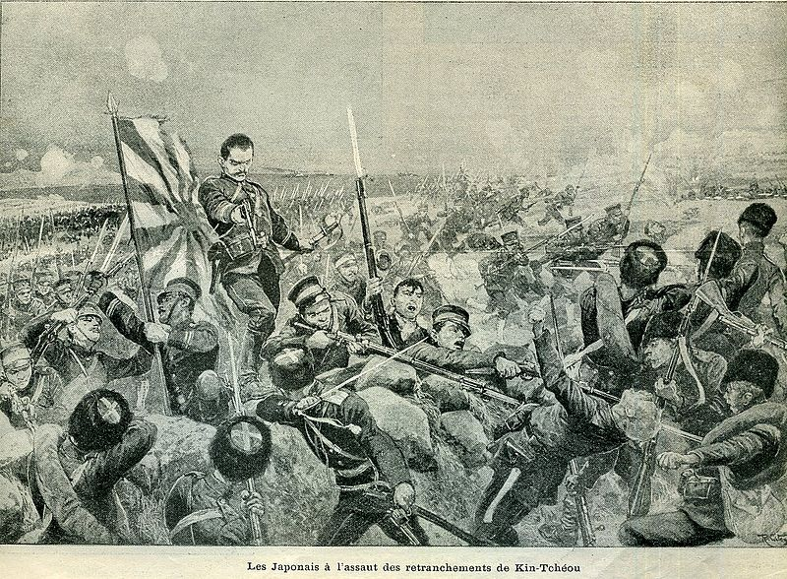
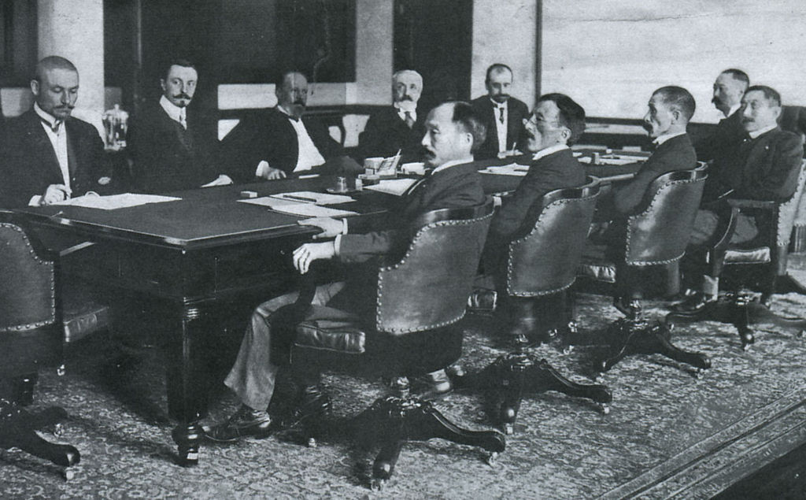
Russo-Japanese War, 1904-1905
Tsar Nicholas II of Russia vs. Meiji Emperor of Japan
Port Arthur – occupied by Russia in 1897
Battle of Tsushima (naval) – British prevented use of Suez Canal, Russians routed, lost 10 of 19 ships
Treaty of Portsmouth (Maine) – Roosevelt helped mediate, won Nobel Peace Prize
Russia recognized Korean Peninsula as Japan’s, withdrew from Manchuria, Japan won no land or reparations

Slide 7
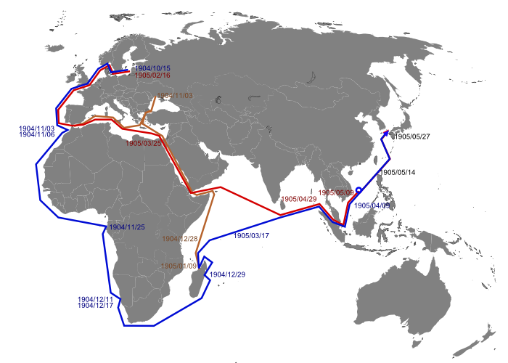
Route of Russian fleet

Slide 8
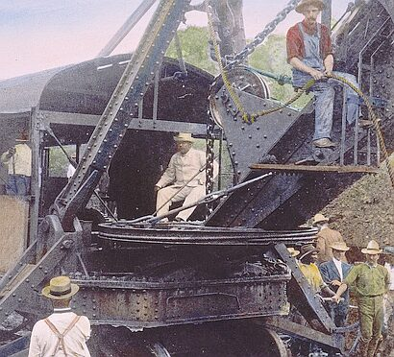
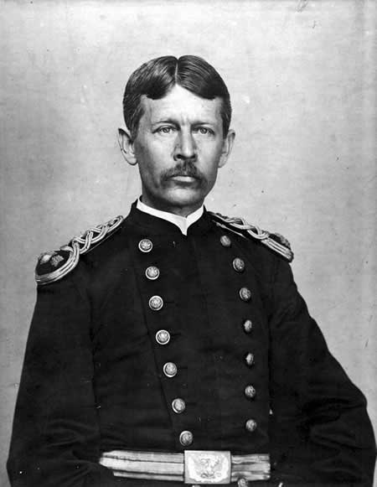
Panama Canal
Isthmus was part of Colombia
1881 – France begins work, gives up due to disease
Offer from Colombia to US to lease canal zone, Colombian Senate would not ratify
TR learns of possible revolt by Panamanian separatists
TR supports rebels, recognizes new Panamanian govt, signs lease
Gunboat Diplomacy
1904 – US takes over canal zone
Dr. Walter Reed and mosquitos
1914 – Canal opens

Slide 9
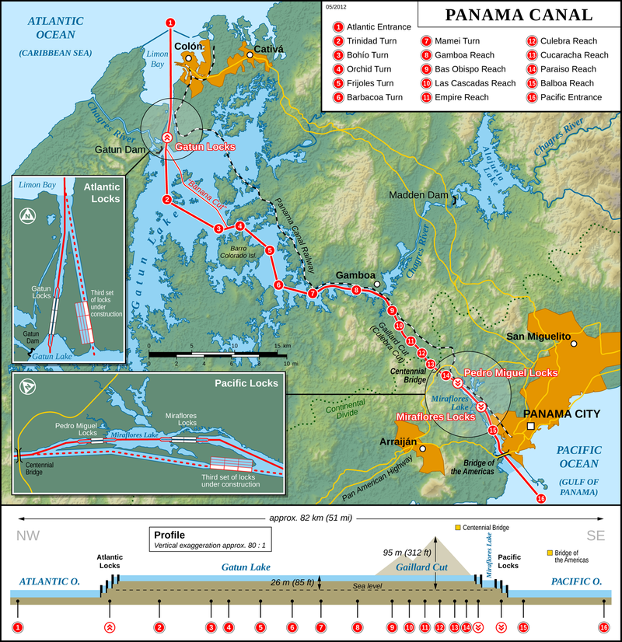
Panama Canal

Slide 10
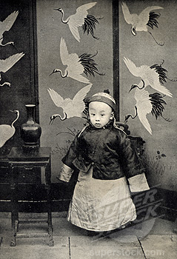
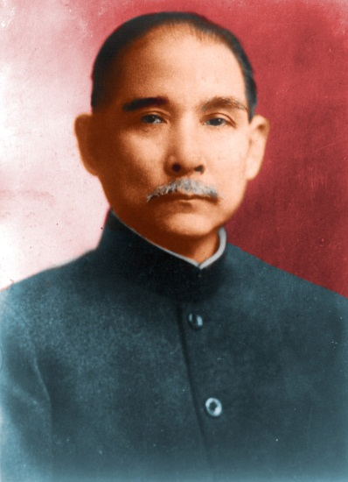
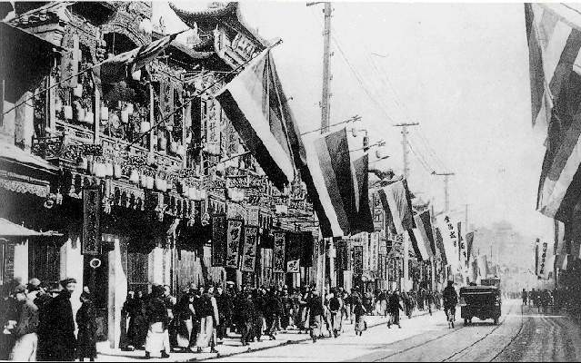
Birth of Republic of China
Qing (Ching) Dynasty 1644-1912 – last of 2000 years of dynastic imperial China, Manchurians ruling over Han
Emperor Pu Yi, the Last Emperor, Forbidden Ciy
1911 Wuchang Uprising (Double Ten Day) – transfer of railroads to foreign banks, General Yuan Shi Kai for the Qing Dynasty
Xinhai Revolution 1911 – overthrow of Qing Dynasty, est. ROC
Dr. Sun Yat-Sen – KMT party, 1st president of ROC
Yuan negotiated with Sun for abdication of emperor (age six)
Yuan given provisional presidency 1912-1915
Yuan cracks down on KMT
Became Hongxian Emperor, abandoned in 1915

Slide 11
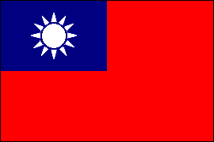
Flag of ROC
Han, Manchus?, Mongols, Muslim Turkics, Tibetans

