Slide 1
19th Century, Part 3
Boer Wars, Japan, Spanish-American War

Slide 2
Lead up to 1st and 2nd Boer Wars
1880-81 and 1899-1902
Boers vs. British
Boers (Afrikaners) – Dutch settlers, spoke Afrikan
Britain acquired Cape of Good Hope from Dutch in Congress of Vienna
1830s - The Great Trek - Voortrekkers forced by British to leave Cape Colony (aka Cape Province) and established Transvaal and Orange FS

Slide 3
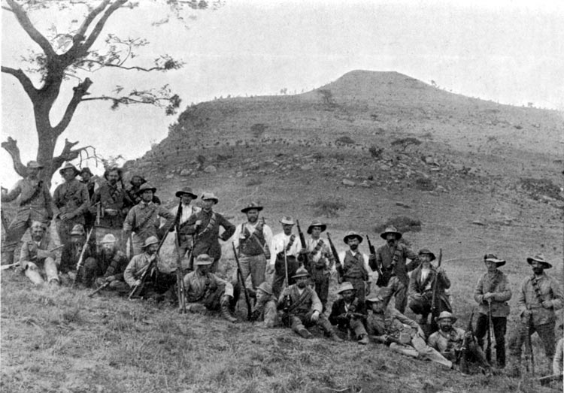
First Boer War, 1880-81
1868 – diamonds in Kimberly, Transvaal
Lord Roberts – took Bloemfontain, Johannesburg, Pretoria
1877 – Britain annexed Transvaal
Zulu War – Battle of Rorke’s Drift, Battle of Blood River, Battle of Isandlwana
1880 – protest against tax, SAR declared independence, war begins
Guerrilla warfare, khakis
1881 – Pretoria Convention, PM Gladstone, Queen Victoria, semi-self rule for Transvaal

Slide 4
Causes of 2nd Boer War
Germany est. colony in Namibia
1886 – Gold discovered in Transvaal
1899 – British military buildup around Transvaal and Orange FS
Afrikaner President Paul Kruger declares war

Slide 5
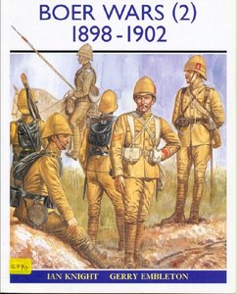
Second Boer War, 1899-1902
1899 - Boers invaded Natal and Cape Colony
1900 - Lord Roberts invaded Transvaal and took the capital Pretoria
Guerrilla warfare by Boers
British Lord Kitchener - Scorched earth, “drives”
British first used concentration camps for Afrikaners and Black Africans
Boers forced to surrender
1902 – Treaty of Vereeniging – Transvaal and OFS become part of British Empire
1910 – Union of South Africa established, autonomous, no decision yes on blacks in government

Slide 6
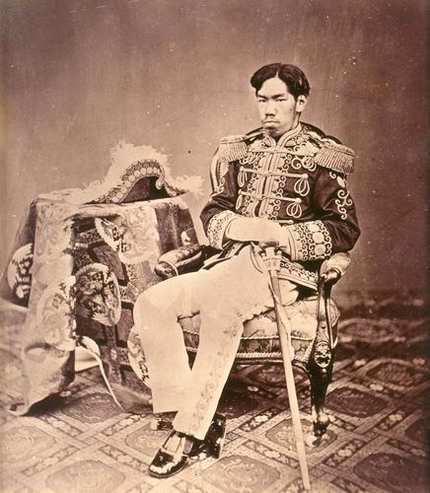
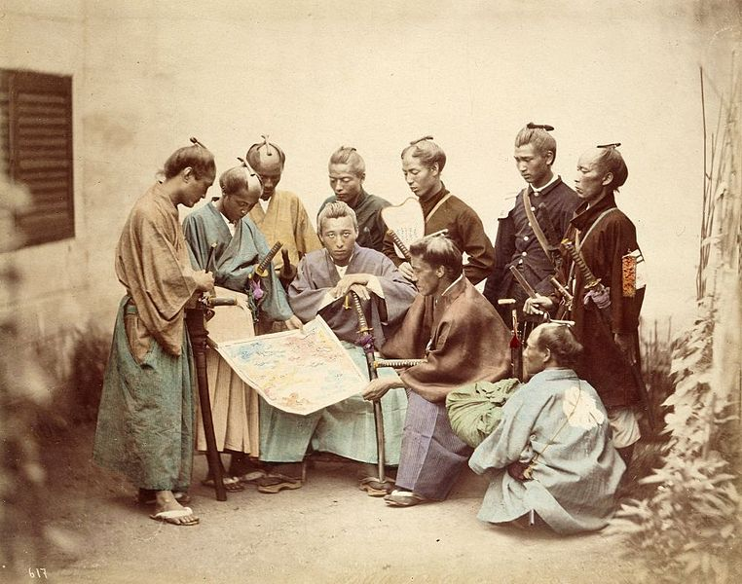
Japan: 1603-1867, the Edo Period
Edo Period - Tokugawa Shogunate, feudal military government
Manifest destiny, gunboat diplomacy
1852-1854 – Commodore Perry, Fillmore’s letter, bombardment, response, letter addressed to emperor, not shogun
1854 - Kanagawa Treaty – ports open
Boshin War 1868-1869– Pro Shogun vs. Pro Imperial Court
Imperials not happy with relations with West
Imperials more modernized
Battle of Hakodate
Fall of Edo (Tokyo)
Meiji Emperor – moves from Kyoto to Tokyo
Meiji Restoration

Slide 7
Meiji Restoration
Militarization
Industrialization
Education
Diet – parliament
Shinto, emperor worship
1894-95 – Sino-Japanese War – gained Taiwan

Slide 8
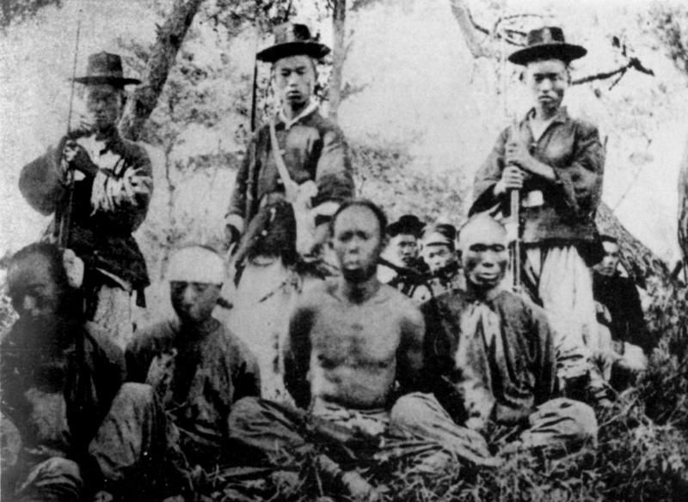
1894-95 Sino-Japanese War
Qing Dynasty of China (would end up being last dynasty of China) vs. Empire of Japan
Fought over control of Korean Peninsula
Korea was tributary state of China under Joseon Dynasty
1884 – pro-Japanese Koreans overthrew government
1885 Convention of Tianjin – both sides withdrew
Yuan Shikai’s Chinese influence
1894 – Japan claimed violation of Convention of Tianjin when Yuan sent to help quell Donghak Rebellion, occupied Seoul and installed new pro-Japan government

Slide 9
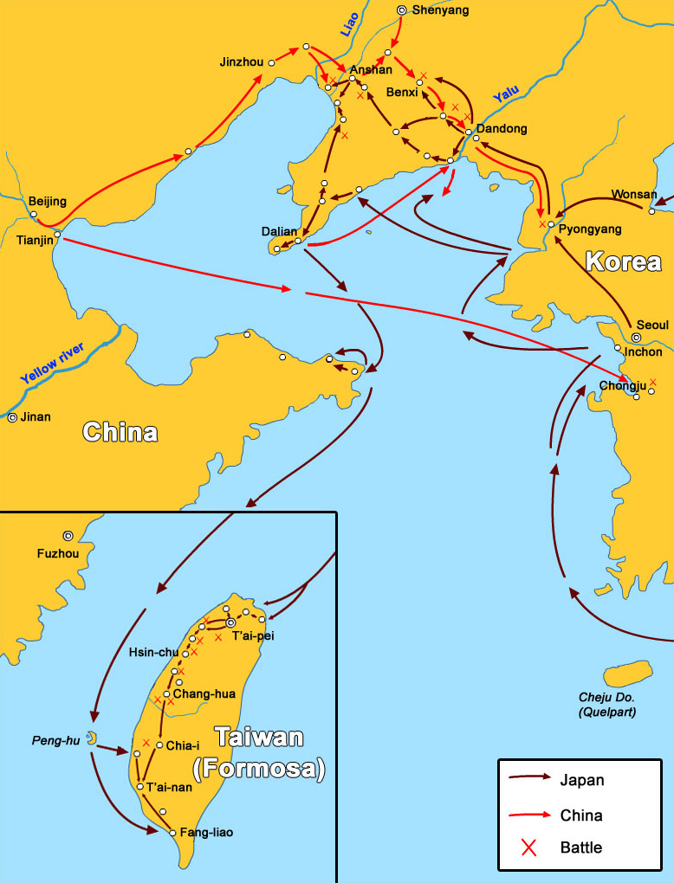
Sino-Japanese War, cont.
Pyongyang
Retreat of Beiyang Army of China
Battle of Yalu River
Invasion of Manchuria
Pescadores Islands, Invasion of Taiwan
1895 – Treaty of Shimonoseki
13,600 pounds of silver = 6.4 times the Japanese annual revenue

Slide 10
Spanish-American War
The Maine
Battle of Manila Bay – Dewey
Battle of San Juan Hill – Rough Riders, Roosevelt
Treaty of Paris – Guam, Puerto Rico, Philippines
Malaria
Yellow journalism
Expansionism

