Slide 1
19th Century Part 2
Nap III, Italy, Africa

Slide 2
Napoleon III,
Louis-Napoleon Bonaparte, president of 2nd republic, elected 1848, nephew of NB
Coup d’etat, Emperor 1852 - 1870
1866 Austro-Prussian War – Austrians/Italians v. Prussia, France neutral, Austrians lost
Franco-Prussian War
Intervention in Mexico
Protected Papal States from Italian unification

Slide 3
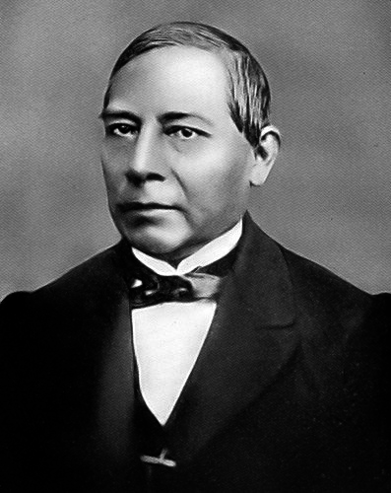
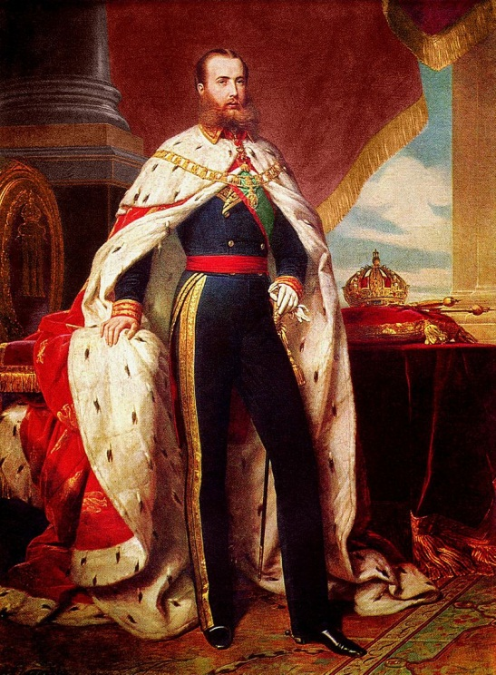
French Intervention in Mexico, 1864-67
1864 - Nap III tries to establish French empire in Mexico
Interrupts term of President Benito Juarez (1858-71)
Archduke Maximilian of Austria crowned Emperor Maximilian of Mexico, appeasement of Austrians
Guerrilla warfare led by Juarez
1865 – US commits troops and supplies to Juarez
1866 – France withdraws troops
1867 - Maximilian captured and executed by Mexican Republicans

Slide 4
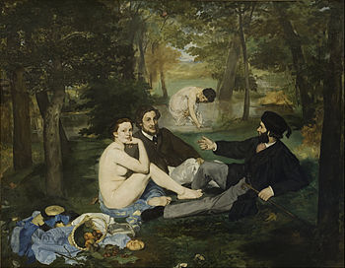
Luncheon on the Grass by Manet
Pre-impressionist
Salon de Refuse

Slide 5
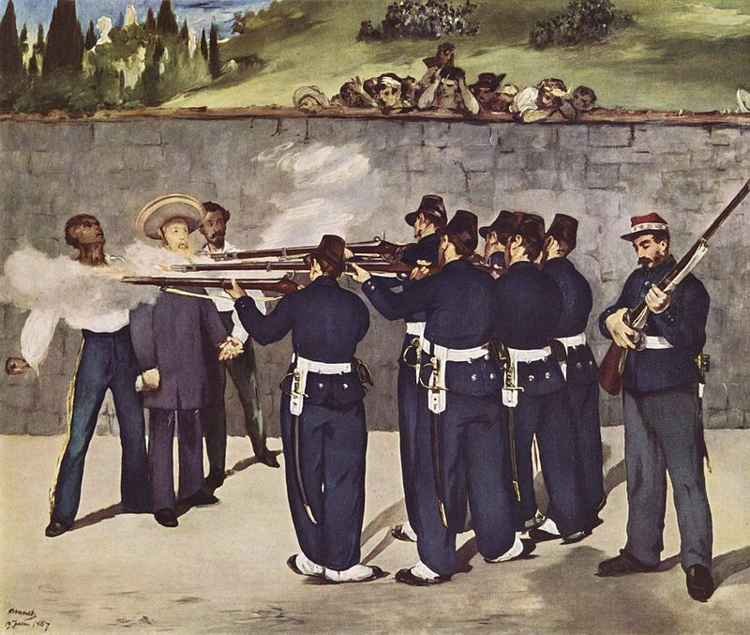
Execution of Maximilian by Eduard Manet

Slide 6
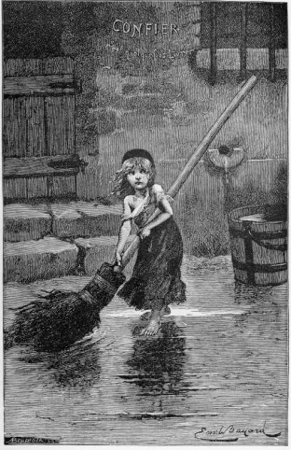
Les Miserarbles by Victor Hugo
Published in 1862
Hugo went into exile during Nap III’s reign
Jean Valjean – jailed for stealing bread
Inspector Javert
Bishop
Fantine
Cosette
Marius

Slide 7
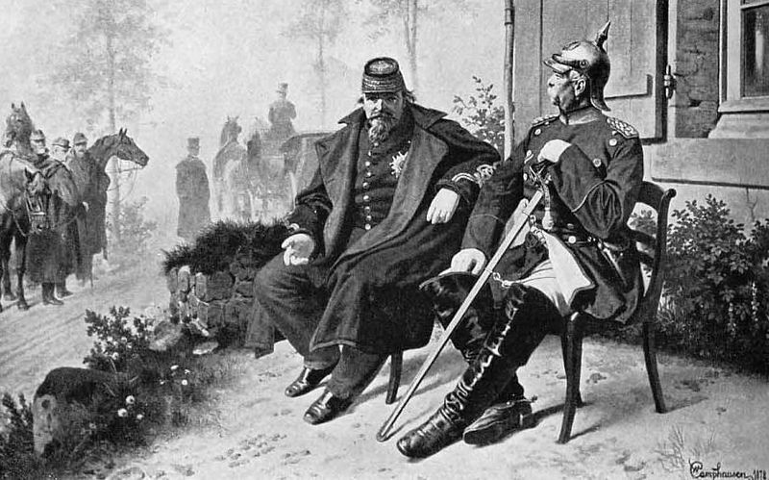
Franco-Prussian War, 1870-71
Napoleon III vs. King Wilhelm I (Prussia)
Chancellor Otto von Bismarck pro-German unity
Tried to unite southern to northern German states
The Ems Dispatch – meeting between King Wilhelm and French foreign minister
France worried about Hohenzollern heir in Spain
Battle of Sedan, Nap III captured, swift Prussian victories
Treaty of Frankfurt – Alsace-Lorraine to Prussia
Nap III retired to Britain

Slide 8
Risorgimento: Mazzini and Garibaldi
Metternich looking down on Italians: “Italy is just a geographical expression.”
Congress of Vienna split up Italy
1831 – Mazzini (writer) forms Young Italy Movement, desires unification
Cavour becomes PM of Sardinia, “brains” of the unification movement
Cavour and Garibaldi become rivals
Garibaldi – the “Sword” of the movement, participated in wars in S. Amer, learned guerrilla warfare, his followers wore “red shirts”

Slide 9
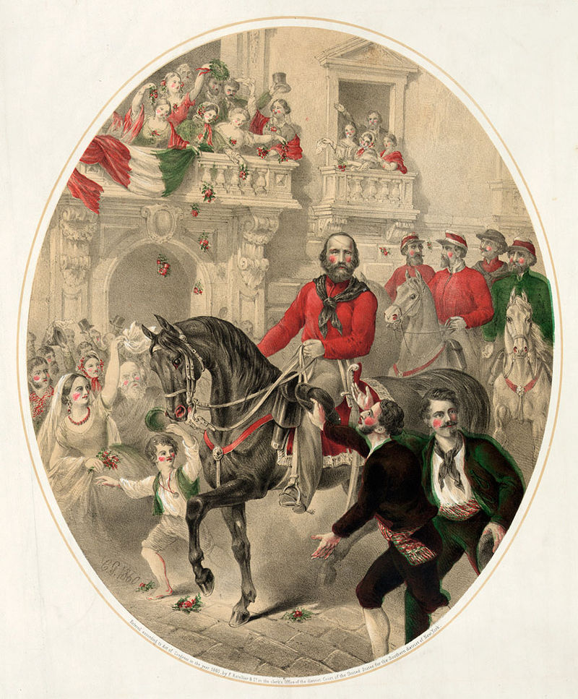
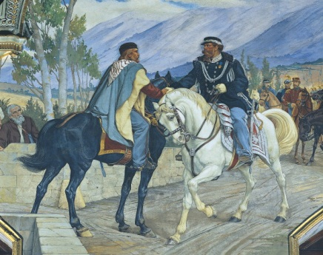
Italian Unification
Garibaldi returned to Italy after republics formed in 1848, defended Papal States against Nap III, retreated to mountains, 2nd exile (USA)
1850s – came back, defeated nations of Italy in the name of the King of Piedmont/Sardinia (Victor Emmanuel II)
Expedition of a Thousand – bold landing on Sicily, brought Naples and Sicily under Sardinia
1861 - Handed Italy to Victor Emmanuel II, first king of Italy, “retired”
Offered services to Lincoln in US Civil War

Slide 10
Risorgimento map

Slide 11
Charles Darwin’s Origin of Species
Published in 1859
The Beagle – Darwin’s ship, traveled in 1830s
Galapagos Islands – observed finches
Natural selection
Survival of the fittest

Slide 12
White Man’s Burden by Kipling, 1899
Take up the White Man's burden, Send forth the best ye breed Go bind your sons to exile, to serve your captives' need; To wait in heavy harness, On fluttered folk and wild-- Your new-caught, sullen peoples, Half-devil and half-child. Take up the White Man's burden, In patience to abide, To veil the threat of terror And check the show of pride; By open speech and simple, An hundred times made plain To seek another's profit, And work another's gain.

Slide 13
European Colonization of Africa: “White Man’s Burden”
Raw materials, missionaries, social Darwinism, racism
Cecil Rhodes – South Africa, De Beers Company, Zambesia, Rhodesia, Zimbabwe, Zambia, Rhodes Scholarship
Cape to Cairo Red Line – The French
Dr. Livingstone
Heart of Darkness by Joseph Conrad

Slide 14
Origins of First Boer War, 1880-81
Boer – Dutch for “farmer”
Congress of Vienna 1815
Changes in Cape Colony
The Great Trek - Voortrekkers leave Cape Colony and est. Natal, Transvaal and Orange FS (1830s)
Britain vs. Boers

Slide 15
The Battle of Blood River (Natal) Boers vs. Zulu

Slide 16
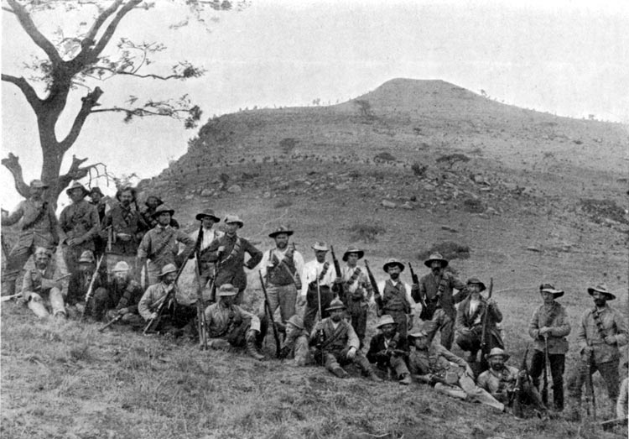
First Boer War, 1880-81
1868 – diamonds in Kimberly (Transvaal)
Lord Roberts – took Bloemfontain, Johannesburg, Pretoria
1877 – Britain annexed Transvaal
Zulu War – Battle of Rorke’s Drift
1880 – protest against tax, SAR declared independence
Guerrilla warfare, khakis
1881 – Pretoria Convention, PM Gladstone, Queen Victoria

Slide 17
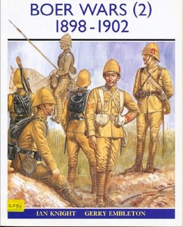
Second Boer War, 1899-1902
1899 - Boers invaded Natal and Cape Colony
1900 - Lord Roberts invaded Transvaal and took Pretoria
Guerrilla warfare
Lord Kitchener - Scorched earth, “drives”
Concentration camps
1902 – Treaty of Vereeniging – Transvaal and OFS become part of British Empire
1910 – Union of South Africa established

Slide 18
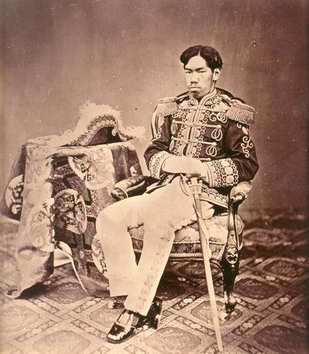
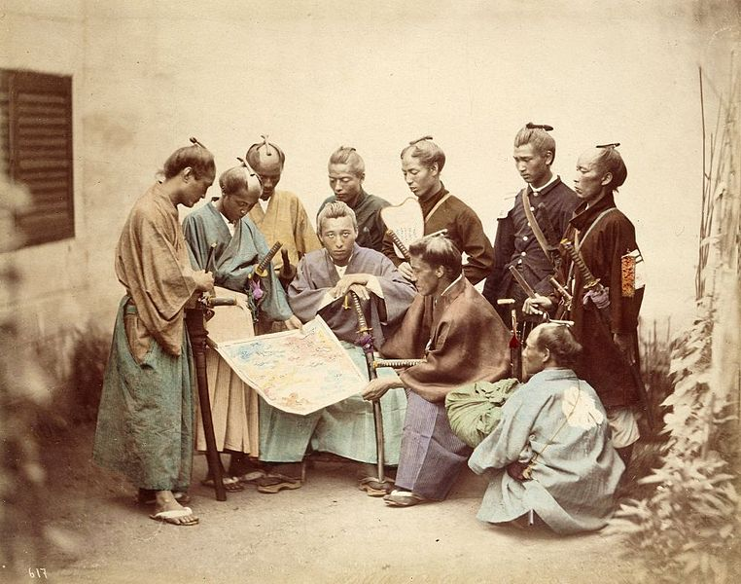
Japan: 1603-1867, the Edo Period
Edo Period - Tokugawa Shogunate
1852-1854 – Commodore Perry, Fillmore’s letter, bombardment, response
1854 - Kanagawa Treaty - ports
Boshin War 1868-1869– France and UK
Fall of Edo (Tokyo)
Meiji Emperor – Kyoto to Tokyo
Meiji Restoration

Slide 19
Meiji Restoration
Militarization
Industrialization
Education
Diet – parliament
Shinto, emperor worship
1894-95 – Sino-Japanese War – gained Taiwan

Slide 21
Spanish-American War
The Maine
Battle of Manila Bay – Dewey
Battle of San Juan Hill – Rough Riders, Roosevelt
Treaty of Paris – Guam, Puerto Rico, Philippines
Malaria
Yellow journalism
Expansionism

