Slide 1
The French Revolution, 1798-1799

Slide 2
Feudalism
System of land ownership
Since 10th century
Lord, Vassal, Fief
Inheritance to nobility
Hard to leave contract
Lack of freedom, no ownership of land

Slide 3
Caricature of Feudalism

Slide 4
Enlightenment Philosophers
Voltaire - Candide
Locke – Tabula Rasa, Natural rights
Montesquieu – Separation of Powers
Rousseau – General Will of People
Newton
Diderot - Encyclopedia

Slide 5
Poor economy
American Revolution 1776
Seven Year’s War 1756-1763
Famine

Slide 6
Current monarchs in 1789
France – King Louis XVI and Marie Antoinette
Great Britain – King George III, William Pitt
Holy Roman Empire – HRE Leopold II (1791)
Prussia – King Frederick William II
Russia – Tsaritsa Catherine II
Sweden – King Gustav III
Tuscany – Grand Duke Peter Leopold I

Slide 7
Map of Europe 1789 (German)

Slide 8
Louis XVI and Marie Antoinette
Louis-Auguste, son of Dauphin Louis de France, son of Louis XV
1774-1792
Maria Antonia, Austro-Hungarian, daughter of Maria Theresa, still a teenager
Married by proxy to Louis in 1770
Extravagant reputation

Slide 9
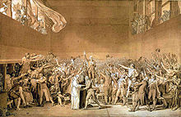
Convocation of Estates General
May 1789 at Versailles Palace
Clergy (300), Nobility (300), Everyone else (600)
Necker – finance minister, speech
Emergency meeting, had not met since 1614
Heads or orders?
National Assembly
Tennis court oath
"What is the Third Estate? Everything. What has it been until now in the political order? Nothing. What does it want to be? Something.” - Abbe Sieyes

Slide 10
July 1789 - Things Get Bad
Troops to Paris
Necker dismissed
Storming of the Bastille on July 14
Weapons cache, governor murdered
August - , Feudalism abolished, Declaration of the Rights of Man and the Citizen

Slide 11
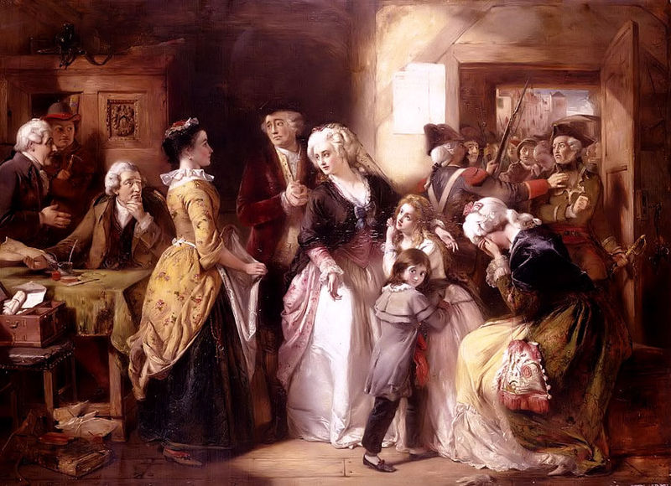
October 1789 - 1791
Working on new constitution
Women’s March on Versailles
Tuileries house arrest
The Emigrees
Royal Flight to Varennes, June 1791
Jacobins – Republic versus Constitutional Monarchy
1791 Massacre at Champ de Mars – Lafayette
August 1791 - Declaration of Pillnitz – HRE Leopold II, Frederick William II of Prussia
1791 – Constitution (constitutional monarchy)

Slide 12
French Revolutionary Wars: The War of the First Coalition 1792 - 1802
April 1792 - France declares war on Austria
King and some revs agree
Prussia and the Brunswick Manifesto
National Assembly declares republic, 1400 killed in riots

Slide 13
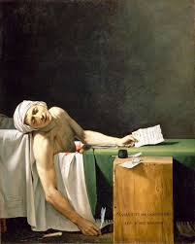
French Rev. Wars, cont.
September - new constitution of 1792, 1st French Republic
1793 – Louis and Marie guillotined for “conspiring”
February – declares war on Great Britain and Dutch Republic
Levee en masse – one million
April 1793 – Committee on Public Safety led by Robespierre

Slide 14
Death of Marat
Jacques Louis-David - Jacobin
Jean-Jacques Marat – radical killed by Charlotte Corday in 1793

Slide 15
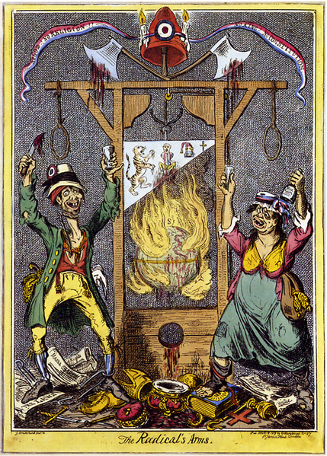
Reign of Terror
April 1793 – Committee on Public Safety led by Robespierre
40,000 executions by gun and guillotine in Paris
July 1793 – royalist revolt in Toulon put down (Napoleon Bonaparte)
July 1794 – Thermidorean Reaction, National Convention
Robespierre executed

Slide 16
New Government
1795 – peace with Prussia and Spain
August – new constitution - bicameral
Republic
The Directory – Five people
Legislature - council of elders, council of 500
October 1795 - royalist uprising, seized Tuileries, Napoleon saves the day

Slide 17
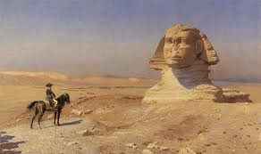
Rise of Napoleon
1796 - Napoleon sent to Italy to fight Austria
Oct. 1797 – peace with Austria, Treaty of Campo Formio, ends 1st Coalition
1798 – Napoleon takes Malta and invades Egypt, defeats Mamluks
Battle of the Nile
Admiral Horatio Nelson wins
Napoleon invades Syria
1799 – Napoleon back to France

Slide 18
Napoleon to his soldiers
The peoples we will be living alongside are Muslims; their first article of faith is "There is no other god but God, and Mahomet is his prophet". Do not contradict them; treat them as you treated the Jews, the Italians; respect their muftisand their imams, as you respected their rabbis and bishops. Have the same tolerance for the ceremonies prescribed by the Quran, for their mosques, as you had for the convents, for the synagogues, for the religion of Moses and that ofJesus Christ. The Roman legions used to protect all religions. You will here find different customs to those of Europe, you must get accustomed to them. The people among whom we are going treat women differently to us; but in every country whoever violates one is a monster. Pillaging only enriches a small number of men; it dishonours us, it destroys our resources; it makes enemies of the people who it is in our interest to have as our friends. The first city we will encounter was built by Alexander [the Great]. We shall find at every step great remains worthy of exciting French emulation.

Slide 19
The Rosetta Stone
Same text in hieroglyphics, Demotic and ancient Greek
Inscribed in 196 BC under Ptolemy V

Slide 20
End of Revolution, 1799
Directors and two councils unpopular
Jacobins unpopular
Abbe Sieyes plans coup with Napoleon’s help
Resignations
Councils lured outside Paris
Napoleon dissolves legislature
Consulate: Sieyes, Napoleon, Ducos

