Slide 1
The 19th Century, Part 1
Changes in Europe, The British Empire

Slide 2
The Congress of Vienna, 1814-15
Metternich (Austria) – Nap’s wedding
Talleyrand (France)
Alexander I of Russia
Louis XVIII of France
Netherlands created
Prussia got Rhineland
Switzerland neutral
Russia gets Finland and Poland
Norway/Sweden one nation

Slide 5
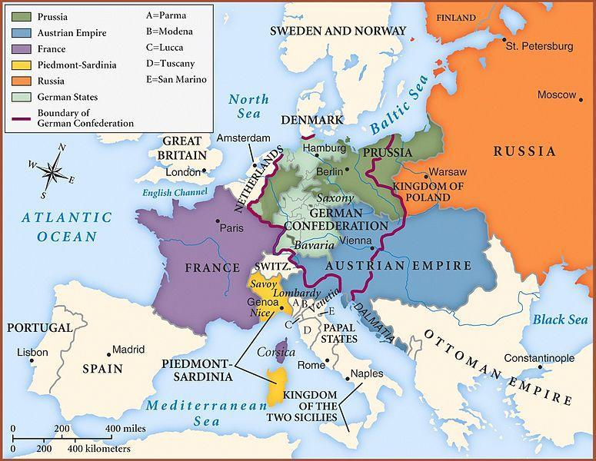

Slide 6
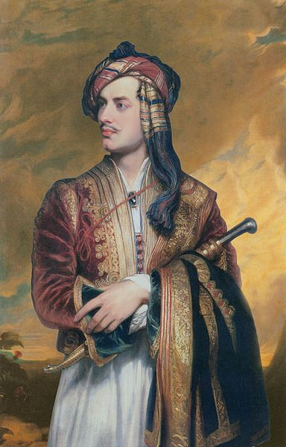
Greek War of Independence, 1821-1832
Ipsilantis
Lack of support
Execution of Patriarch Gregory
Alexander’s Third Rome complex
Lord Byron – Don Juan
First European ethnic state

Slide 7
1848 Revolutions: “When France sneezes, Europe catches a cold.”
Revolutions
Results
France – King Louis-Philippe (1830) July Monarchy, 2nd republic after
Budapest – Magyars
Prague and Vienna
Prussia – Kaiser Frederick Wilhelm IV (refused crown from assembly, German unification), Frankfurt Assembly (first ever parliament)
Young Italy Movement – Mazzini, Republic of Rome (1849)
France – absolutist Louis Napoleon in 1851
Austria – Franz Josef I (Metternich resigns), Austria to Austro-Hungary
Prussia – aristocrats in assembly
Mazzini – France and Austria

Slide 8
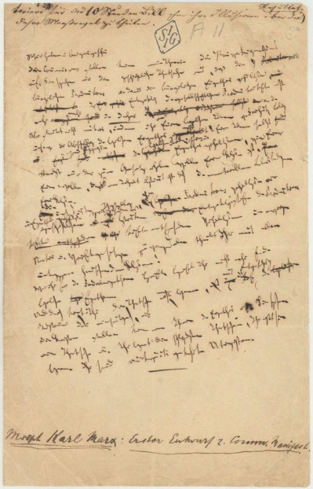
The Communist Manifesto, 1848
Published in London
Marx and Engels
Bourgeoisie
Proletarians
Capitalism
Exploitation
Private property
Prior revolutions
Inevitable revolution

Slide 9
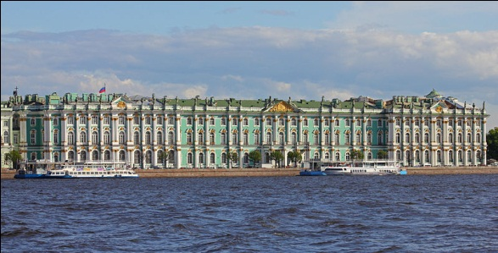
Russia after Peter the Great
Catherine the Great 1762-1796 – wife of Peter III, golden age, The Hermitage, Alaska, Russo-Turkish Wars, “Star of the North”, enlightenment
Alexander I 1801-1825– grandson, Napoleon relationship, Ottoman Empire, Greek independence
Nicholas I 1825-1855– Russo-Turkish War, Crimean War
Alexander II `1855-1881 – freed the serfs, planned Duma, assassinated by The People’s Will

Slide 10
Growth of Russian Empire

Slide 11
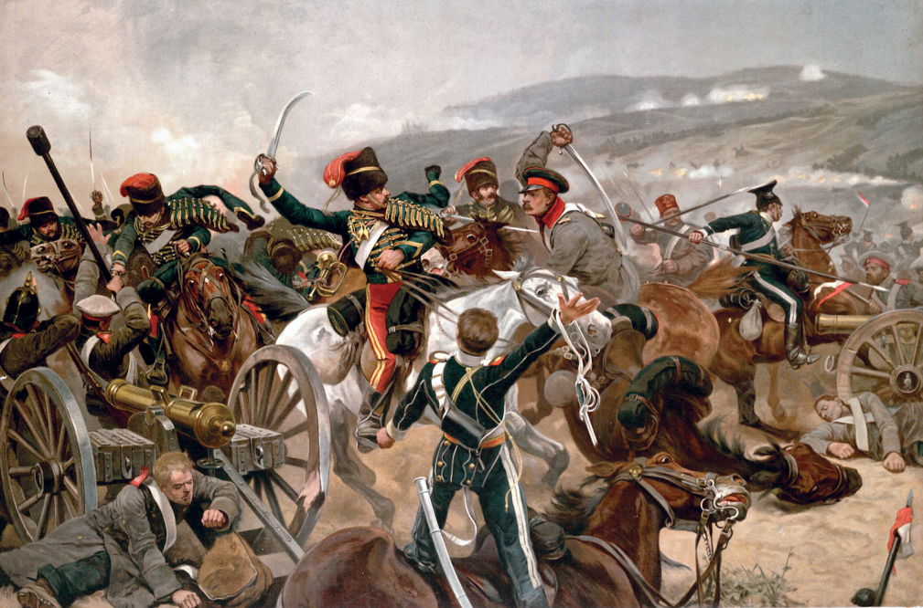
The Crimean War, 1853-1856
Fear of Russian Empire
Nicholas I
Russia vs. France/UK/Austria/Ottoman Empire/Sardinia
Balaclava, Siege of Sevastopol
Florence Nightingale
The Charge of the Light Brigade by Tennyson, Earl of Cardigan

Slide 12
Charge of the Light Brigade by Tennyson
Half a league, half a league,
Half a league onward,
All in the valley of Death
Rode the six hundred.
“Forward, the Light Brigade!
Charge for the guns!” he said.
Into the valley of Death
Rode the six hundred.
“Forward, the Light Brigade!”
Was there a man dismayed?
Not though the soldier knew
Someone had blundered.
Theirs not to make reply,
Theirs not to reason why,
Theirs but to do and die.
Into the valley of Death
Rode the six hundred.

Slide 13
Queen Victoria, 1837-1901
Queen of GB and Ireland (UK)
Married Prince Albert
Also Empress of India
63 year reign, last Hanover
Irish Potato Famine 1845-1852
“Victorian” – strict personal morality, style of furniture

Slide 14
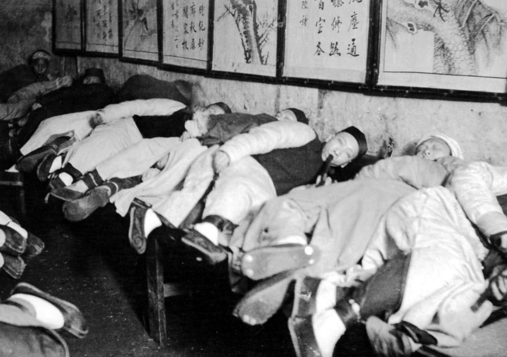
The First Opium War, 1839-1842
1832 – Jardine, Matheson &Co. in Canton
Traders losing money
India’s opium harvest
1839 – factory raids
1840 – British fleet in Pearl River delta
1842 – Treaty of Nanking, aka “unequal treaty” – five open ports, Hong Kong, Shanghai

Slide 16
Letter to Queen Victoria from Lin Zixu, 1839
Suppose there were people from another country who carried opium for sale to England
and seduced your people into buying and smoking it; certainly your honorable ruler would deeply hate it and be bitterly aroused. We have heard heretofore that your honorable ruler is kind and benevolent. Naturally you would not wish to give unto others what you yourself do not want. We have also heard that the ships coming to Canton have all had regulations promulgated and given to them in which it is stated that it is not permitted to carry contraband goods. This indicates that the administrative orders of your
honorable rule have been originally strict and clear. Only because the trading ships are numerous, heretofore perhaps they have not been examined with care. Now after this communication has been dispatched and you have clearly understood the strictness of the prohibitory laws of the Celestial Gourt, certainly you will not let your subjects dare again to violate the law.
We have further learned that in London, the capital of your honorable rule, and in Scotland,
Ireland, and other places, originally no opium has been produced. Only in several places of India under your control such as Bengal, Madras, Bombay, Patna, Benares, and Malwa has opium been planted from hill to hill, and ponds h ave been opened for its manufacture. For months and years wark is continued in order to accumulate the poison. The obnoxious odor ascends, irritating heaven and frightening the spirits. Indeed you, O King, can eradicate the opium plant in these places, hoe over the fields entirely, and sow in its stead the five grains [millet, barley, wheat, etc.]. Anyone who dares again attempt to plant and manufacture opium should be severely punished. This will really be a great, benevolent government policy that will increase the common weal and get rid of evil. For this, Heaven must support you and the spirits must bring you good fortune, prolonging your old age and extending your descendants. All will depend on this act.

Slide 17
Second Opium War
1856 – taking of The Arrow caused war
Enforcement of Treaty of Nanking
More demands
UK and France v. China
1858 – Treaty of Tianjin legalized opium trade, opened China to other nations, missionary movement

Slide 18
Spanish-American War
The Maine
Battle of Manila Bay – Dewey
Battle of San Juan Hill – Rough Riders, Roosevelt
Treaty of Paris – Guam, Puerto Rico, Philippines
Malaria
Yellow journalism
Expansionism

