Slide 1
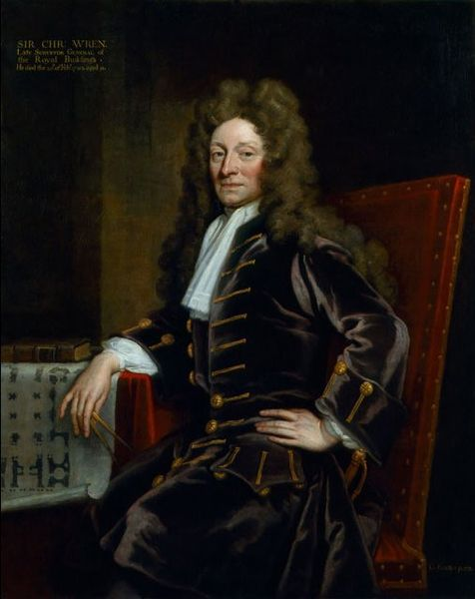
Sir Christopher Wren, 1632-1723
Astronomer, geometer, mathematician, ARCHITECT
1666 – Great Fire of London
51 churches
St. Paul’s Cathedral
Charles II

Slide 2
Road to Revolution

Slide 3
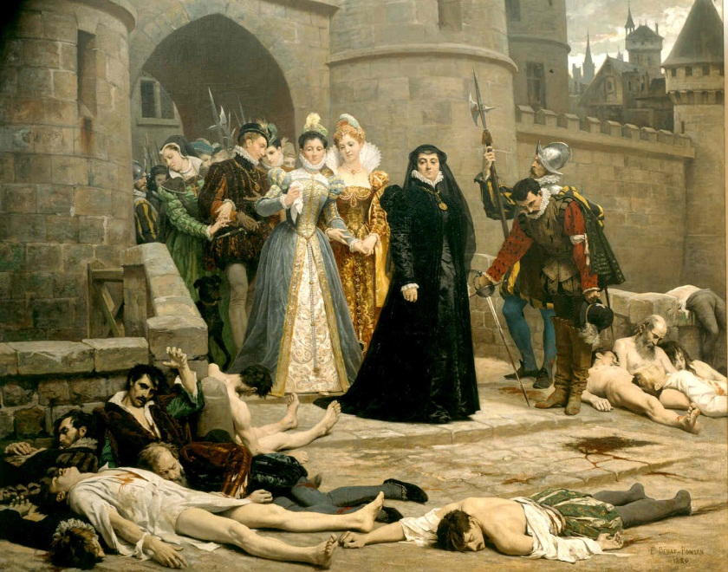
After Hundred Years’ War (1337-1453)
1453 - Calais and Channel Islands
Charles VII
Louis XI
Charles VIII
Louis XII
Francis I
Henry II
Francis II
(Seven) French Wars of Religion 1562-1598
Charles IX – 1572 - St. Bartholemew’s Day Massacre, anti-Huguenots, instigated by Catherine de Medici, the king’s mother
Henry III – last of Capetian Dynasty

Slide 4
The Bourbons
Henry IV (1589-1610) – first Bourbon, raised Protestant, converted
Edict of Nantes – rights for Huguenots
Louis XIII (1601-1643) – Cardinal Richelieu, anti-Hapsburgs
Louis XIV (1638-1715) – 72 years, The “Sun King”, Cardinal Mazarin, Thirty Years’ War, Grand Alliance, War of Spanish Succession
War of Devolution – Spanish Netherlands, Triple Alliance defeated Louis, Treaty of Aix-la-Chappelle
“L’etat, c’est moi”
Versailles Palace

Slide 5
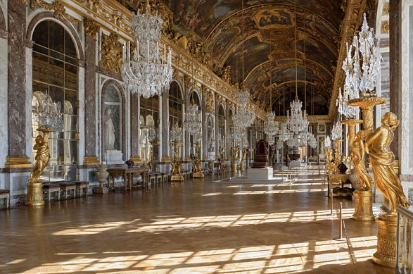
Versailles

Slide 6
Enlightenment (Age of Reason) Thinkers, mid to late 18th century
Thomas Hobbes – pessimist, social contract, sacrifice freedom, Leviathan, govt keeps order
Locke – Natural rights, social contract, Tabula Rasa, govt has responsibility, right to overthrow, individuality
Jean-Jacques Rousseau – different “Social Contract”, General Will, community over individual
“Man is born free, and everywhere he is in chains”
Montesquieu – separation of powers, checks and balances
Voltaire – satire, Candide, Bastille
“I do not agree with a word you say, but I will defend to the death your right to say it.”

Slide 7
More thinkers
Diderot – Encylopedia wasn’t just an encyclopedia
Heavily anti-monarchy and anti-religion
Mary Wollstonecraft – first feminist, equal education, even enlightenment thinkers didn’t like her
Adam Smith – father of capitalism, Wealth of Nations, invisible hand, laissez-faire

Slide 8
Romantic Poets
Samuel Taylor Coleridge – Rime of the Ancient Mariner, the albatross
Percy Bysshe Shelley – Prometheus Unbound, Ozymandias, Ode to the West Wind
John Keats – Ode to a Nightingale, Ode on a Grecian Urn
“Beauty is truth, truth beauty”
Lord Byron – Don Juan

Slide 9
Rime of the Ancient Mariner
Day after day, day after day,
We stuck, nor breath nor motion;
As idle as a painted ship
Upon a painted ocean.
Water, water, every where,
And all the boards did shrink;
Water, water, every where,
Nor any drop to drink.

Slide 10
Ozymandias (Ramses II) Shelley vs. Smith
I met a traveller from an antique land Who said: Two vast and trunkless legs of stone Stand in the desert. Near them, on the sand, Half sunk, a shattered visage lies, whose frown, And wrinkled lip, and sneer of cold command, Tell that its sculptor well those passions read Which yet survive, stamped on these lifeless things, The hand that mocked them and the heart that fed: And on the pedestal these words appear: "My name is Ozymandias, king of kings: Look on my works, ye Mighty, and despair!" Nothing beside remains. Round the decay Of that colossal wreck, boundless and bare The lone and level sands stretch far away.[4]
IN Egypt's sandy silence, all alone, Stands a gigantic Leg, which far off throws The only shadow that the Desert knows:— "I am great OZYMANDIAS," saith the stone, "The King of Kings; this mighty City shows "The wonders of my hand."— The City's gone,— Nought but the Leg remaining to disclose The site of this forgotten Babylon. We wonder,—and some Hunter may express Wonder like ours, when thro' the wilderness Where London stood, holding the Wolf in chace, He meets some fragment huge, and stops to guess What powerful but unrecorded race Once dwelt in that annihilated place.^{[9]}

Slide 11
Smith’s New Title
"On A Stupendous Leg of Granite, Discovered Standing by Itself in the Deserts of Egypt, with the Inscription Inserted Below".

