Slide 1
James I, Charles I, Oliver Cromwell, Charles II, William and Mary

Slide 2
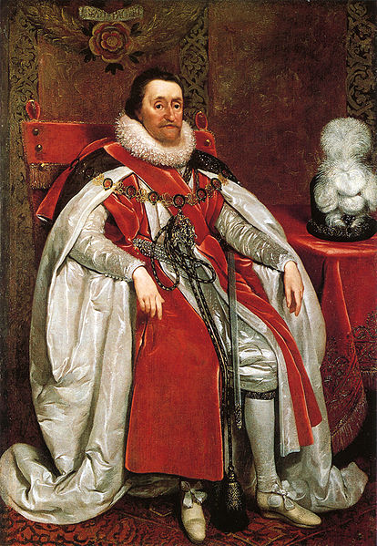
James I (VI of Scotland), 1603-25
Gunpowder Plot 1605 – restore Catholic monarch
Guy Fawkes Day – Nov. 5
Golden Age of Elizabethan literature
King James Version of Bible – “thou sayest”

Slide 3
Elizabethan Golden Age of Literature
Shakespeare
John Donne – “Death Be Not Proud”, holy sonnets
Ben Jonson – Volpone, burial
Sir Francis Bacon – scientific method, Shakespearean hypothesis, jurisprudence

Slide 4
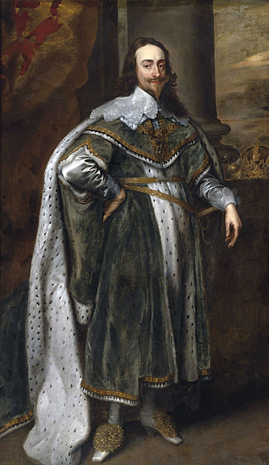
Charles I, 1625-49
Son of James I, Married Henrietta Maria of France
Divine Right of Kings
Catholic tendencies
1645-1647 English Civil War vs. two parliaments
Cavaliers v. Roundheads
Isle of Wight
Cromwell’s New Model Army
1649 – Executed for treason

Slide 5
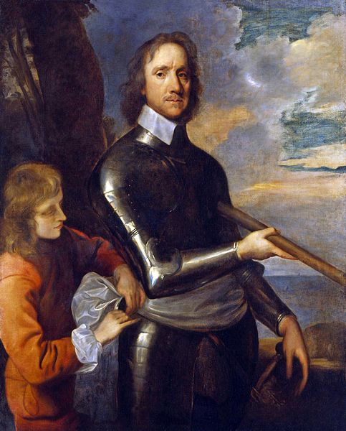
The English Commonwealth, 1649-59
Aka The Interregnum
Monarchy abolished
The Protectorate
Lord Protector Oliver Cromwell, deeply Puritan
Invaded Ireland in 1649
“I shall not..suffer the exercise of the Mass”
“curse of Cromwell upon you”
His portrait in Westminster

Slide 6
The Protectorate, 1653-58
Cromwell Lord Protector for life
Ability to dissolve parliaments
Cavaliers in Virginia
1657 – offered crown by parliament

Slide 7
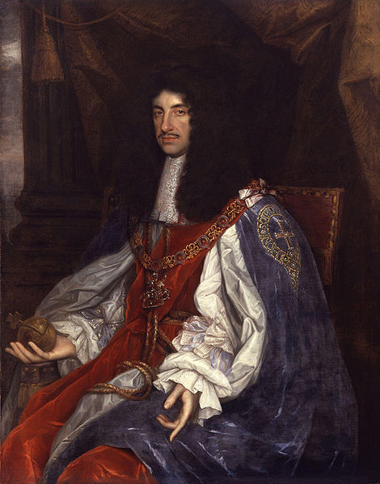
Charles II, 1660-85
Son of Charles I
Scots declared him king in 1650, Cromwell arrives from Ireland
Fled to Europe following defeats to Cromwell
1660 - The Restoration, king of England, Scotland and Ireland
Alliance with France, secret promise
Birth of Whigs and Tories
Converted on deathbed

Slide 8
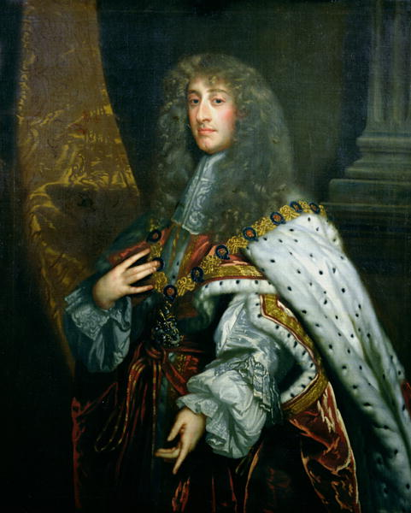
James II (VIII of Scotland), 1685-88
Catholic, brother of Charles II
Court suspicious of his Catholicism
1688 - Fled when William III of Orange (Dutch) invaded

Slide 9
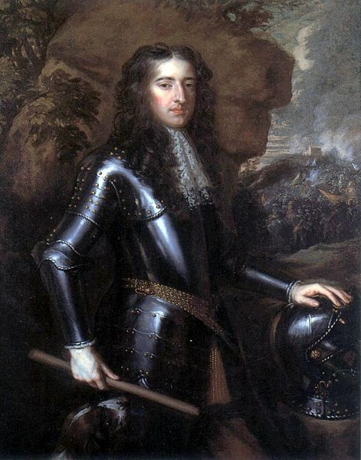
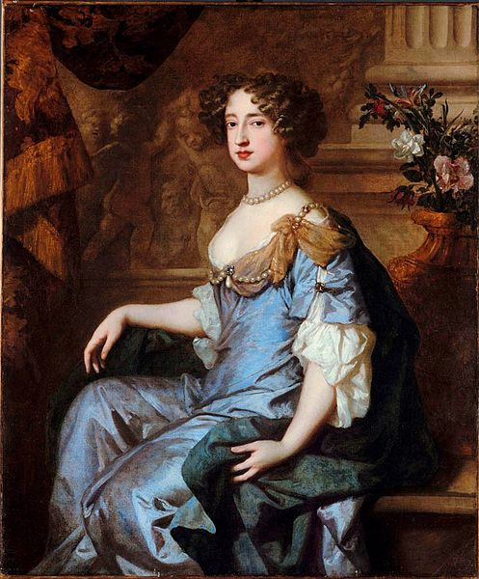
William and Mary, 1689-94
Glorious Revolution
Power takeover without bloodshed
Yes, that school in Williamsburg is named after them

Slide 10
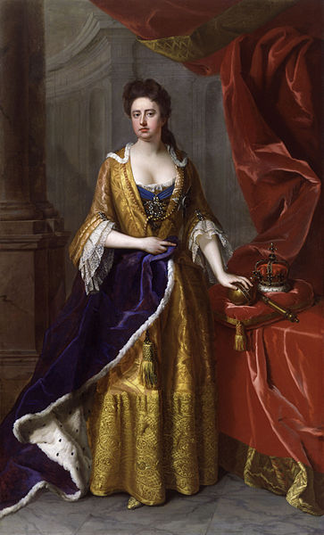
Queen Anne, 1702-1714
Acts of Union 1707
War of the Spanish Succession
Queen Anne’s War

Slide 11
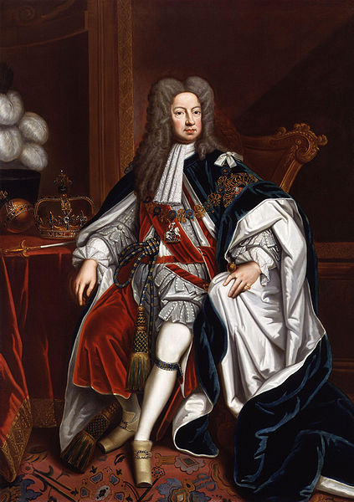
George I, 1714-1727
House of Hanover

Slide 12
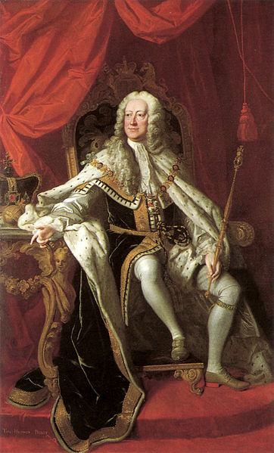
George II, 1727-1760
Son of George I
War of the Austrian Succession 1740-48
Seven Years’ War (French and Indian War)

Slide 13
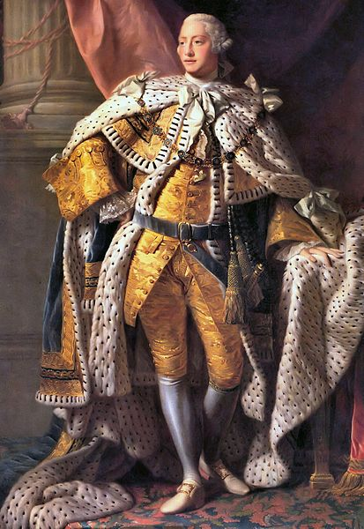
George III, 1760-1820
Grandson of George II
Mental illness
American War of Independence
William Pitt

