Slide 1
Russia, Part 1
Beginnings to 17th Century

Slide 2
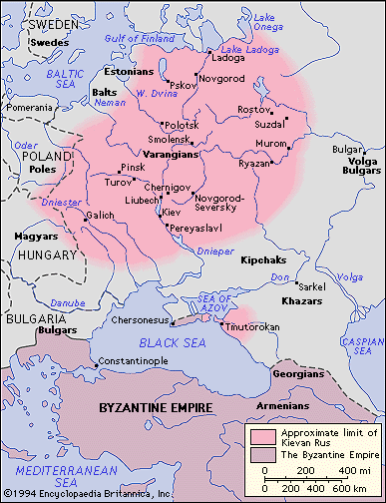
The Beginning of Rus
Slavs
862 – Rurik, a local chieftain establishes Rus centered at Novogrod
882 – Oleg adds Kiev to Rus
989 – Prince Vladimir I chooses Byzantine Orthodox Christianity as state religion

Slide 3
Invasions During Middle Ages
Mongols
Batu Khan’s Golden Horde (part of Mongol Empire), including Tatars
Golden Horde takes Kiev
Does not take Novogrod
Alexander Nevsky – 13th century, defends against Teutonic Knights and Swedes

Slide 4
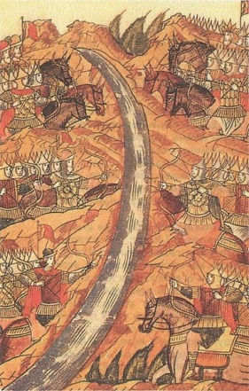
The Rise of Moscow, 14th – 15th C.
Originally vassal to Vladimir
Kiev metropolitan moved to Moscow
Expelled Tatars from Russia, refused to pay tributes
Grand Prince Ivan III “The Great” – annexes Novogrod
The Great Stand on Ugra River – end of Tatar presence
“Third Rome”, Italian artisans

Slide 5
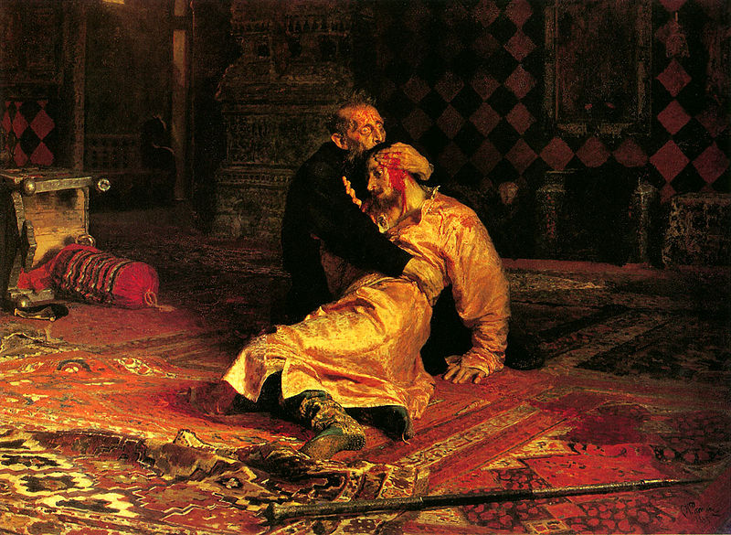
Boris Gudonov and Time of Troubles
Ivan IV “The Terrible” – adopted title “Tsar”, eroded power of boyars
Patriarch of Moscow
Killed own son
Followed by Fyodor, mentally challenged, needed help
Little Dimitri died mysteriously
Boris Gudonov – regent, brother-in-law of Fyodor
False Dimitris – first one appears in Polish Lithuania
First false Dimitri crowned when Gudonov dies in 1605, murdered by Shuisky forces
New False Dimitri II
Poles occupy Moscow, attempt to conquer and convert Russia
Swedes (rival of Poles) declare war on Russia, they have their own False Dimitri III
1612 – Russians unite under Pozharsky, Polish army in Kremlin surrender, Poles expelled

Slide 6
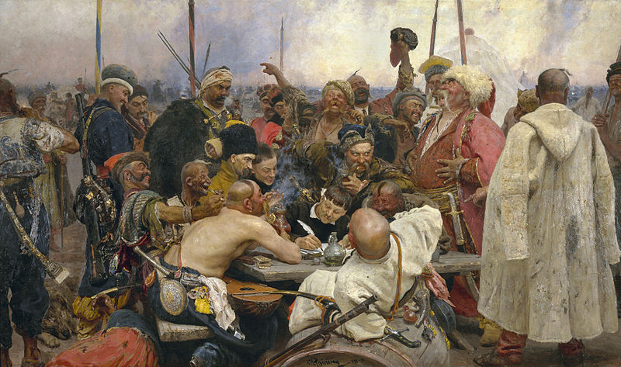
The Romanovs
1613 – Michael elected new Tsar after Poles expelled
Boyars enact serfdom
Salt riot, copper riot, the Moscow Uprising
Cossack Stenka Razin
Peter the Great
Catherine the Great
Nicholas II (last tsar and last Romanov)

Slide 7
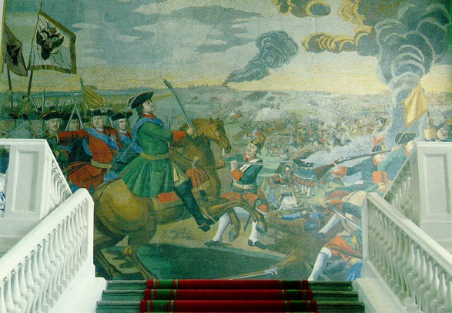
Peter the Great, 1672-1725
Reigned 1721-1725
Alliance with Poles against Swedes
1703 - St. Petersburg – western style new city
Expansion of Russian empire
Great Northern War – against Charles XII of Sweden
Swedes invade Ukraine, eventually defeated
Replaced the Duma with a small ten-person council
Absolutism
Abolished patriarch

Slide 9
Catherine the Great
German, married to Peter III who was assassinated in 1762
Golden Age of Russia – mansions for nobility, patron of the arts, Hermitage Museum, Enlightenment
More expansion – settling of Alaska, big chunk of Poland
Crushed Crimean Khanate
Pugachev’s rebellion – serfs and Cossacks, tried to end serfdom, declared alternative government in name of peter III

Slide 10
Don Quixote by Miguel Cervantes, 1605
Characters
Plot
Don Quixote
Sancho Panza – Don Quixote’s squire
Dulcinea – object of Don Quixote’s love
Rocinante – Don Quixote’s horse
Dapple – Panza’s donkey
Two books
Man thinks he’s a knight after reading books about chivalry
Sancho Panza acts as his squire
People humor him
He attacks windmills he thinks are giants
In 2nd book, he meets people who know him because they read the first book about him

Slide 11
Paradise Lost by John Milton, 1667
Epic poem
Quotes
Epic poem about the creation of the world
Retells the Jewish/Christian creation story from Genesis
Adam, Even, Satan, Archangels
“Justify the ways of God to men”
“It is better to reign in Hell than serve in Heaven”

