Slide 1
European Explorers, Mughal Empire and Baroque Art

Slide 2
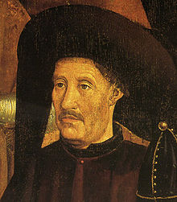
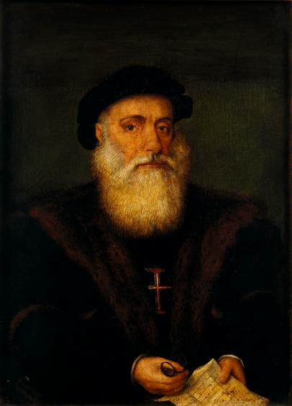
Portuguese Explorers
Vasco Da Gama
1394 – 1460 Prince Henry the Navigator
Patron of exploration, maritime trade, Age of Discoveries, interested in legend of Prestor John
1519 – 1522 Magellan’s (sailing under Spanish crown) first circumnavigation around the world, died in Battle of Mactan (Philippines)
1580 – Philip II of Spain annexes Portugal, loyalists held out in Azores (still part of Portugal today) until 1583

Slide 3
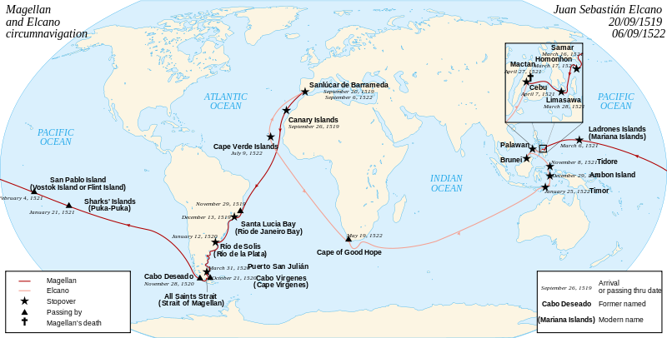
Magellan’s Circumnavigation, 1519-1522

Slide 4
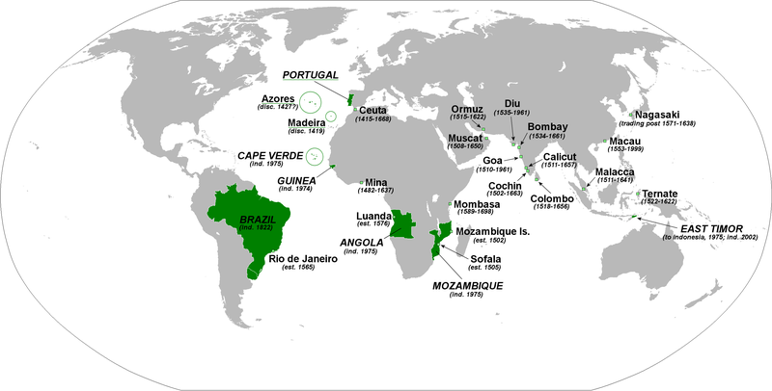
Portugal Overseas

Slide 5
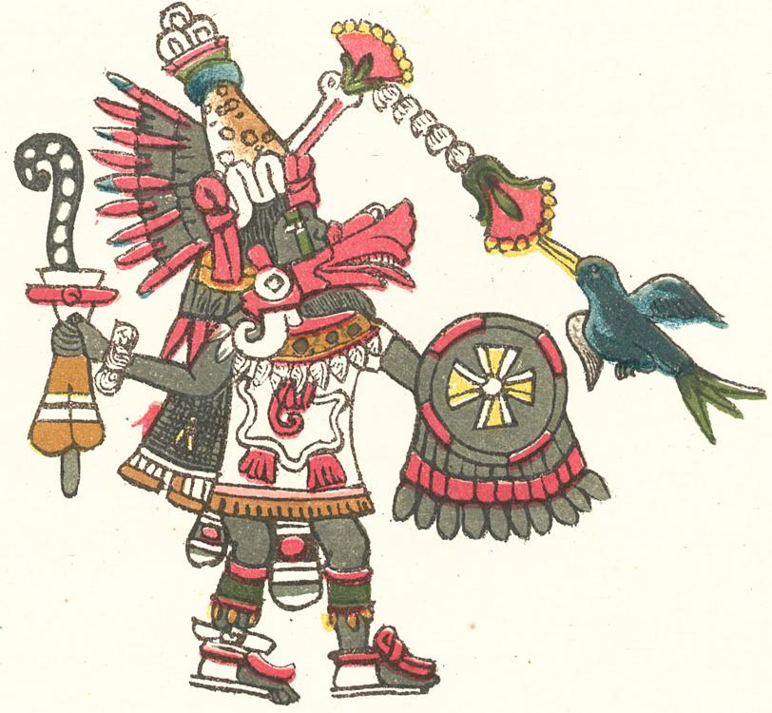
Spanish Explorers
1492 (1st voyage) – Columbus (Geonan) visits Bahamas, Cuba and Hispaniola
2nd voyage – Jamaica, Puerto Rico
3rd voyage – South America
1513 – Ponce de Leon lands in Florida
1513 – Balboa sees Pacific (Panama), accompanied by Pizzarro
1520 – conquistador Cortez conquers Aztecs and King Montezuma II
Cortez mistaken for Quetzalcoatl
Tenochtitlan – capital of Aztecs
1526 – Pizzarro conquers Incas (Cuzco), accompanied by De Soto
Atahualpa had overthown half-brother Huascar
1540 – Coronado explores SW
1541 - DeSoto crosses Mississippi

Slide 6
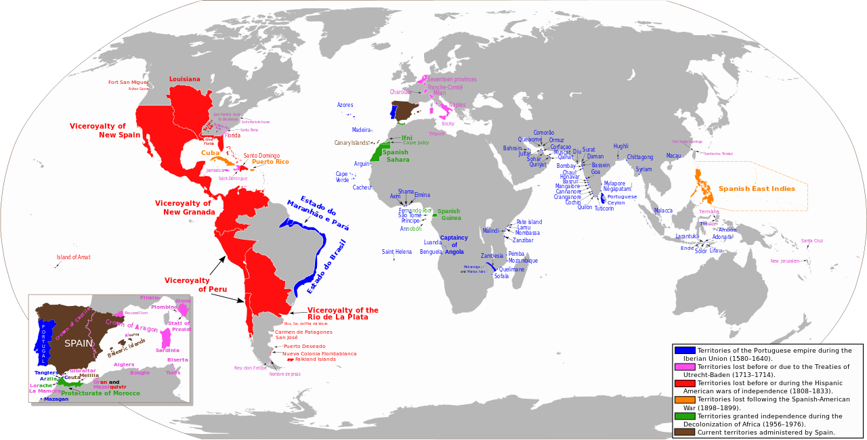
Spanish-Portuguese Territories

Slide 7
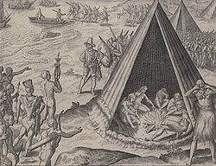
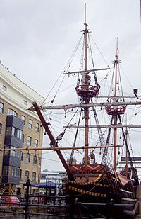
British Explorers
Iberian Union 1580-1640
British maritime trade expanded after defeat of Spanish Armada in 1588
1540 – 1596 Sir Francis Drake – 1st English discovery of New World, claimed part of California for Elizabeth, 1st Englishman to circumnavigate the world, Golden Hind
1554 – 1618 Sir Walter Raleigh – named Virginia after Elizabeth, Roanoke Colony, tried to find El Dorado

Slide 8
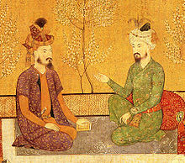
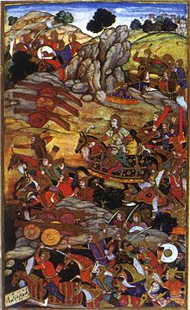
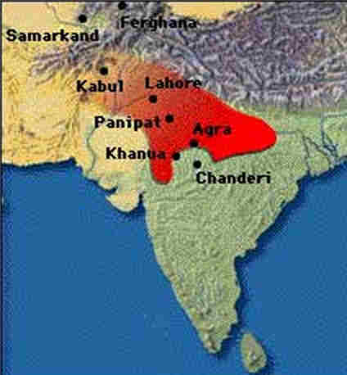
Babur and the Mughal Empire
Born 1483 in Central Asia
Descendant of both Genghis Khan and Tamerlane
1495 – Ruler of Farghana
Sieged Samarkand (Tamerlane’s old capital) several times
1504 – crossed Hindu Kush and captured Kabul
1513 – Ottoman Empire agreed to help Babur in his conquests
1526- First Battle of Panipat, last king of Lodi Dynasty killed
Babur took Delhi and Agra
Declared formation of Mughal Empire
1531 – Succeeded by son Humayun

Slide 9
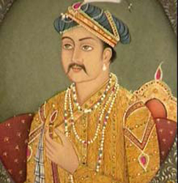
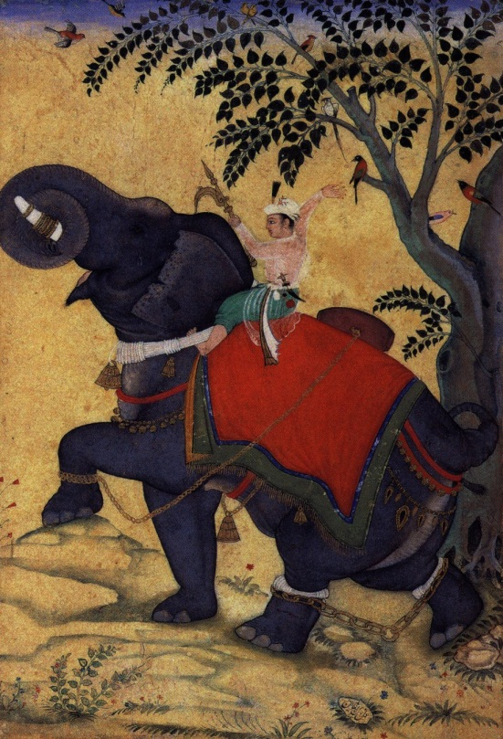
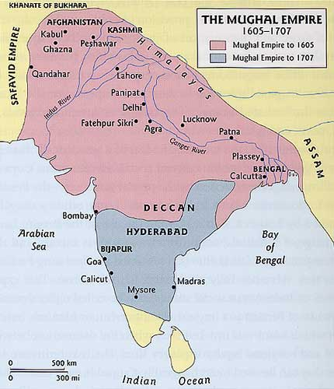
Akbar the Great
Grandson of Babur
Emperor 1556-1605
Repealed Muslim jizya tax, created Din-i-Ilahi
“Gunpowder Empire”
Capital Fatehpur (City of Victory), moved capital to Agra
Jesuits from Goa

Slide 10
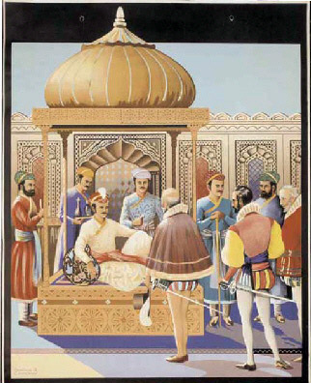
Akbar International Relations
Ottoman Suleiman the Magnificent tried to get Mughal help to weaken Portuguese navy
Received envoys from Queen Elizabeth I
Married Hindu Rajpat princess
Grandson Shah Jahan, builder of Taj Mahal in Agra
Jahangir rebelled against him

Slide 11
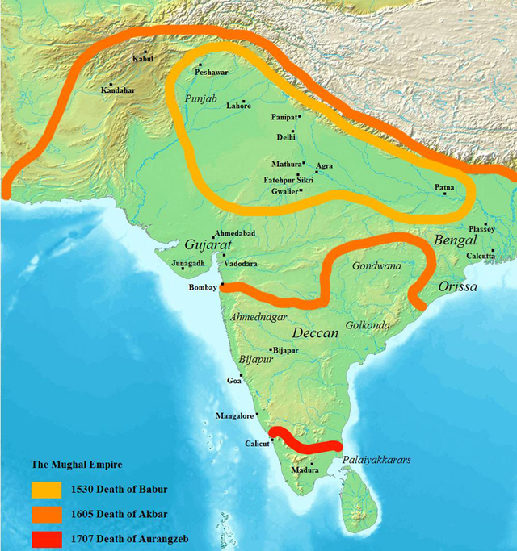

Slide 12
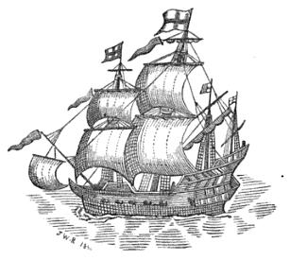
The British East India Company
1600 – Royal Charter given by Elizabeth I
Oldest European east Indies company
Had their own military
Charter gave monopoly on all trade between Cape of Good Hope and Straits of Magellan
Dutch East India Company major competitor
Jahangir gave BEIC permission

Slide 13
"Upon which assurance of your royal love I have given my general command to all the kingdoms and ports of my dominions to receive all the merchants of the English nation as the subjects of my friend; that in what place soever they choose to live, they may have free liberty without any restraint; and at what port soever they shall arrive, that neither Portugal nor any other shall dare to molest their quiet; and in what city soever they shall have residence, I have commanded all my governors and captains to give them freedom answerable to their own desires; to sell, buy, and to transport into their country at their pleasure. For confirmation of our love and friendship, I desire your Majesty to command your merchants to bring in their ships of all sorts of rarities and rich goods fit for my palace; and that you be pleased to send me your royal letters by every opportunity, that I may rejoice in your health and prosperous affairs; that our friendship may be interchanged and eternal"
—Nuruddin Salim Jahangir, Letter to James I.

Slide 14
Baroque Style: Music, Architecture, Sculpture, Painting
Handel – Water Music
Bach – Well-Tempered Clavier, Mass in B Minor, Brandenburg Concertos
Vivaldi – Four Seasons
Pachelbel – Canon in D Major
Architecture: grandeur & impressive, flashy designs
Painting: intense lighting/shading
Lots of Baroque art was a reaction to Reformation

Slide 15
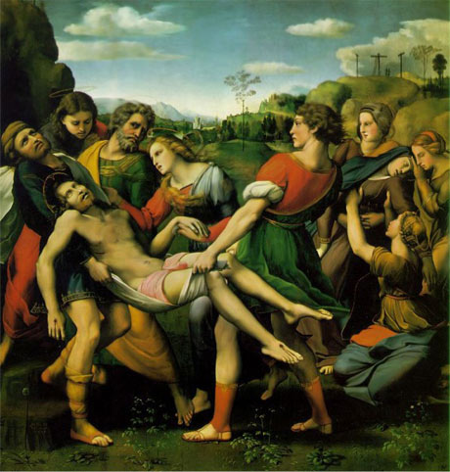
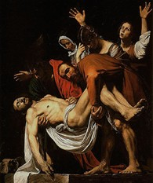
Comparing Renaissance and Baroque

Slide 16
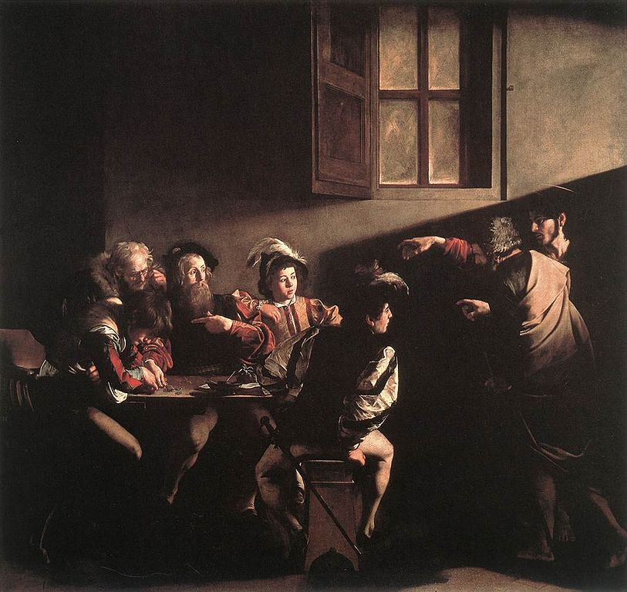
The Calling of St. Matthew, 1600 by Caravaggio
Italian
Light leads to Matthew
Extreme chiaroscuro, called tenebrism

Slide 17
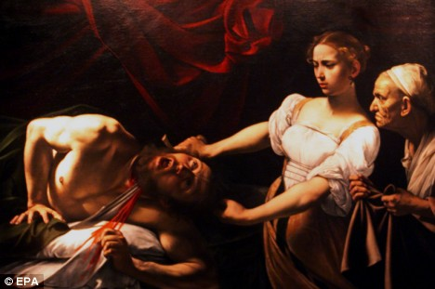
Judith Beheading Holofernes, 1599 by Caravaggio
Emotion
Judith in light and white
Lines lead to head

Slide 18
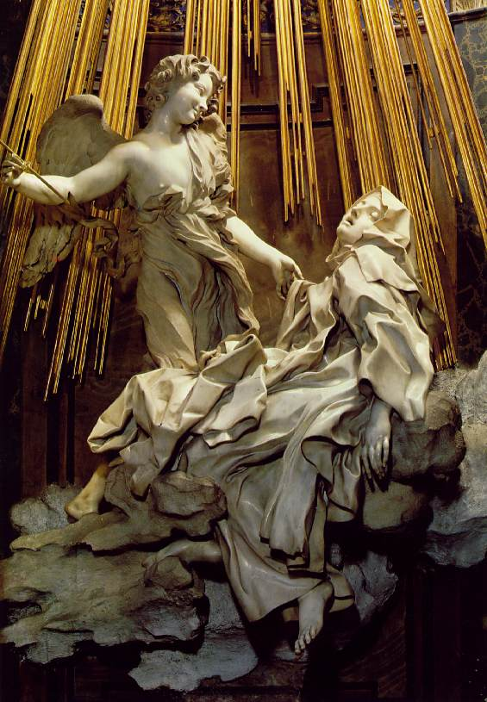
The Ecstasy of St. Theresa, by Bernini
Italian artist, sculptor
Face, toes
Arrow piercing heart
drapery
Notable works:
Fountain of Four Rivers; four sculptures of gods to represent the Nile, La Plata, Danube, and Ganges
Apollo and Daphne
St. Peter’s Basilica; made the baldacchino (canopy) beneath the dome

Slide 19
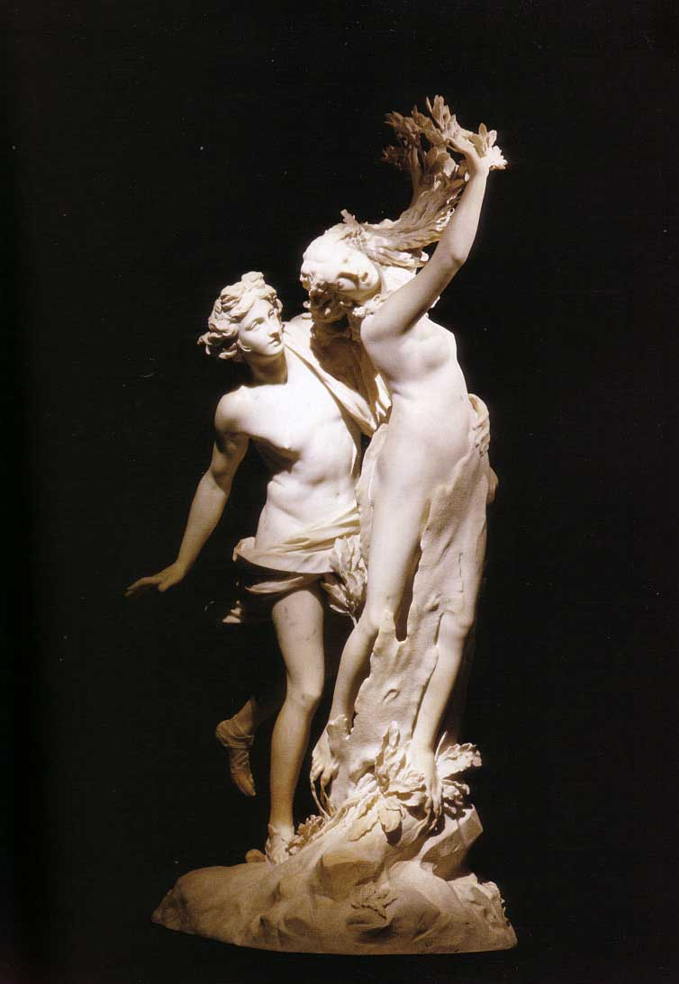
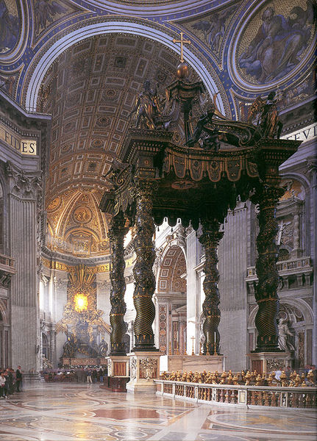
More Bernini
Apollo and Daphne
Baldachino above altar of St. Peter’s

Slide 20
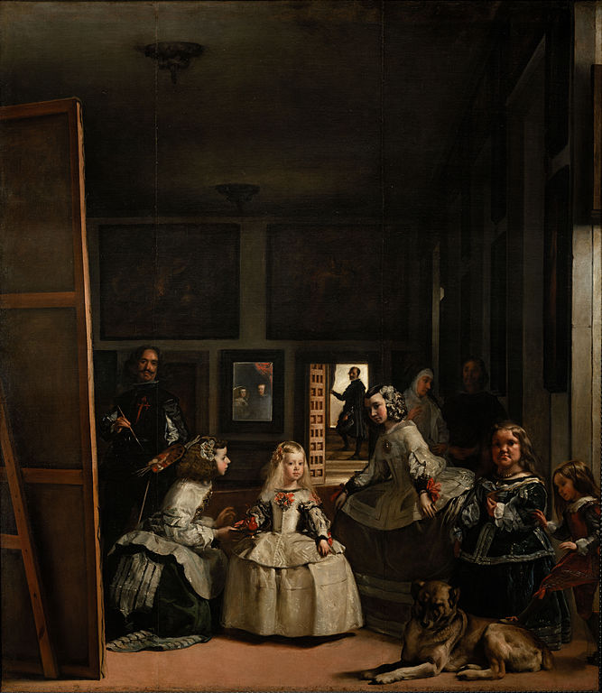
Las Meninas, 1656 by Diego Velasquez
Spanish court painter
Man in door
Dwarf
Dog
Subjects in mirror
Painter painted himself

Slide 21
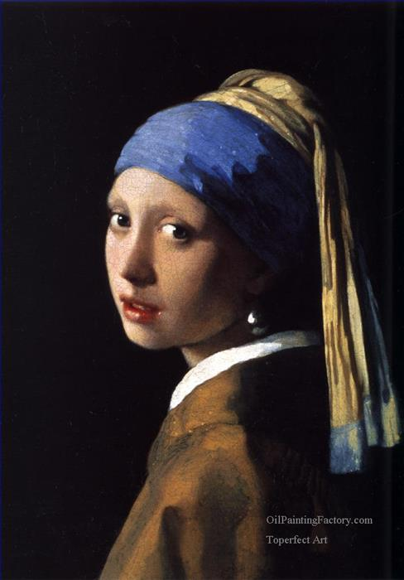
Girl with a Pearl Earring, 1665 by Johannes Vermeer
Dutch
Light from the left
Earring attracts light

Slide 22
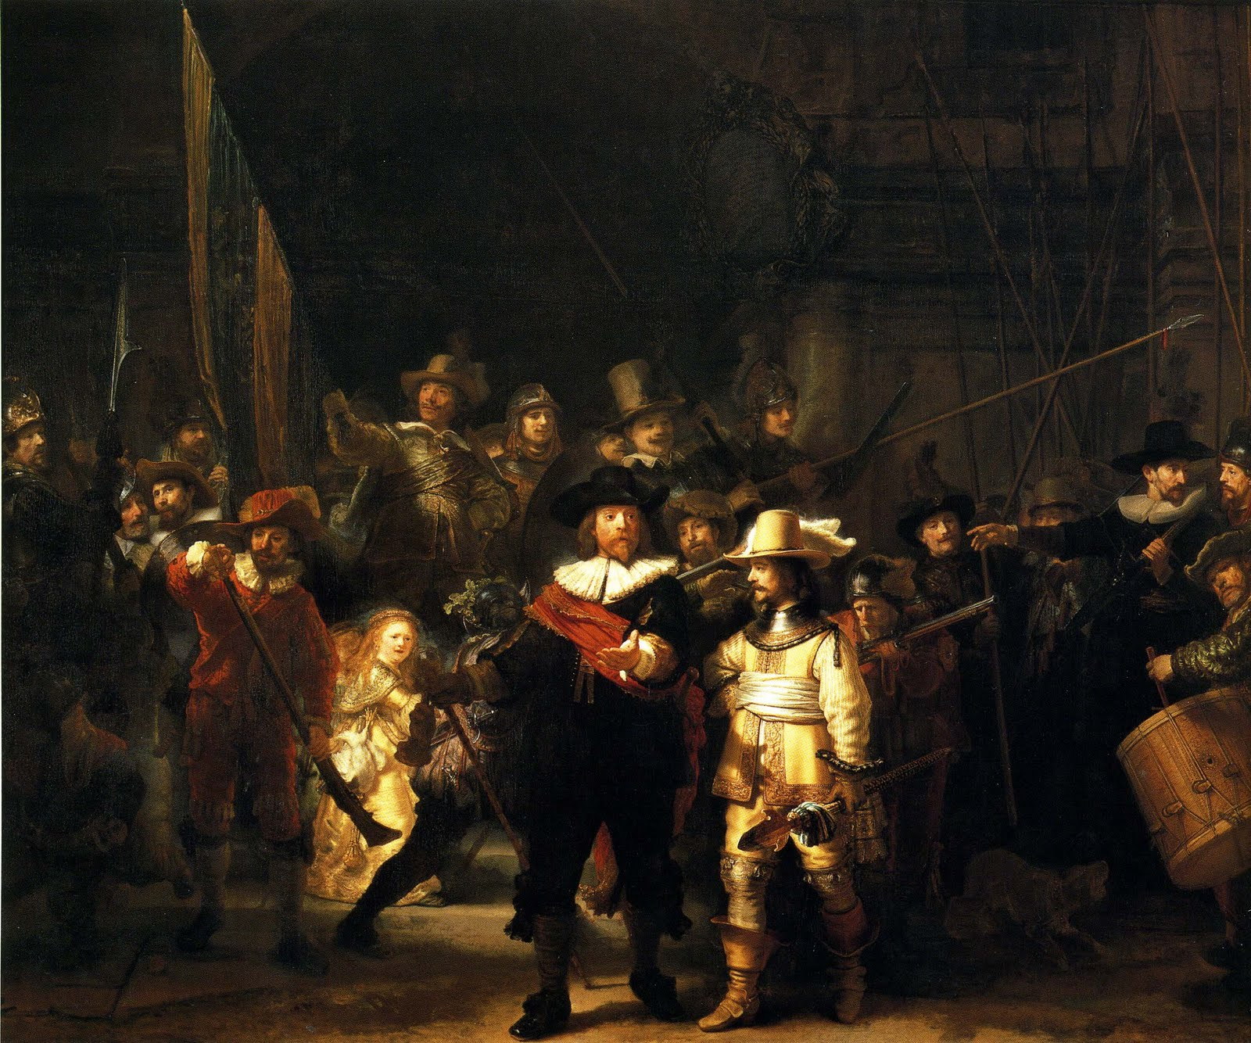
The Nightwatch, by Rembrandt
Dutch
part of the “Dutch Golden Age”
Wife, Saskia, included in some of his works
Military group
Woman holding chicken
Shield with 18 names
Dog barking at drummer
Notable works:
Belshazzar’s Feast: Babylonian king watches illuminated Hebrew letters being writ on a wall

Slide 23
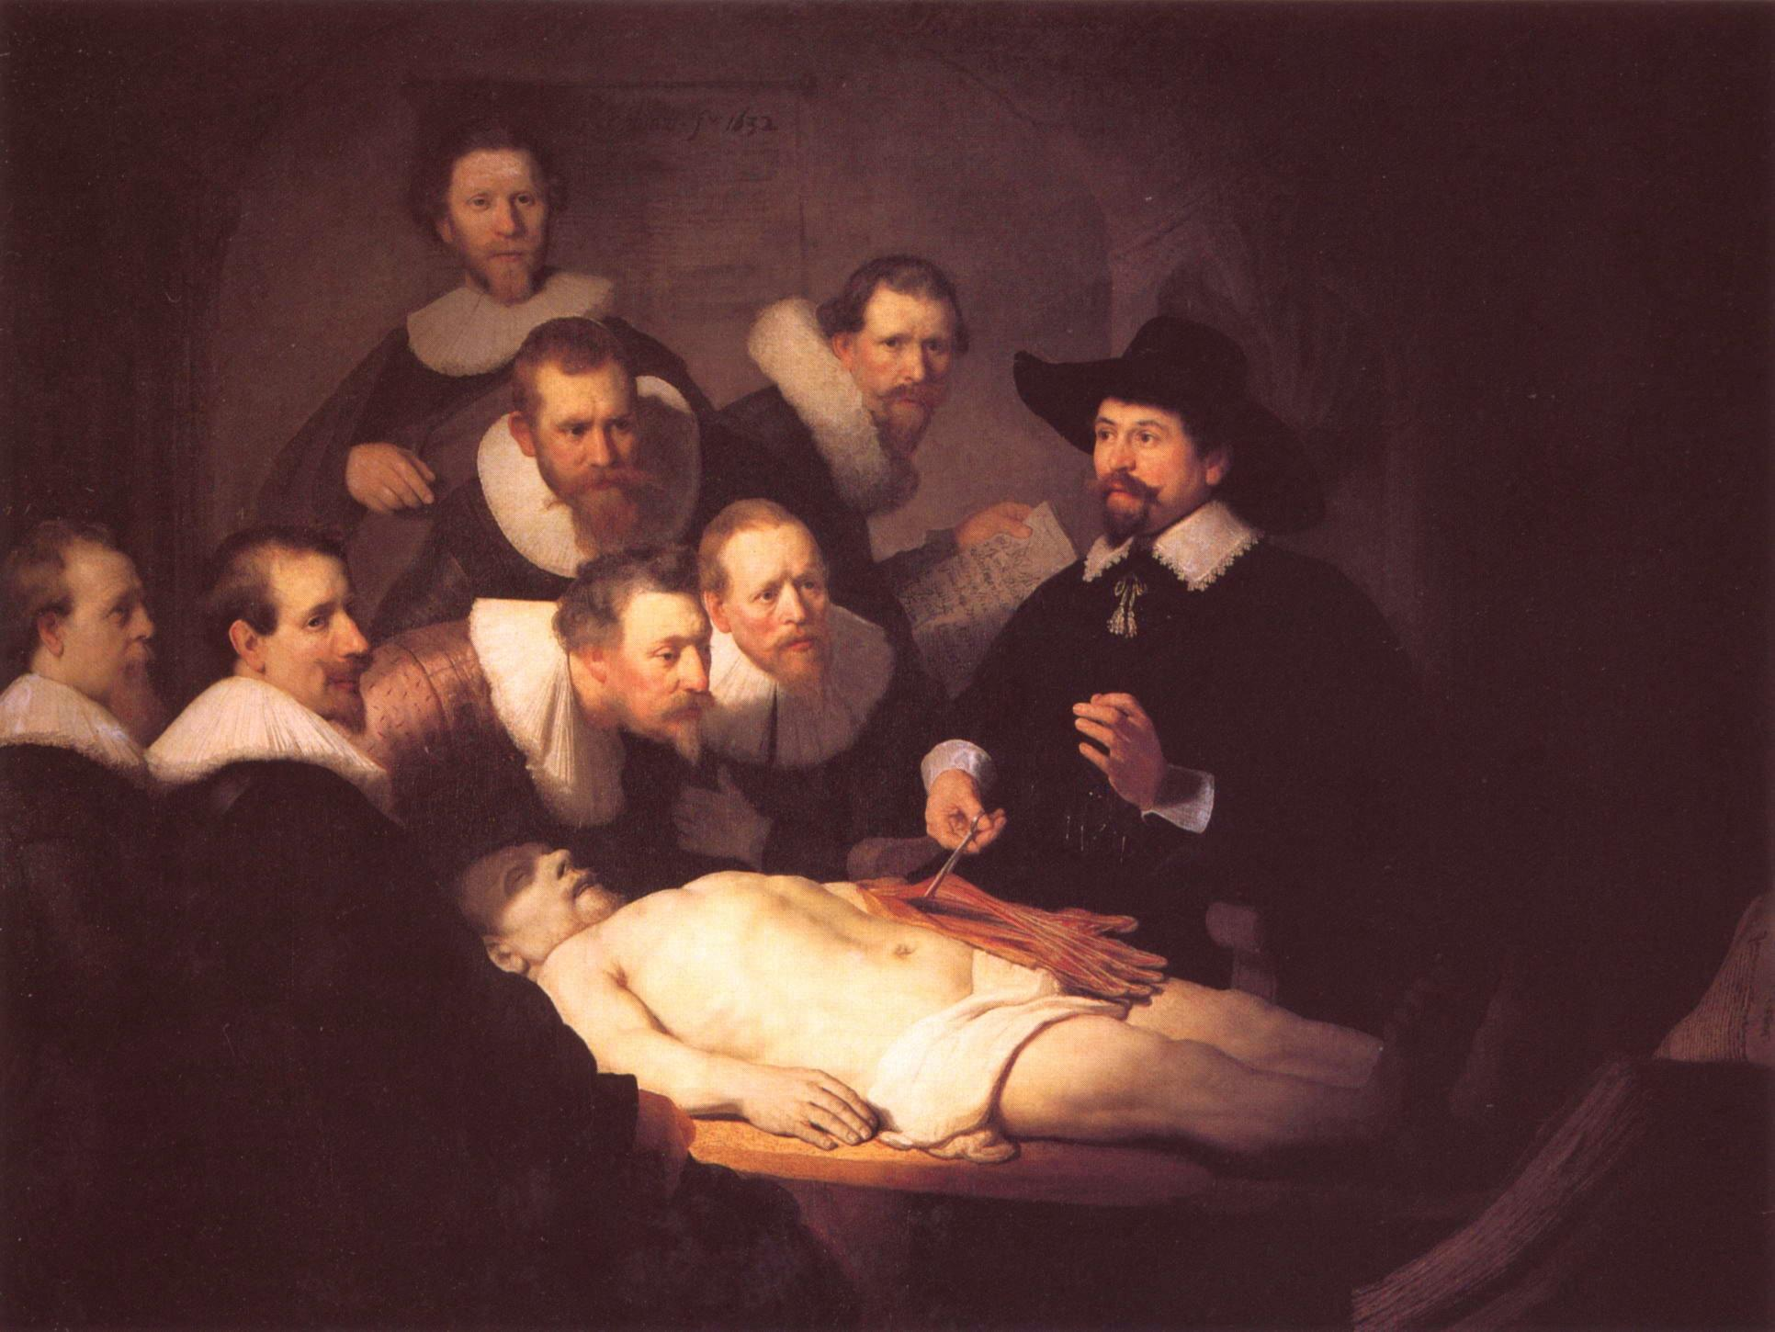
Anatomy Lesson of Dr. Nicolaes Tulp, 1632 by Rembrandt
Typical Dutch attire
Examining forearm

Slide 24
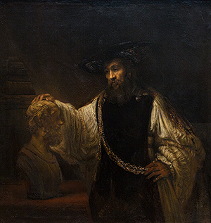
Aristotle Contemplating the Bust of Homer, by Rembrandt

Slide 25
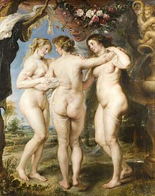
The Three Graces, by Peter Paul Rubens
Rubenesque bodies
Lighter flesh tones

