Slide 1
Tossup 1
The aftermath of this event has recently been researched by Australian engineer David Billings, whose findings are disputed.
Unfamiliarity with or lack of new direction-finding antennae is theorized to be one cause of this event, which was followed by a search by the USGS Itasca.
The main subject of this event was accompanied by Fred Noonan, and a longstanding theory to explain this event is that the Japanese military on Saipan were at blame.
It took place after radio contact was lost with a Lockheed 10E near Howland Island.
For 10 points, name this event after which the first female to fly solo across the Atlantic was never heard from again.
ANSWER: Disappearance of Amelia Earhart [accept obvious equivalents]

Slide 2
Tossup 2
After his greatest defeat, this man went into self-exile and led Seleucid forces belonging to Antiochus III at the Eurymedon River.
This man's siege of Saguntum resulted in his most famous war, during which he faced scorched- earth tactics that resulted in Fabius Maximus' nickname, "the Delayer."
This general pinned the army of Flaminius against Lake Trasimene in one victory and was assisted by his brother Mago in wiping out forces under the consuls Paullus and Varro at the Battle of Cannae.
The invasion of Scipio Africanus recalled this man to his home city.
For 10 points, name this Carthaginian general of the Second Punic War who led elephants across the Alps.
ANSWER: Hannibal Barca

Slide 3
Tossup 3
In one of these works, a shepherd ventures to a bridge and finds a snow white bone that magically states that his brother murdered him in the aftermath of a boar hunt.
The second volume of them ends before a little boy can use a golden key to open an iron chest.
One of these works describes how a donkey, a rooster, a cat and a dog scare away robbers in a cottage.
They include a work about a clever boy that gouges out the eye of his fiancé after mishandling his previous gifts.
One of these works sees the title figures return home by using pebbles, only to get lost the next day at a house made out of gingerbread and cakes.
These works include "Town Musicians of Bremen" and "Rumpelstiltskin." For 10 points, name these fairy tales written by a pair of German brothers.
ANSWER: stories by the Brothers Grimm

Slide 4
Tossup 4
In October 2013, the University of Malaysia awarded this world leader an honorary doctorate in economics.
He was visited by an escaped sushi chef who had previously served his father.
This figure's first public speech was converted into the hymn "Onwards Toward the Final Victory."
His government once threatened to "strike mercilessly without notice" in a fax to a neighboring country.
In December 2013, this leader executed his (*) uncle, who had been his second-in-command.
This "Supreme Leader" is currently the youngest head of state in the world.
For ten points, name this current leader of North Korea who came to power after the death of his father Kim Jong-il.
ANSWER: Kim Jong-un [prompt on partial answer]

Slide 6
Tossup 5
One of this band's songs begins prominently featuring two violas in its backing track.
This band sang "I can stay / till it's time to go" in the responses to a reprise of the first verse of one of their songs.
In one song by this band, a guitar slide down a minor third always precedes the words "Oh no."
The last section of that song by this band constantly repeats the nonsense lyrics "Hela heba helloa."
One of their songs begins with the line "You say yes, I say no / You say stop and I say go go go."
For 10 points, name this British band behind singles like "Hello, Goodbye " and "Yellow Submarine," which were written by its members John Lennon and Paul McCartney.
ANSWER: The Beatles

Slide 7
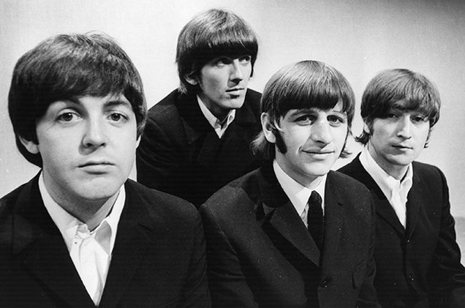

Slide 8
Tossup 6
The recently-discovered F16 antibody binds to all 16 subtypes of a protein expressed by this pathogen.
During infection, this pathogen's matrix protein M1 dissociates from the ribonucleoprotein after M2 proton channel activity lowers the pH.
Another protein expressed by this pathogen is cleaved by proteases into two forms, one of which extends a triple alpha helix to the endosomal membrane.
This pathogen, whose different strains are all members of Orthomyxoviridae, binds to sialic acid-rich sites.
Different subtypes of its surface proteins (*) hemagglutinin and neuraminidase are used for classification.
Cold temperatures contribute to its spread during its namesake "season" in winter.
For 10 points, name this virus whose H1N1 "swine" strain emerged in 2009.
ANSWER: influenza virus [accept Orthomyxoviridae before mention]

Slide 9
Tossup 7
This character questioned his identity so much during the Watergate scandal that he chose to give up his identity and become Nomad; prior to that, he had worked with The Falcon.
After the events of the Civil War, this character opposed the mandatory registration of all superheroes and fought Iron Man, but was killed on the steps of a federal courthouse.
This character became a superhero after he was bathed in the Super Solider serum, and he began fighting Nazis in Europe with the help of his sidekick Bucky.
For ten points, name this super hero whose real name is Steve Rodgers and who is equipped with a vibranium shield, a founder of the Avengers and a frequent adversary of the Red Skull.
ANSWER: Captain America

Slide 11
Tossup 8
The pastel version of this work, which was created two years after the first two versions, depicts one of the two people in the background leaning over the bridge and most clearly shows a boat in the background lake.
In the last version of this work, completed in 1910, the foreground character does not have eyeballs.
There is debate over whether this work's red sky was influenced by the Krakatoa eruption.
The 1893 pastel version of this work is displayed at the Nationalgalleriet in Oslo.
Name this work showing a man with his hands around his head and his mouth and eyes wide open, created by Edvard Munch [moonk].
ANSWER: The Scream (of Nature) [or Skrik or Der Schrei der Natur]

Slide 12
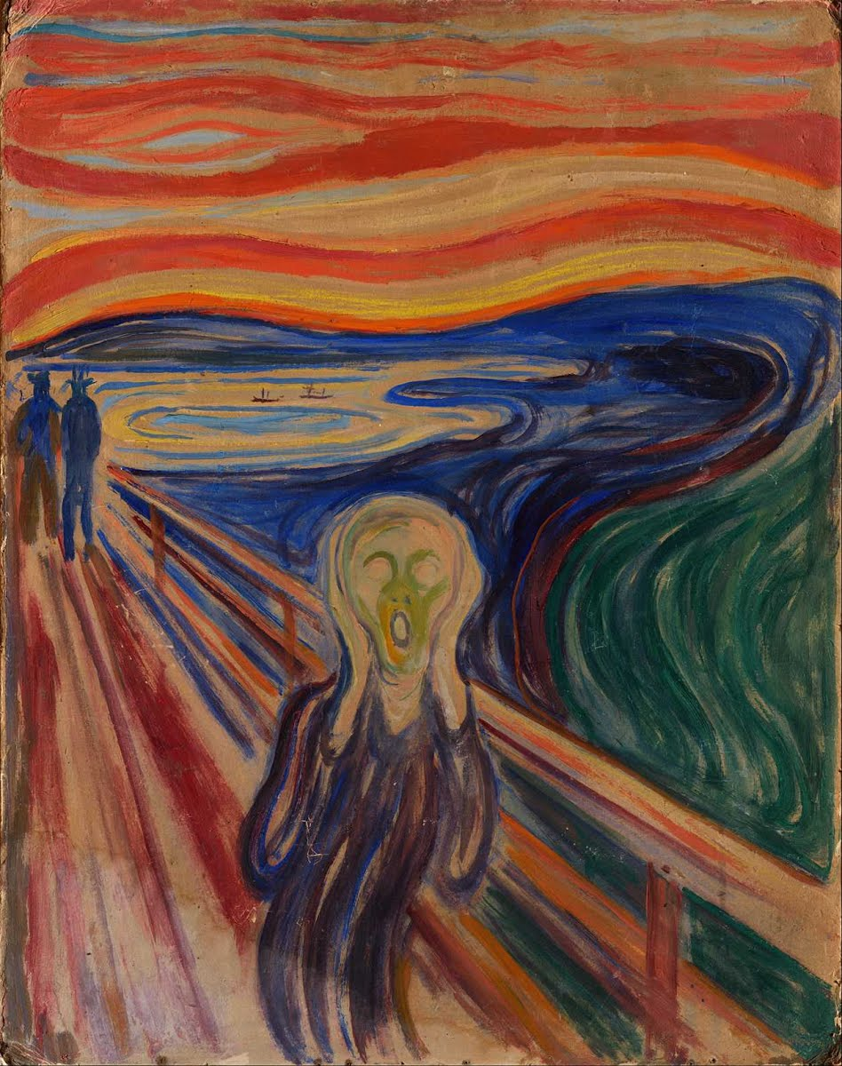
The Scream by Edvard Munch

Slide 13
Tossup 9
His first political affiliation was with the Vietnam-centered Liberty Union Party, and he once threw the election of Madeleine Kunin to the legislature as a spoiler candidate.
He defeated Richard Tarrant for the seat of the retiring (*) Jim Jeffords in 2006, after serving in the House and spending the 1980s as mayor of Burlington.
For 10 points name this self-declared socialist, an independent member of the Senate from Vermont.
ANSWER: Bernard "Bernie" Sanders

Slide 14
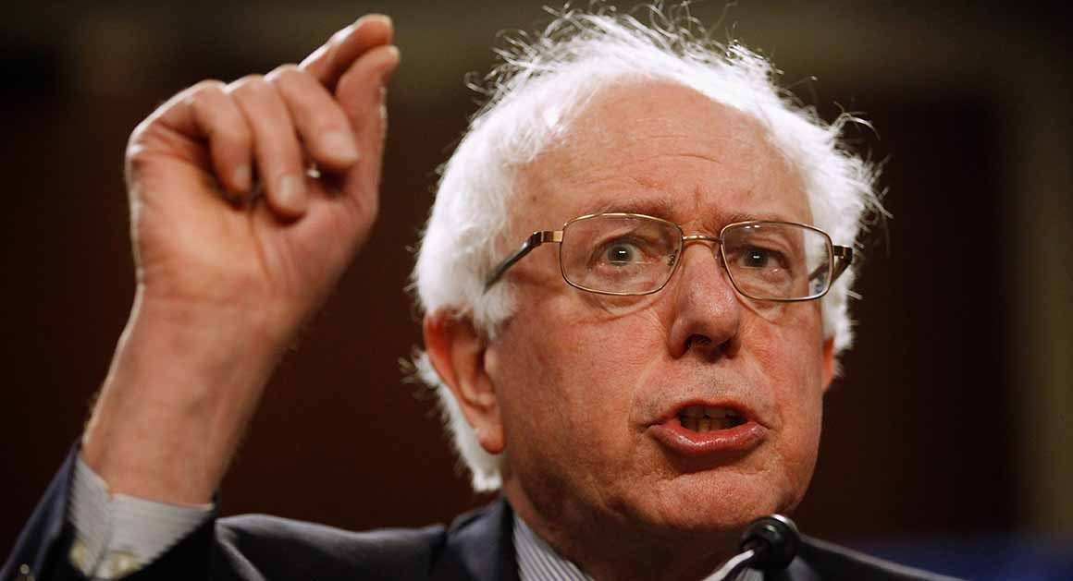

Slide 15
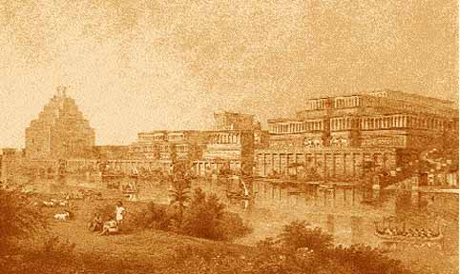
Mesopotamia

Slide 16
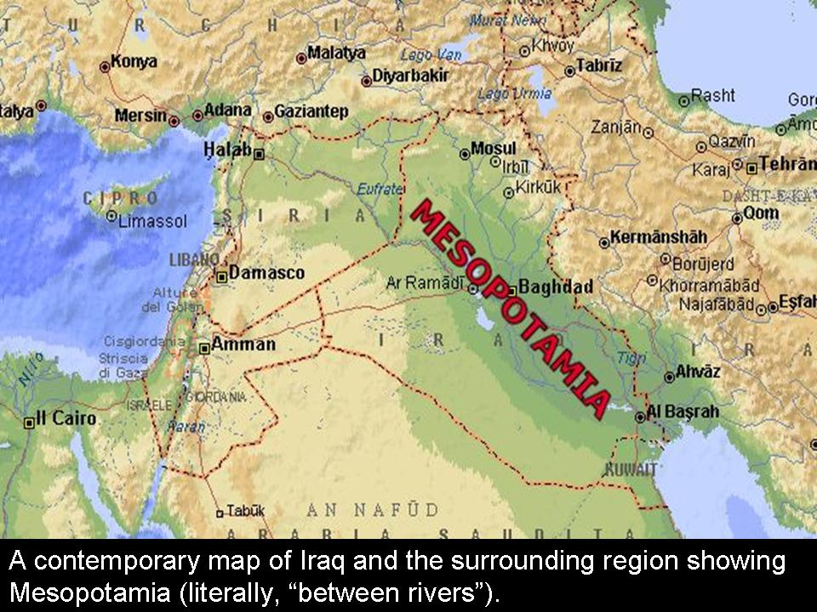
Where is Mesopotamia?
Present day Iraq, Turkey, Syria, Lebanon, Israel, Iran
Word means “land between two rivers”
The rivers are the Tigris and Euphrates
Tigris goes through Baghdad
Tigris is more eastern than Euphrates
Tigris forms Shatt-al-Arab with Euphrates
Fertile Crescent

Slide 17
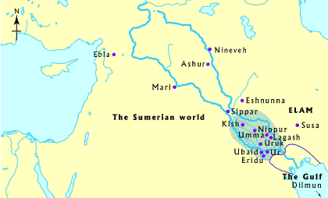
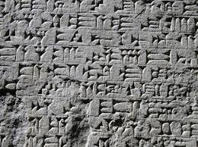
Sumeria
Earliest civilization including cities of Ur and Akkad
4000 – 2340 BC
Cuneiform – wedges in clay tablets
Epic of Gilgamesh
Ziggurats – stepped pyramids
Abraham from Ur

Slide 18
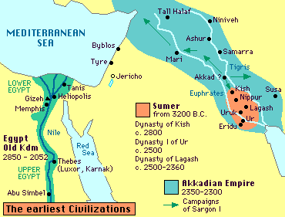
Akkadians
2340-2230 BC, centered at Akkad
Sargon the Great – served as cupbearer for king of Kish (a Sumerian city) before conquering Sumerian cities
Naram-Sin – another well-known leader

Slide 19
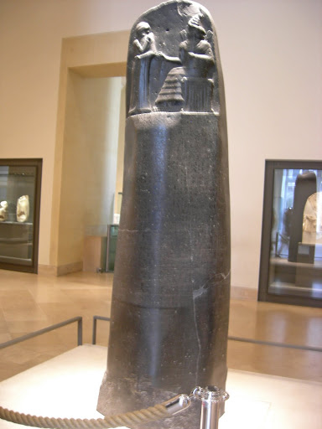
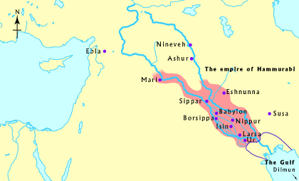
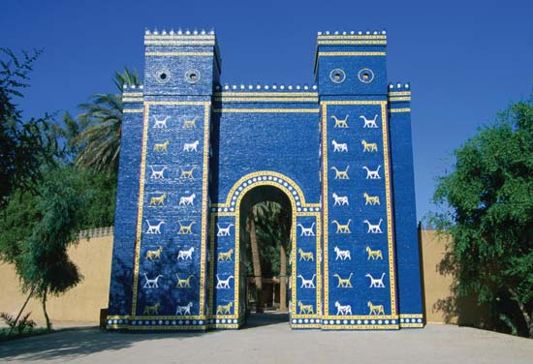
Babylonians
1800 BC – 1650 BC
Hammurabi
The Law Code of Hammurabi – oldest law code in history
“Eye for an eye”
The Stele

Slide 20
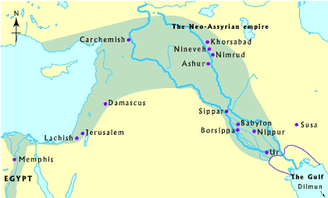
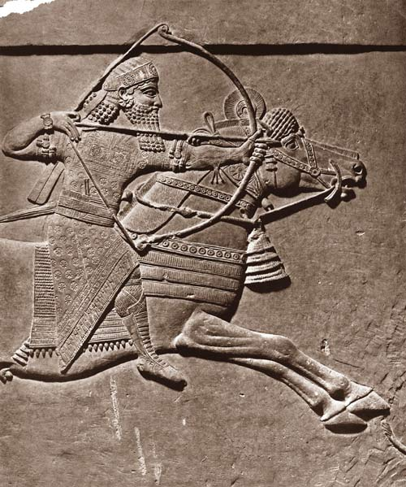
The Assyrians, 7th Century BC
Early king – Tiglath-Pileser I
King Ashurbanipal – more well-known
Capitals as Ashur and later Nineveh
Conquered by Medes and Chaldeans after death of Ashurbanipal

Slide 21
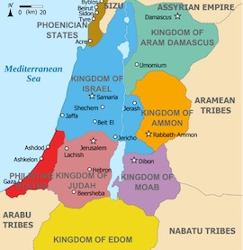
Judea
1800 BC – Abraham originally from Ur (in Babylon)
Isaac, Jacob (Israel), 12 sons including Joseph
Captivity in Egypt
1300 BC – Moses born
Israelites freed during Ramses II reign, return to Palestine
10th Century BC – after the wise King Solomon, Israel divides into two kingdoms, Judah and Israel, for 200 years
Conquered by Chaldeans (Neo-Babylonians) Babylonian Captivity – 6th or 5th century BC

Slide 22
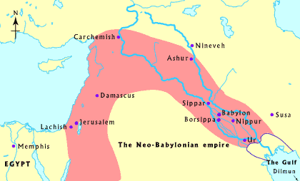
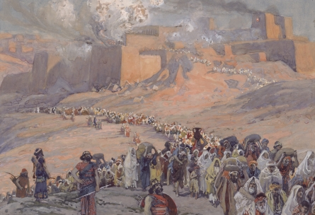
Chaldeans (Neo-Babylonians)
626-539 BC
612 BC - allied with Medes to defeat Assyrians
Nebuchadnezzar II – won battle of Carchemish, built Hanging Gardens of Babylon and Ishtar Gate
Took Hebrews (Israelites) into slavery, destroyed the temple in Jerusalem

Slide 23
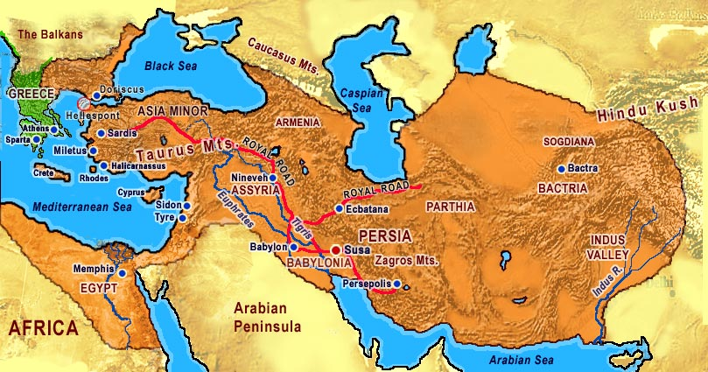
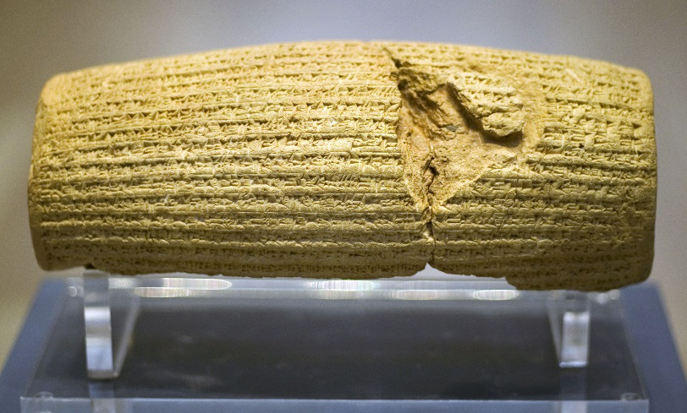
Persian Empire
Achaemenid Dynasty 550-330 BC founded by Cyrus the Great
Cyrus the Great defeated Nabonidus, ending Babylonian Empire
Cyrus freed Israel from Babylonian Captivity
Cyrus Cylinder – Cyrus chosen by the god Marduk, repatriation of displaced people groups, prayer to Marduk for Cyrus and son Cambyses
518 BC – Darius the Great took power, built Persepolis

Slide 24
Mesopotamian Literature
Epic of Gilgamesh
Epic poem about Gilgamesh, king of Uruk
Enkidu – close companion of Gilgamesh and wild man, tamed by temple harlot Shamhat
Goddess Ishtar – made advances but rejected by Gilgamesh, she sends Bull of Heaven to attack him
They defeat Humbaba, giant guardian of Cedar Forest appointed by god Enlil
They cut down trees and take them back home
Enkidu dies from illness
Gilgamesh mourns his friend
Gilgamesh searches for eternal life
Talks to Utnapishtim who was a survivor of the Great Flood and given eternal life from the gods
Gilgamesh fails to find eternal life and returns to Uruk

Slide 25
Mesopotamian Religion
Zoroastrianism (Persian)
Polytheistic gods (Babylon)
Dualistic religion founded by prophet Zoroaster
Ahura Mazda – supreme god, having being and mind
Ahriman – the one destructive spirit
Zoroastrianism coexisted with polytheism during Achaemenid Dynasty
Ishtar – goddess of war, love, fertility, lover of Tammuz, god of the harvest
Marduk - son of Ea, slayer of dragon Tiamat, chief god of Babylon

Slide 26
Tossup
It opens by describing the great deeds done by Anu, and it gives payments of gold and silver in units of minu.
It was discovered in 1901 by J. De Morgan and V. Schiel at the site of Susa, the former capital of the Elamite civilization.
Its final section discusses slaves who disobey their masters, right before an epilogue which thanks the gods Zamama and Ishtar.
Currently located in the Louvre, other parts discuss the taking of a second wife, the payment of physicians, and cutting off the hand of a son for striking his father.
Featuring a section of "an eye for an eye", this is, FTP, what legal code of a Babylonian king?
ANSWER: Hammurabi's code/law

Slide 27
Tossup
This mythological figure built a palace named Esharra after his greatest victory, and he gave his son Nabu a dragon named Mushussu.
His father warned a figure of a great flood that would destroy mankind, and his four horses each held poison in their mouths.
He organized the years into months after his victory over a monster.
He created tornados with the winds given to him by Anu, and he disturbed a monster that he would later defeat with a net and an arrow.
For 10 points, name this god who defeated Tiamat in a battle to become the chief god of Babylon.
ANSWER: Marduk [accept Bel]

Slide 28
Tossup
This figure's son defeated Psamtik III at the Battle of Pelusium but later lost his army to a sandstorm while attempting to capture the Siwa Oasis.
This figure was killed by the Massagetae under Queen Tomyris.
His victory at the Battle of Thymbra led to his capture of Croesus of (*) Lydia.
His namesake cylinder, which was excavated from a temple dedicated to Marduk, tells of his defeat of Nabonidus, which ended the Babylonian Captivity.
He established his capital at Pasargadae after defeating his grandfather Astyages, who was the leader of the Medes.
For ten points, identify this founder of the Achaemenid Persian Empire.
ANSWER: Cyrus the Great [or Cyrus II; or Cyrus the Elder; prompt on Cyrus]

Slide 29
Tossup
This man assumed the throne after winning the Battle of Carchemish, in which he defeated Egypt to conquer Syria and Phoenicia.
He went to great lengths to rebuild his empire to its former glory, overseeing construction of Entemenanki, Ezida, Esagila, and the Ishtar Gate during the sixth century BCE.
The Hebrew Bible, mainly the books of Daniel and Jeremiah, details his destruction of Jerusalem and the Temple, as well as the attempted murder of three Jews by tossing them into a fiery furnace only to watch them come out unharmed.
Name this Chaldean king most famous for the Hanging Gardens of Babylon.
ANSWER: Nebuchadnezzar II

Slide 30
Tossup
In his first appearance, this figure's "womanly hair" is compared to that of Nisaba, the goddess of corn.
After only ever drinking milk from animals, this figure's first encounter with alcohol ends with him drinking seven full goblets of wine.
This figure finds that he can no longer chase gazelle after spending six days and seven nights sleeping with a harlot.
This figure's arrival is presaged by dreams of a falling meteorite and of an axe that won't budge.
After this figure's death, his companion seeks out of a plant to renew his youth at the bottom of the ocean on the advice of the flood survivor Utnapishtim.
This man is cursed to die after he aids his more famous companion in defeating the Guardian of the Cedar Forest and the Bull of Heaven.
For 10 points, name this Mesopotamian wild man, the bosomcompanion of Gilgamesh.
ANSWER: Enkidu

Slide 31
Tossup
After stealing "mes" from one deity, this deity was pursued by sea monsters known as Abgallu, although she successfully escaped.
While in the underworld, this deity had to be revived by the water of life after an incident in which she was forced to shed an article of clothing at each gate she passed, as part of this deity's failed attempt to retrieve her consort Tammuz.
This deity once asked Gilgamesh to be her new lover, but he refused, reminded by the ill fate that befell each of her previous consorts.
For 10 points, name this Mesopotamian goddess of fertility, love, and sex.
ANSWER: Ishtar [accept Inanna]

Slide 32
Tossup
A ruler of this empire defeated twelve kings at the Battle of Qarqar, which is described on the Kurkh monolith.
During one campaign, this empire's army retreated after a plague of mice chewed through their bowstrings.
After being deposed, this empire's final king allied with Necho II but was defeated at Carchemish.
This non-Median empire warred with the mountain-dwelling Urartu people and built statues of man-headed winged bulls called lamassu.
Essahardon and Tiglath-Pileser III ruled this empire during its "neo" period.
The Venus tablet was found in a library built in this empire's capital by its king Ashurbanipal.
For 10 points, name this ancient empire whose kings ruled from Nineveh.
ANSWER: Assyria [or Assyrian empire]

Slide 33
Tossup
Cyrus the Great allowed this structure to be built to replace a similar building destroyed during Nebuchadnezzar II's reign.
Judas Maccabaeus cleansed and rededicated this structure in events celebrated during Hanukkah.
This building served as the Sanhedrin's meeting place and was mostly destroyed in 70 AD.
For 10 points, the West, or Wailing, Wall is the only remaining part of the latter of what Jewish holy site?
ANSWER: Second Temple of Jerusalem [prompt on Temple of Jerusalem; do not accept "First Temple of Jerusalem"]

