Slide 1
The Spanish Armada and The Thirty Years’ War
Two seemingly unrelated events

Slide 2
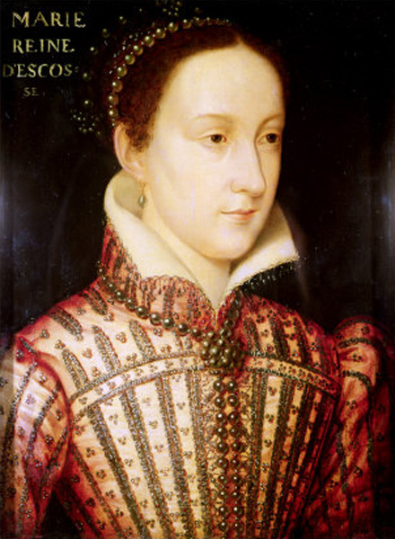
Mary, Queen of Scots
Eldest daughter of Henry VIII’s older sister, Catholic, raised in France
John Knox preached against her
Married Henry Stuart, Lord of Darnley
Darnley had her male secretary Rizzio killed
Darnley later killed, Mary and her friend Earl of Bothwell suspected, never accused
Mary marries Bothwell in Protestant service
Forced to abdicate, fled to England
Mary spent years under house arrest in England
Elizabeth did not free her
The Casket Letters (from Mary to Bothwell?)
Catholic support in England grows
1587 – executed by England
“As a sinner I am truly conscious of having often offended my Creator and I beg him to forgive me, but as a Queen and Sovereign, I am aware of no fault or offence for which I have to render account to anyone here below.”

Slide 4
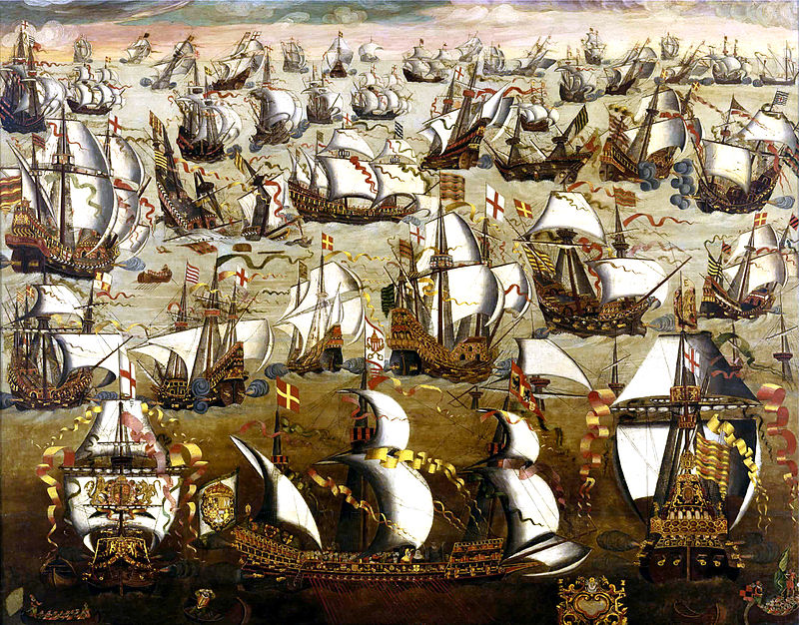
Why would Philip II attack England?
Spanish Netherlands
Sir Francis Drake, the privateer
Elizabeth I had Mary, Queen of Scots executed
Protestant vs. Catholic monarchs

Slide 5
Problems with the plan from the beginning
No suitable port in Spanish Netherlands to pick up reinforcements
Duke of Medina was not an admiral
1587 - Drake attacked Cadiz before Armada set sail
Elizabeth’s Tilbury Speech

Slide 6
Elizabeth’s Tilbury Speech
My loving people We have been persuaded by some that are careful of our safety, to take heed how we commit our selves to armed multitudes, ….I am come amongst you, as you see, at this time, not for my recreation and disport, but being resolved, in the midst and heat of the battle, to live and die amongst you all; to lay down for my God, and for my kingdom, and my people, my honour and my blood, even in the dust. I know I have the body of a weak, feeble woman; but I have the heart and stomach of a king, and of a king of England too, and think foul scorn that Parma or Spain, or any prince of Europe, should dare to invade the borders of my realm; to which rather than any dishonour shall grow by me, I myself will take up arms, I myself will be your general, judge, and rewarder of every one of your virtues in the field…. we shall shortly have a famous victory over these enemies of my God, of my kingdom, and of my people.

Slide 7
The Spanish Armada 1588
Giambelli’s Hell Burners (fireships) at Battle of Gravelines
Western winds
The Irish
Scurvy
Starvation
67/130 ships survived
10,000/26,000 survived

Slide 8
British Colonies vs. Spanish Colonies since 1588
British Colonies
Spanish Colonies
13 American colonies
Belize
Canada
Bahamas, Barbados, Jamaica
Falkland Islands
Sudan, Kenya, Egypt
South Africa, Zimbabwe
Hong Kong
Australia, New Zealand, India
Central America
Cuba, Puerto Rico
South America (not Brazil)
Philippines

Slide 9
The Thirty Years’ War 1618-1648
Traditional side
Reformation side
Hapsburgs of Austria – Ferdinand II and Ferdinand III
Philip IV of Spain
Maximilian I of Bavaria (HRE)
German states loyal to Hapsburgs
Mainly Catholics, continuation of Counter-Reformation
Church property
France
Sweden
The Danes
The Dutch
Protestant Union under Frederick V of the Palitanate (HRE)
German states rebelling against Hapsburgs
Mainly Protestants

Slide 11
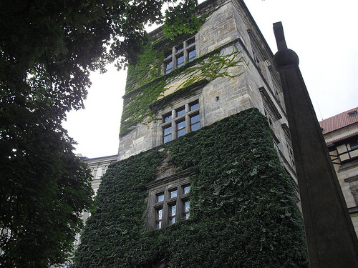
How it started: The Defenestration of Prague
Ferdinand’s (Catholic) predecessor Rudolf was pro-Protestant who had set up a Prot. Church in Bohemia that self-governed
Ferdinand dissolved it and took back lands
Catholic regents met dissolved assembly in Prague
They “left” through the window

Slide 12
Bohemian Phase, 1618-1621
Bohemians revolted against Hapsburgs (Ferdinand II)
Crowned Frederick V of the Palatinate as their king
Ferdinand fights back with help of Spain and Lutheran Saxony
Bohemians defeated near Prague at White Mountain
Spain gains land along Rhine River

Slide 13
The next two phases
Palatinate Phase, 1621-1624
Danish Phase, 1625-1630
The Palatinate sought to regain Rhine lands lost to Spain, the Dutch help
Protestants fail utterly
Unsuccessful attempts to convince James VI (King of England and Scotland) to help
French, English and Dutch form Prot. alliance led by Christian IV of Denmark
Defeated by Catholic League led by Bohemian Wallenstein
Edict of Restitution – attempt to weaken Protestant claims to land
Wallenstein removed from power by rulers

Slide 14
Swedish Phase, 1630-1634
Gustavus Adolphus of Sweden invades Germany, supplied by France
He defeats imperial army at Breitenfeld
Emperor recalls Wallenstein who meets Adolphus at Lutzen
Battle is a draw, Adolphus killed ☹
Spain and Hapsburgs join and annihilate Swedes at Nordlingen
Swedes lose all the territories they had gained
Wallenstein later murdered

Slide 15
French Phase and Peace of Westphalia, 1648
German territories finally made peace with HRE (Peace of Prague)
France declares war on HRE with help of Swedes
France gets Alsace
Swedes get cash and Bremen and Verdun
HRE very limited control over German states, lands remained secular
Catholic church still strong in Bohemia and Austria
Dutch independence from Spain

Slide 17
Don Quixote by Miguel Cervantes, 1605
Characters
Plot
Don Quixote
Sancho Panza – Don Quixote’s squire
Dulcinea – object of Don Quixote’s love
Rocinante – Don Quixote’s horse
Dapple – Panza’s donkey
Two books
Man thinks he’s a knight after reading books about chivalry
Sancho Panza acts as his squire
People humor him
He attacks windmills he thinks are giants
In 2nd book, he meets people who know him because they read the first book about him

Slide 18
Paradise Lost by John Milton, 1667
Epic poem
Quotes
Epic poem about the creation of the world
Retells the Jewish/Christian creation story from Genesis
Jusitfy the ways of God to men
It is better to reign in Hell than serve in Heaven

