Slide 1
1940s - 1950s
Korea, French Indochina, Cuba

Slide 2
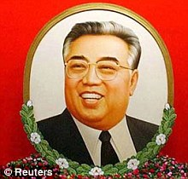
Kim Il-Sung, “The Great Leader”
Born 1912
Family in Korea during Japanese occupation, fled to Manchuria, influenced by communism there
1930s - Became anti-Japanese guerrilla leader, chased into USSR
1940-45 – served Red Army until end of WWII
1945 – 38th parallel established between USA and USSR occupation zones
1945 – USSR installed him as leader of leader of N. Korean communist party
1948 – DPR proclaimed, started to be called “The Great Leader”, legends about him

Slide 3
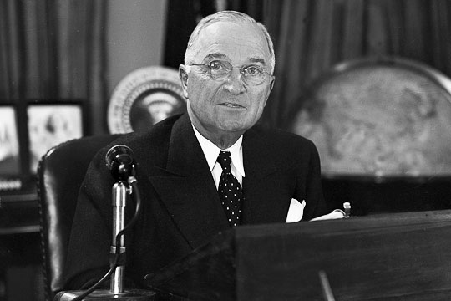
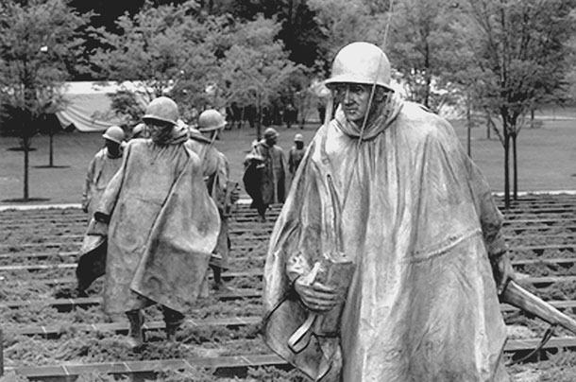
Korean War, 1950-53
Post WWII – USSR and USA divided Korea at 38th parallel
Syngman Rhee (ROK) v. Kim Il Sung (DPR)
June 25, 1950, North Korean army crossed the 38th parallel, capture Seoul and most of South, Staling reluctantly gave ok
July – USA enters, MacArthur’s landing at Inchon
ROK, UN forces and USA capture Pyongyang, push to the Yalu River
Mao tells Soviets China will intervene
Dec. 1950 - Chinese cross Yalu River
MacArthur wanted to cross into China and use ROC against PRC
April 1951 - Truman fires MacArthur
Possible invasion of Taiwan by PRC, Truman sends 7th Fleet to protect Taiwan, PRC withdraws
1953 – Armistice signed
The DMZ and the JSA

Slide 5
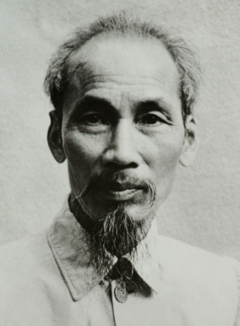
French Indochina
1880s - Laos, Cambodia, Vietnam all under French control
Three Vietnamese provinces
WWII – Japanese forces weakened French control
Viet Minh formed – communist nationalists led by Ho Chi Minh
1945 – Ho Chi Minh seizes Hanoi, beginning of First Indochina War between Viet Minh and French, lasted 9 years
1954 – French defeat at Dien Bien Phu, French withdrawal
Americans backed anti-communist south while Ho Chi Minh controlled north (Viet Cong)
USA installed Ngo Dinh Diem as leader of south

Slide 6
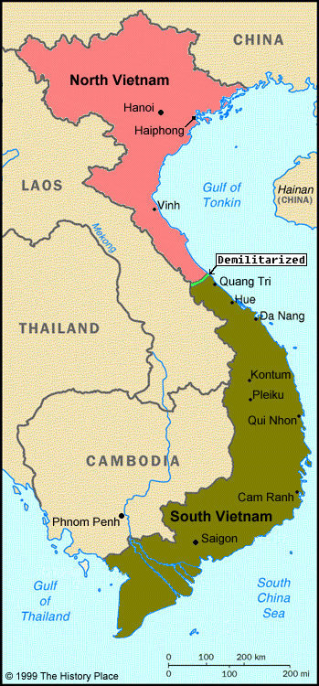
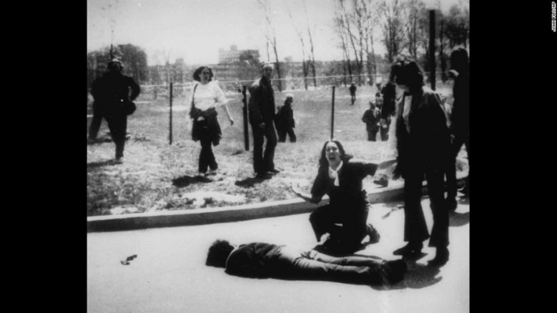
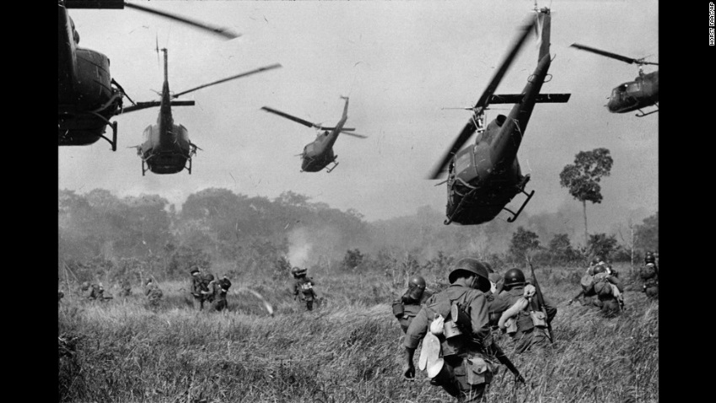
Vietnam War, 1965-1975
Gulf of Tonkin (USS Maddox)incident leads to resolution by USA
Robert McNamara – Sec. of Defense
William Westmoreland – commanded US forcecs
1968 – Tet Offensive and My Lai Massacre (Lt. William Calley)
Calley found guilty of murdering 22 civilians, Calley claimed he was following orders
1969 – Ho Chi Minh dies
1970 Kent State University shooting – students protesting Cambodian Campaign, Ohio National Guard, 4 killed, 9 wounded
Operation Frequent Wind - evacuation
1975 - Fall of Saigon, renamed Ho Chi Minh City, South Vietnam surrendered, reunification of Vietnam under

Slide 7
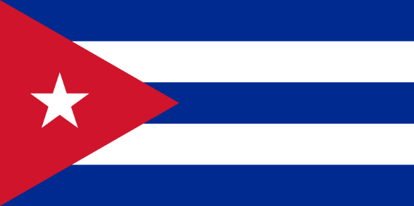
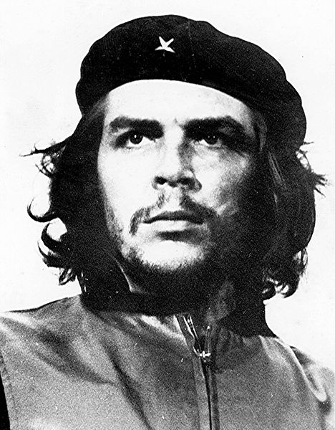
Cuban Revolution
Batista was president from 1940-44
1952 – coup led by Fulgencio Batista, USA supports, becomes dictator
1953 – Fidel Castro imprisoned
1950 – Che Guevara’s motorcycle journey
1955 – Castro set free, Che Guevara and Castro meet, 26th of July Movement
1955-1958 – Guerrilla war
1958 – Batista flees to DR
1960s – Che goes to S. America, killed in Bolivia (CIA)
1961 – Bay of Pigs Invasion
Castro really liked baseball

