Slide 1
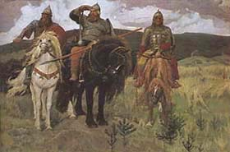
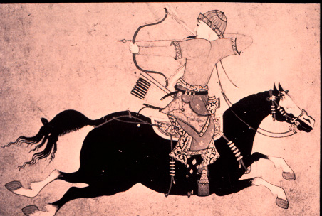
Rus and The Mongols

Slide 2
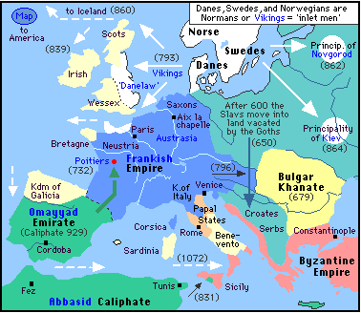
Migration of the Slavs

Slide 3
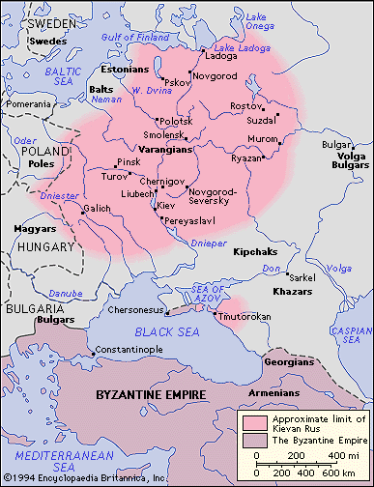
The Beginning of Rus
Slavs
862 – Rurik, a local chieftain establishes Rus centered at Novogrod
882 – Oleg adds Kiev to Rus
989 – Prince Vladimir I chooses Byzantine Orthodox Christianity as state religion

Slide 4
Pre-Mongol Eurasia

Slide 5
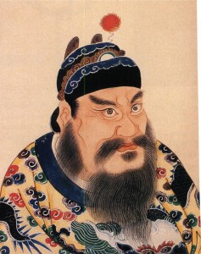
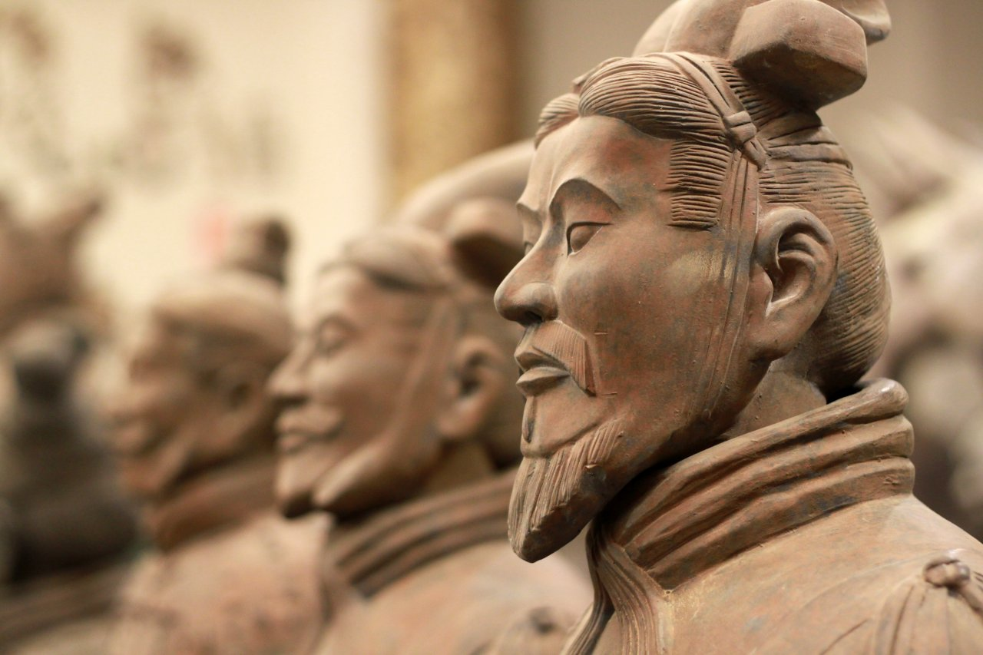
Major Chinese Dynasties
Warring States Period 475-221 BC
Qin 225-206 BC – Great Wall, terra-cotta warriors
Han 206 BC - 220 AD
Three Kingdoms 220-280
Jin 1115—1234 – Genghis Khan invades
Yuan 1271—1368 – Mongol-led, founded by Kublai Khan, grandson of Genghis
Ming 1368—1644 – Drives out Mongols, nice vases
Qing 1644—1911 – Last dynasty before Republic of China, overthrown by Chiang kai-Shek and Dr. Sun Yat-Sen

Slide 6
Temujin, 1206-1227
Born 1167
Mongols were nomadic
Yurts
1206 - Declared leader of all Mongol tribes, Genghis Khan (Chinggis Khan)
1211 – Invades Jin Dynasty in northern China
1227 – Genghis Khan dies, Ogodei is next Khan
Empire divided into Khanates

Slide 7
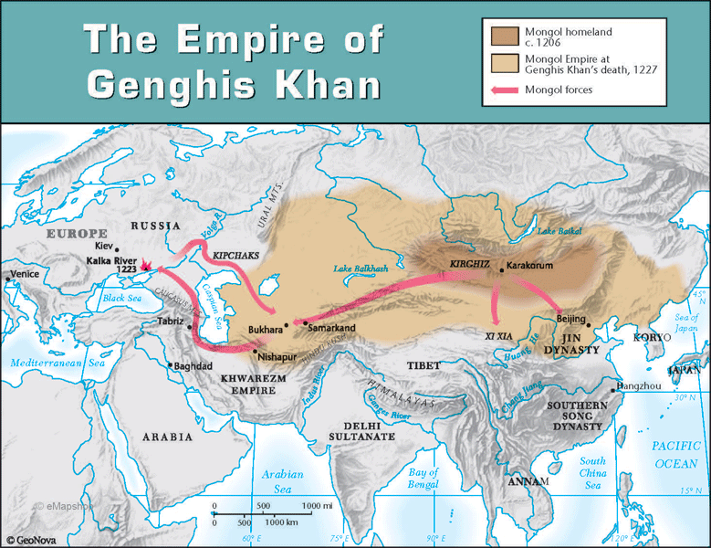

Slide 8
Khan Family Tree

Slide 9
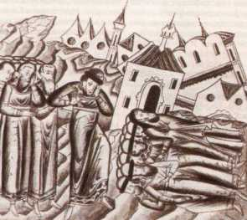
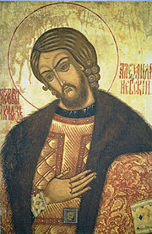
Invasion of Rus by Golden Horde
Ogedei (2nd Great Khan) ordered outer Khanates to conquer west
1235 - Batu Khan’s (grandson of Genghis Khan) Golden Horde and Tatars earlier conquered Crimean Peninsula
1236 - General Subatai crossed Volga River
Horde destroyed Vladimir and Moscow
1240 Kiev becomes vassal state
Novogrod not reached
Alexander Nevsky of Novogrod beat Teutonic Knights and Swedes
Batu appointed Alexander Nevsky Prince of Kiev Teutonic Knights and Swedes

Slide 10
The Khanates

Slide 11
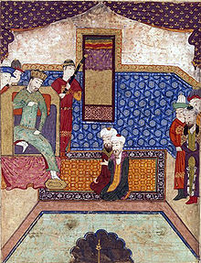
Guyuk Khan, 1246-1248
3rd Great Khan
Letter to Pope Innocent IV: "from the rising of the sun to its setting, all the lands have been made subject to the Great Khan“
Died while probably planning to assassinate Batu Khan
Mongols focused on Chinese afterwards instead of Europe

Slide 12
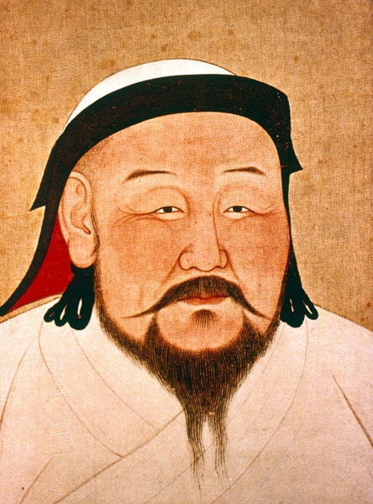
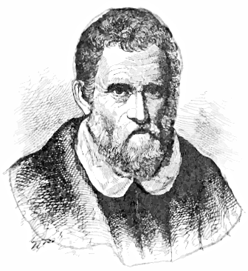
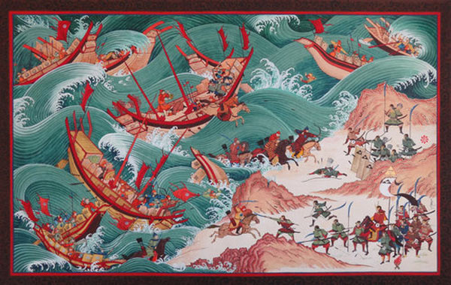
Kublai Khan, 1260-1294
1251-1259 Mongke Khan 4th Great Khan – added Syria and Iraq, made deals with Crusader kingdoms
Kublai Khan founded Yuan Dynasty, Chinese mandate of heaven
First non-Chinese to conquer all of China
Summer palace in Xanadu (subject of Coleridge poem), probably Shangdu
Marco Polo wrote of him in the Polo Travels
National paper currency
Rebuilt The Grand Canal
Son Temur (aka Tamerlane)
Two failed invasions of Japan: 1274, 1281
Kamikaze – “divine wind”

Slide 14
XANADU THE BALLAD OF KUBLAI KHAN by SAMUEL TAYLOR COLERIDGE (1816)
In Xanadu did Kublai Khan a stately pleasure-dome decree, where Alph, the sacred river, ran through caverns measureless to man down to a sunless sea, so twice five miles of fertile ground with walls and towers were girdled round. and there were gardens bright with sinuous rills, where blossom'd many an incense-bearing tree. And here were forests as ancient as the hills, enfolding sunny spots of greenery.

Slide 15
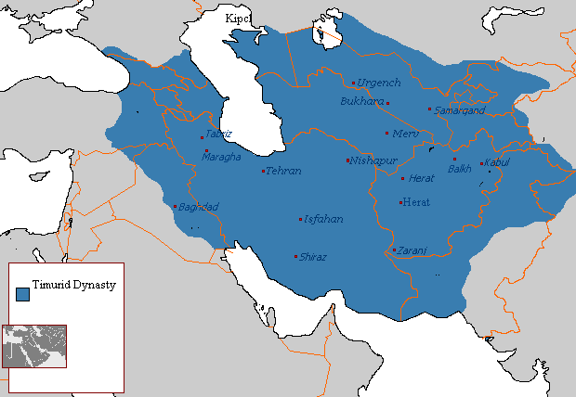
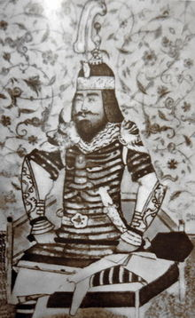
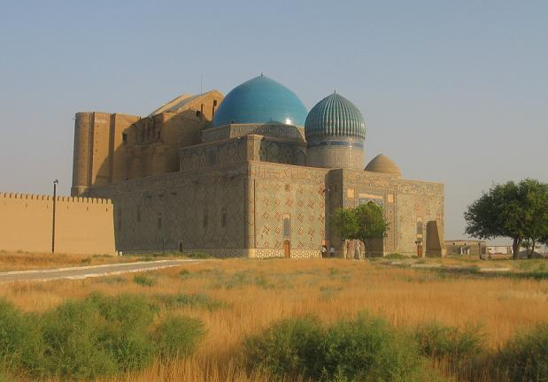
End of Mongols and Tamerlane
1369 - Ming Dynasty (ethnically Han Chinese) took capital Shangdu, Mongols fled north
Khan still kept title Emperor of China but the Chinese believed Khan lost the Mandate of Heaven
1370-1405 – Tamerlane (Turko-Mongol) last of great nomadic conquerors of Eurasia
Defeated Mamluks, Sultanate of Delhi, Knights Hospitaliers and est. Timurid Empire
Tried to conquer Ming Dynasty and re-establish Yuan Dynasty
Timurids end in 1507

Slide 16
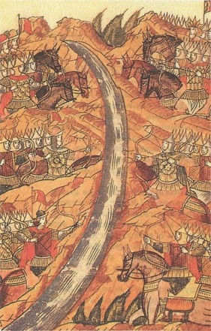
The Rise of Moscow, 14th – 15th C.
Moscow originally vassal to Vladimir
Kiev metropolitan moved to Moscow
Est. Grand Prince of Moscow
Expelled Tatars from Russia, refused to pay tributes
Ivan III “The Great” – annexes Novogrod
1480 - The Great Stand on Ugra River – Ivan defeats remnant of Golden Horde, Tatars kicked out of Rus
“Third Rome”, Italian artisans brought in

